Slide 1

IMDB SCORES… WHAT DO THEY DEPEND ON?
AN ANALYSIS BY LEXI GILLIAM

Slide 2

The components of this project
Regression
Classification
Clustering

Slide 3
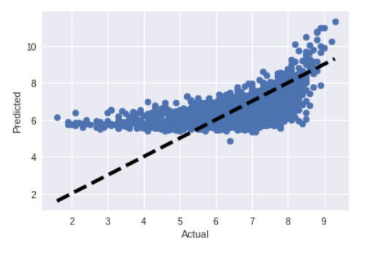
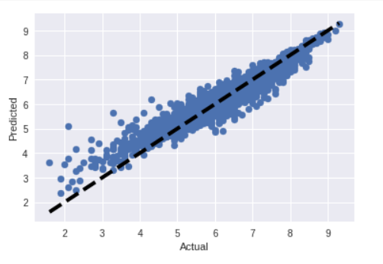

regression
F-Regression
Random Forest Regression
MSE: .70
Accuracy: 37%
MSE: .09
Accuracy: 91%
Lasso
F-Regression:
The MSE is very high and the accuracy is relatively low, meaning that this would not be a good model to predict IMDB Score
Random Forest Regression:
The MSE is very low and the accuracy is very high at 91%! This would be a good model to predict IMDB Score
Lasso:
The MSE is very high and the accuracy is relatively low, meaning that this would not be a good model to predict IMDB Score
MSE: .74
Accuracy: 34%

Slide 4
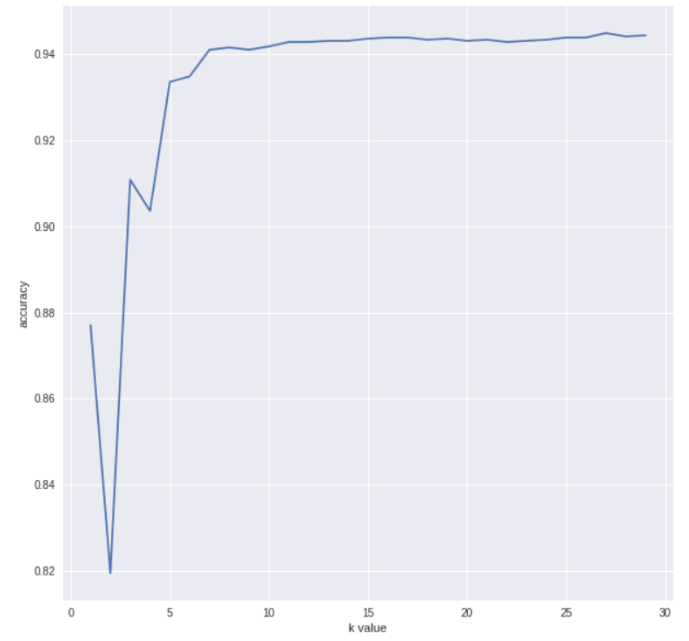
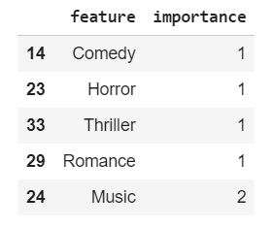
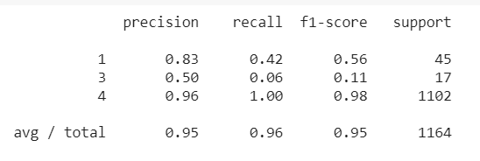
classification
Random Forest Classifier | KNN | Feature Importance with Logistic Regression
96% Accuracy # of Estimators = 50 All variables used | 95% Accuracy # of neighbors = 28 from optimal value of k chart above All variables used | 95% Accuracy 4 important values selected: Comedy, Horror, Thriller, Romance.

Slide 5
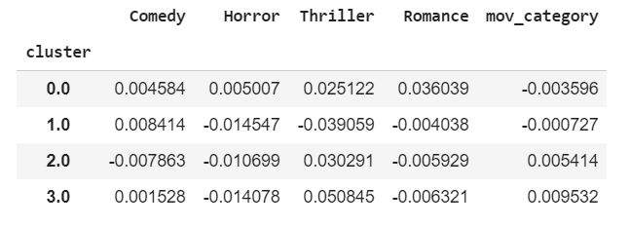
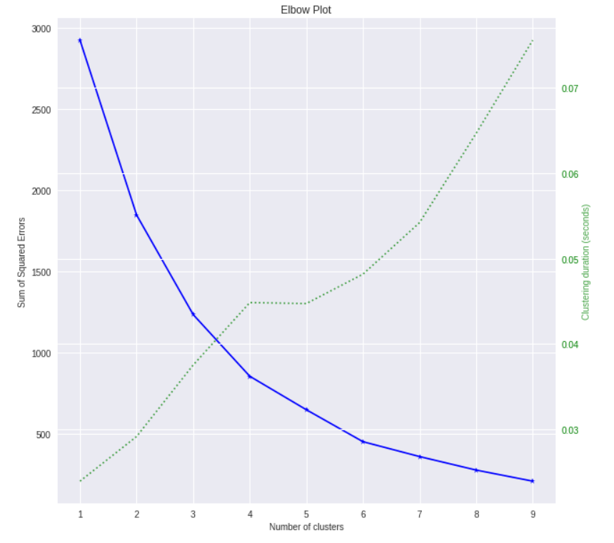
Cluster analysis
The elbow method determined that 4 would be the optimal number of clusters
Profiling:
Cluster 0 is a Romance and has a low IMDB score
Cluster 1 is a Comedy and has a low IMDB score
Cluster 2 is a Thriller and has a high IMDB score
Cluster 3 is a Thriller and has a high IMDB score

Slide 6
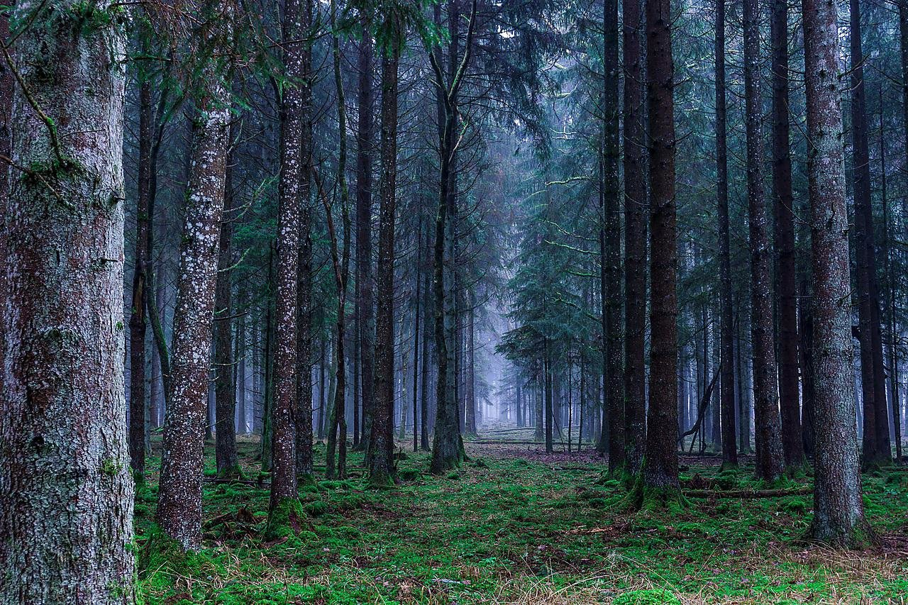

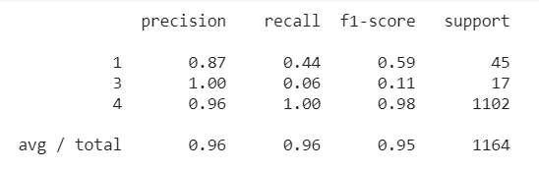
Random Forest Classifier
Precision: how many you got correct in each column
1: 20/22 = 87%
3: 1/1 = 100%
4: 1100/1140 = 96%
Recall: how many you got correct in each row
1: 20/45 = 44%
3: 1/17 = 6%
4: 1100/1102 = ~100%
F1-Score: Weighted average between precision and recall
1: 59%
3: 11%
4: 98%
Support: Number of answers for each response

Slide 7
Overall
Using feature selection, the most important factor to IMDB score is whether the movie is a comedy, horror, thriller, or romance
it seems that Random Forest Classifier is the best model because it has a 96% accuracy
KNN and Random Forest Regressor were also good models because they had high accuracy
Redo-ing the models several times showed me which models used all of the variables and which were better using variables chosen with feature selection. Random Forest Classifier used all of the variables
Additional variables to consider:
Money spent on marketing
If the movie is a sequel

Slide 8

Thank You

