Slide 1


Research Title
Split Federated Learning for Emotion Detection
Authors : Dinah Waref, Mohammed Salem
Paper Review Presentation 01
Course : CSE 707 Distributed Computing Systems
ST & RA : Md Sabbir Hossain , Mehnaz Ara Fazal
Name : Sadia Tasnim
Student ID : 23366028

Slide 2

Introduction
Motivation
The incredible benefits of Machine Learning in our lives.
Need for more data for better ML performance.
Privacy risks associated with sensitive data, such as facial expressions.
Problem Statement
Overcome resource constraints of federated learning
Decrease the computational time of split learning

Slide 3
Objectives
Develop a Face Emotion Classifier.
Utilize Split Federated Learning for privacy preservation.
Contributions
Introduction of three algorithms (SplitFed V1, SplitFed V2, FedSL).
Demonstration of privacypreserving Emotion Classifier.
Comparison with PyVertical and centralized learning.

Slide 4

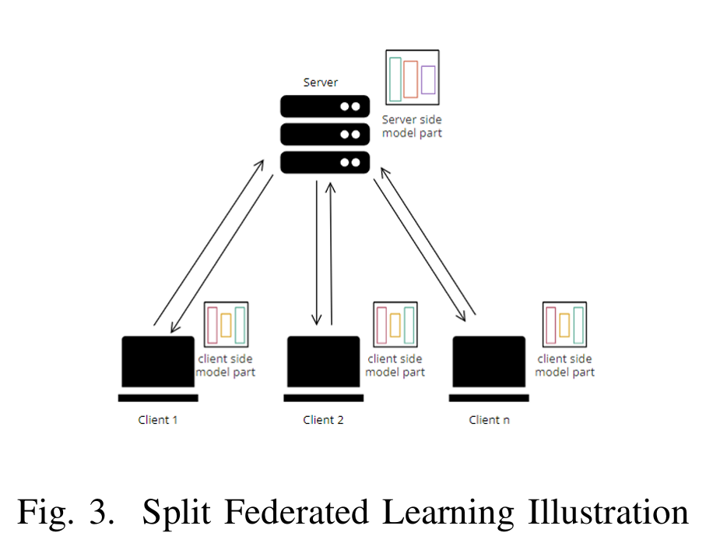
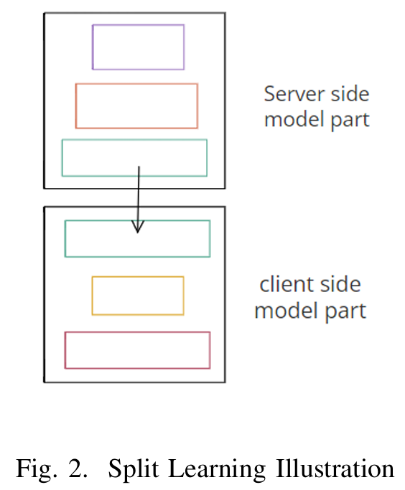
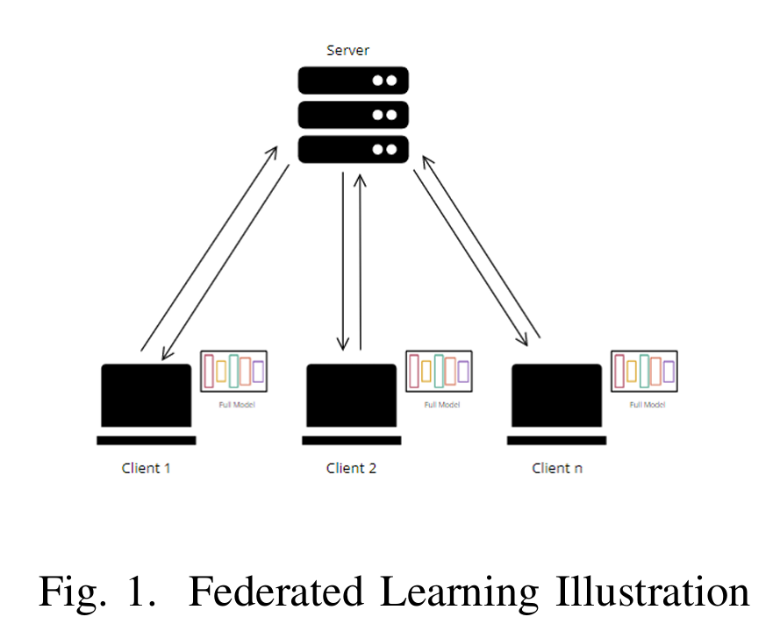
KEY CONCEPTS
Federated Learning
Split Learning
Split Federated Learning

Slide 5
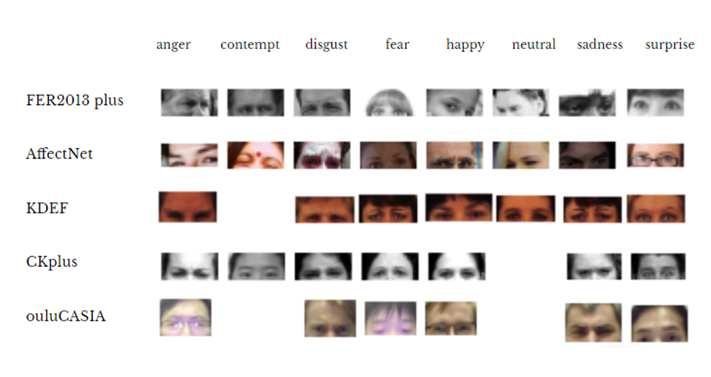
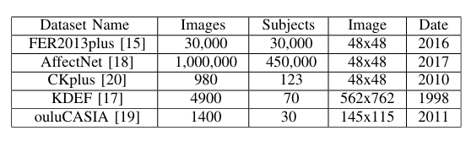
DATASET
DESCRIPTION
Datasets Used:
FER2013plus
AffectNet
CKplus
KDEF
ouluCASIA.

Slide 6
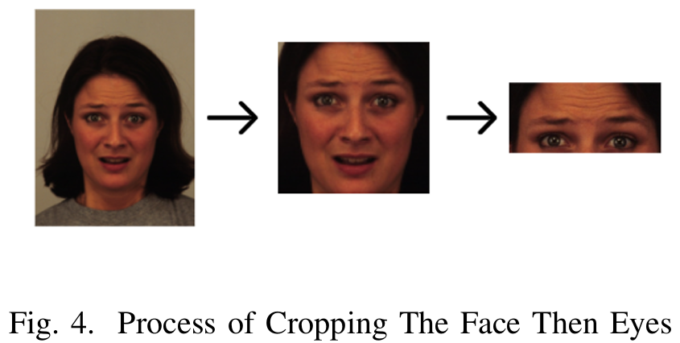
METHODOLOGY OVERVIEW : Data Preprocessing:
Custom datasets created by cropping images (upper part of the face)

Slide 7
METHODOLOGY OVERVIEW : Algorithms
SplitFed (combining Split and Federated Learning).
FedSL (Integration of Federated Learning and Split Learning).
PyVertical (Hybrid architecture between Split and Federated Learning).

Slide 8
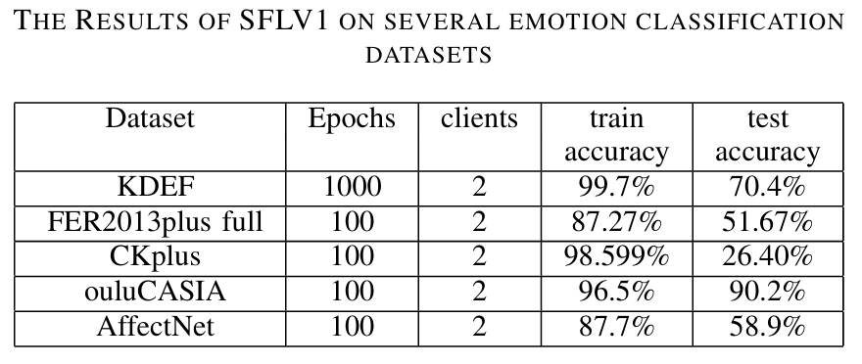
Result Analysis
SplitFed
Achieved high accuracies (87.27% to 99.7%) across datasets.

Slide 9
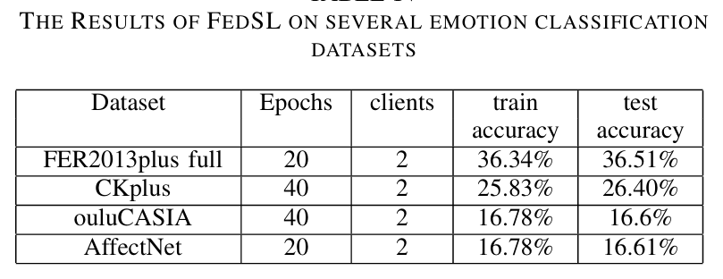
Result Analysis
Fed SL
Relatively lower accuracies observed, emphasizing the need for improvement.

Slide 10
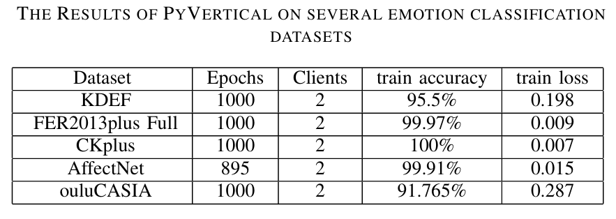
Result Analysis
PyVertical
Demonstrates good performance with high accuracies
(up to 99.97%).

Slide 11
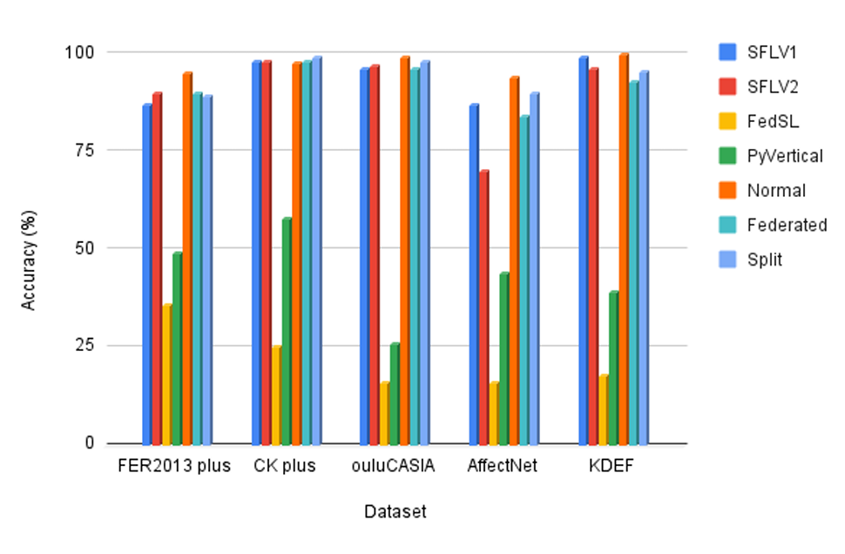
Overall classifier performance Comparison
SplitFed and PyVertical: Good
Achieved relatively high accuracies, up to 99% with some datasets
FedSL: Not as good
Demonstrated relatively low accuracies, with a maximum of 35%

Slide 12

Limitations
Critique
Further investigation and potential refinement of the FedSL algorithm.
Lower accuracy observed with FedSL
Exclusive focus on the upper part of the face may result in information loss.
Strike a balance between privacy concerns and the comprehensive analysis of facial expressions.

Slide 13
CONCLUSION
Summary:
Successful implementation of privacypreserving Emotion Classifier.
SplitFed and PyVertical exhibit robust performance.
FedSL shows potential for improvement.
Key Takeaways:
Balancing accuracy and privacy is achievable with Split Federated Learning.

Slide 14
Potential Applications:
Healthcare for patient data confidentiality.
Human Computer interaction, sentiment analysis,
Personalized experiences.
Future Research:
Refinement of algorithms, addressing limitations.
Exploring diverse application domains.
Real world implementations.
FUTURE SCOPES

Slide 15
THANK YOU

