Slide 1

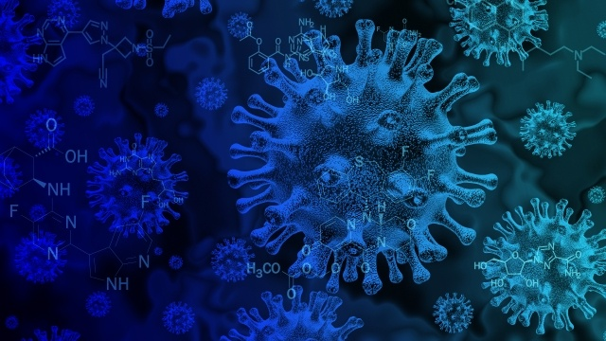
Research Title : Federated deep learning for detecting COVID-19 lung abnormalities in CT: a privacy-preserving multinational validation study
Authors : Qi Dou , Tiffany Y. So , Meirui Jiang , Quande Liu , Varut Vardhanabhuti , Georgios Kaissis, Zeju Li , Weixin Si , Heather H. C. Lee , Kevin Yu , Zuxin Feng, Li Dong,
Egon Burian, Friederike Jungmann, Rickmer Braren, Marcus Makowski, Bernhard Kainz ,
Daniel Rueckert , Ben Glocker , Simon C. H. Yu and Pheng Ann Heng
Published In : 2022 4th International Conference on Frontiers Technology of Information and Computer (ICFTIC)
Paper Review Presentation
Name : Sadia Tasnim
Student ID : 23366028
Course : CSE707 Distributed Computing Systems
Notes:
**Slide 1: Title and Introduction**
Assalamu Alaikum
I am Sadia Tasnim and My student ID is 23366028.
Today, I'm here to discuss a paper titled "Federated deep learning for detecting COVID-19 lung abnormalities in CT: a privacy-preserving multinational validation study."

Slide 2
Introduction
The significance of federated learning in medical image analysis
Presentation overview
Study design and data sources
Experimental setting and methodology
Key statistics and findings
Strengths and Weakness

Slide 3

Study Design and Participants
Data sources from Hong Kong hospitals
75 patients with confirmed COVID-19
Ethical approvals
Waiver of informed consent
External Validation Datasets from international centers
External-Set-1: Wenzhou Medical University, China
External-Set-2: Technical University of Munich, Germany
External-Set-3: Peking University Shenzhen Hospital, China
External-Set-4: Zhijiang People's Hospital, Hubei, China
Ethical approvals

Slide 4

Experimental Settings
Use of federated learning
Transfer learning from DeepLesion dataset
Data augmentation
Model training process

Slide 5
Statistical Analysis
Evaluation using ROC curves
Mean Average Precision (mAP)
False-Positive Rate
P-Values using t-test

Slide 6
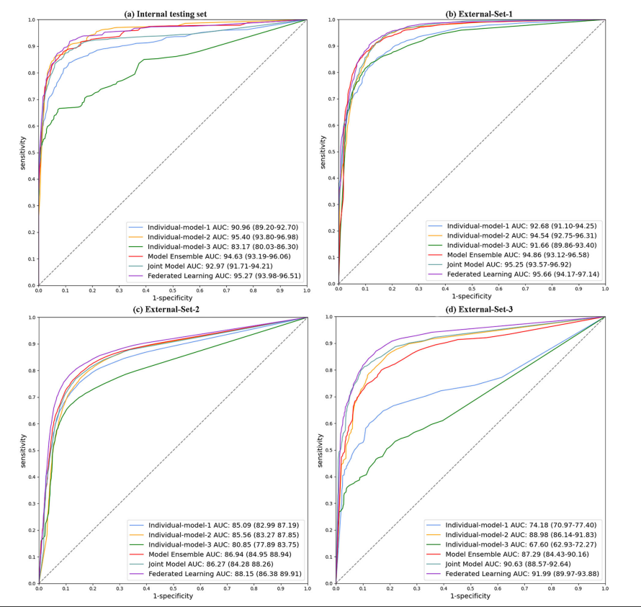
Performance on Internal and External Testing Sets

Slide 7
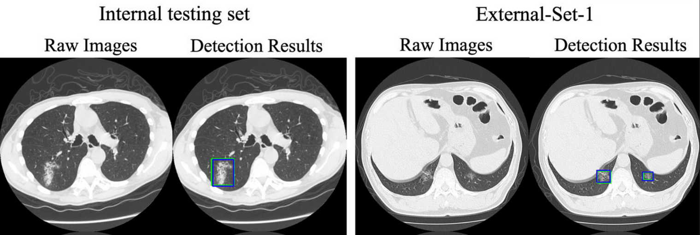
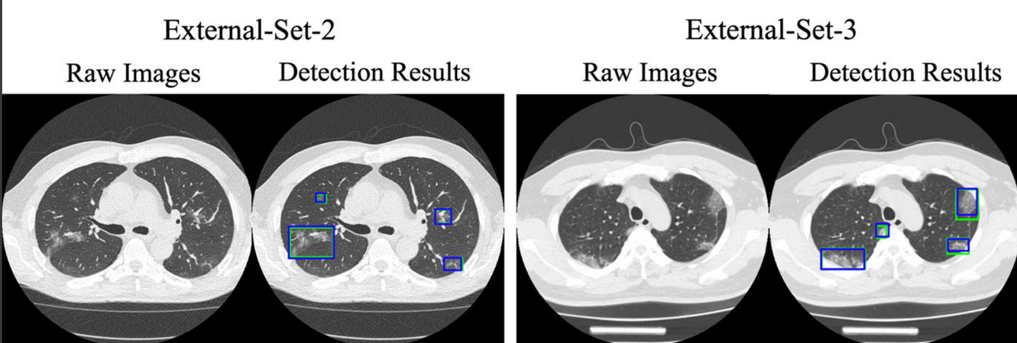
Qualitative results of lesion detection in COVID-19 CT images using federated learning model

Slide 8
Strengths and Contributions
Federated Learning
for
Multicenter Collaboration
Generalizable AI Model
Data Diversity and
Real-world Challenges
Transfer Learning
from
Large-scale Dataset
Lesion Detection
Performance
Enhancing
Multicenter Collaboration

Slide 9
Weakness
Small Sample Sizes and Data Imbalance
Data Exclusion and
Concept Shift
Limited Data Sharing and Access

Slide 10

Discussion and Conclusion
- Feasibility of federated learning
- Generalizability of the AI model
- Real-world challenges
- Potential of distributed computing system

Slide 11
Thank You For Watching

