Slide 1
Born2beRoot
yhwang

Slide 2
What is the virtual machine?
- Virtual machine (VM) is an operating system or application environment that is installed on software, which imitates dedicated hardware.
- Advantages of VMs
  1. Virtualization limits costs by reducing the need for physical hardware systems.
  2. VMs have an extra level of security because it operates in isolated environment. (also easy to roll it back using snapshots and backups)
  3. VMs ease management. (it can be easily managed from a centralized interface and developers can quickly deploy VMs)

Slide 3
CentOS vs Debian
CentOS | Debian
Does not support many different architectures | Has more packages
Does not have an easy GUI | Has desktop friendly applications and GUI
Uses the RPM package format and YUM/DNF as the package manager | Uses the DEB package format and dpkg/APT as the package manager
Is supported primarily by the community, but the bug reports are accepted by Red Hat | Does not have commercial support, but people can connect with Debian consultants around the world

Slide 4
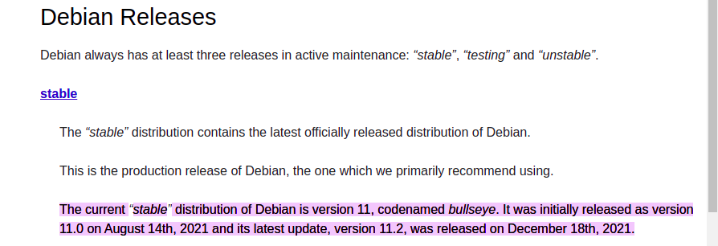
Debian
- The current latest stable version of Debian is 11.2.
- I downloaded a “netinst” CD which contains just the minimal amount of software.
(debian-11.2.0-amd64-netinst.iso)

Slide 5
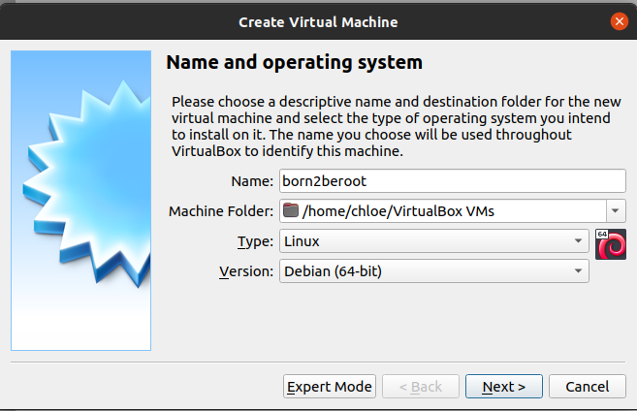
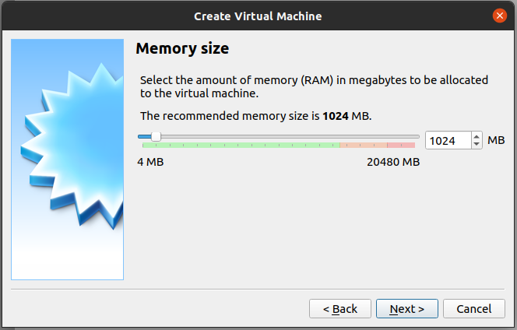
Setting up the machine
- Name : The name of the machine
- Machine Folder : The location of the machine
- Type : OS
- Version : The version of OS
- Selecting the memory size of the virtual machine
  : should be the range of the green area
- The recommend size is 3000MB but I selected 1024MB.

Slide 6
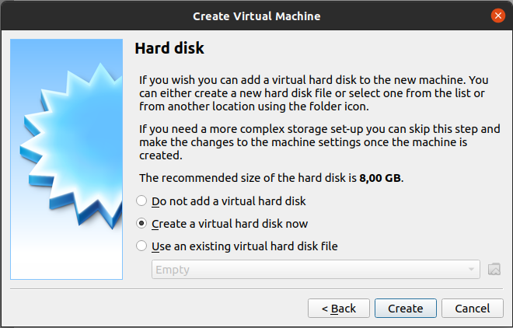
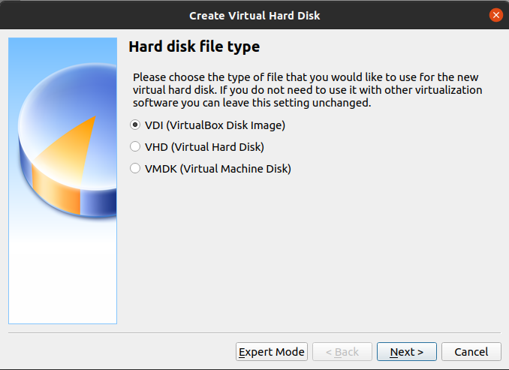
- Select “Create a virtual hard disk now”
- Select “VDI”
- VDI (VirtualBox Disk Image) : can use only on Virtualbox
- VHD (Virtual Hard Disk) : can use on Virtualbox, Hyper-V, Xen
- VMDK (Virtual Machine Disk) : can use on Virtualbox, Vmware Player

Slide 7
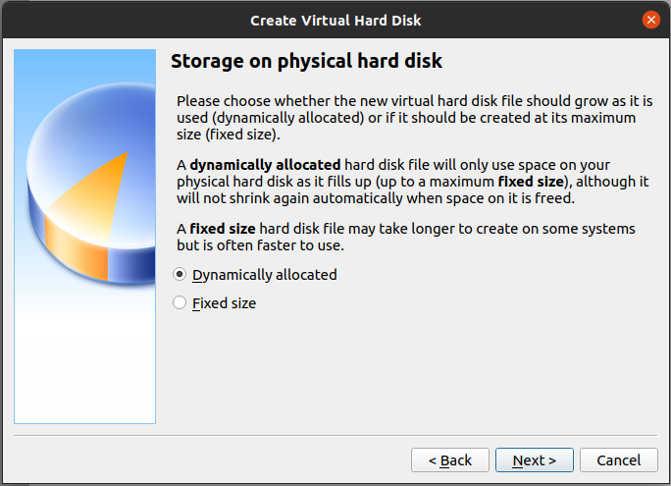
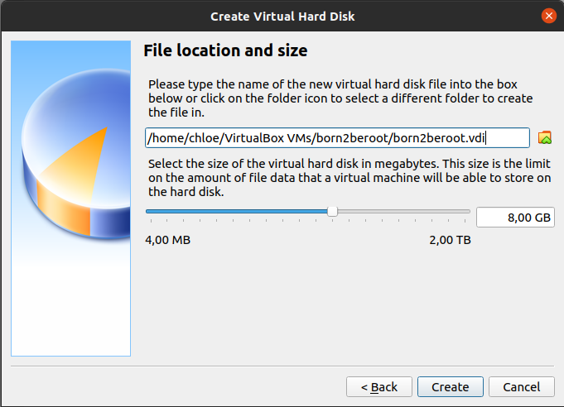
- Select “Dynamically allocated”
- Dynamically allocated : the size increases automatically when data records on the hard disk (slow but can save the space)
- Fixed size : fix the size of the hard disk of the virtual machine (fast but could waste the space)
- Select the default value

Slide 8
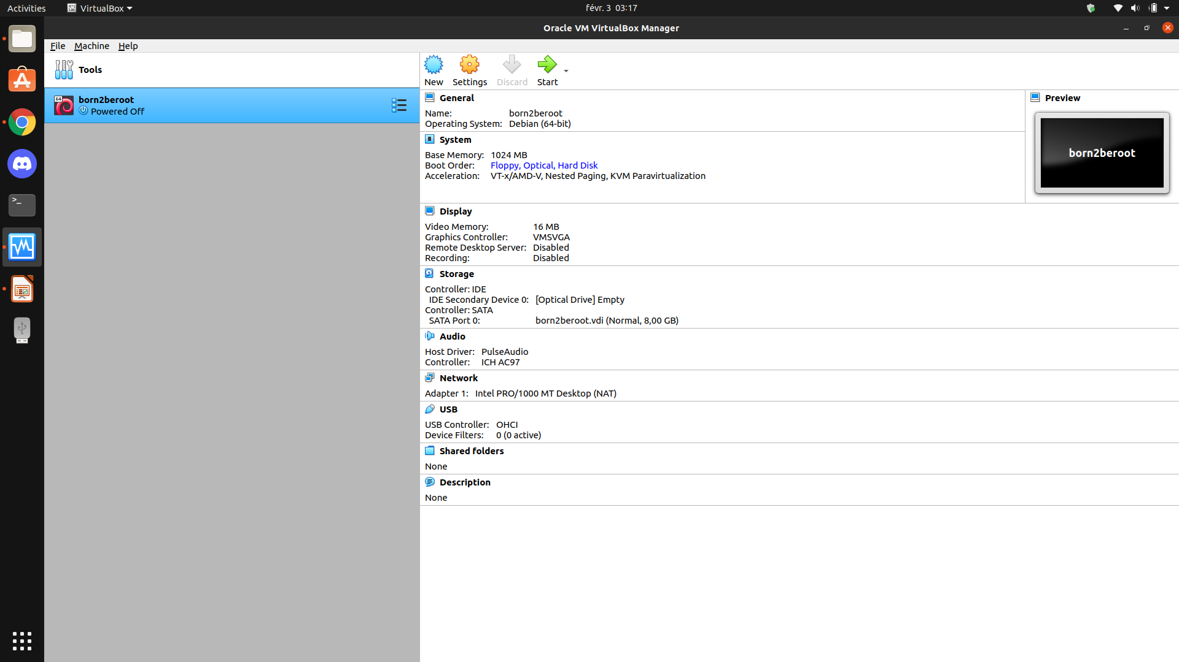
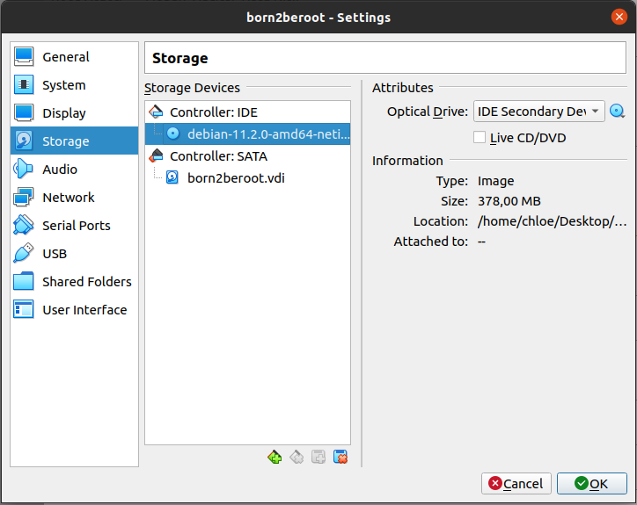
- Click the “settings”
- Select the ISO image

Slide 9
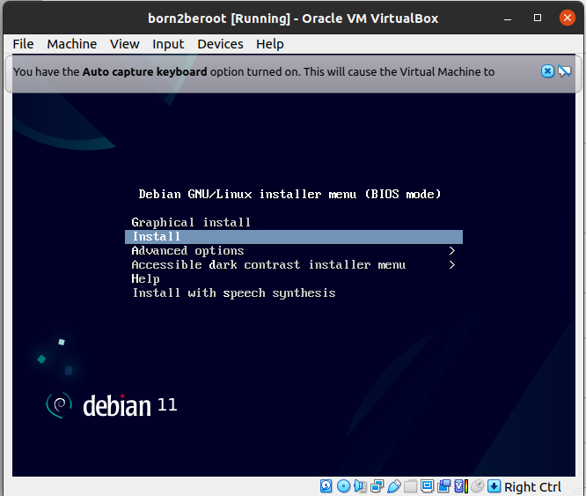
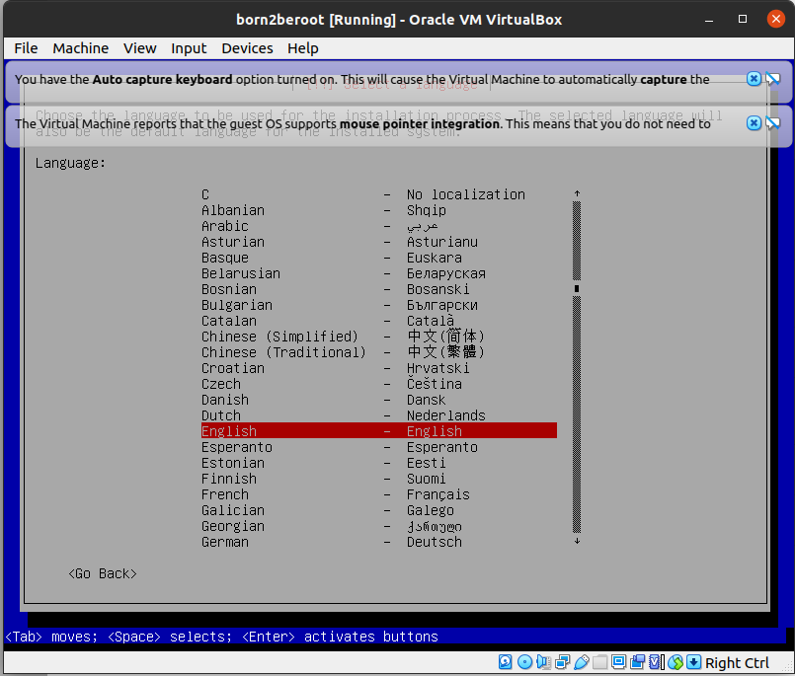
- Select “install” because any graphical interface is prohibited
- GUI (Graphical User Interface) : implemented graphically
- CLI (Command-Line Interface) : communicating through terminal
- Language : English, Location : France, Locale : United States, Keymap : American English

Slide 10
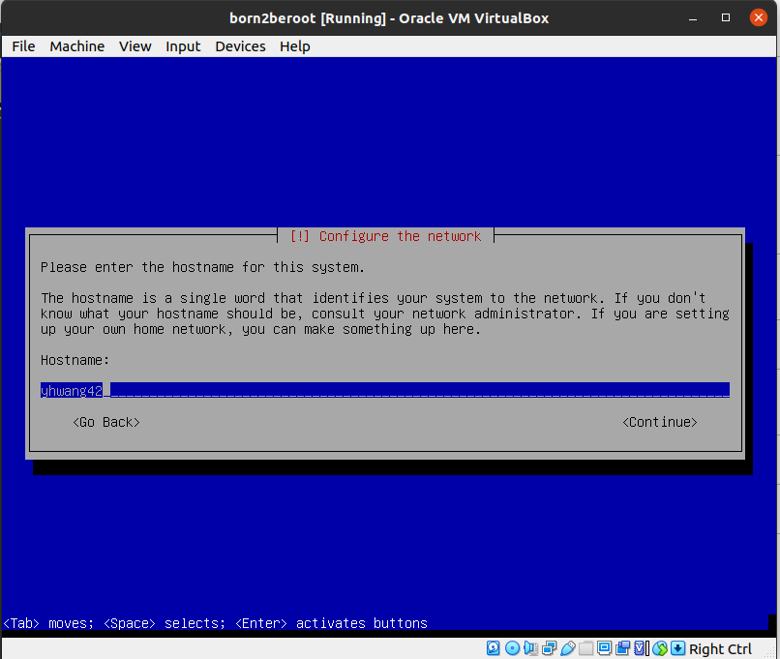
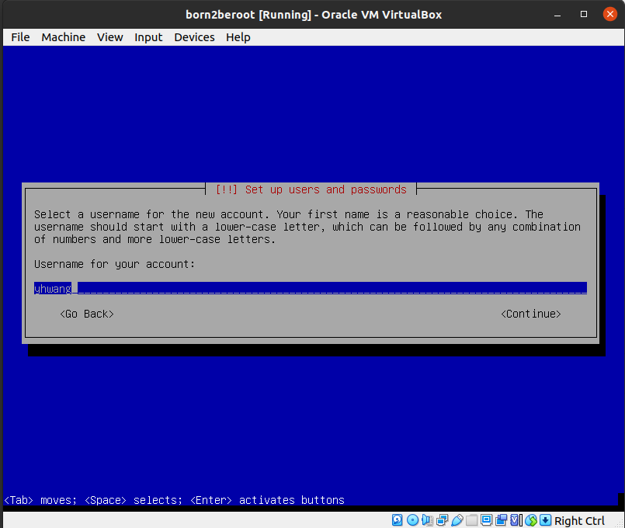
- Hostname : yhwang42, Domain name : do not put anything
- Select Root password(may not be set)
- Username : yhwang(Full name may not be set)
- Select password for the new user

Slide 11
Disk partitioning
Partition
- A partition is a logical portion of a physical storage volume.
- Just a portion of the disk with an allocated size that is set upon the creation.
- Users create multiple partitions on the same hard disk to house different operating systems without them interrupting each other.
(OS recognizes each partition as if it is different disks)
Volume
- A volume is a storage container in a particular file system that computer can use and recognize.
- Storage volume : can contain multiple partitions. (hard drives, USB drives, DVDs, and CDs)
- Logical volume : not limited to one physical disk. If needed, it can contain multiple physical drives, as well as partitions.
→ a partition is always created on a single physical disk,
a volume can span multiple disks and have many partitions

Slide 12
LVM (Logical Volume Manager)
- A system of managing logical volumes, or filesystems, that is more advanced and flexible than the traditional method. (because it changes the physical size to logical size)
- There are 3 concepts that LVM manages
  1. Volume Groups : A named collection of physical and logical volumes. Typical systems only need one Volume Group to contain all of the physical and logical volumes on the system.
  2. Physical Volumes : Correspond to disks; block devices that provide the space to store logical volumes.
  3. Logical Volumes : Correspond to partitions: hold a filesystem.
  → works by [1]chunking the physical volumes (PVs) into physical extents (PEs). [2]The PEs are mapped onto logical extents (LEs) which are then [3]pooled into volume groups (VGs). These [4]groups are linked together into logical volumes (LVs) that act as virtual disk partitions and that can be managed as such by using LVM.
- Using LVM to segment logically sequential data or combine partitions increases throughput and makes it simpler to resize and move storage volumes as needed.

Slide 13
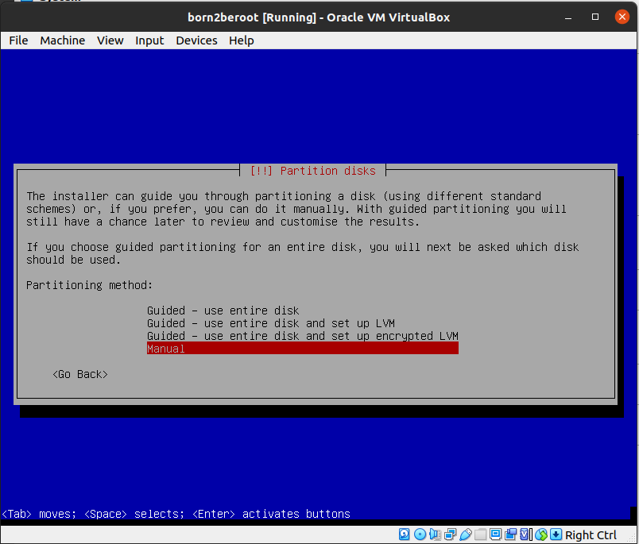
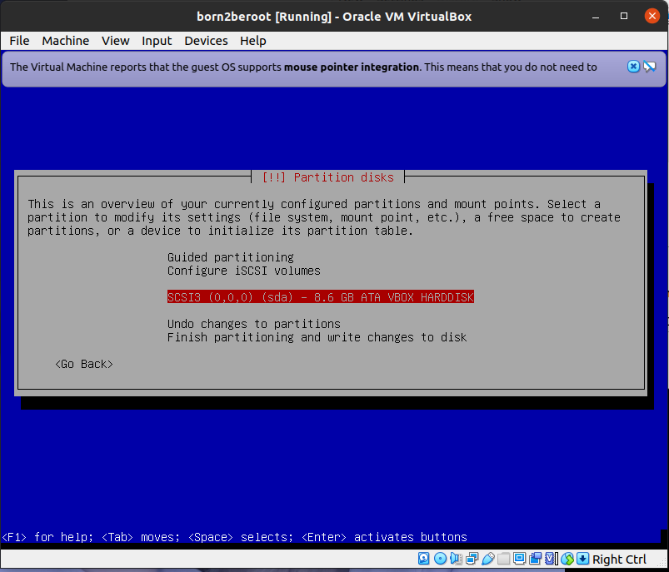
- Select “manual”
- Select “SCSI3 (0, 0, 0) (sda) – 8.6 GB ATA VBOX HARDDISK”

Slide 14
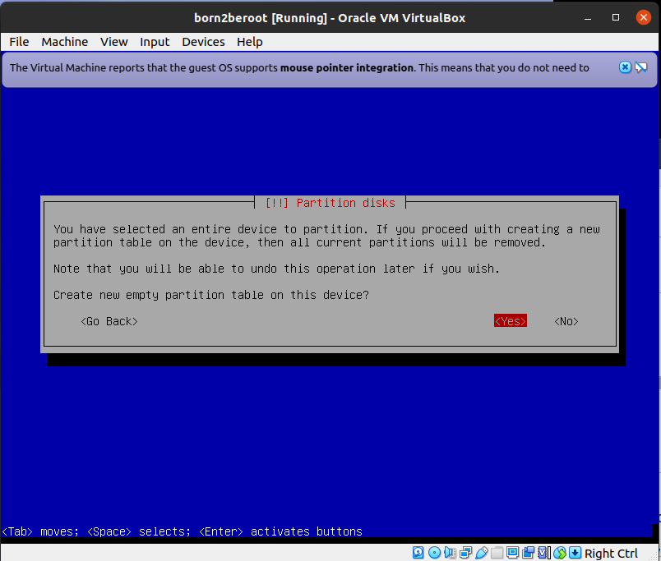
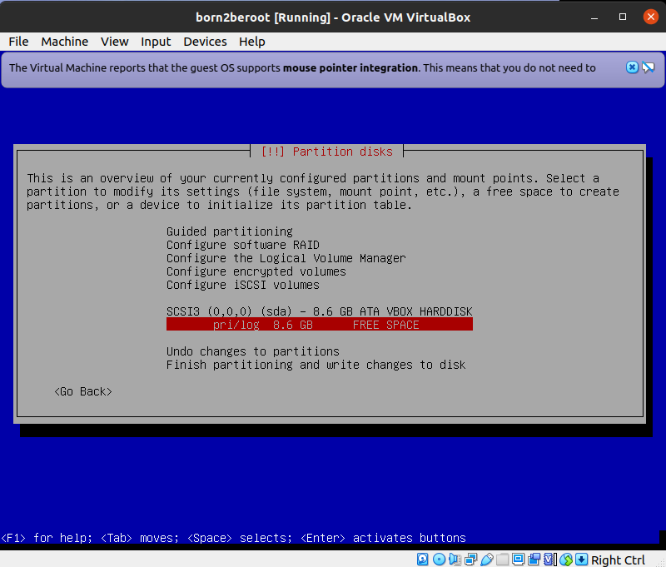
- Select “Yes” to make new partition
- Select “pri/log 8.6GB FREE SPACE”

Slide 15
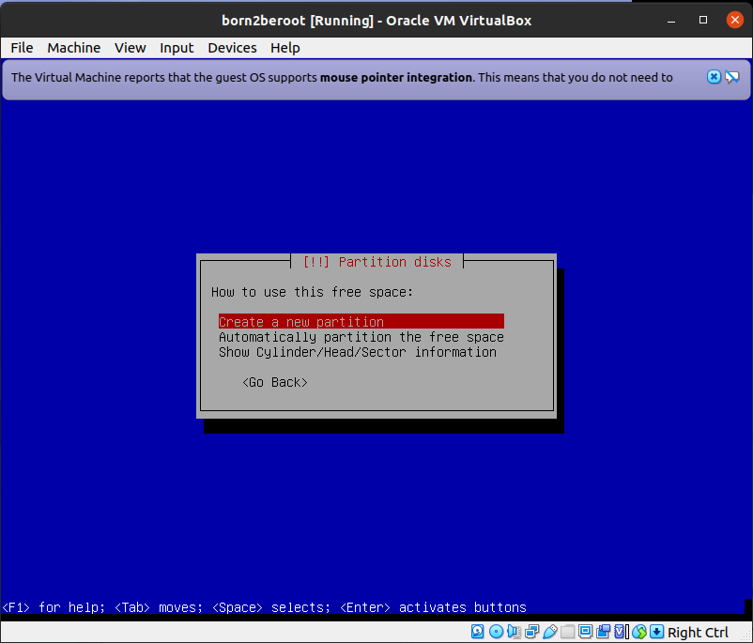
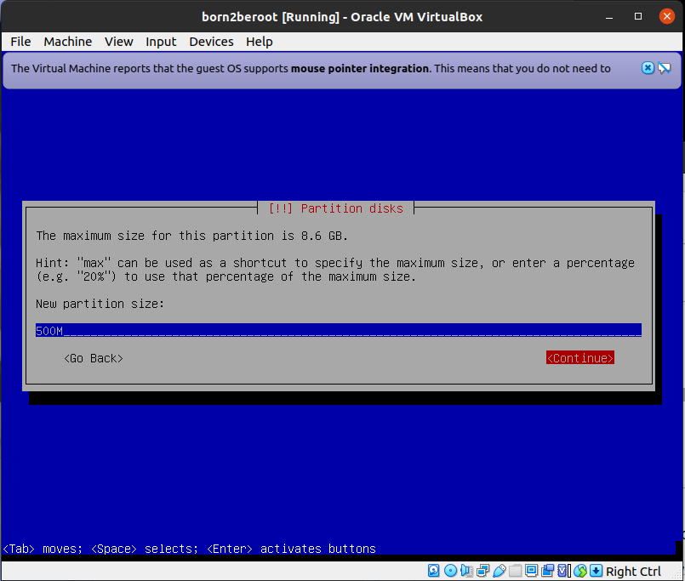
- Select “Create a new partition”
- New partition size : 500M
- To setting root on sda1

Slide 16
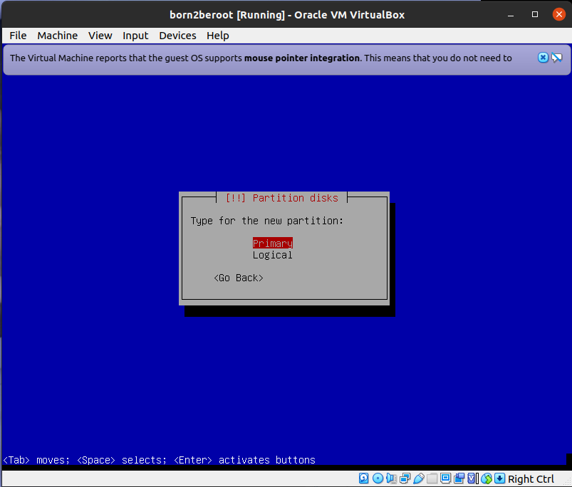
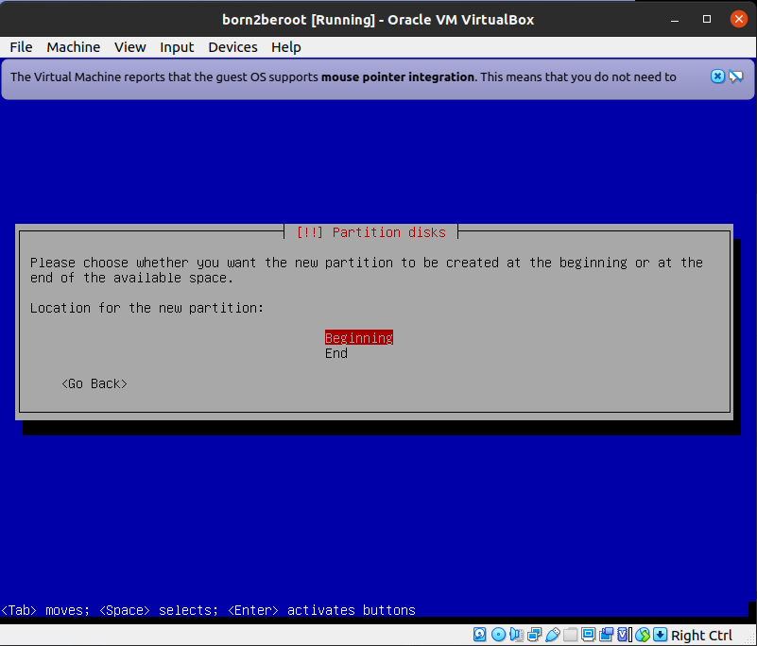
- Select “Primary”
- Select “Beginning” to select starting point(sda1)

Slide 17
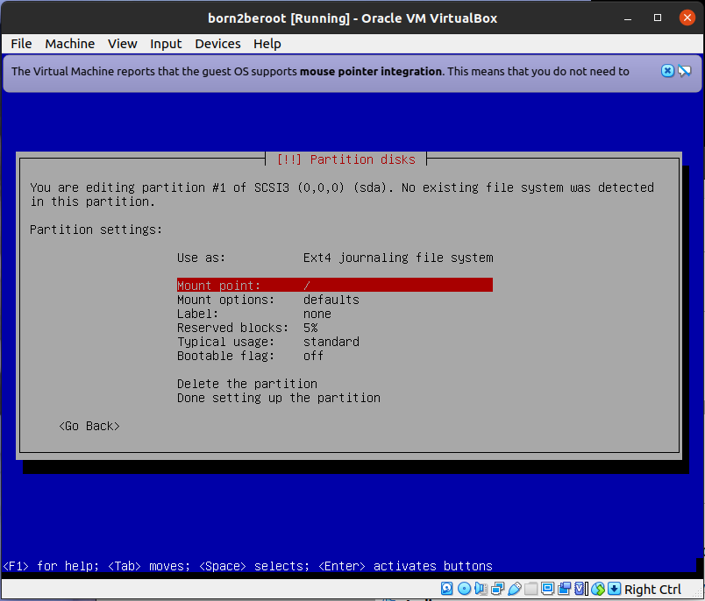
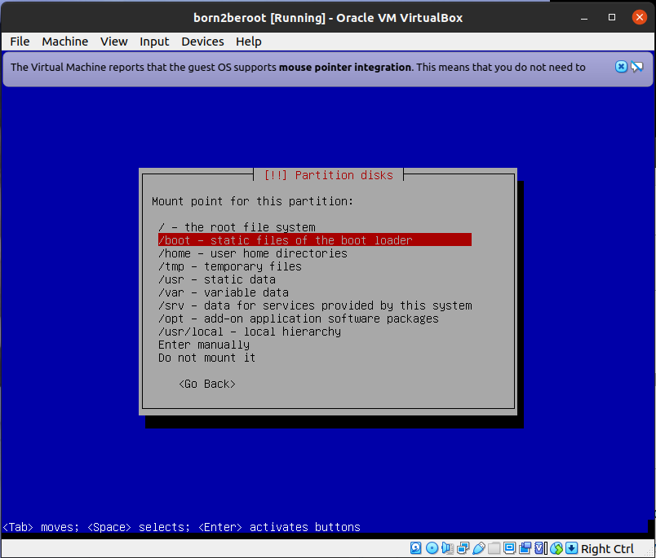
- Select “Mount point”
- Mount Point : A specific directory for recognizing devices
- Mount : The process of linking to a directory so that the partition’s resources are available
- Select “/boot”
- boot : A kerner boot image partition. Booting system files are installed here

Slide 18
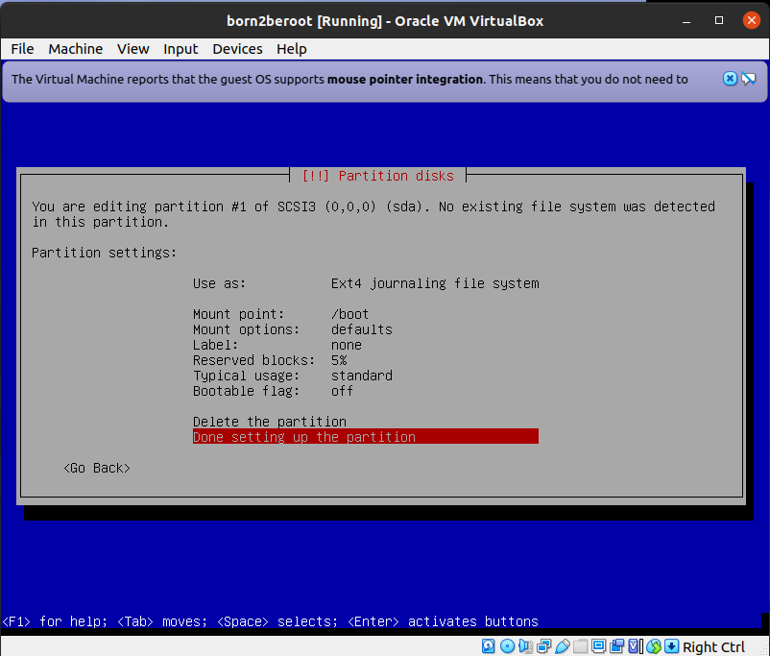
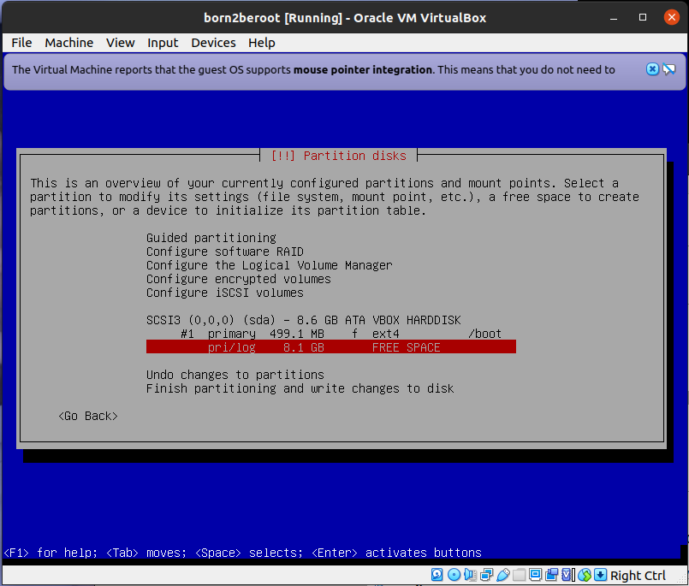
- Select “Done setting up the partition”
- Select “pri/log 8.1GB FREE SPACE”

Slide 19
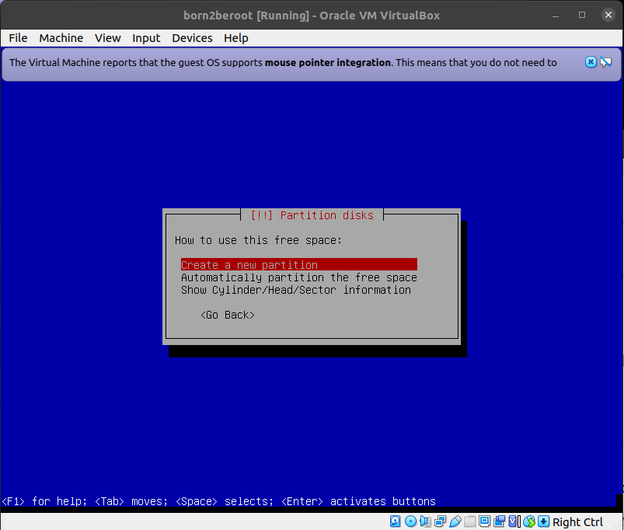
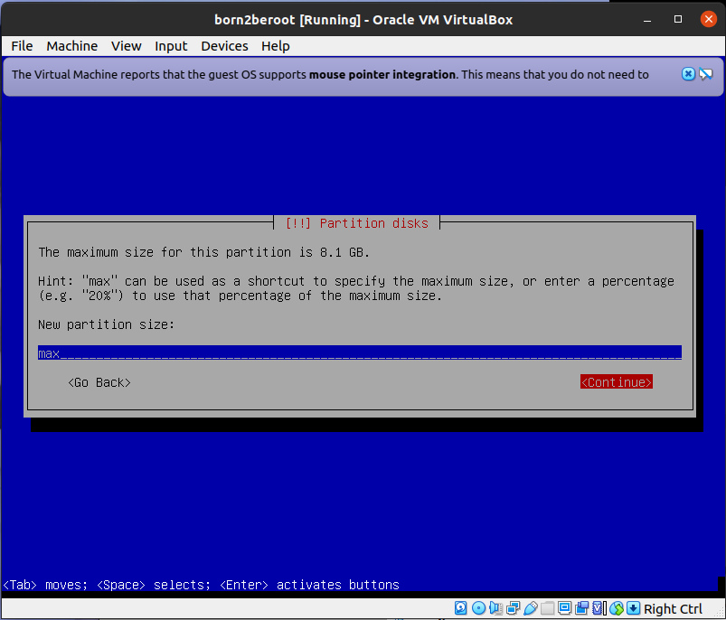
- Select “Create a new partition”
- New partition size : max
(to setting LVM using the all left space)

Slide 20
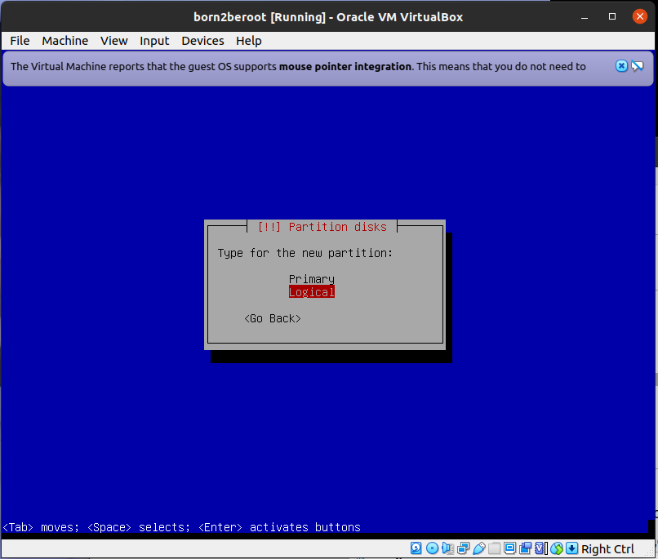
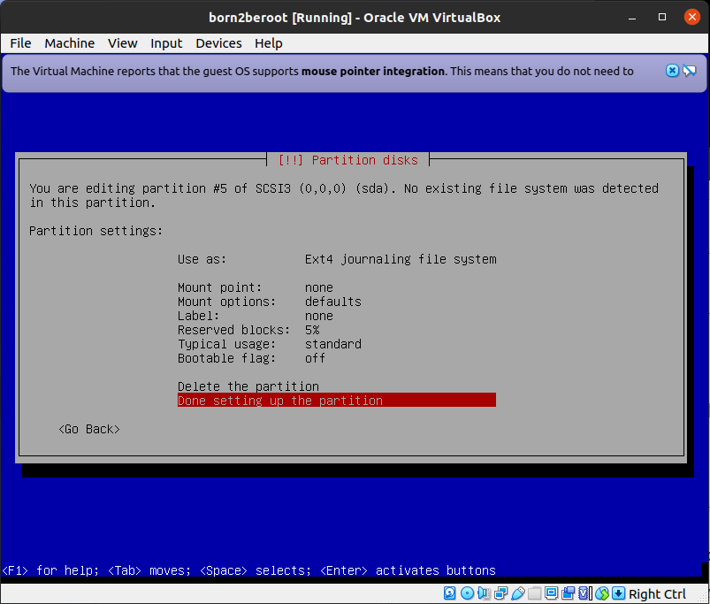
- Select “logical”
- After setting mount point as none(Do not mount it), select “Done setting up the partition”

Slide 21
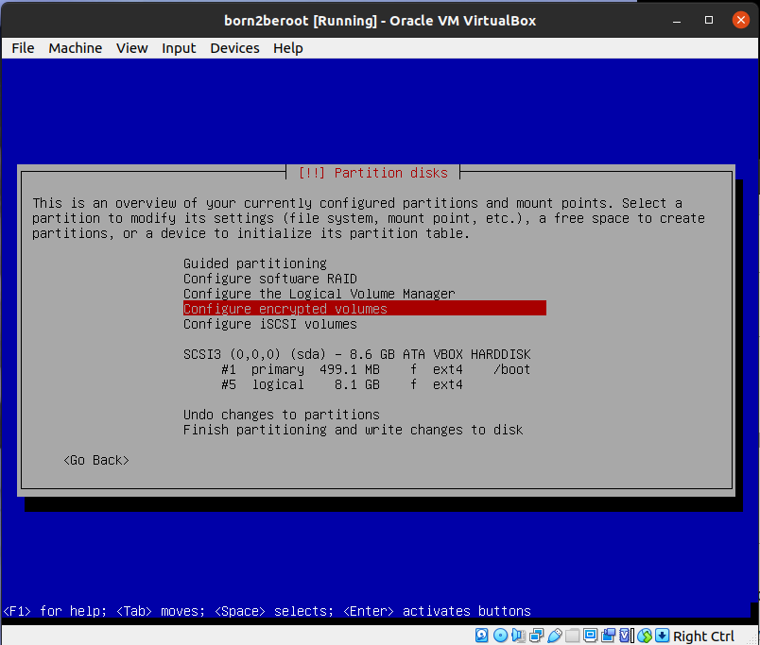
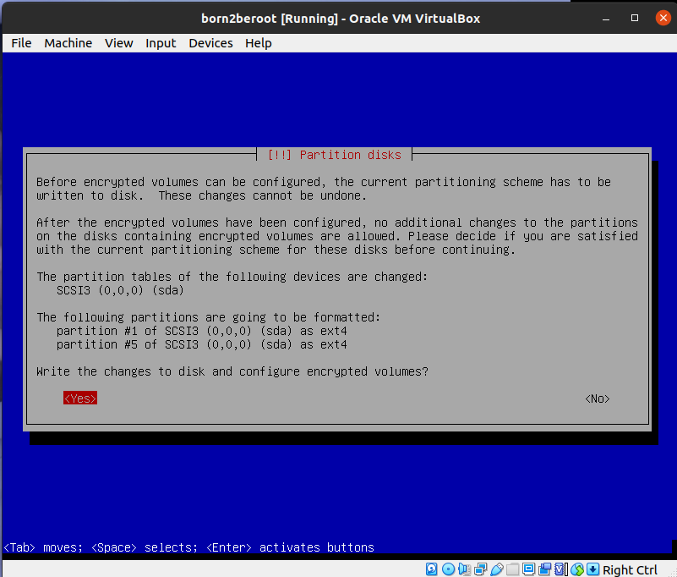
- Select “Configure encrypted volumes” to encrypt
- Select “Yes”

Slide 22
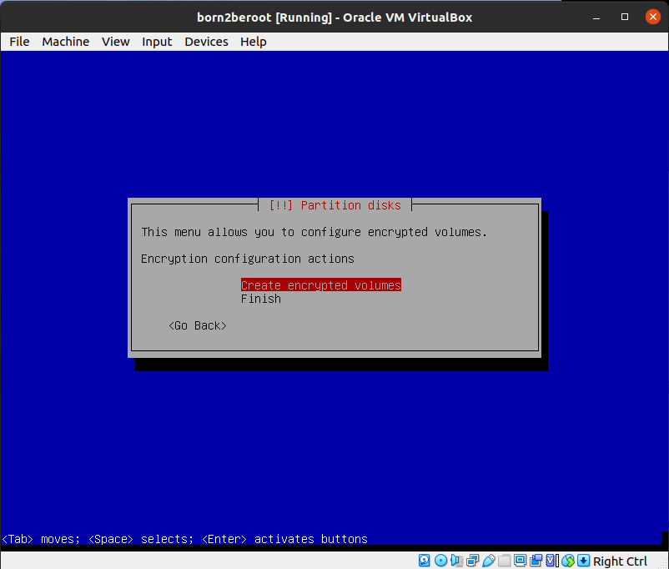
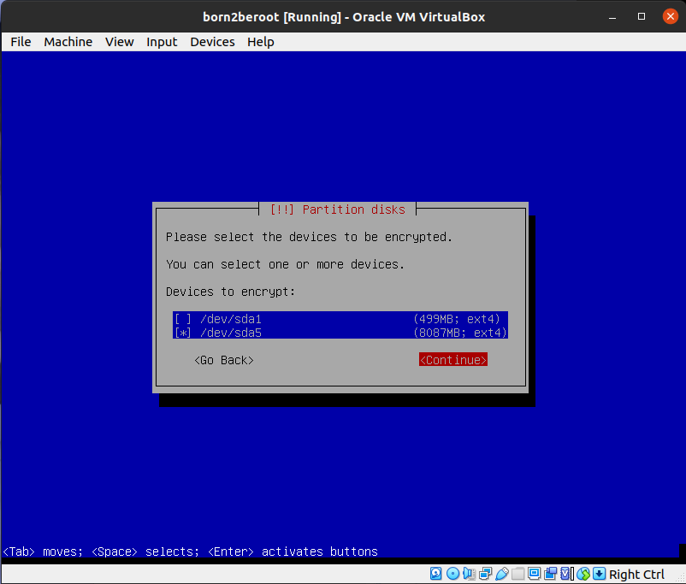
- Select “Create encrypted volumes”
- Select “/dev/sda5” because logical partition start from 5th hard disk

Slide 23
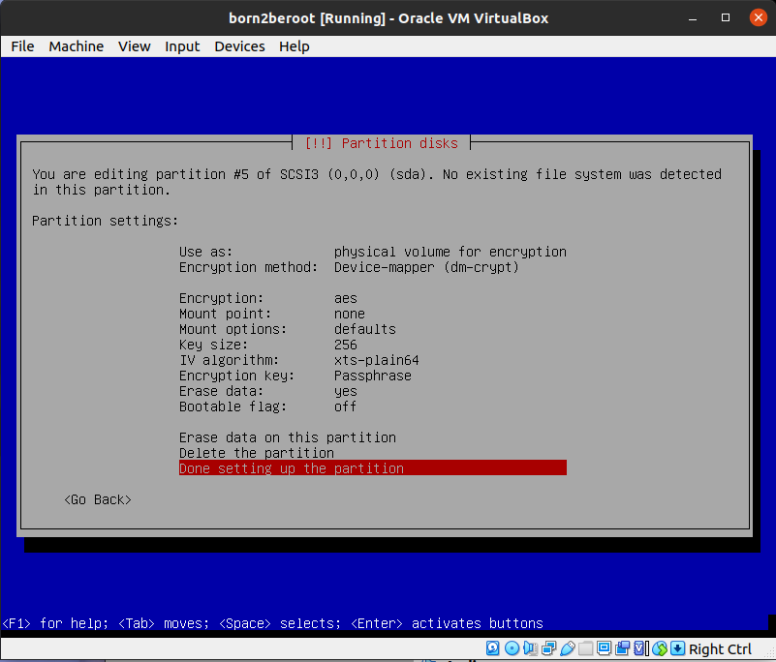
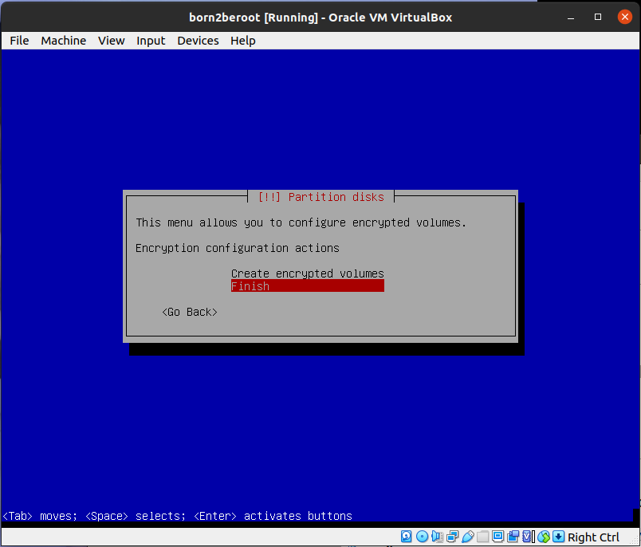
- Select “Done setting up the partition”
- Select “Finish”

Slide 24
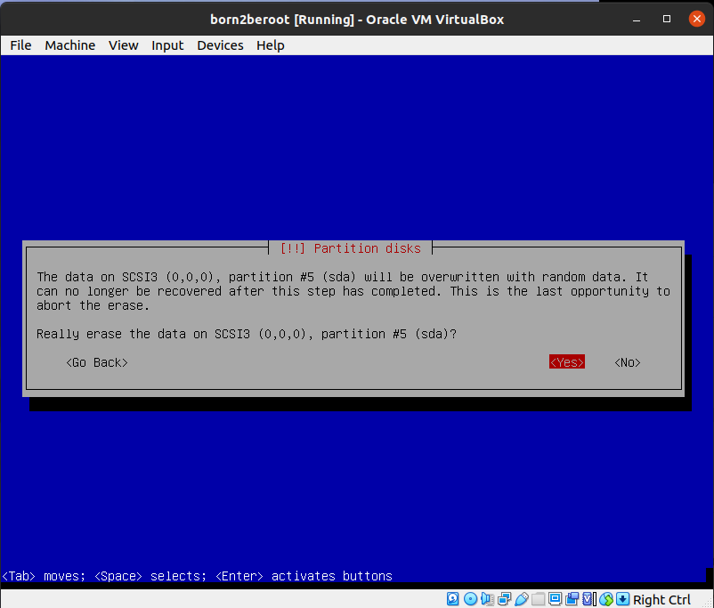
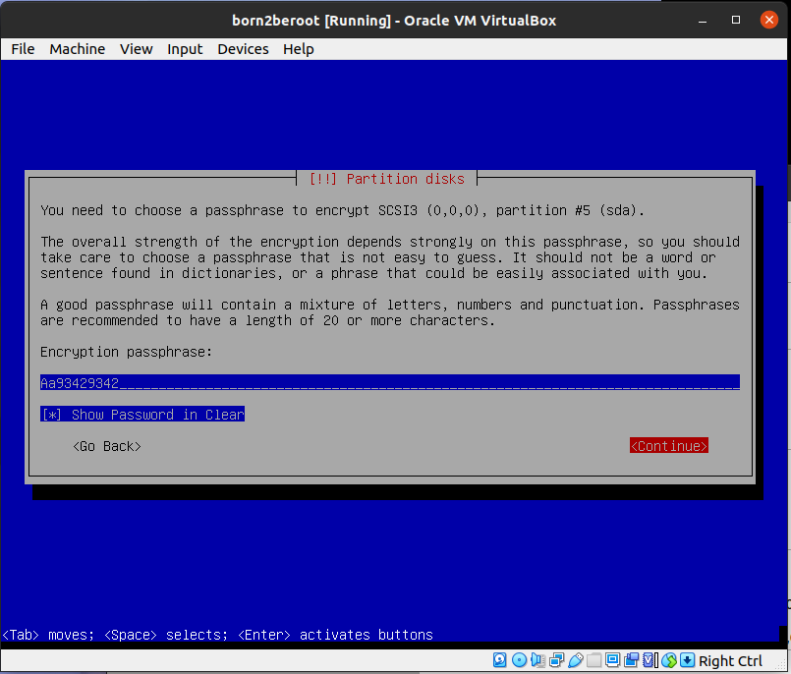
- Select “Yes”
- Set the password of the logical partition

Slide 25
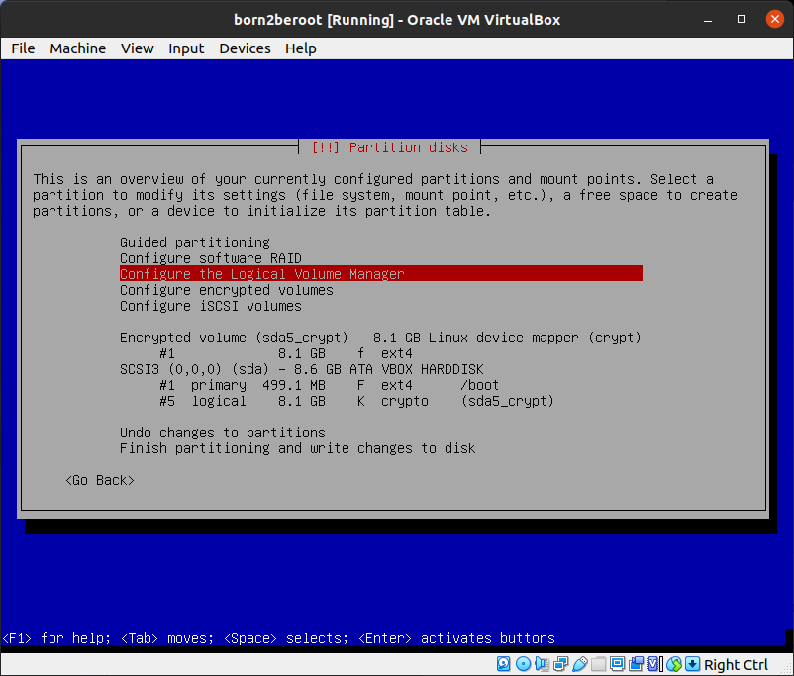
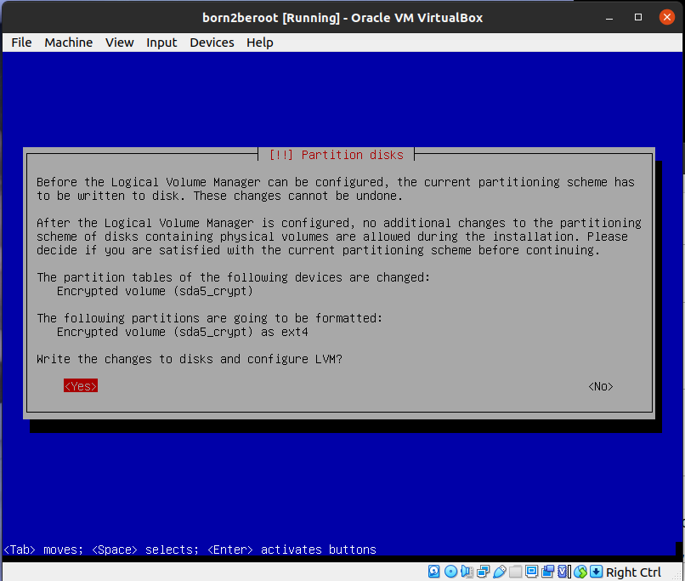
- Select “Configure the Logical Volume Manager”
- Select “Yes”

Slide 26
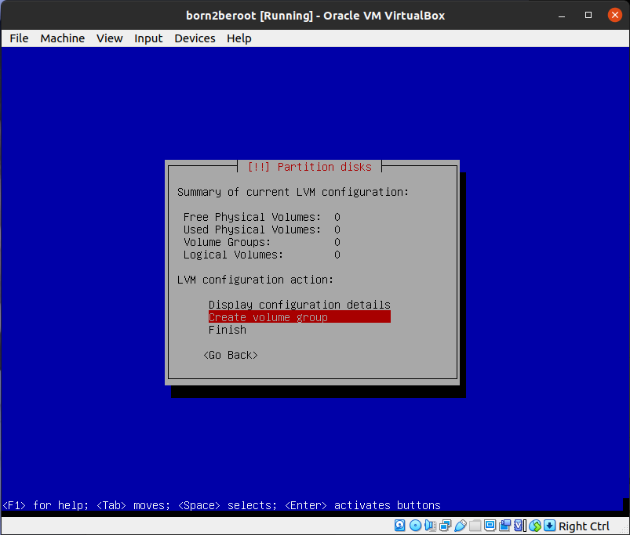
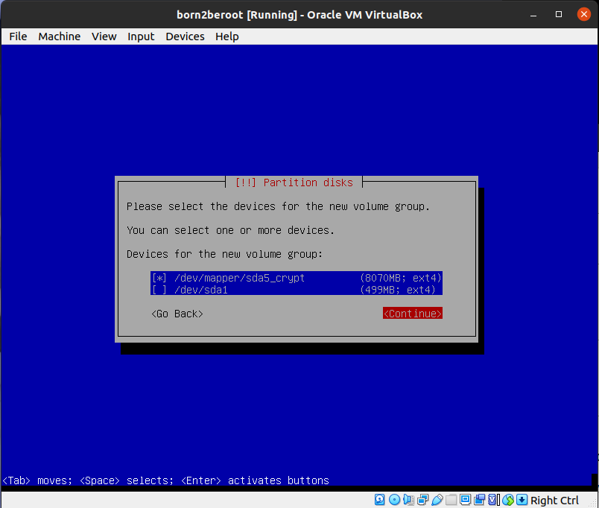
- Select “Create Volume group”
- Select “/dev/mapper/sda5_crypt” because of group of the logical partition

Slide 27
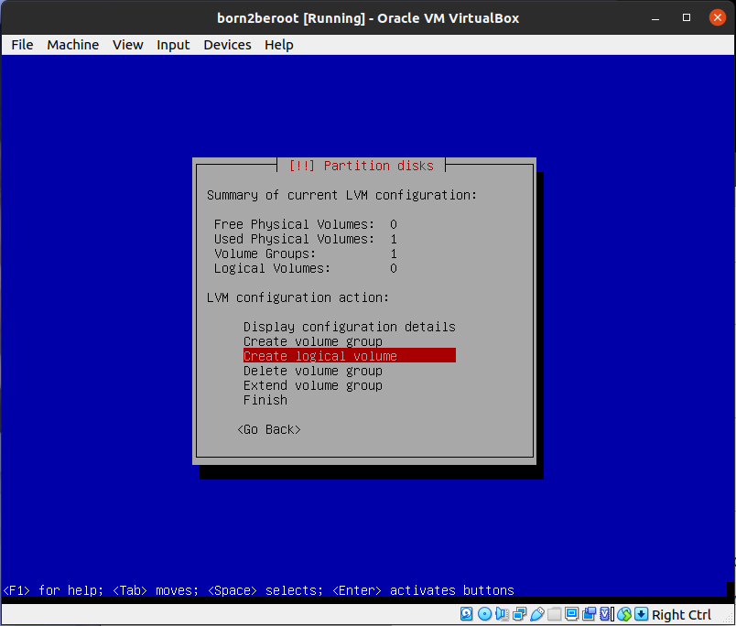
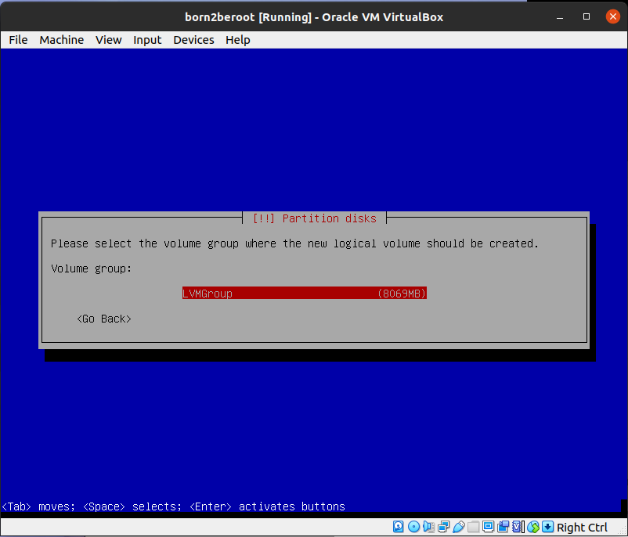
- Select “Create logical volume”
- Select “LVMGroup”

Slide 28
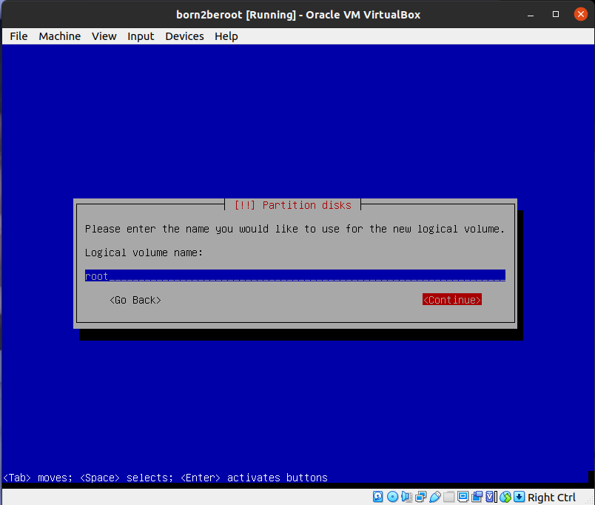
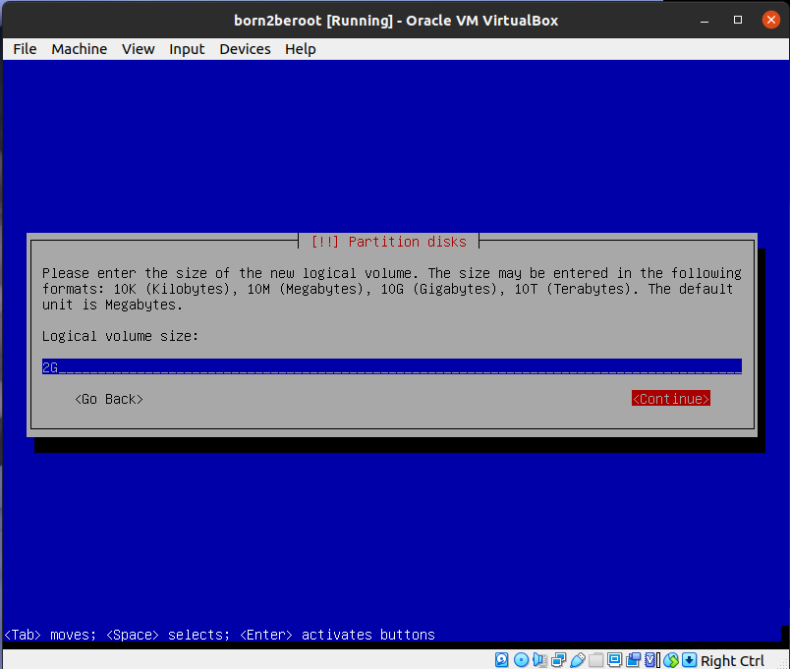
- Logical volume name : root
- /root : top-level directory as top-mounted partition
- includes /bin, /etc
- Logical volume size : 2G
- Usually 250~350MB

Slide 29
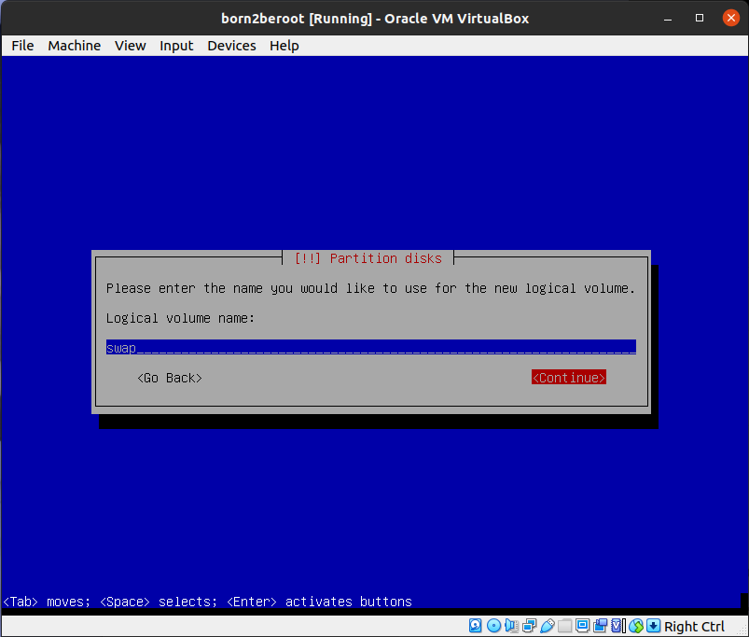
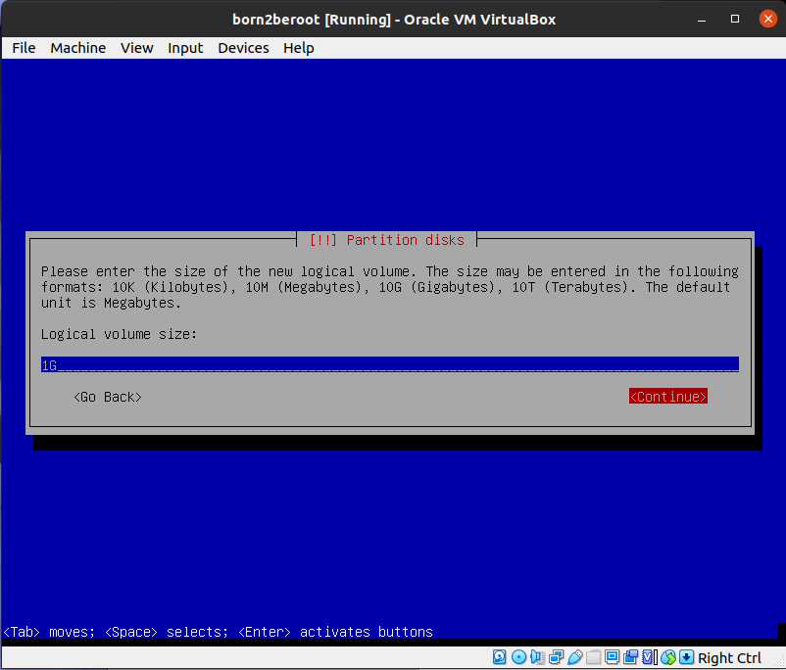
- Same step
- Logical volume name : swap
- Logical volume size : 1G
- it should be at least 256MB, and at least twice of RAM size is recommended
- /swap : used as virtual memory as a swap partition
- it is used instead when the actual physical RAM is insufficient
- essential partition with /root

Slide 30

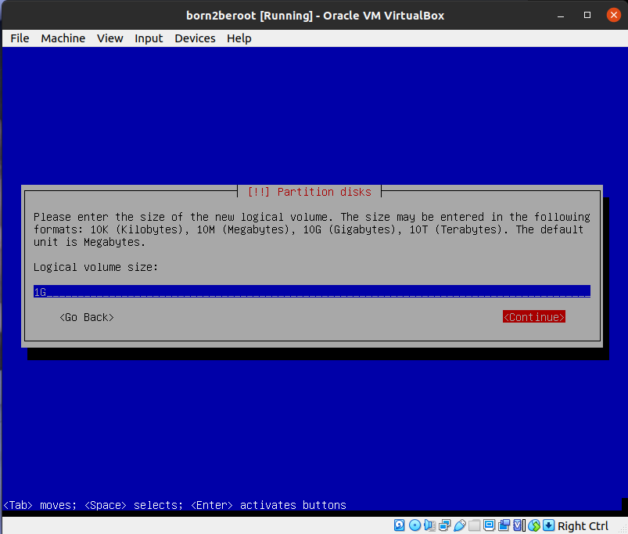
- Logical volume name : home
- Logical volume size : 1G
- it should be at least 100MB
- /home : user accounts partition where user accounts are located

Slide 31
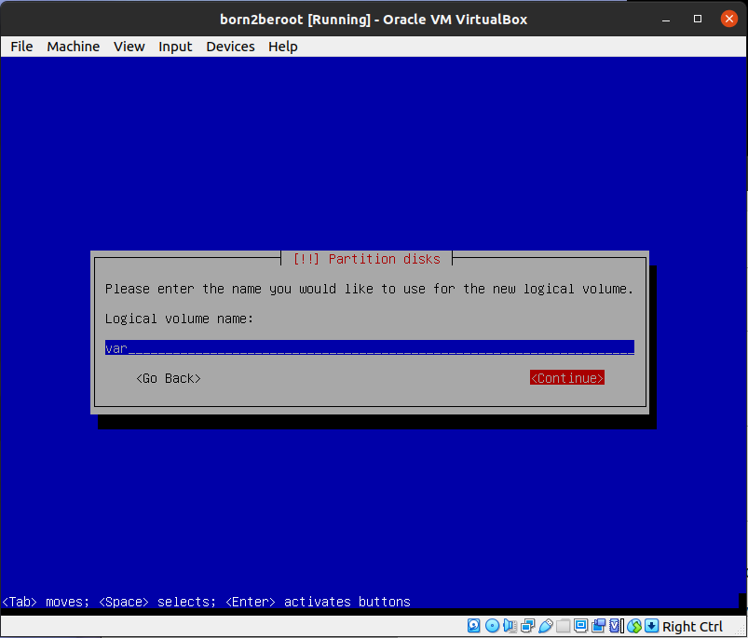
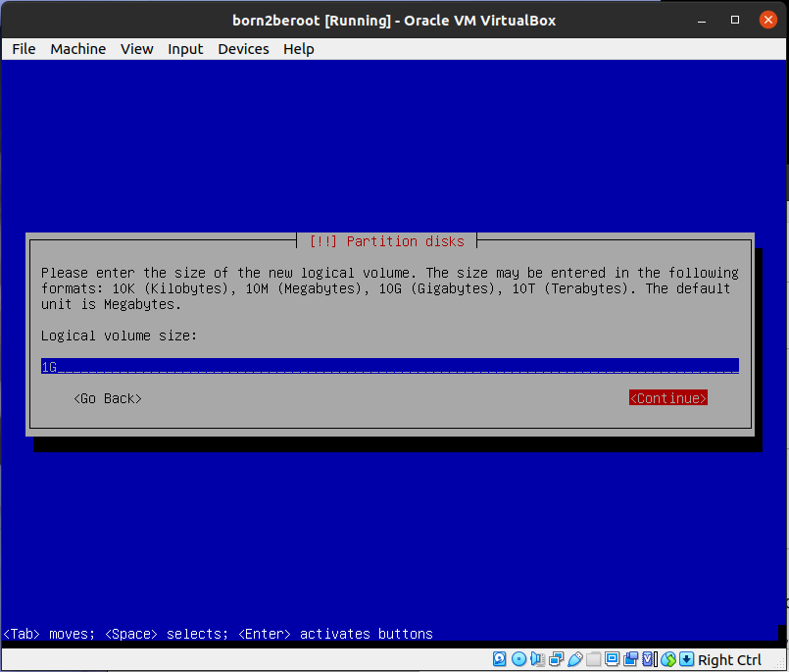
- Logical volume name : var
- Logical volume size : 1G
- it should be 30MB and 2~3GB is recommended
- because log files take up a lot of space, it is necessary to handle it so that the system does not become paralyzed due to insufficient disk capacity.

Slide 32


- Logical volume name : srv
- Logical volume size : 1G
- /srv : server partition used for sharing with external users using protocol.

Slide 33


- Logical volume name : tmp
- Logical volume size : 1G
- it should be at least 40MB
- /tmp : a partition used to store temporary files as a temporary partition, or to perform temporary work on the system

Slide 34


- Logical volume name : var-log
- Logical volume size : 1024MB(the left size)
- /var/log : a directory where program log files are stored separately

Slide 35


- Select “Finish”
(Mounting process)
- Select “LVMGroup - LVhome”

Slide 36


- Select “Use as”
- Select “Ex4 journaling file system”

Slide 37


- Select “Mount point”
- Select “/home”

Slide 38


- Select “Done setting up the partition”
- Select “LVMGruop – LV root”
- Use as : Ex4file system
- Mount point : /

Slide 39


- Select “LVMGruop – LV srv”
- Use as : Ex4file system
- Mount point : /srv
- Select “LVMGruop – LV swap”
- Use as : swap area

Slide 40


- Select “LVMGruop – LV tmp”
- Use as : Ex4file system
- Mount point : /tmp
- Select “LVMGruop – LV var”
- Use as : Ex4file system
- Mount point : /var

Slide 41


- Select “LVMGruop – LV var-log”
- Use as : Ex4file system
- Select “Mount point”

Slide 42


- Select “Enter manually”
- Mount point for this partition : /var/log

Slide 43


- Select “Done setting up the partition”
- Select “Finish partitioning and write changes to disk”

Slide 44


- Select “Yes”
- Select “No”

Slide 45


- Select “France”
- Select “deb.debian.org”

Slide 46


- do not put anything and select “continue”
- Select “No”

Slide 47


- Select “SSH server” and “standard system utilities”
- Select “Yes”
- Boot loader : A program that is pre-executed before the OS to perform pre-work so that the kernel can run properly and runs the OS without any problem

Slide 48


- Select “/dev/sda” where /boot exists
- Select “Continue”

Slide 49


- should put the password because LVM is encrypted
- login with user(yhwang)

Slide 50

- can check the partition structure with the command “lsblk”

Slide 51
aptitude and apt
aptitude
- advanced packaging tool (front-end tool that gives users access to the user-interface to access functionality)
- high-level package manager
- it suggests possible measures to remove the conflict in case of conflicting action regarding installation or removal of package
- while removing any installed package, it will automatically removed unused packages
apt
- Advanced Packaging Tool
- lower-level package manager
- processor would probably die-out in case of conflicting action regarding installation or removal of package
- while removing any installed package, it needs additional option

Slide 52

APPArmor
- Application Armor
- A Linux kernel security module that allows the system administrator to restrict programs' capabilities with per-program profiles.
- provides “mandatory access control” (MAC) security
- focus on protecting individual programs and implement a per-program security model
- Check the apparmor status via “sudo aa-status” after installing sudo

Slide 53
What is the sudo?
- command “sudo”
: allows a user with proper permissions to execute a command as another user.
(default : it executes commands as root)

Slide 54


Installing sudo and creating a new group
- Switch to root and its enviroment via “su”
- install sudo via “apt install sudo”

Slide 55

- Verify whether sudo was successfully installed via “dpkg -l | grep sudo”
- Add user to sudo group via “adduser yhwang sudo”

Slide 56


- Verify whether user was successfully added to sudo group via “getent group sudo”
- “reboot” for changes to take effect, then login and verify sudopowers via “sudo -v”

Slide 57


- Create new yhwang42 group via “sudo addgroup yhwang42”
- Add user(yhwang) to yhwang42 group via “sudo adduser yhwang yhwang42”

Slide 58

- Verify whether user was successfully added to yhwang42 group via “getent group yhwang42”
- “sudo apt update” to update all the packages of the system

Slide 59

Creating a new user
- Create new user via “sudo adduser chloe”
- Verify whether user was successfully created via “getent passwd chloe”

Slide 60


Creating a new group
- Create new group via “sudo addgroup sleepy”
- Add a user to a group via “sudo adduser chloe sleepy”

Slide 61


- Verify whether group was successfully created via “getent group sleepy”
- Add a user to sudo group via “sudo adduser chloe sudo”

Slide 62

- Check the user was successfully added in sudo group via “getent group sudo”

Slide 63


Changing hostname
- Check current hostname via “hostname”
- Change the the hostname via “sudo hostnamectl set-hostname chloe”

Slide 64
- Check if hostname was successfully changed via “hostanme”
- Reboot and check the hostname is changed to new one

Slide 65


Configuring sudo
- Create a log directory to store the log file that would archive each action performed using sudo via “sudo mkdir /var/log/sudo”
- Access the sudoers file via “sudo visudo”

Slide 66
- Default passwd_tries=3
: To limit authentication using sudo to 3 attempts in the event of an incorrect password
- Default baddpass_message=”Wrong password”
: The error message due to a wrong password

Slide 67

- Default log_input
- Default log_output
: To create the logs of the inputs and outputs of every use of
- Defaults iolog_dir=”/var/log/sudo”
: The directory where those logs(input and output) will be stored(created previously)

Slide 68
- Defaults requiretty
: To enable TTY mode
- Default secure_path=”/usr/local/sbin:/usr/local/bin:/usr/sbin:/usr/bin:/sbin:/bin:/snap/bin”
: To restrict the PATHs that can be used by sudo specifically to those specified

Slide 69

- “Ctrl + X” to save
- Filename : sudoers (remove the ‘.tmp’
- Switch to root and its enviroment via “su”
- Go inside the /var/log/sudo via “cd” and then “cd /var/log/sudo”
- Check the number via “cat seq”
(The number is 4)

Slide 70


- Go inside /var/log/sudo/00/00/ and check that check that the number of directories inside /var/log/sudo/00/00/ is 4
- Now try to run command via sudo (I did “sudo pwd”)
- And then check that the number of directories inside /var/log/sudo/00/00/ is 5

Slide 71

- Go inside /var/log/sudo/00/00/05/ and check the command “pwd” via “cat log”
- the first line “/var/log/sudo/00/00” is the path when I run the command “pwd”
- I can check the command “pwd” on last of the second line “/usr/bin/pwd”

Slide 72
What is the SSH?
- Secure Shell Protocol : a cryptographic network protocol (public key + private key)
- The communication between the two computers is encrypted meaning that it is suitable for use on insecure networks.
- It is often used to login and perform operations on remote computers but it may also be used for transferring data

Slide 73


Installing and configuring SSH
- Install openssh-server via “sudo apt openssh-server”
- Verify whether oppenssh-server was successfully installed via “dpkg -l | grep ssh”

Slide 74

- Configure SSH via “sudo nano /etc/ssh/sshd_config”
- To set up SSH using Port4242, replace the line “#Port 22” with “Port 4242”

Slide 75

- To disable SSH login as root irregardless of authentication mechanism, replace line “#PermitRootLogin prohibit-password” with “PermitRootLogin no”
- Restart SSH service via “sudo systemctl restart ssh”
- Check SSH status via “sudo service ssh status”

Slide 76
What is the UFW?
- Uncomplicated Firewall : a program for managing a netfilter firewall designed to be easy to use
  (Firewall : a network security device that monitors incoming and outgoing network traffic and permits or blocks data packets based on a set of security rules. )
- It uses a command-line interface consisting of a small number of simple commands, and uses iptables for configuration

Slide 77
Installing and configuring UFW
- Install ufw via “sudo apt install ufw”
- Verify whether ufw was successfully installed via “dpkg -l | grep ufw”
- Enable Firewall via “sudo ufw enable”

Slide 78


- Allow incoming connections using Port 4242 via “sudo ufw allow 4242”
- Check UFW status via “sudo ufw status”

Slide 79


Adding new port and deleting it
- Allow new port (9999) via “sudo ufw allow 9999”
- Check the ufw status via “sudo ufw status”

Slide 80


- Check the ufw status of each rule with numbers on the left via “sudo ufw status numbered”
- Delete the rule that corresponds to number 2 via “sudo ufw delete 2”

Slide 81


- Check if the rule 2 was successfully deleted via “sudo ufw status numbered”
- Delete the rule that corresponds to number 3 via “sudo ufw delete 3”

Slide 82

- Check if the rule 3 was successfully deleted via “sudo ufw status numbered”

Slide 83


(do this step after finishing up everything)
- Check that if “Default : allow(outgoing)” via “sudo ufw status verbose”
- Deny outgoing via “sudo ufw default deny outgoing”

Slide 84

- Verify whether outgoing was successfully denied via “sudo ufw status verbose”

Slide 85
Connecting to server via SSH
- Check the Host IP address(for me it is Ubuntu) via “hostname -I | awk '{print $1}'”
- Host IP is 192.168.1.82
- The default value of Guest IP of the virtual machine on Virtualbox is 10.0.2.15
- Try to connect as user(yhwang) to guest via “ssh yhwang@192.168.1.82 -p 4242”
- (ssh <vmuser>@<Host IP> -p 4242)
→ failed

Slide 86


- Go in VirtualBox to
: VM settings → Network → Advanced → Port Forwading → New rule
(Protocol : TCP, Host IP : 192.168.1.82, Host Port : 4444, Guest IP : 10.0.2.15, Guest Port : 4242)
- Connect as user(yhwang) to guest via “ssh yhwang@192.168.1.82 -p 4444”
- (because I put Host Port as 4444, so if I connect Port 4444 of the local IP, it will connect to Port 4242 of the virtual environment
- Type the user password of virtual machine

Slide 87

- Terminate SSH session at any time via “logout”
- Try to connect as root to guest via “ssh root@192.168.1.82 -p 4444”
- Type the user password of virtual machine
- I am not supposed to connect as root to guest because of configuring SSH that I did before

Slide 88

Setting up a strong Password Policy
- Configure password policy via “sudo nano /etc/login.defs”
- To set password to expire every 30 days, replace the line “PASS_MAX_DAYS 99999” with “PASS_MAX_DAYS 30”

Slide 89
- To set minimum number of days allowed before modification of a password to 2, replace the line “PASS_MIN_DAYS 0” with “PASS_MIN_DAYS 2”
- To send user a warning message 7 days before their password expires, replace the line “PASS_MIN_DAYS 7” (default value is 7 anyway)

Slide 90

- To set up policies in relation to password strength, install the libpam-pwquality package via “sudo apt install libpam-pwquality”
- And then verify whether libpam-pwquality was successfully installed via “dpkg -l | grep libpam-pwquality”
- Configure password strength policy via “sudo nano /etc/pam.d/common-password”

Slide 91
- Add the parameter “minlen=10” to set password minimum length to 10 characters
- Add the parameter “ucredit=-1 dcredit=-1” to require password to contain at least un uppercase character and a numeric character

Slide 92
- Add the parameter “maxrepeat=3” to set a maximum of 3 consecutive identical characters
- Add the parameter “reject_username” to reject the password if it contains <username> in some form

Slide 93
- Add the parameter “difok” to set the new password must have at least 7 characters that are not part of the former password
- Add the parameter “enforce_for_root” to implement the same policy on root

Slide 94
- After this settings, the resulting line should be like this
: password requisite pam_pwquality.so retry=3 minlen=10 ucredit=-1 dcredit=-1 maxrepeat=3 reject_username difok=7 enforce_for_root
- In case of a password policy, it is applied only to users and passwords that are created after the setting
- So we have to change password of existing user(yhwang) and root and to apply the password to expire

Slide 95

- Apply password policy to root via “sudo passwd -e root”
- The password will be forcibly changed at the next login
- Apply password policy to yhwang via “sudo passwd -e yhwang”

Slide 96


- Reboot the machine to change password
- Change the password of yhwang
- Change the password of root

Slide 97
- Update the maximum number and minimum number of days for root password manually via “sudo chage -m 2 -M 30 -W 7 root”
- Update the maximum number and minimum number of days for yhwang password manually via “sudo chage -m 2 -M 30 -W 7 yhwang”

Slide 98


- Check that if the setting of root was changed via “sudo chage -l root”
- Check that if the setting of yhwang was changed via “sudo change -l yhwang”

Slide 99
monitoring.sh
- Command “uname” : print system information
  -s : print kernel name (Linux)
  -r : Kernel release information (5.10.0-11-amd64)
  -v : output kernel version (#1 SMP Debian 5.10.92-1 (2022-01-18))
  -m : output the hardware type of the system (architecture) (x85_64)
  -o : Display operating system name (GNU/Linux)
- Command “uname -srvmo”

Slide 100

- Command “nproc --all”
: print the number of CPUs available on Linux
- Command “cat /proc/cpuinfo | grep processor | wc -l”
: print exact number of virtual cpu (vCPU)

Slide 101
- Command “free” : print information about the memory and swap in KB
  -m : change unit to MB)
- Command “free -m | grep Mem | awk ‘{printf”%d/%dMB (%.2f%%)\n”, $3, $2, $3/$2 * 100}’”
: print the current available RAM and its utilization rate as a percentage

Slide 102

- Command “df” : print information related to file systems about total space and available space
  -BM : print sizes in units of 1MB
  -BG : print sizes in units of 1GB
- Check the memory via “df -BM | grep /dev/mapper” (unit : MB)
- The current available memory is 1123+1+1+1+212+132 =1470(MB) → $3
- The total memory is 1837+919+919+919+919+982 =6495(MB) → $2

Slide 103
- Command “df -BM | grep /dev/mapper | awk '{ut += $3} END {print ut}'”
: print the current available memory (unit : MB)
- Command “df -BG | grep /dev/mapper | awk '{ft += $2} END {print ft}'”
: print the total memory (unit : GB)

Slide 104
- Command “df -BM | grep /dev/mapper | awk '{ut += $3} {ft+= $2} END {printf("%d%%\n"), ut / ft * 100}'”
: Utilization rate of the current available memory as a percentage
- Command “top”
: display linux processes
- Command “top -bn1 | grep '^%Cpu' | cut -c 9- | xargs | awk '{printf("%.1f%%\n"), $1 + $3}'”
: The current utilization rate of the processors as a percentage

Slide 105
- Command “who”
: print information about users who are currently logged in
  -b : time of last system
- Command “who -b | awk '$1 == "system" {print $3 " " $4}'”
: The date and time of the last reboot
- Command “if [ “$(lsblk | grep lvm | wc -l)” -gt 0 ] ; then printf “yes\n” ; else printf “no\n”; fi”
: Whether LVM is active or not

Slide 106

- Command “cat /proc/net/sockstat{,6} | awk ‘$1 == “TCP:” {print $3}’”
: The number of active connections
- /proc/net/sockstat file : contains TCP/IP stats of individual layer.
- Command “who | wc -l”
: The number of users using the server

Slide 107

- Command “hostname -I”
: The IPv4 address
- Command “ip link show | awk '$1 == "link/ether" {print $2}'”
: The MAC(Media Access Control) address

Slide 108

- Command “journalctl _COMM=sudo | grep COMMAND | wc -l”
: The number of commands excuted with the sudo program
- journalctl should be running as sudo but the script is running as root so don't need in sudo here

Slide 109

- Go to /usr/local/bin and make monitoring.sh via “sudo nano monitoring.sh”

Slide 110

- Change the permission of the monitoring.sh file via “sudo chmod 755 monitoring.sh”
- Check if the permission was successfully changed via “ls -la”

Slide 111

- Run script via “./monitoring.sh”

Slide 112
What is the cron?
- A job scheduler
- users can use cron to schedule jobs to run periodically at fixed times, dates, or intervals
- It is most suitable for scheduling repetitive tasks

Slide 113


- Configure corn as root via “sudo crontab -e”
- Replace “# m h dom mon dow command” with “*/10 * * * * /usr/local/bin/monitoring.sh”
- Check root’s scheduled cron jobs via “sudo crontab -u root -l”

Slide 114

- To set the time to every 30 second,
“ * * * * * /path/
* * * * * sleep 30; /path/”
- Stop the cron via “sudo /etc/init.d/cron stop”
- Start it via ”sudo /etc/init.d/cron start”
- Stop it after reboot via “sudo systemctl disable cron”

