Slide 1
1
Background

Slide 2
Wechat Overview The most popular multipurpose messaging app in China:
800M+
15-40
93%
1KW+
3billion+
Active Users
Majority User Age
Coverage
Official Account
Article Reads
The number of user of Wechat exceeded 800 million and is still growing.
The majority user age ranges from 15 to 40.
Coverage on first-tier city in China exceeds 93%.

Slide 3
Wechat Miniprogram
No need
for Download
· WeChat mini-programs are “sub-applications” within the WeChat ecosystem.
· There is no needs to download or install the mini program, more user friendly.
· The search & scan function allow user to find or access the mini program quickly.
·
No need for Installation
Mini Program
Accessible

Slide 4
What makes the Wechat miniprogram powerful:
Easy to use Search, Connect to friend, Connect to official account, Share…

Slide 5
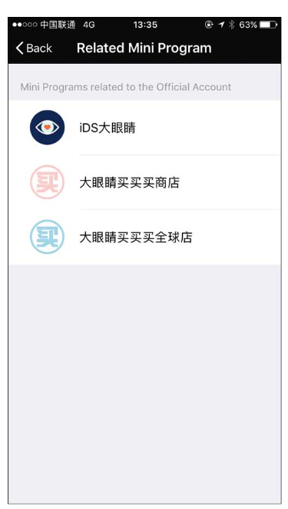
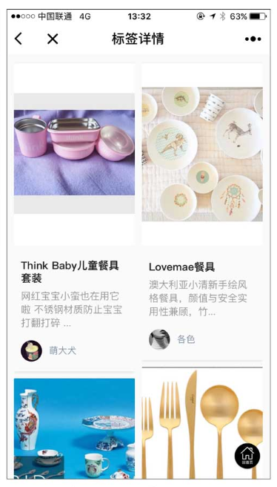
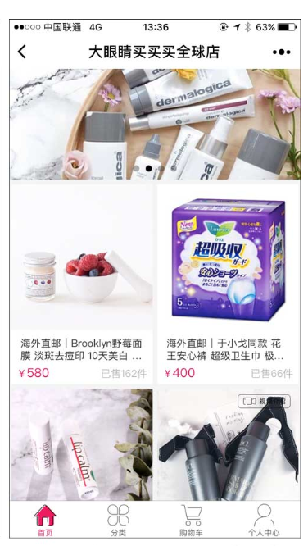
WeChat Mini-programs and social e-commerce:
- Key Opinion Leaders such as Yu Xiaoge started to boast more than 1.5 million USD of monthly sales through their e-commerce mini-programs.
Notes:
Her team developed 3 miniprograms, with one focus on content and community engagement, and the other 2 focus on local and c

Slide 6
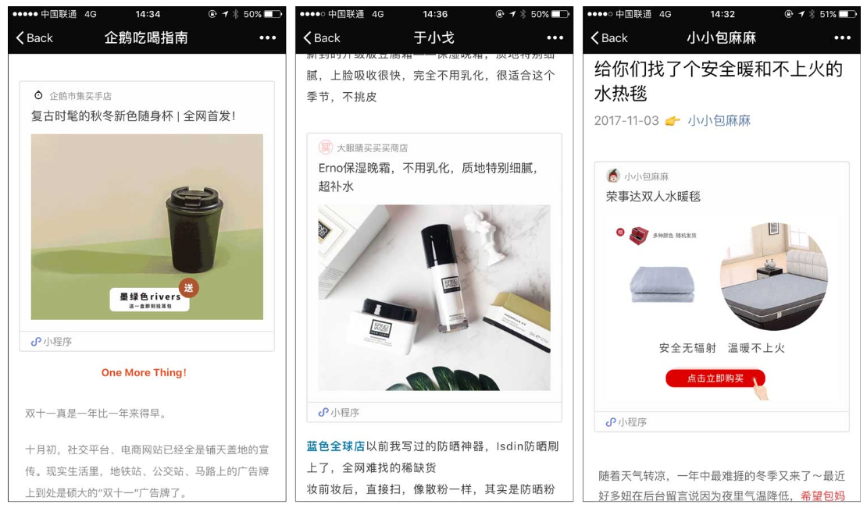
WeChat Mini-programs and social e-commerce: Other Example:
Notes:
WeChat has been the place where a striving community of influencers developed (partly due to specificities of the Chinese market, and partly due to the fact that WeChat advertising wasn’t that good at targeting customers).
These influencers became huge growth drivers for fashion, childcare and cosmetic brands. Their recommendations were extremely trusted by Chinese users, driving a huge amount of sales.
But there was one problem: influencers use WeChat Subscription Accounts (somehow equivalent to Facebook Pages) to send notifications, but the articles sent on these accounts can’t contain hyperlinks! It was therefore difficult for influencers to link to products in order to convert from content to e-commerce.
There came mini-programs, which conveniently solved this problem: WeChat made it possible to link from a Subscription Account article to a mini-program, increasing conversion rates.

Slide 7
Product Overview
2

Slide 8
Our Product: Little Notebook
Product Idea:
We are building a Wechat Mini Program of that a user could investigatea new cosmetic product they would like to try and are curious about the experience of based on review from their friends. In the mini program, user can write about favorite lipsticks, upload photos wearing them and add a video showing how to pick the right color for different outfits. User could also add links to the product or add tags to make the notes searchable by my friends or by public. Other users who searched for this lipstick could see the Notes and reply to leave their comments or clicked the link directly to purchase if one feels like buying, which saves time for both looking for reviews or looking for trustable website for purchase.

Slide 9
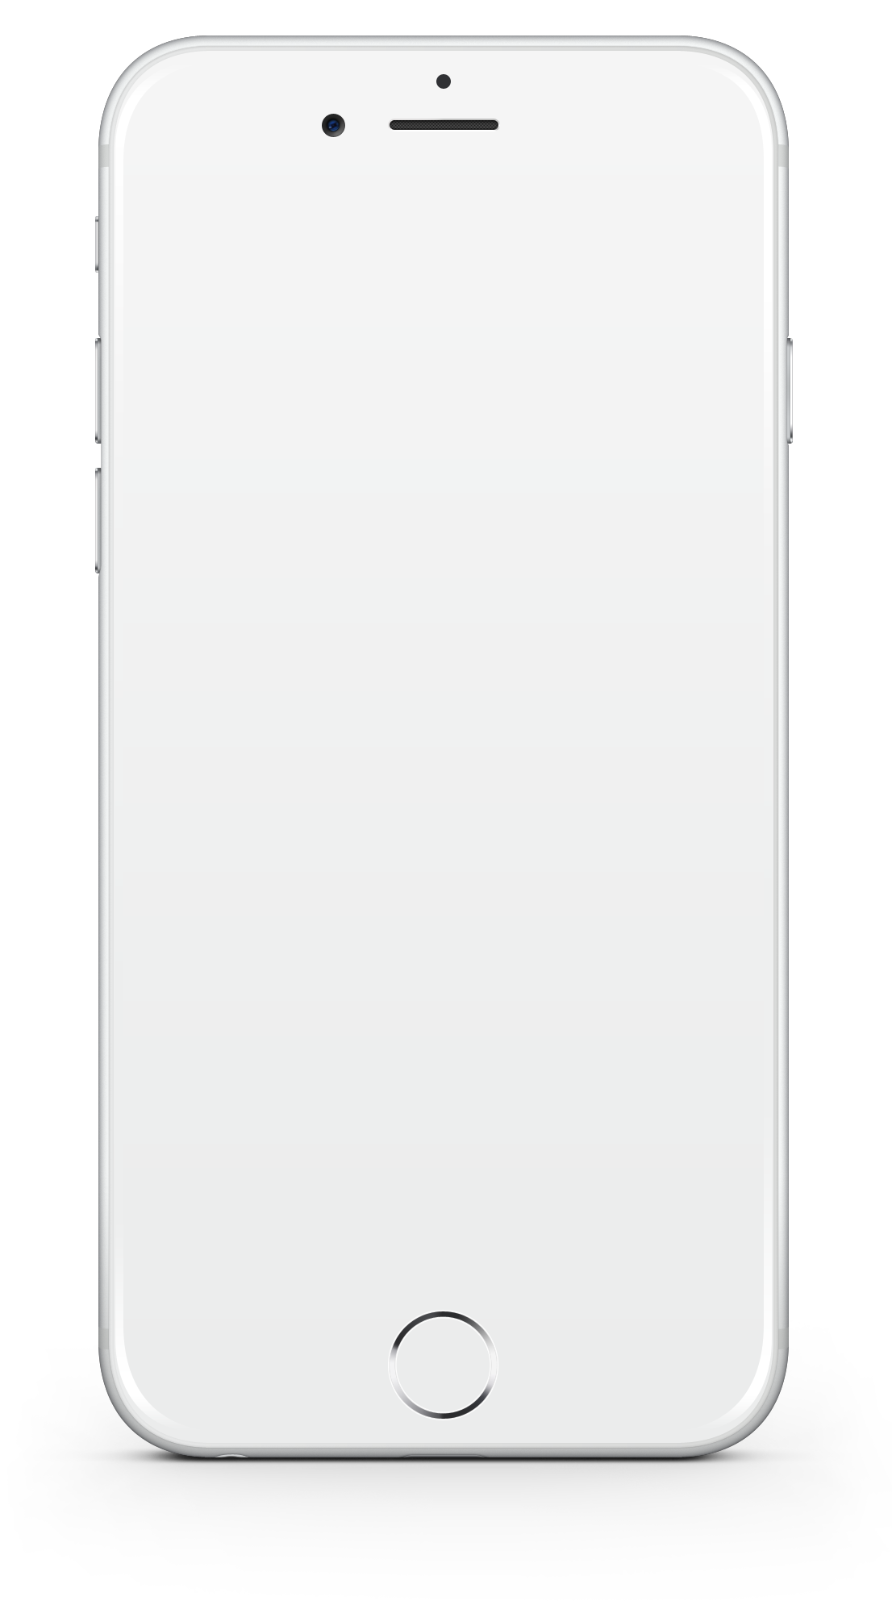
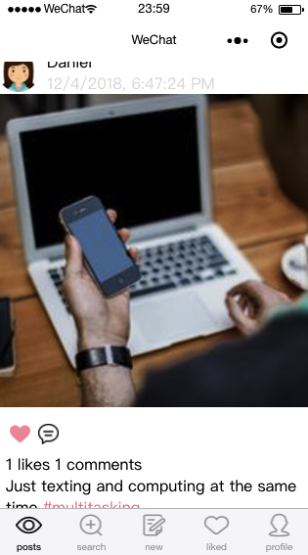
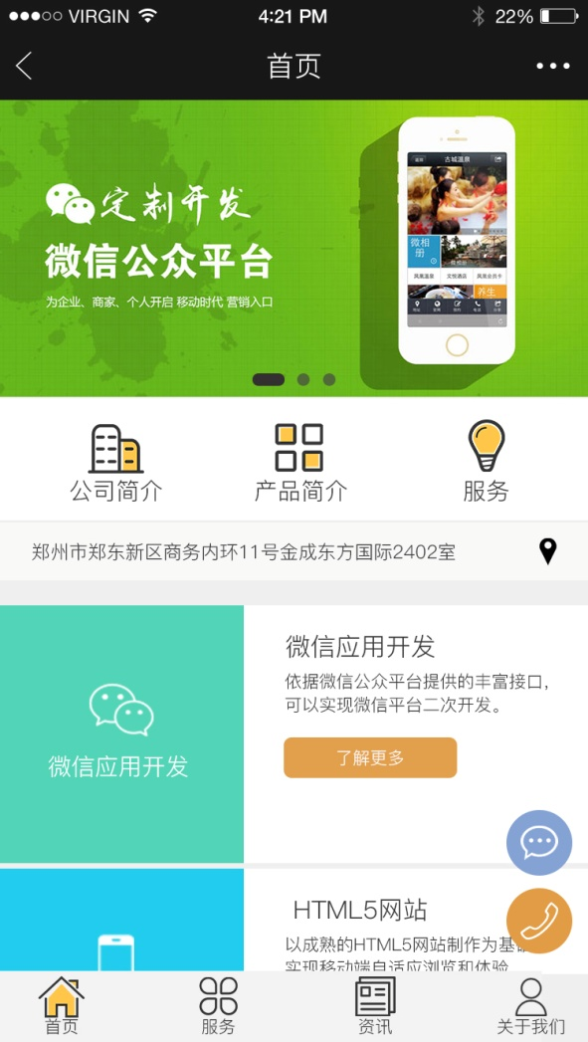
Our Product: Functions Overview
LITTLE NOTEBOOK

Slide 10
Product Function: Overview
LITTLE NOTEBOOK
Home Page: Display post from other users

Slide 11
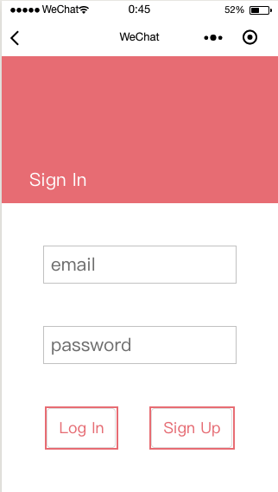
Product Function: Sign in/ Sign up
LITTLE NOTEBOOK
User can choose to sign in or sign up

Slide 12
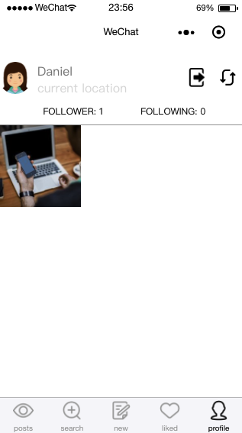
Product Function: User Profile
LITTLE NOTEBOOK
User can see his/her profile
User can see his/her posts
User can change his/her nickname

Slide 13
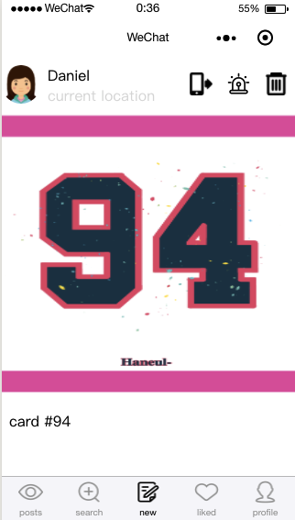
Product Function: New Post
LITTLE NOTEBOOK
User can write posts and upload photos from albums

Slide 14
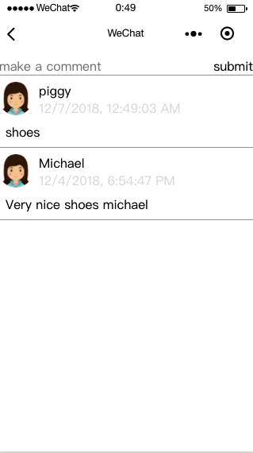
Product Function: Comments
LITTLE NOTEBOOK
User can write comments under posts

Slide 15
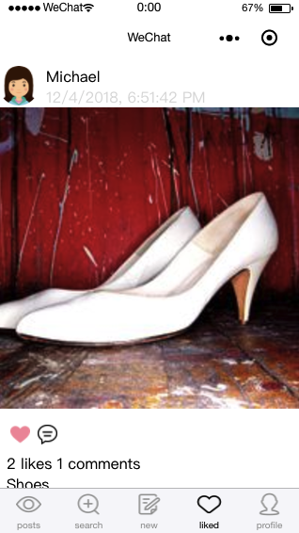
Product Function: “Liked”
LITTLE NOTEBOOK
User can see the posts he/she liked.

Slide 16
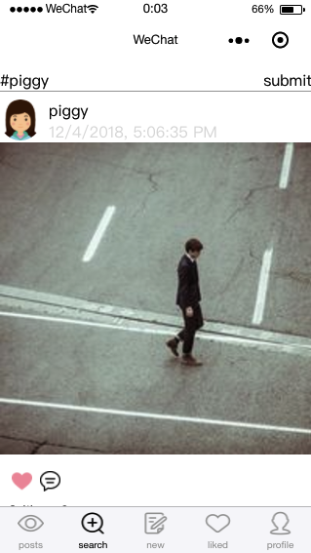
Product Function: Search
LITTLE NOTEBOOK
User can search for the product or the review they interested in by product name or other keywords.

Slide 17
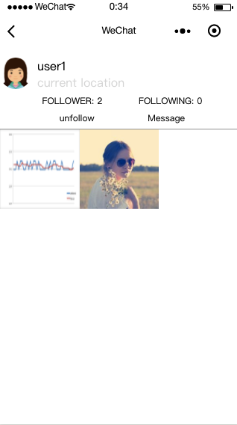
Product Function: Follow
LITTLE NOTEBOOK
User can follow other users from their profile page
User can also send message to other users from this page

Slide 18
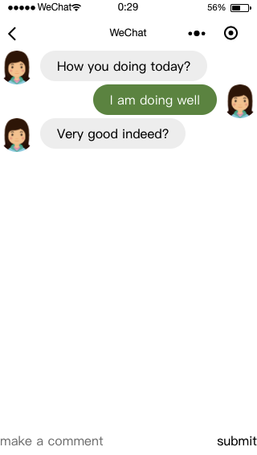
Product Function: Chat
LITTLE NOTEBOOK
- Real time chatting

Slide 19
Architecture
3

Slide 20
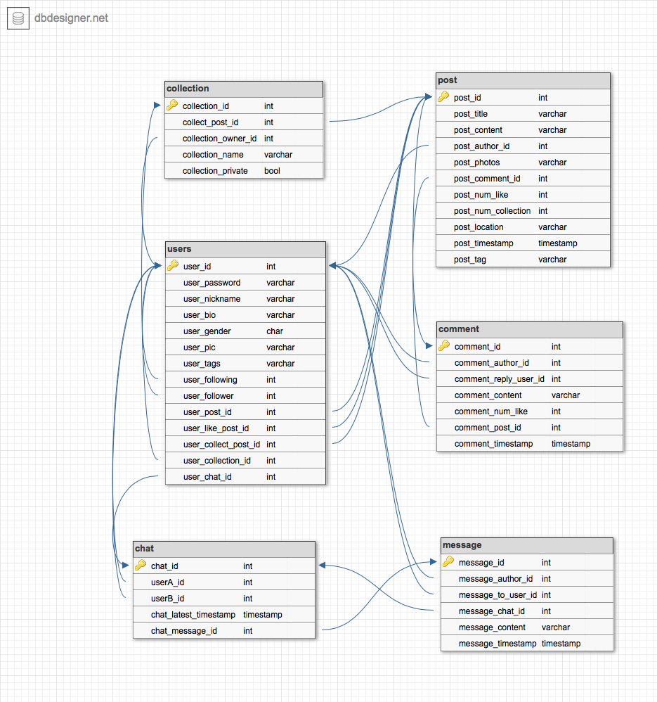
Product Architecture - Backend
LITTLE NOTEBOOK
mySQL – Database
Java – Logics, Database connection
RestfulAPI – GET, PUT parameter

Slide 21

Product Architecture - Frontend
LITTLE NOTEBOOK
mpVue.js:
Pages – contains many component
Index
Sign in
Sign up
User
Profile
Others’ profiles
Posts
New post
Comment
Liked
Search
Messages
2. Components
HTML
CSS
Scripts
https://cn.vuejs.org/index.html

Slide 22
Life Cycle
4

Slide 23
Where are you versus where you thought you would be? ○ How closely did you follow your schedule? ○ How close was the average PI to schedule? ○ How often did you complete your sprint goals? ○ What serious problems did you run into? ○ What features were removed from scope? ○ What features were added to the scope?

Slide 24
User Testing
4

Slide 25
User Testing: Our Approach
LITTLE NOTEBOOK
In order to both qualitatively and quantitatively evaluate the result from user testing, we ask the user to rate the different aspects – determined by what we are optimizing during that period - of our product on a 0 – 10 scale and comment on what need to be improved.

Slide 26
User Testing: Our Approach
LITTLE NOTEBOOK
In order to both qualitatively and quantitatively evaluate the result from user testing, we ask the user to rate the different aspects – determined by what we are optimizing during that period - of our product on a 0 – 10 scale and comment on what need to be improved.
We tried to keep the questionnaire short and ask more people. We than look at the score for each function to determine which we need to improve, and look at the comment on possible new features.

Slide 27
User Testing: Sample Question
LITTLE NOTEBOOK
Below are the list of questions we asked when we are doing our first round of user testing, when we are focusing refining UI/UX design and function design :
Generally, is the app easy to use? (0 – 10)
How friendly is the UI design on the aspects of: (0 – 10)
User have control of the interface
Product is comfortable to interact with
Consistent
3. How friendly is the design of each function (functions are listed below): (0 – 10)
Register and Login
Create /Modify profile
Social features (like post and follow)
4. What additional function will you think would be interesting?

Slide 28
Thanks
End of Presentation
Ciel WU, Yushu LIU

