Slide 1
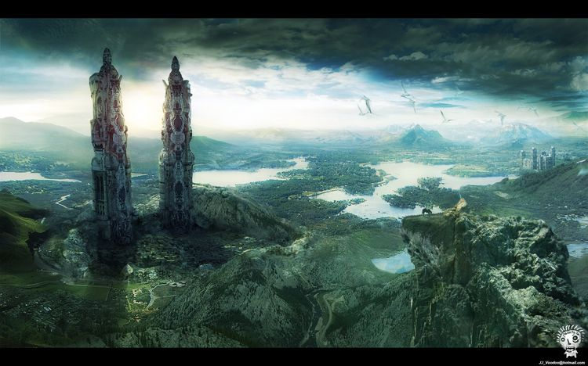
Dream Tower

Slide 2

TARGET USERS
13 years old and above that is literate and has great understanding and open-mindedness.

Slide 3
SCOPE AND LIMITATION
SCOPE
Open world
Modifiable
Easy to use
Familiar game feel
Personalized
Free demo
LIMITATION
Full version is not free

Slide 4
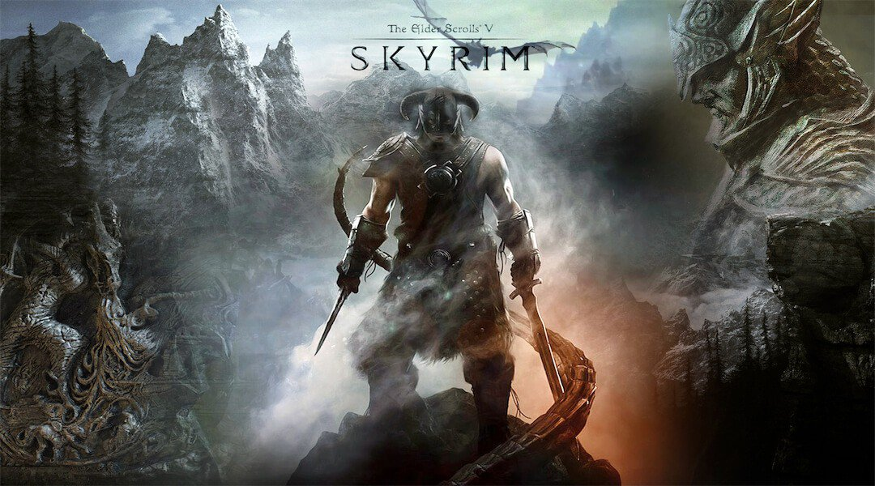

EXISTING

Slide 5
PROPOSAL
open world free roam where you can create your own virtual reality to be in by choosing a genre and timeline.
An aspiration can be chosen accordingly to the chosen genre and timeline but it doesn’t have to be necessarily followed.
The game follows this rule:
“The more goals are accomplished, the more the virtual reality expands, the more it expands the more things to be discovered.”

Slide 6


USABILITY
KIT

