Slide 1

AI BUILDER CUP · SUBMISSION
Team details
QuantarisAI
1. Team name: [add your team name]
2. Team leader name: Krishna Tandon
3. Problem statement:
Build an AI-powered solution that addresses challenges related to efficiency, quality, reliability, supply and demand, or sustainability across manufacturing and industrial operations. Solutions should demonstrate how AI can transform operational data into meaningful insights, recommendations, or actions.
AI manufacturing intelligence: from one sentence to a plant that runs clean
Notes:
Introduce the team and the problem statement. One sentence: QuantarisAI helps someone who has a raw material or a farm decide what factory to build, where, and how to run it clean, then keeps working as the plant's AI.

Slide 2



Most owners start with a material, not a plan
100 kg of coconut husk every day. Forty cows. A pineapple farm.
The owner has the raw material and the will, but not the answers.
What should I build?
Which product, which steps, which machines
Today they pay consultants, or guess. Pollution, wasted water and the wrong site are discovered after the money is spent.
Where should I build it?
Which area, which sources, what it costs
How do I run it clean?
Water, smoke and waste: what can be reused
Notes:
Tell the coconut husk story: 100 kg a day. The three questions on the right are what every new owner faces.

Slide 3


QuantarisAI plans it, places it, then helps run it clean
Plan
Place
Run clean
Describe a factory in English or Hindi. Get a researched blueprint: steps, machines, a 3D plant with raw material arriving and product leaving, and a farm beside the gate.
Find the best areas in your city with sources and a map, the nearest suppliers, indicative machine prices and land options.
See how water, smoke and waste can be reused, then load your own plant records: AI finds the leak, the weak machine, the quality drift.
Honest by design. Every claim is labelled fact, assumption, calculation, idea to validate, simulation or unknown. Where data is simulated or a figure is unknown, the app says so.
Notes:
The three verbs. Stress the honesty line: judges will see the labels on every screen.

Slide 4
Opportunities: why this is different and why it works
How is it different?
How does it solve the problem?
Our USP
Starts before the factory exists, then follows it into operations
Researches real places and suppliers with Google Search, with source links
Shows the evidence: fact, assumption, calculation, or unknown
Efficiency: bottleneck and OEE
Quality: photo inspection, defect drift
Reliability: failing machines found early
Supply and demand: sources, 13-week forecast
Sustainability: reuse loops, smoke and water with AI
One tool from idea to operations, in plain words
English and Hindi, voice and text
Works on the owner's own CSV, not only demos
Gemini plus Google Search, with guardrails
Notes:
Different: most tools are dashboards for plants that already exist. We start with a sentence and carry through to operations, and we label what is evidence versus idea.

Slide 5





What the solution offers
Chat-first design
3D plant
Best location
Sourcing and costs
English and Hindi, voice or text, edit the plant by speaking
Raw material in, product out, people, farm, smoke
Ranked real areas with sources and map pins
Nearest suppliers, indicative machine and land prices
Reuse and save
Plant AI
Your data
Copilot + vision
Water, smoke and heat, waste: Today, Fix, Result
Maintenance, OEE, quality drift, demand, smoke and water
Upload a CSV: use per unit, gap to your best, reuse levers
Copilot quotes the numbers; Gemini vision checks a photo
Notes:
Eight things the user can do today. Everything shown here is built and running.

Slide 6
Process flow: from one sentence to daily operations
1
2
3
4
5
6
Describe
AI drafts
Research
Visualise
Improve
Operate
Text or voice, English or Hindi. Photos for an existing plant.
Steps, equipment, waste, raw material in and product out.
Google Search: sources, costs, best locations, good practice.
3D plant, material flow, farm. Edit by voice.
Reuse loops. Pollution with and without AI.
Your data in, insights and actions out. Ask the AI.
Where AI acts: Gemini designs and explains; Google Search grounds the facts; Gemini vision checks photos; plain statistics, not a model's guess, compute every trend, forecast and balance.
Notes:
Walk the six steps left to right. Point out that computed numbers come from ordinary statistics, which is why they can be trusted and tested.

Slide 7
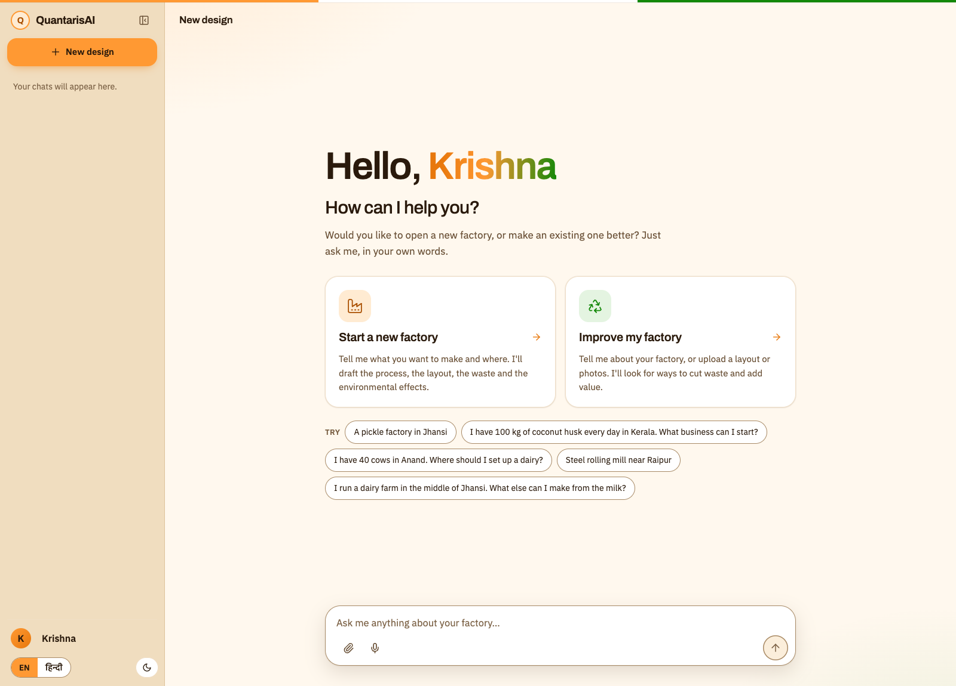
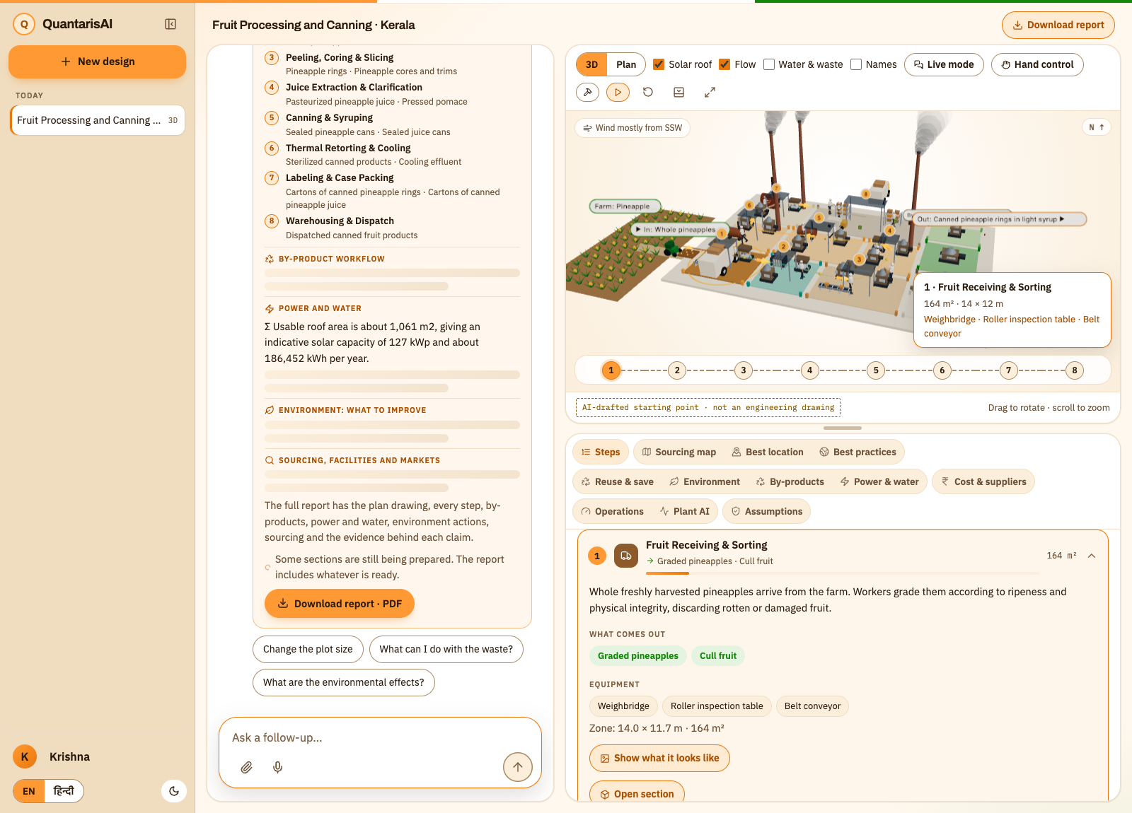
Screens: chat first, plant and tabs beside it
Landing: two clear choices, in English or Hindi, light or dark
Workspace: chat on the left, 3D plant above, grouped tabs below
Notes:
Chat-first, like the tools people already use, with a saved-chat sidebar. The right side is the plant and its tabs.

Slide 8
Architecture: one container on Cloud Run, Gemini behind it
Browser
Cloud Run container (Docker)
Gemini API
Next.js 16 · React 19
Three.js 3D plant
Leaflet map
MediaPipe hand control
Voice in and out
Chats saved locally
Next.js server
Structured JSON · Google Search grounding
Vision · image · Veo video
Serves the app and forwards /api
FastAPI agents
Design · research · costs · practices · reuse
best location · copilot · photo inspection
Open data
Analytics engine + guardrails
OpenStreetMap places
Open-Meteo wind and sun
Trends, OEE, forecast, balance (plain statistics)
Schema limits · injection check · call budgets
Planned next (not built yet)
Firebase Auth + Firestore (Google login, saved chats) · BigQuery + Pub/Sub + Dataflow (plant data pipeline) · Vertex AI (Gemini on Vertex, forecasting) · Cloud Storage (files and photos) · Secret Manager holds the Gemini key today
Notes:
One container keeps deployment simple: the browser only talks to the same address. The dashed box is honest: those Google Cloud services are planned, not built.

Slide 9
Technologies: used today and planned
Used today
Planned
Gemini API: structured JSON, Google Search grounding, vision, image generation, Veo video
FastAPI + Pydantic: agents, bounded outputs, call budgets
Next.js, React, Three.js: chat app, 3D plant, Leaflet map, MediaPipe
Docker, Cloud Run, Secret Manager: deployment-ready, key kept out of the image
OpenStreetMap, Open-Meteo: places, wind and sunshine
Vertex AI (Gemini on Vertex, forecasting)
BigQuery (plant data)
Pub/Sub and Dataflow (streams)
Cloud Storage (files, photos)
Firebase Auth and Firestore
Vision AI for inspection at scale
Notes:
Be clear: Gemini and Cloud Run are used. The other Google Cloud services are the roadmap.

Slide 10
Estimated implementation cost: what drives it
Item | What drives the cost | Today
Gemini calls | About six web requests build one full plan, each one to two model calls; photos, video and the copilot are extra and on demand | Not yet measured in rupees
Cloud Run | One 1 GB container; can scale to zero when idle, or keep one instance warm for a demo | Deployment-ready
Storage and database | None on the server: chats stay in the browser | No cost yet
Cost control | Per-hour call limits per instance; max instances capped at deploy time | In place
Next phase | BigQuery, Firebase and Vertex AI bring usage-based costs when real plants connect | To be estimated
We have not turned usage into a rupee figure: model pricing changes, and we would rather say so than invent one.
Notes:
Optional slide. We deliberately do not quote a rupee number we have not measured.

Slide 11
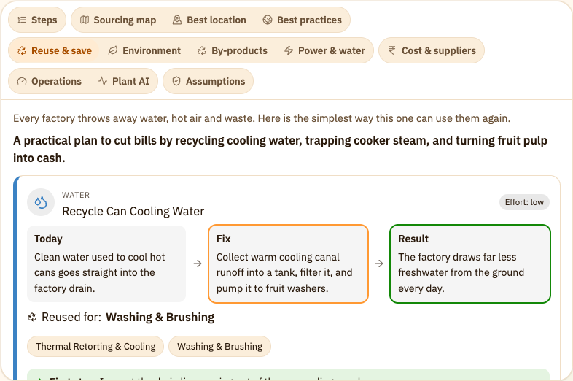
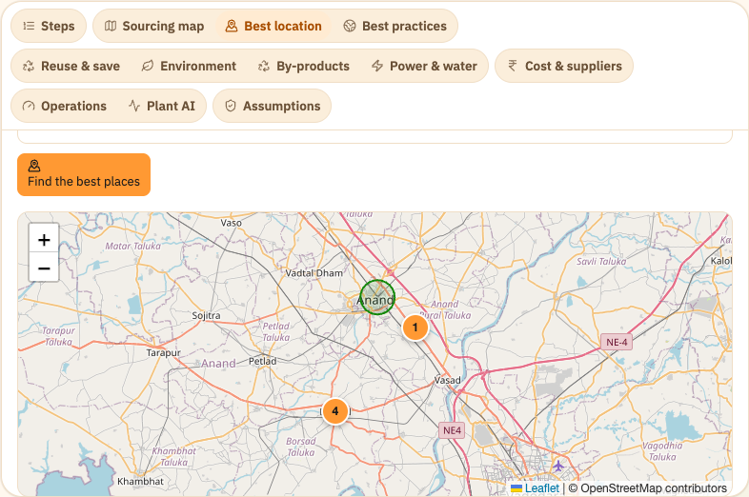
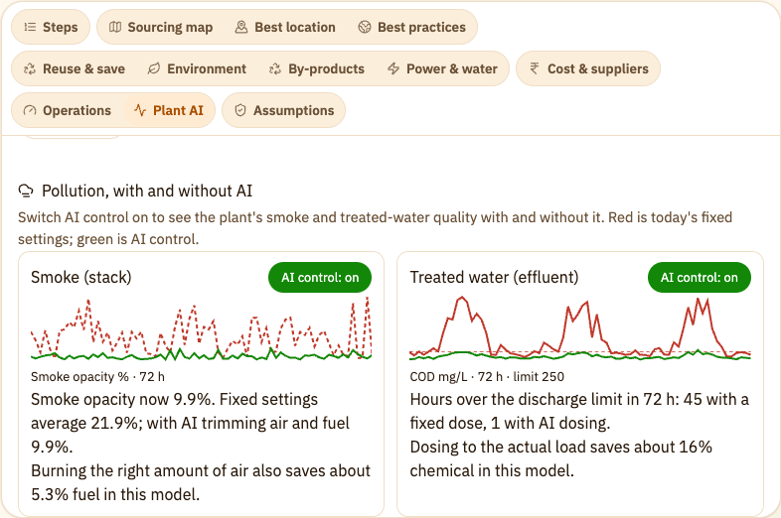
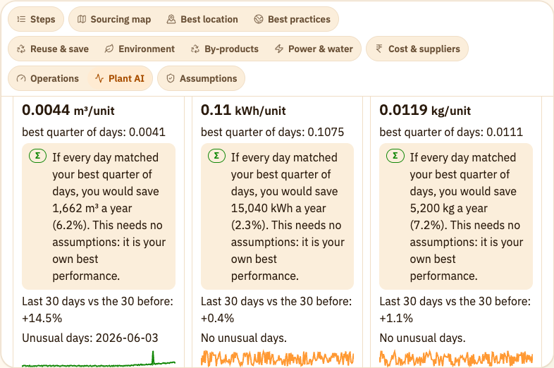
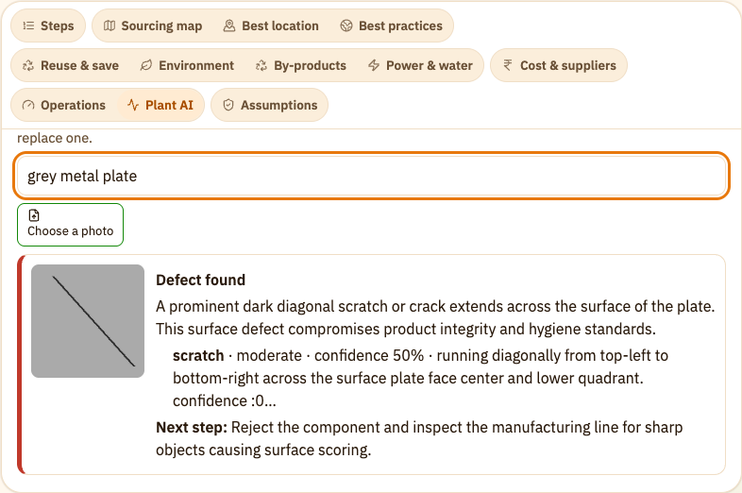
Snapshots of the working prototype
Pineapple plant: farm in, cans out
Reuse and save: Today, Fix, Result
Best location: ranked areas on the map
Smoke and water, with and without AI
Your data: per-unit use, gap, trend
Photo inspection with Gemini vision
Notes:
Real screenshots from the running app, taken in this session with live Gemini.

Slide 12
Prototype performance: measured, not promised
Response time in seconds (live Gemini)
229
92
Analytics (no AI)
about 0.01
backend tests passing
frontend tests passing
Photo inspection
4.1
Reuse plan
4.9
Ask the AI
5.4
5 to 13%
+14.5%
Best location
12.7
forecast back-test error on simulated plants
water per unit trend found in the dairy sample (planted problem)
Full plant design
15.7
Measured 18 Oct 2026 on a laptop through the web proxy; AI timings are single live runs, analytics are the median of five. The plant data behind the forecast is simulated.
Photo inspection of a scratched test plate: verdict fail, defect scratch, 98% confidence.
Notes:
Every number here was measured in this session. The forecast error is on simulated plants, so say that out loud.

Slide 13
Additional details: what comes next and what is limited today
Build next
Honest limits today
Google login and saved chats (Firebase)
Plant data pipeline: BigQuery, Pub/Sub, Dataflow
Forecasting and anomaly models on Vertex AI
Upload sensor and sales files, Excel as well as CSV
Exact map pins with the Google Maps API
Realistic 3D models (Blender)
Measure inspection accuracy on real products
Machine, production, quality and demand numbers are simulated until a CSV is loaded
Prices are indicative web figures, not quotes
Location ranking is AI judgement; some places are not pinned
People, animals and machines are stylised
Hand control not tested with a real hand
Nothing is stored on the server
Notes:
Credibility comes from saying what is not done. Keep this slide short in the talk.

Slide 14



Links
GitHub public repository
https://github.com/sleepyowl1208/GoogleHackathon_QuantarisAI
Demo video (3 minutes)
[add the video link]
Final product link
[add the Cloud Run URL after deploying]
Notes:
Fill in the demo video and the live URL before submitting.

Slide 15
The seven suggested directions: what is real today
Direction | What it does | Status
Predictive maintenance | Trend and time-to-limit per machine; schedule the fix | Simulated data; CSV upload next
Visual quality inspection | Gemini vision finds defects in your photo | Real
Production optimization | Bottleneck, OEE, capacity what-if | Simulated data
Supply-chain intelligence | Nearest sources, lead time, risks, order-by week | Real research, simulated risk figures
Demand forecasting | 13-week range, back-tested error shown | Simulated history
Waste reduction | Reuse loops; water and waste balance from your CSV | Real on your data
Operational copilot | Voice and text; quotes only computed numbers | Real
Notes:
This answers the problem statement directly. Three directions are real end to end; the rest are built and demonstrable on simulated data, with CSV upload as the next step.

Slide 16
Describe it. Place it. Run it clean.
QuantarisAI helps an owner with a raw material and a plan decide what to build, where, and how to cut water, smoke and waste, with the evidence shown and nothing faked.
github.com/sleepyowl1208/GoogleHackathon_QuantarisAI
Thank you
Notes:
Close on the one-line promise and the repo link.

