Slide 1
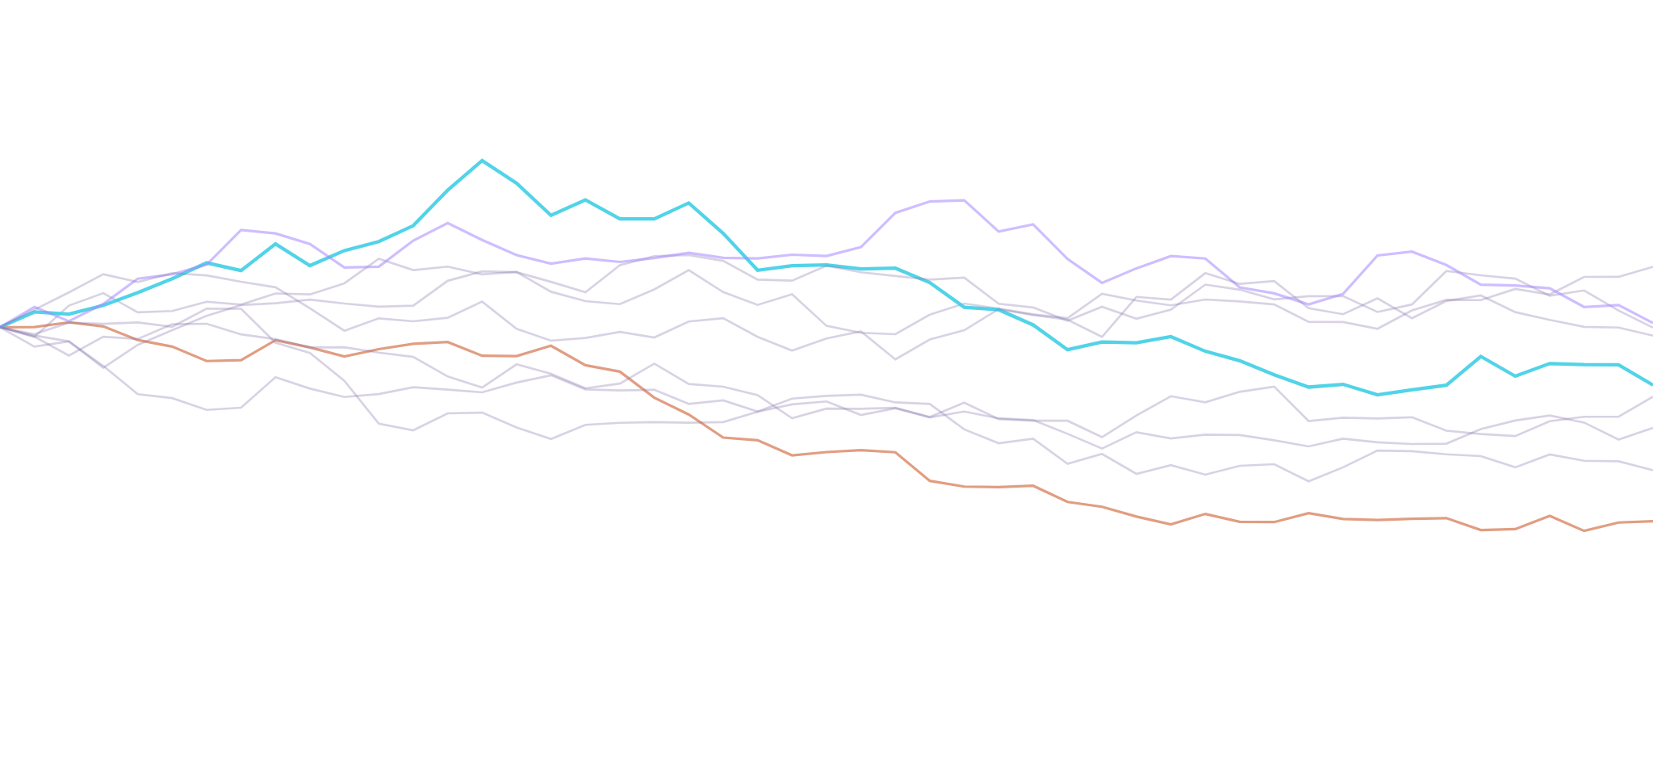
CSE 402 · NUMERICAL ANALYSIS, SIMULATION & MODELING · GROUP G07
Pricing the Path
beyond antithetic variates
Extending S. R. Gottimukkala (2024), Optimizing Exotic Option Pricing: Monte Carlo Simulation and Variance Reduction Techniques, Preprints.org
Nafis Nahian · 2105007
Aritra Debnath · 2105010
Tamzeed Mahfuz · 2105012
Arnob Biswas · 2105015
Zaki Rehnoom Unmona · 2105016
Notes:
Cover slide. Frame the talk: we rebuilt the base paper's Monte Carlo pricing engine from scratch, validated it against closed forms, then went past its one technique (antithetic variates) to four more, benchmarked head to head. Tonight is about results — the code is available, but we will spend our time on what we found.

Slide 2
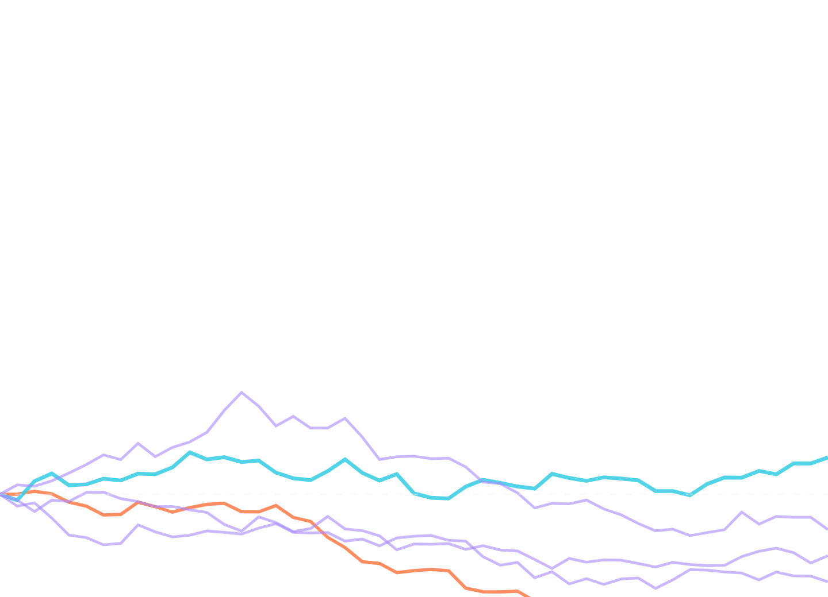
1 · THE JARGON, WITH NUMBERS
A stock that wanders
Every scenario in this project starts from the same stock: one seed, one year, endless possible futures. This is what geometric Brownian motion looks like.
S₀ = 100
$100
20%
start price, S₀
volatility, σ (a year's swing)
day 252 → $64 to $111
3%
252
risk-free drift, r
trading days, T = 1 year
Five draws of one scenario, seed 402 — illustrative, same S₀, σ, r as every experiment
Notes:
Set the scene concretely: this is what one path of the underlying looks like under the model everyone uses, geometric Brownian motion. Same starting price, same volatility and drift feed every option in the deck — an up-and-in barrier call, a geometric and an arithmetic Asian option.

Slide 3
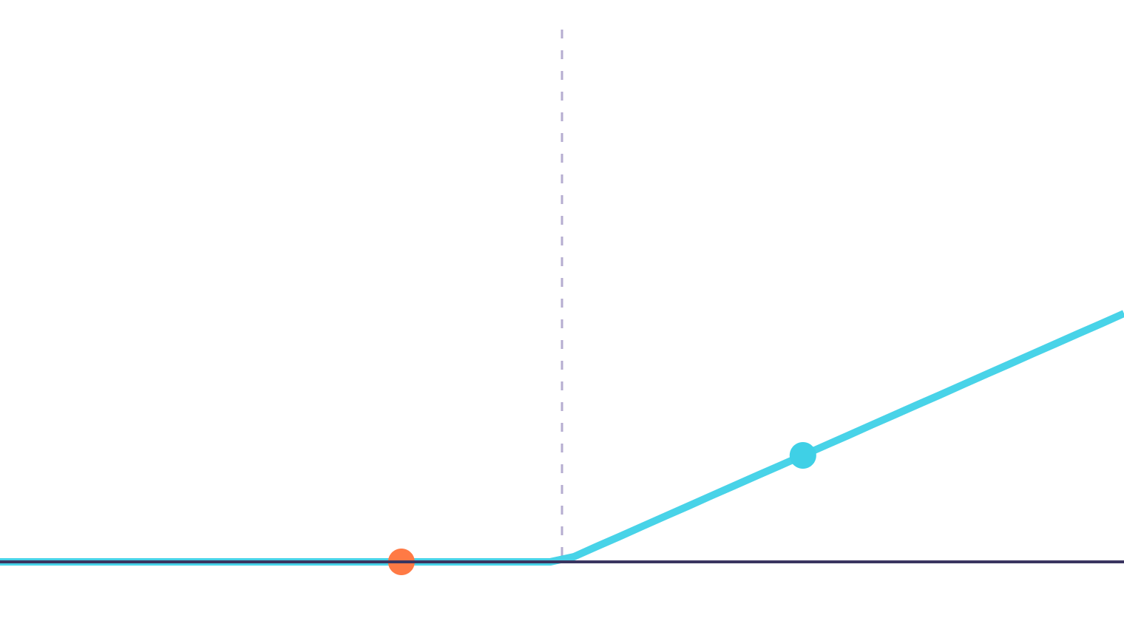
1 · THE JARGON, WITH NUMBERS
A call option
K = 105
The right, not the obligation, to buy at a fixed strike K = $105. Below the strike it is worthless; above it, every extra dollar is yours.
$120 → $15
S=120, payoff 15
stock finishes above K: payoff = 120 − 105
S=95, payoff 0
$95 → $0
stock finishes below K: the option lapses
Price today = e−rT × average payoff, over every simulated path.
Every exotic in this deck adds a twist to this same payoff: a barrier gate, or an averaged S
Notes:
The hockey-stick payoff is the base case. Everything that follows — barrier and Asian — modifies when or on what price this payoff is applied.

Slide 4
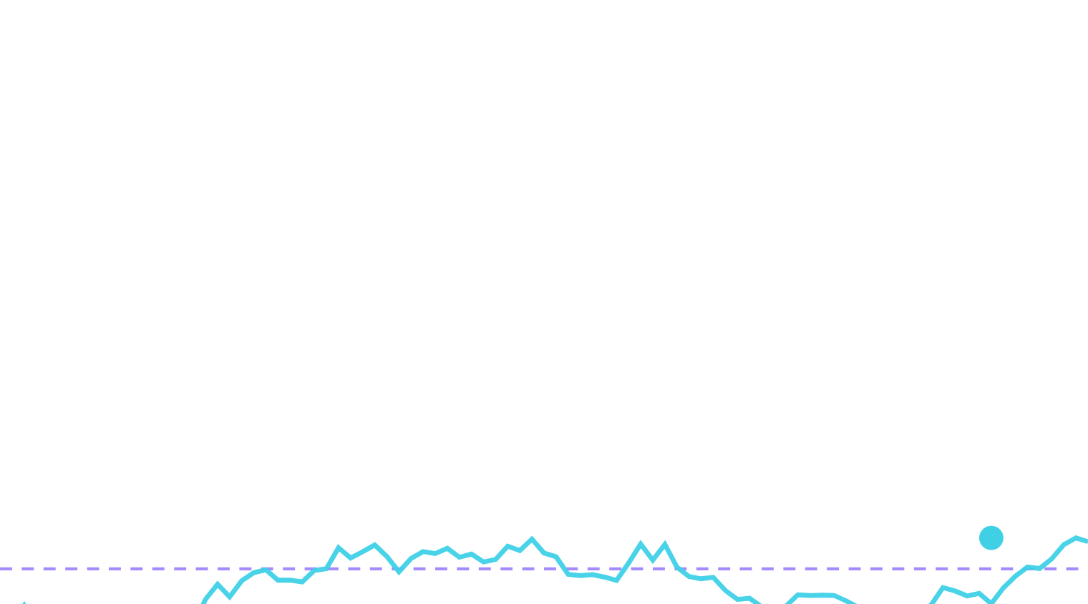
1 · THE JARGON, WITH NUMBERS
touches B → knocked in
An up-and-in barrier
B = 110.68
A call that starts switched off. It only pays out if the stock ever touches a barrier B above the strike — and even then, only if it also finishes in the money.
touches B → knocked in, prices like a normal call
stays below → worthless
never touches B → expires worthless
paper: B = 110.68
deep: B = 140
rare: B = 160
Discrete monitoring: the barrier is only checked on the 252 simulated days, not continuously
Notes:
The path in cyan crosses the barrier partway through the year and is knocked in, so it prices like the vanilla call from that point. The orange path never gets there and is worth nothing, no matter where it ends up. This on/off switch is what makes barrier options much harder to price accurately than a vanilla call.

Slide 5
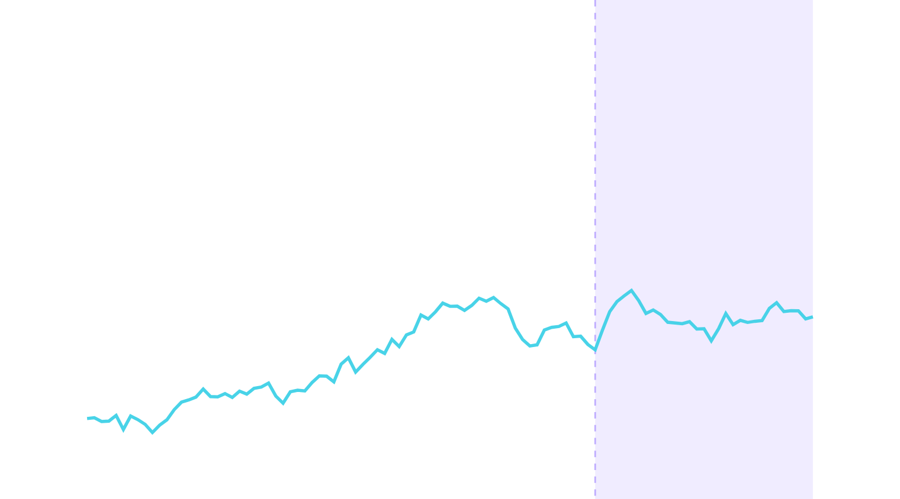
1 · THE JARGON, WITH NUMBERS
30-day averaging window
Priced on the average
An Asian option pays off on the average price over a window, not the final tick — it dampens the effect of one wild last day.
geometric average → closed-form price exists
arithmetic average → no closed form, must simulate
We also test a 30-day window: price 6.71, against 3.00 for the full 252-day average — the shorter window is worth more than double.
Kemna–Vorst gives the geometric closed form; the arithmetic case is this project's control-variate target
Notes:
The shaded band is the averaging window — the payoff depends on the mean price over that stretch, not the single value at day 252. Geometric averaging has a closed form we use as ground truth; arithmetic averaging, the one investors actually use, has none, so Monte Carlo is not optional there.

Slide 6
2 · SIMULATING THE PATH
One step of geometric Brownian motion
S(t+Δt) = S(t) · exp[ (r − ½σ²)Δt + σ√Δt · Z ]
r = 3%
σ = 20%
Z ~ N(0,1)
the drift — the average pull upward, risk-free rate
the shock size — how hard each step can swing
one fresh random draw per step, per path
252 steps of this equation trace one year. We tested three ways to take that step:
exact log-GBM
Euler–Maruyama
Milstein
Notes:
This is the discretisation every experiment shares. r and σ are fixed by the scenario; Z is the only randomness, and it is generated once per path, up front, never inside the engine — that discipline is what lets us pair schemes and methods on the same random numbers later.

Slide 7
3 · ERROR, AND HOW TO SHRINK IT
The √N wall
Standard error falls as 1/√N. To halve the error, you need 4× the paths — every single time.
95% CI half-width, barrier call, by path count
23.2%
±4.9%
barrier price CI at N = 5,000 paths — where the paper's plots visually "settle"
11.6%
5.8%
≈120,000
2.9%
1.4%
paths needed for ±1% — 24× more than "where it looked stable"
256
1,024
4,096
16,384
65,536
Fitted RMSE·√N slope: −0.51 (barrier), −0.50 (Asian) — no plateau, just N⁻ᐧ⁵ throughout
Notes:
This isn't a flaw in our runs — it is what Monte Carlo does. Doubling paths from 256 to 65,536 (256×) only cuts the error by 16×. The only way out is either brute-force scale, which is expensive, or smarter sampling — which is the rest of this talk.

Slide 8




3 · ERROR, AND HOW TO SHRINK IT
Two ways past the wall
Shrink the variance per path, or spread the sampling points more evenly than randomness would. We tried one of each, plus a way to aim at what matters.
Antithetic variates
Control variates
pair every draw Z with its mirror −Z
subtract a correlated price we already know exactly
RQMC + Brownian bridge
Importance sampling
cover the sample space evenly, not randomly
steer draws toward the barrier, reweight after
Notes:
Four techniques, four different mechanisms. The rest of the talk measures each one against plain Monte Carlo on the same scenarios, with the same acceptance checks.

Slide 9
4 · HOW WE JUDGE A WIN
Four numbers, every slide
VRF
Efficiency
Var(plain) ÷ Var(method)
1 ÷ (variance × runtime), vs plain
how much quieter the estimator is, at equal path count
VRF charges rent — a slower method needs a bigger VRF to win
RMSE slope
Trust
log(RMSE) vs log(N)
within 3 SE of the reference, CI coverage
plain sits at −0.5; steeper means faster convergence
a fast estimator that's wrong is not a result
Every number in this deck reports all four, with a bootstrap 95% CI where R=20 replicates allow one
Notes:
We insist on efficiency, not just variance reduction, because several of these methods cost more per path — a pilot run, a Sobol scramble, an extra likelihood-ratio calculation. And we insist on a trust check, because a method that is fast and wrong is worse than plain MC.

Slide 10

4 · HOW WE JUDGE A WIN
One pipeline, every number in this deck
Scenario
Seeded normals
Path engine
Payoff
Estimator
Summarise
6 frozen configs — barrier, Asian, deep & rare
SeedSequence 402, CRC32-keyed, paired
exact log-GBM, Euler–Maruyama, Milstein
barrier, geometric & arithmetic Asian
5 registered methods, one registry
R=20 replicates → CSV, figures, tables
1,700-row master sweep
90 tests, all passing
one-command reproduction
Randomness is always a pre-built array — never drawn inside the engine — so every method and scheme can be compared on identical draws
Notes:
Every figure in this deck traces back to this same pipeline, run once per scenario and method, then summarised across 20 replicates. The seeding discipline is what lets us say a difference between methods is real, not luck of the draw.

Slide 11
4 · HOW WE JUDGE A WIN
Six scenarios, one grid
Paper barrier
Deep barrier
Rare barrier
B = 110.68
B = 140
B = 160
up-and-in call, base paper's own level
harder to knock in — 9.3% of paths do
our extension — 1.9% knock-in, a true tail event
Geometric Asian
Arithmetic Asian
30-day window
call & put
no closed form
last 30 of 252 days
closed form exists — our ground truth
what investors actually trade — the control-variate target
price 6.71, more than double the full-year average
N = 256 → 65,536
R = 20 replicates
252 daily monitoring steps
S₀=100, r=3%, σ=20%, T=1 year, K=105 — shared by every scenario
Notes:
Six scenarios chosen to stress different things: a near-the-money barrier like the paper's, a deep and a rare barrier to test tail behaviour, and both Asian averaging conventions. Every method below is run on this same grid.

Slide 12
PART ONE
What the paper claimed —
and what we confirm
Two claims, checked from scratch, on our own re-implementation.
Notes:
Section divider. We are not trying to overturn the base paper — we rebuilt its experiment independently and are about to show that two of its central claims hold up. Later we go further, with techniques the paper never tried.

Slide 13
5 · CONFIRMING THE PAPER
Antithetic speedup: confirmed
variance reduction factor at N = 65,536, flat across all five N
3.91×
Read as a variance ratio at equal path count, our numbers land on the paper's 1.5× and 1.3× for both options it actually tested.
1.47×
1.35×
1.48×
Bonus: the Asian put's 3.91× wasn't in the paper — its Fig. 8 (put) appears to reuse Fig. 6 (call).
barrier call
(paper: 1.5×)
Asian call
(paper: 1.3×)
Asian put
(bonus finding)
30-day Asian
corr(Y, Y′): −0.32 (barrier), −0.26 (call), −0.74 (put) — the more negative, the bigger the win
Notes:
Antithetic pairs a normal draw with its mirror. Because option payoffs are convex, the pair correlates negatively and the average of the two has lower variance than either alone. Our dashed lines mark the paper's own reported factors — we land right on them for the two options it tested.

Slide 14
5 · CONFIRMING THE PAPER
Scheme choice: negligible — confirmed
bias vs the exact scheme, drawn on the scale of a 65,536-path standard error
SE = 0.049
The scheme effect is ~50–90× smaller than the noise of a single large run — detectable only because we used common random numbers to cancel that noise out.
The paper's own Figs. 2–4 (its three schemes) plot visually identical sample points — consistent with sharing one set of random draws.
−0.00057
−0.00105
Euler–Maruyama
vs exact
Milstein
vs exact
65,536-path plain-MC SE
measured with common random numbers, 1,000,000 paths, dt = 1/252
Notes:
The point isn't that the bias is exactly zero — it's O(Δt) and we measure it precisely — it's that no realistic run would ever notice it. The paper's claim of "negligible difference" holds, though not for the reason its own figures suggest.

Slide 15
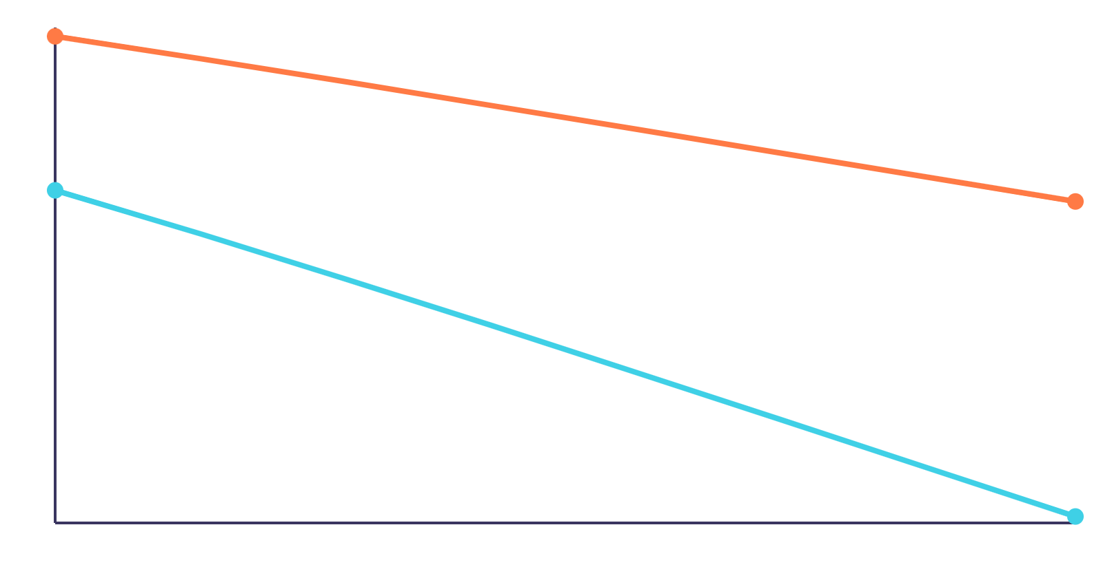
5 · CONFIRMING THE PAPER — OUR EXTENSION
Milstein fixes the path, not the price
Euler–Maruyama, slope ≈ 0.49
pathwise error (log)
Strong order (pathwise): Milstein 0.97 vs Euler 0.49
Weak order (on the price): both ≈ 1.0
Milstein tracks each individual path 66× more precisely — but a European or barrier price only needs the expectation right, and there both schemes are equally first-order. That's why the price bias barely moves even though the paths themselves look very different.
Milstein, slope ≈ 0.97
4 steps
512 steps
Notes:
This is why "the scheme doesn't matter" is true for pricing but not for path fidelity — Milstein is the right choice if you ever need individual paths to be accurate, e.g. for hedging simulations, but buys nothing for a plain price.

Slide 16
PART TWO
What we added
Four variance-reduction techniques the paper never tried, benchmarked head to head on the same six scenarios.
Notes:
Section divider. Control variates, randomized quasi-Monte Carlo with a Brownian bridge, and importance sampling — plus a close look at the monitoring bias that plain convergence plots hide.

Slide 17
6 / WHAT WE ADDED
How the control-variate experiment works
1 / PILOT
A small independent run estimates b from paired target and control payoffs.
CONTROL-VARIATE CORRECTION
Ycv = Y - b(X - E[X])
2 / PRODUCTION
Target and control payoffs are computed from the same simulated paths.
Y is the target payoff; X is a related payoff whose exact mean E[X] is known.
3 / VERIFY
VRF = Var(Y) / Var(Ycv). A larger value means more Monte Carlo noise was removed.
Independent pilot and production seeds keep the estimate unbiased; pilot cost is included in runtime.
Notes:
The arithmetic Asian has no closed form because the sum of lognormals isn't lognormal. But its geometric cousin does, and the two track each other almost perfectly path by path — so subtracting the geometric estimate (and adding back its known price) removes nearly all the noise.

Slide 18
6 · WHAT WE ADDED
The arithmetic Asian, solved almost exactly
ρ = 0.9995
correlation between the arithmetic and geometric average — nearly a straight line
within-run variance reduction factor
976×
3.162776 ± 0.000361
control-variate price at N=65,536, R=20
using the geometric Asian — which we can price exactly — as the control
0.06 SE
from an independent 2,000,000-path plain-MC reference (3.162517 ± 0.008511)
There is no closed form for the arithmetic average — this is as close to one as Monte Carlo gets
Notes:
The arithmetic Asian has no closed form because the sum of lognormals isn't lognormal. But its geometric cousin does, and the two track each other almost perfectly path by path — so subtracting the geometric estimate (and adding back its known price) removes nearly all the noise.

Slide 19
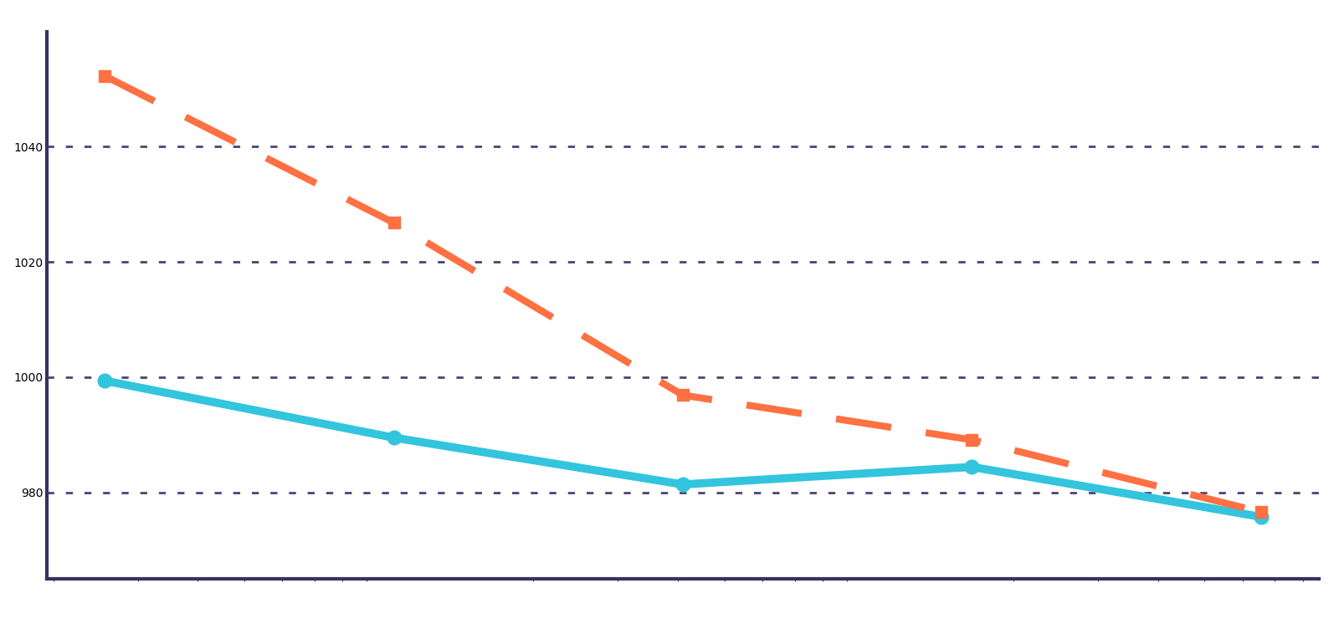
6 / WHAT WE ADDED
Arithmetic Asian: theory and simulation agree
observed within-run VRF
theory 1 / (1 - rho^2)
976x
variance reduction at full scale
theory 976.6x
rho = 0.9995
observed 975.7x
arithmetic and geometric payoffs move almost together
N=256
N=65,536
Measured and theoretical reduction agree across every N: the geometric control removes about 99.90% of payoff variance.
Notes:
Randomized quasi-Monte Carlo replaces pseudo-random draws with a scrambled Sobol sequence — points chosen to cover the space evenly rather than by chance — carried through a Brownian bridge. The slope, not just the level, changes: this is a fundamentally faster way to converge, not just a quieter one.

Slide 20
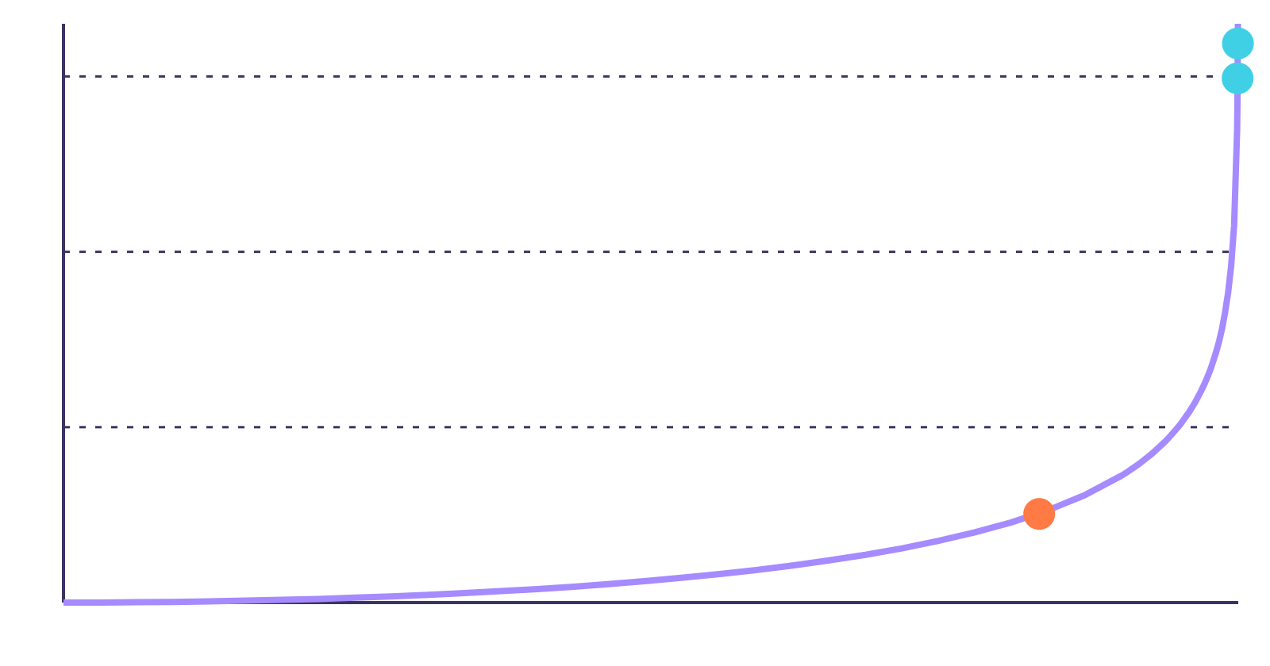
6 · WHAT WE ADDED
A control variate lives or dies on correlation
VRF=1,000
VRF=100
arithmetic Asian ρ=0.9995 → 976×
VRF = 1 ⁄ (1 − ρ²) is exact — a control variate is only as good as how tightly it tracks the target. The paper barrier's payoff is almost the vanilla call itself, so its control nearly cancels all the noise. The deep barrier's knock-in is a much weaker echo of the vanilla payoff, so the same recipe barely helps.
VRF=10
paper barrier ρ=0.9997 → 1,542×
deep barrier, ρ=0.83 → 3.2×
ρ=0
ρ→1
Notes:
This curve is the whole story of when a control variate is worth building: near ρ=1 the payoff comes from a huge win, but the curve is flat almost everywhere else, so a mediocre control (like the deep barrier's) isn't worth much.

Slide 21
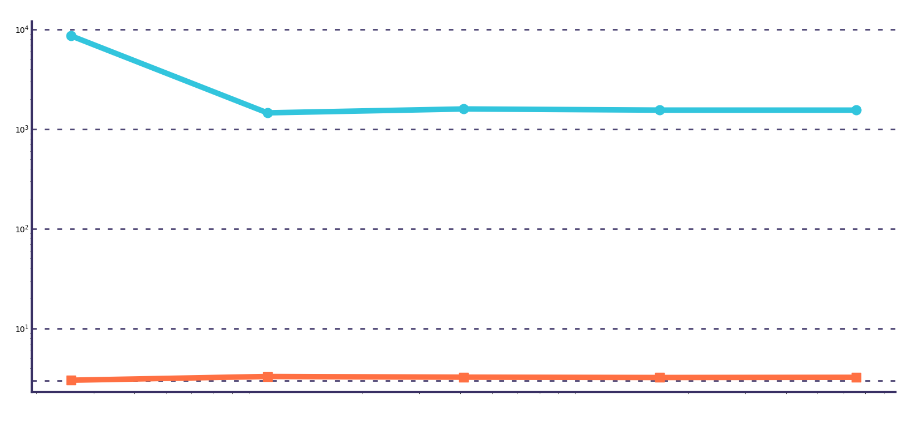
6 / WHAT WE ADDED
Raising the barrier breaks the control
near barrier B=110.68
deep barrier B=140
1,542x
near barrier: payoff almost equals the vanilla call
near: 1,542x
3.2x
deep: 3.2x
deep barrier: many positive calls never knock in
N=256
N=65,536
The control did not change; only B changed. A high barrier weakens correlation, so the control advantage collapses.
Notes:
Randomized quasi-Monte Carlo replaces pseudo-random draws with a scrambled Sobol sequence — points chosen to cover the space evenly rather than by chance — carried through a Brownian bridge. The slope, not just the level, changes: this is a fundamentally faster way to converge, not just a quieter one.

Slide 22
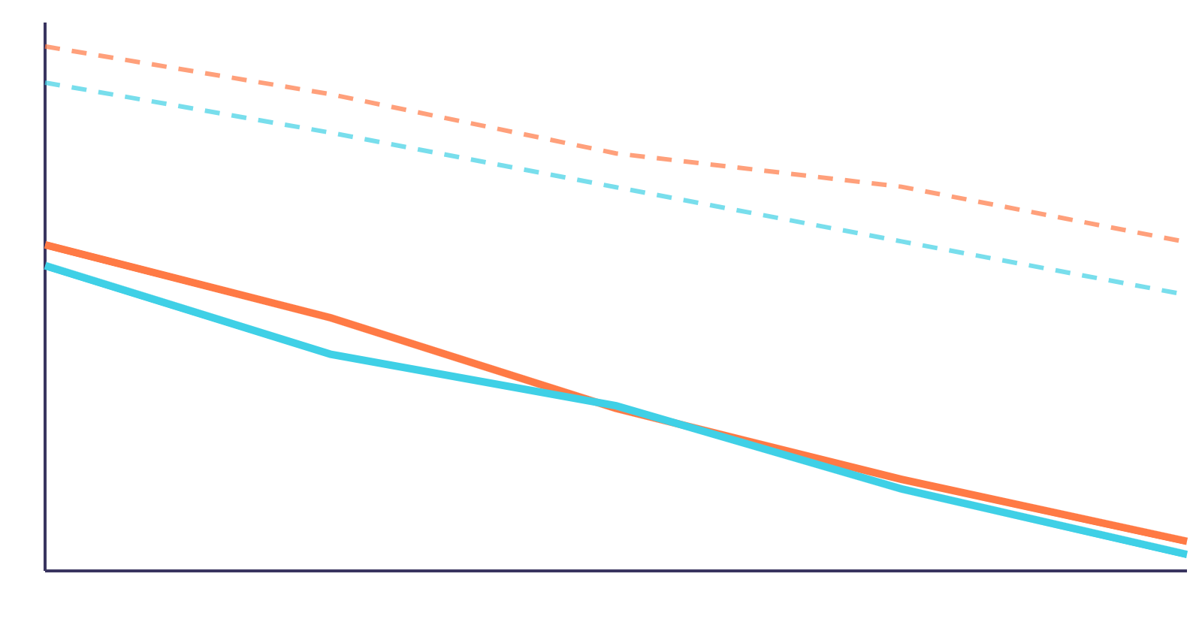
6 · WHAT WE ADDED
RQMC beats the √N wall outright
paper barrier, plain (slope −0.50)
arithmetic Asian, plain (slope −0.56)
2,260×
efficiency vs plain, paper barrier, N=65,536
barrier + RQMC bridge (slope −0.79)
794×
Asian + RQMC bridge (slope −0.74)
efficiency vs plain, arithmetic Asian
N=256
N=65,536
A steeper log-log slope means the error genuinely converges faster — not just a smaller constant, a different rate.
Notes:
Randomized quasi-Monte Carlo replaces pseudo-random draws with a scrambled Sobol sequence — points chosen to cover the space evenly rather than by chance — carried through a Brownian bridge. The slope, not just the level, changes: this is a fundamentally faster way to converge, not just a quieter one.

Slide 23
6 · WHAT WE ADDED
A Brownian bridge front-loads the variance
share of Var(log average price) held by the first k Sobol dimensions
4.7%
75%
1.2%
98.4%
99.9%
17.8%
The bridge maps Sobol dimension 0 straight to the terminal price, so nearly all the low-discrepancy structure lands where the payoff actually looks.
27–536×
lower variance, bridge vs incremental, across N
k = 1
k = 4
k = 16
bridge construction
incremental construction
Notes:
Incremental construction spreads each day's increment across a different dimension, so no single Sobol coordinate matters much. The bridge instead assigns dimension 0 to the endpoint, then bisects — concentrating the low-discrepancy advantage exactly where the payoff is most sensitive.

Slide 24
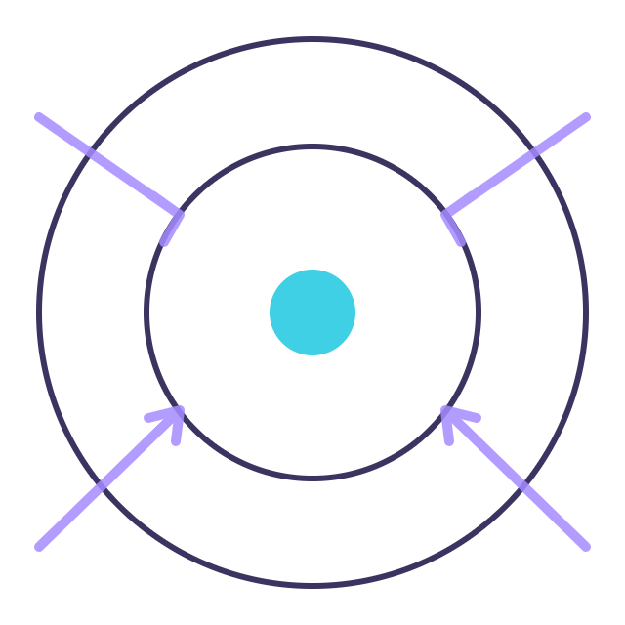
6 · WHAT WE ADDED
Steering paths toward the rare event
48.6×
8.8×
efficiency, rare barrier B=160 (1.9% knock-in), N=65,536
efficiency, deep barrier B=140 (9.3% knock-in)
1.9% → 57%
9.3% → 60%
rare barrier: knock-in rate under plain sampling → under the tilted proposal
deep barrier: same shift under its own tuned tilt
drift-shift the simulation toward the barrier, then reweight every path by its likelihood ratio to stay unbiased
Notes:
Importance sampling shifts the drift so paths that matter — the ones that actually cross the barrier — happen far more often, then corrects for that shift with a likelihood-ratio weight. The rarer the event, the bigger the win: the effect is small at the deep barrier and dramatic at the rare one.

Slide 25
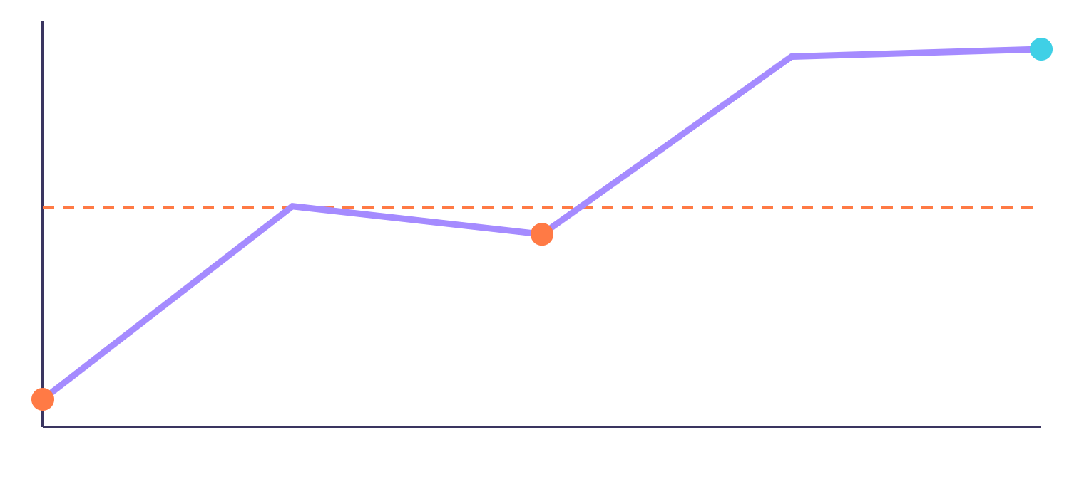
6 · WHAT WE ADDED
Importance sampling has fine print
8.6× at N=65,536
efficiency = 1 (break-even)
Below N ≈ 2,000–4,000, the pilot run to tune the drift costs more than plain MC saves — IS is worse than doing nothing.
0.07× at N=256
N=256
N=65,536
The ESS paradox: the rare barrier's effective sample size is 1.1% of N, yet its VRF is 22× — the few huge weights land on the paths that would otherwise contribute nothing.
A fixed 7-point θ grid also undershoots near the paper barrier — the true optimum runs about 2.3× further than the grid reaches
Notes:
Importance sampling is not free. Its pilot phase is a real cost, and at small N that cost dominates. Read this as: use IS deliberately, at the N you'll actually run, not as a default.

Slide 26
6 · WHAT WE ADDED
Monitoring less often costs you a real bias
barrier price bias vs the continuous formula (7.1055), by monitoring dates
−0.0626
Resolved at 54 standard errors of the control-variate mean — a plain-MC run of the same size (SE ≈ 0.049) could never see it.
−0.0272
−0.0119
−0.160
deep barrier's 252-date bias — 4.5% of its price, far larger than the paper barrier's
12 dates
52 dates
252 dates
BGK correction: accurate to 0.0006 at 252 dates, but overshoots by 0.034 at 12 — an asymptotic fix, not a universal one
Notes:
Checking daily is not the same as checking continuously — a path can spike through the barrier between monitoring dates and be missed. This bias is tiny next to plain Monte Carlo's own noise, but it's real, systematic, and only visible once your estimator is precise enough to see past the noise — which is exactly what a good control variate buys you.

Slide 27
7 · THE VERDICT
RQMC wins, or ties, on every scenario
efficiency vs plain MC at N = 65,536 (log scale)
Bars show RQMC + bridge — the top or tied-top method on all four scenarios at full scale.
2,260×
794×
791×
The control variate ties or leads at smaller N and on two of four scenarios: 1,602× (barrier), 770× (arithmetic Asian).
21×
Deep barrier's low ceiling (21×) reflects a genuinely harder problem — its payoff is discontinuous across many dimensions.
paper barrier
deep barrier
arithmetic Asian
geometric Asian
Notes:
This is the single chart that answers "which technique should I use": at production scale, RQMC with a Brownian bridge is never worse than tied for best, across a near-vanilla barrier, a discontinuous deep barrier, and both Asian conventions.

Slide 28
7 · THE VERDICT
Time to reach ±0.01 on the price
Paper barrier
10.5 s plain
0.011 s control variate
Arithmetic Asian
2.33 s plain
0.005 s control variate
Deep barrier
27.9 s plain
0.66 s RQMC + bridge
bar length ∝ log(time) — the gap between orange and teal is 200× to 1,000×, not a fixed margin
Notes:
This reframes "efficiency" in units anyone can feel: what would have been a 10-second wait becomes 11 milliseconds. Even the deep barrier — the hardest case in the deck — drops from half a minute to two-thirds of a second.

Slide 29
7 · THE VERDICT
What we'd actually reach for
any barrier option
arithmetic Asian
rare knock-in events
RQMC + Brownian bridge
Geometric control variate
Importance sampling, at scale
Best or tied-best everywhere we tested it, near-the-money or deep. The bridge concentrates the payoff's sensitivity into the first few dimensions.
A near-perfect correlated control with a known closed form — 976× the precision at essentially no extra cost.
Worth it once N is large enough to amortise the pilot — 48.6× at the rarest barrier we tested, worse than plain below N≈2–4k.
One rule that applies to all of them: price discrete-monitoring barriers against the 252-date reference, not the continuous formula — the gap is real and RQMC is precise enough to expose it.
Notes:
If we had to compress this whole deck into one instruction for someone pricing these options tomorrow: match the technique to the geometry of the payoff, and always know which reference price you're actually converging to.

Slide 30
7 · THE VERDICT
Can you trust these numbers?
bit-identical
84/85
0.93–0.98
90/90
master-sweep cells within 3 standard errors of the reference
per-replicate 95% CI coverage, across every method
unit and integration tests passing
every table reproduced from a clean checkout, ≤ 6×10⁻¹⁵ relative
seeded, paired random numbers throughout — every method comparison is a paired comparison, not a lucky draw
Notes:
Every headline number in this deck was checked at least twice: once by the person who produced it, and once independently, against a from-scratch recomputation that never imports our own source.

Slide 31
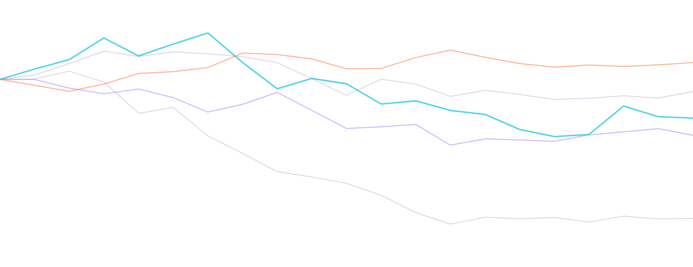
CSE 402 · GROUP G07
Thank you
questions, and the demo, next
One-command reproduction: python run_all.py --analyze-only --only master
Notes:
Close on the live demo if time allows, or open the floor to questions. The reproduction command regenerates every figure and table in this deck from the checked-in CSVs in under 20 seconds.

