Slide 1
Assignment 2
TYPES OF GRAPHS, PLOTS, CHARTS AND DISTRIBUTIONS WITH USAGE AND IMAGE.

Slide 2
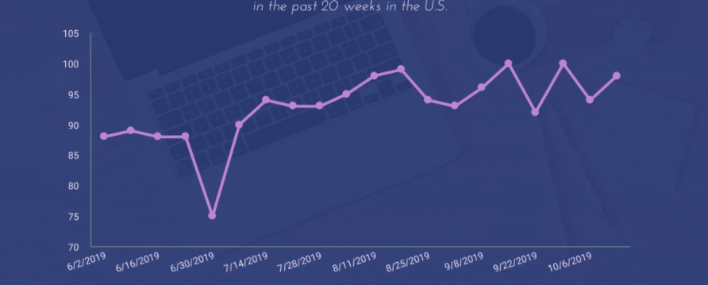
Types of graphs and uses
Graphs are used to visualize data.
1. LINE GRAPHS: This type of graph illustrates trends in data over a period of time.

Slide 3
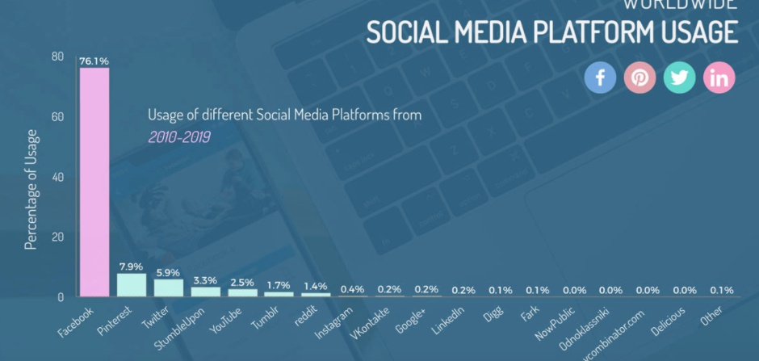
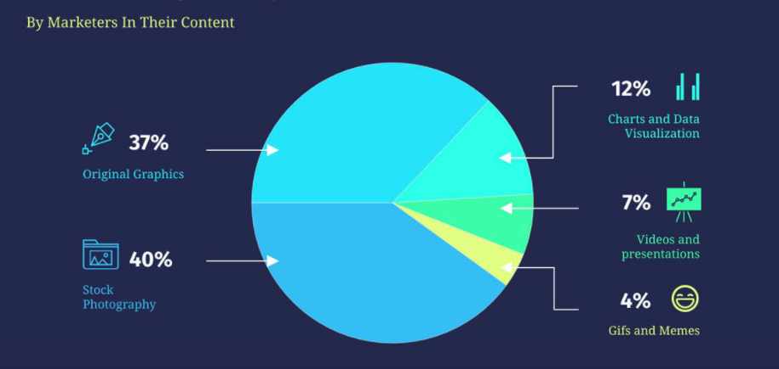
2. Bar graph: Used to compare various graphs.
3. Pie chart: Used to compare parts of a whole.

Slide 4
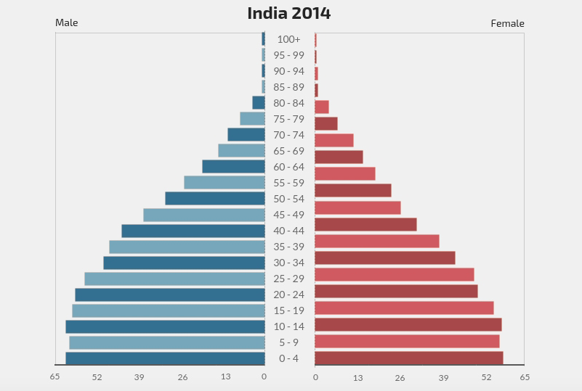
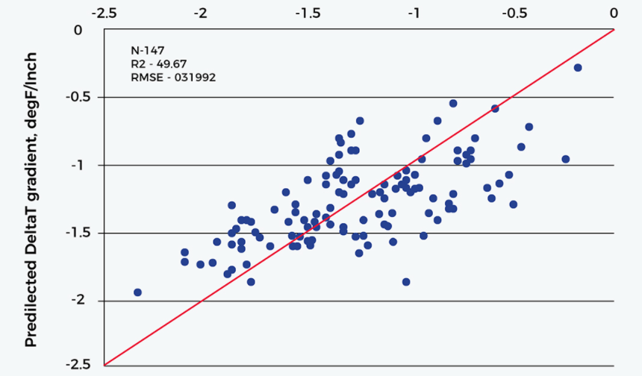
4. Population pyramids: Often based on age and gender, it shows a comparison.
5. Scatter plot: Usually contains two axes which represents two sets of data.

Slide 5
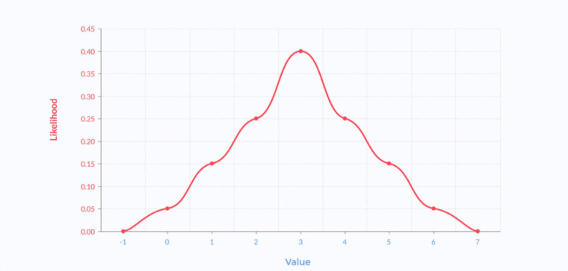
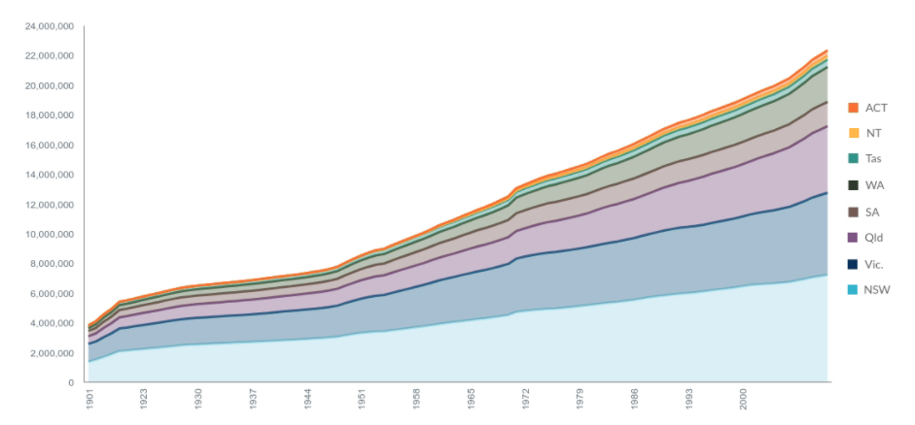
6. Function plots: it's used to determine the value of an equation by graphing its result.
7. Stacked area charts: it's frequently used to diagram changes of multiple variables across time.

Slide 6
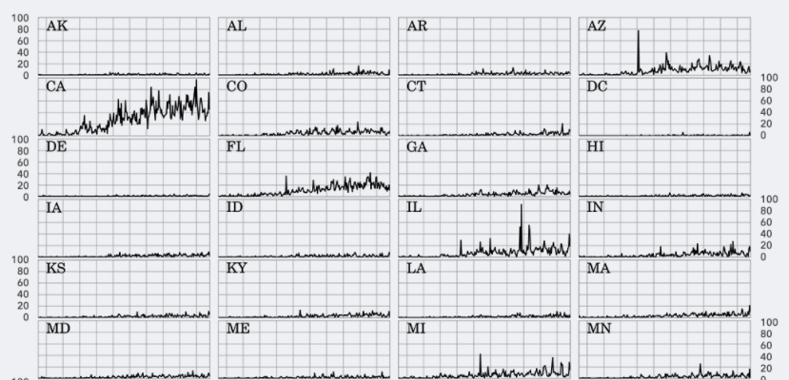
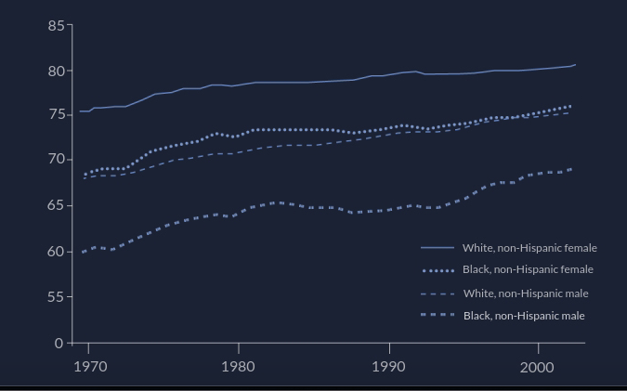
8. Trellis graphs: To examine complex, multi-variable data sets, comparing a greater deal of information at once.
9. Multi-Line Graphs: To reflect multiple data sets with lines of varying patterns or color.

Slide 7
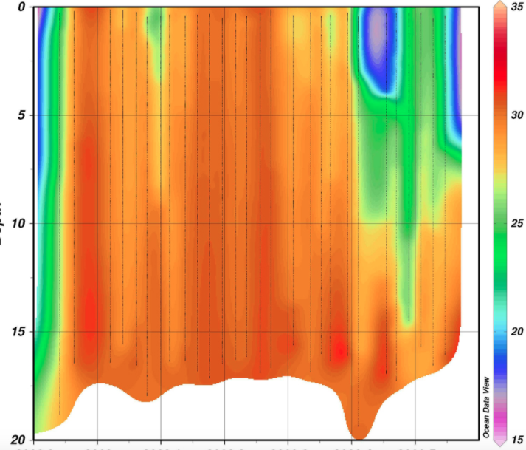
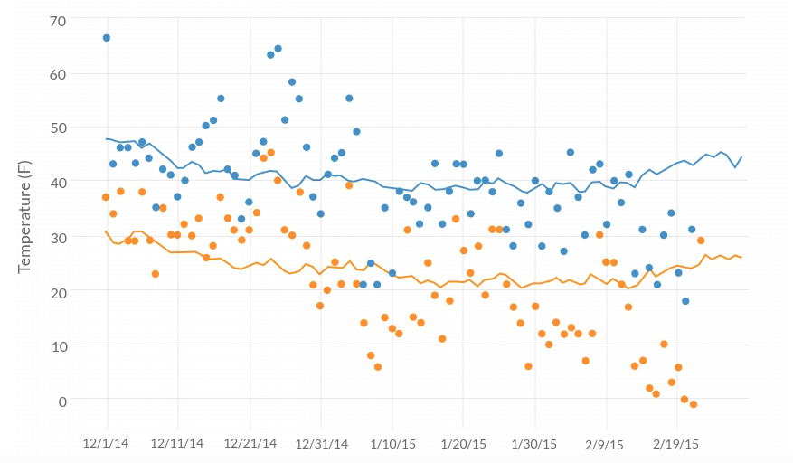
10. Contour plot: allow for the analysis of three variables in a two-dimensional format with a third value in color.
11. Scatter-Line Combo: A combination of the scatterplot and line graph.

Slide 8
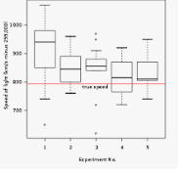
12. Box-plot: displays the five-number summary of a set of data.

Slide 9
Different graphs in R
HISTOGRAM: A histogram is a graphical tool that works on a single variable.
CODE: hist(trees$Height, breaks = 10, col = "orange", main = "Histogram of Tree heights", xlab = "Height Bin").
SCATTER PLOT: This plot is a simple chart type, but a very crucial one having tremendous significance. The chart gives the idea about a correlation amongst variables and is a handy tool in an exploratory analysis.
CODE: attach(trees) plot(Girth, Height, main = "Scatterplot of Girth vs Height", xlab = "Tree Girth", ylab = "Tree Height") abline(lm(Height ~ Girth), col = "blue", lwd = 2).

Slide 10
BOXPLOT: is a way of visualizing data through boxes and whiskers. Firstly, variable values are sorted in ascending order and then the data is divided into quarters.
CODE: boxplot(trees, col = c("yellow", "red", "cyan"), main = "Boxplot for trees dataset").
LINE CHARTS: are useful when comparing multiple variables.
CODE: plot(Girth, type = "o", col = "red", ylab = "", ylim = c(0, 110), + main = "Comparison amongst Girth, Height, and Volume of trees") lines(Height, type = "o", col = "blue") lines(Volume, type = "o", col = "green") legend(1, 110, legend = c("Girth", "Height", "Volume"), + col = c("red", "blue", "green"), lty = 1:1, cex = 0.9)
DOT PLOT: This visualization tool is useful if we want to compare multiple categories against a certain measure.
CODE: attach(mtcars) dotchart(disp, labels = row.names(mtcars), cex = 0.75, + main = "Displacement for various Car Models", xlab = "Displacement in Cubic Inches")

Slide 11
Probability Distribution
A probability distribution tells you what the probability of an event happening is. Probability distributions can show simple events, like tossing a coin or picking a card. They can also show much more complex events, like the probability of a certain drug successfully treating cancer.

Slide 12
BINOMIAL DISTRIBUTION
A binomial distribution can be thought of as simply the probability of a SUCCESS or FAILURE outcome in an experiment or survey that is repeated multiple times. For example, a coin toss has only two possible outcomes: heads or tails and taking a test could have two possible outcomes: pass or fail.

Slide 13
NORMAL DISTRIBUTION
Sometimes called the bell curve, is a distribution that occurs naturally in many situations.
The bell curve is symmetrical. Half of the data will fall to the left of the mean; half will fall to the right. Many groups follow this type of pattern:
Heights of people.
Measurement errors.
Blood pressure.
Points on a test.
IQ scores.
Salaries.

Slide 14
Non-normal distributions
Although the normal distribution takes center stage in statistics, many processes follow a non-normal distribution. This can be due to the data naturally following a specific type of non-normal distribution (for example, bacteria growth naturally follows an exponential distribution). In other cases, your data collection methods or other methodologies may be at fault.

Slide 15
T-distribution
The T distribution (also called Student’s T Distribution) is a family of distributions that look almost identical to the normal distribution curve, only a bit shorter and fatter. The t distribution is used instead of the normal distribution when you have small samples.

