Slide 1
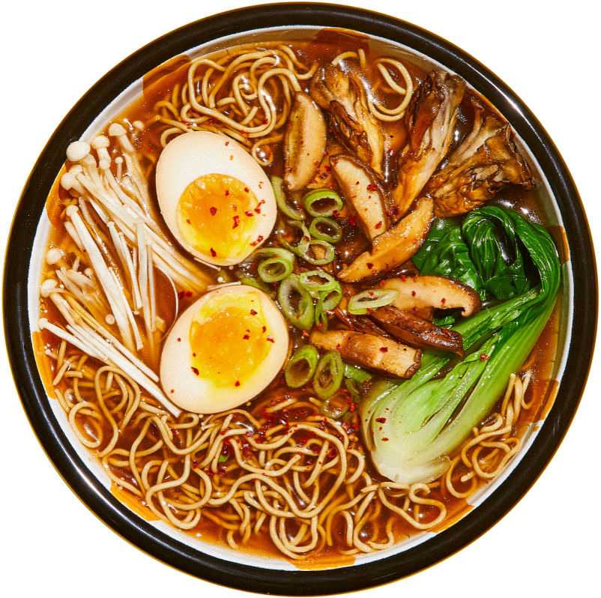
Shane’s P 1 Presenation Shane’s Ramen Restaurant

Slide 2
Technologies Used
Visual Studio 2022
Microsoft SQL Management Studio
C#
.NET Core
ADO.NET
Swagger
Serilog

Slide 3
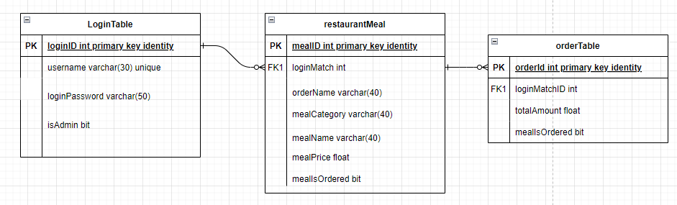
ER DIAGRAMS

Slide 4
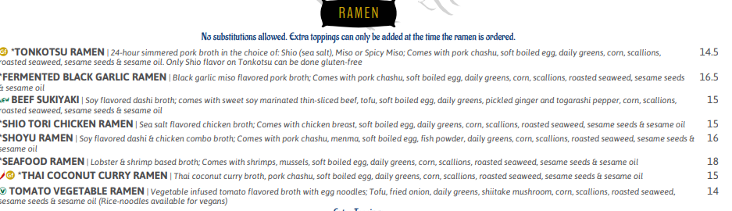
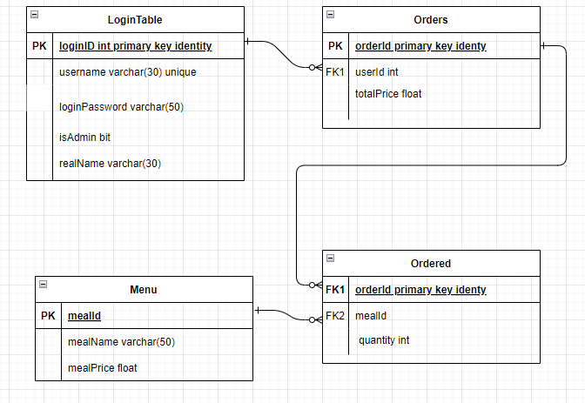
Future Improvements
I’d like to turn this Project into a usable apple using the MVC system with view in which users could login, and perform normal restaurant functions
Add a menu table to include the different bowls of ramen and be able to add various toppings and extras
Add quantity features and other menu features

Slide 5
THANK YOU

