Slide 1
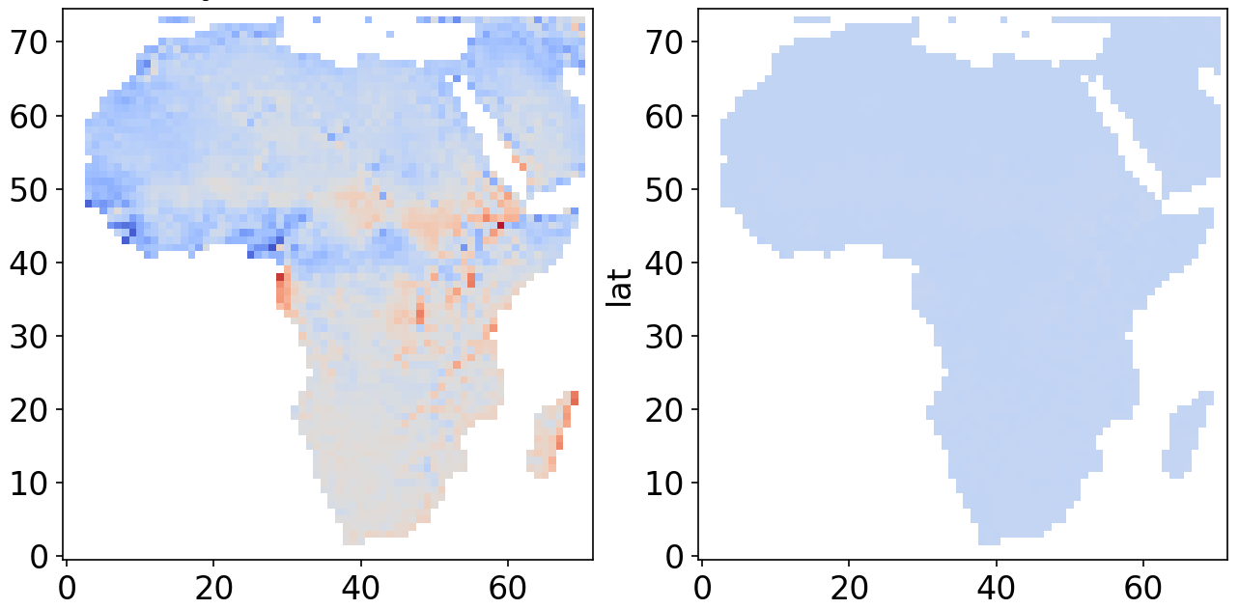

Baseline Mean Bias
Post-QM Mean Bias
Latitudes
Mean Bias
Longitudes

