Slide 1
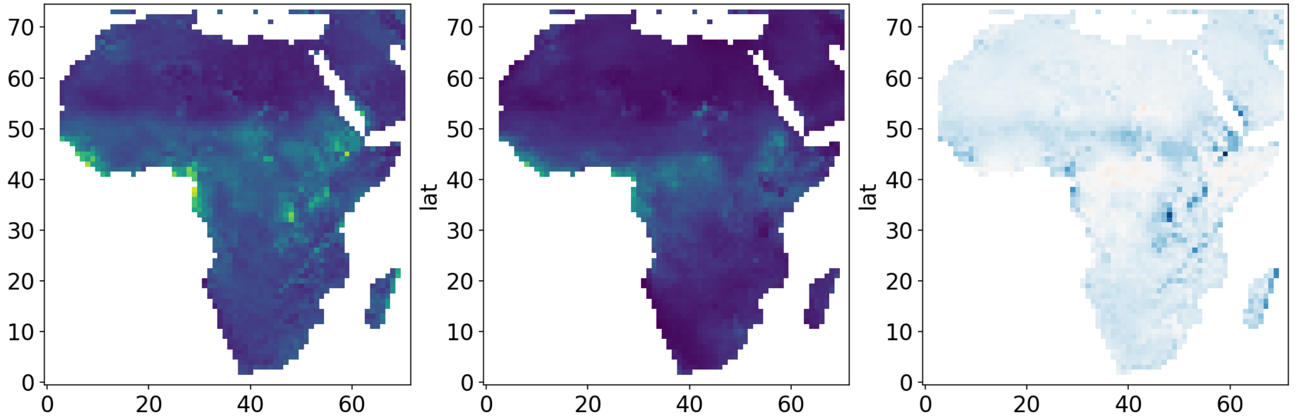
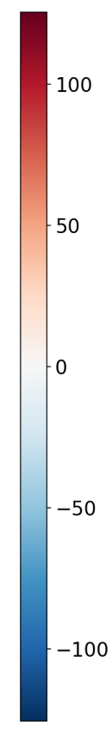
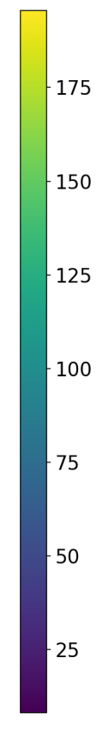
Baseline RMSE
Post-QM RMSE
Difference
Latitudes
RMSE
RMSE Difference
Longitudes

