Slide 1
React JS
January 10, 2017

Slide 2
What is React
  A JavaScript library created by Facebook for creating UI’s
  If done right, think of it as an MVC view

Slide 3
Why React
  Designed to Build Components...
  Manage their own state
  Which are “composable”
  Efficiently update and render only the necessary changes to components.

Slide 4
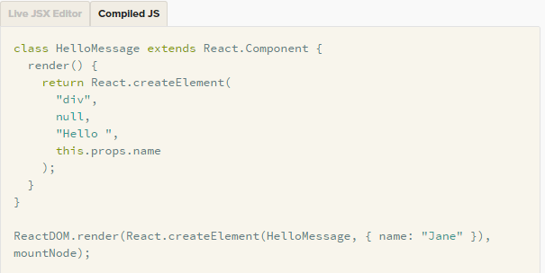
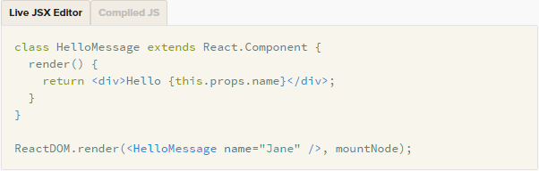
About React - JSX

Slide 5
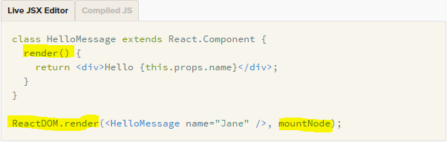
About React – render Method()
  Every React component must implement a “render()” method.
  “render()” accepts input and returns what needs to be displayed in the UI.

Slide 6
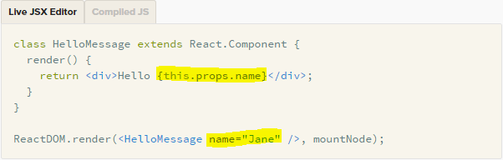
About React – Props
  Data passed into the component are accessible via “this.props” in the render() method.

Slide 7
About React – State
  getInitialState() – Method to invokes when a component is initialized to return the initial state of the component.
  this.state – Provides access to the component’s state.
  this.setState() – Invokes the render() method and updates the view.
  If you want to properly update the component state, you must use “this.setSate” not “this.state.property = “new value”

Slide 8
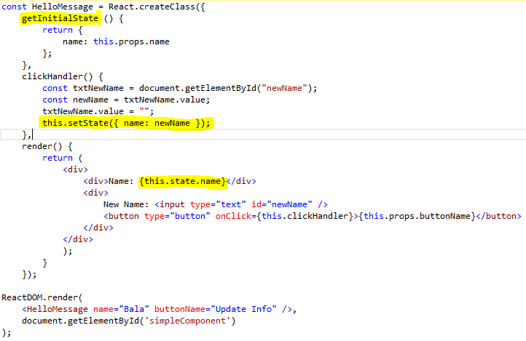
About React – State

Slide 9
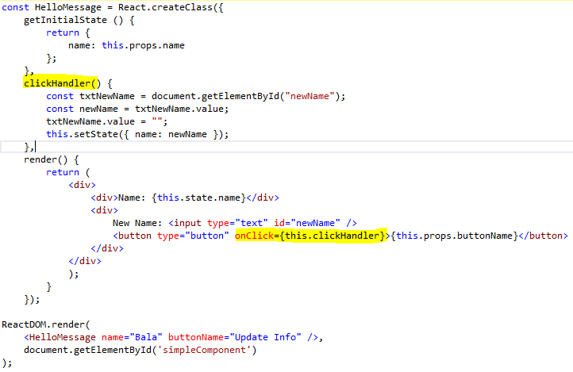
About React – Event Delegation

Slide 10
Demo
Notes:
Programming technique that’s a part of Agile methodologies, including XP (extreme programming)
Goal is to write clean code that works
Simple concept
Three Steps; 1. Write an automated test for new fuctionality that fails. 2. Change the code so the test will pass. 3. verify all tests passes
Refactor any time as needed. All test should pass.

Slide 11
About the CB Experience
What we did …
  Started with small feature
  Implemented with WebAPI to replace ASP.net WebForm
What we learned …
  Learning curve
  Tooling via NuGet
    ReactJS.Net
    WebOptimizer – Implements Babel and ES6 features.
  Need to start learning/planning for state management
Notes:
1. There are some challenges with TDD. It sound simple but harder to do. First, it really does require different min-set. Most Developer are in very much in habit of what best way to do this instead of best code that is testable.
2. It will take longer to code, but idea is it will produce less bug so in long run it will be faster since it will be all test in place.
3. There are lot of misunderstandings about TDD. This doesn’t replace QA or User
4. Another challenge is around code coverage. How much of you code should be test? Lot of people will argue that it should cover in range 90% to 100% of code. It should be what you are comfortable with. Test should cover logical pieces of your code.

Slide 12
Learn More…
Facebooks React Page
  https://facebook.github.io/react/
“Baby’s First Reaction” – Eric Elliott
  https://medium.com/javascript-scene/baby-s-first-reaction-2103348eccdd#.aizpv55mc
JSX Looks Like and Abomination… but it’s Good for You – Eric Elliott
  https://medium.com/javascript-scene/jsx-looks-like-an-abomination-1c1ec351a918#.q38gfskh0
ReactJS.NET – Website for .Net tooling for React
  https://reactjs.net/
Notes:
A PERSPECTIVE ON TDD
TDD is Mostly about Design Gives Confidence Enables Change Is Automated Validates Your Design Is Documentation By Example As Well As an Up To Date, “Live”, And Executable Specification Provides Rapid Feedback Quality of Implementation Quality of Design Forces Constant Integration Requires More Discipline Brings Professionalism to Software Development Isn’t The Only Testing You’ll Need To Do Developers Write Tests

