Slide 1
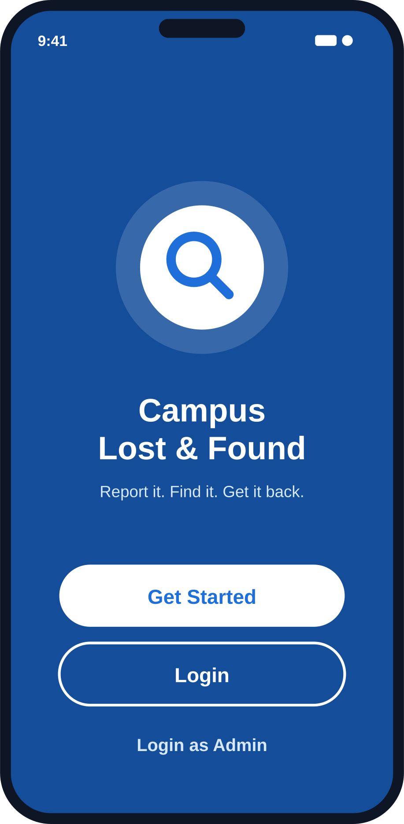

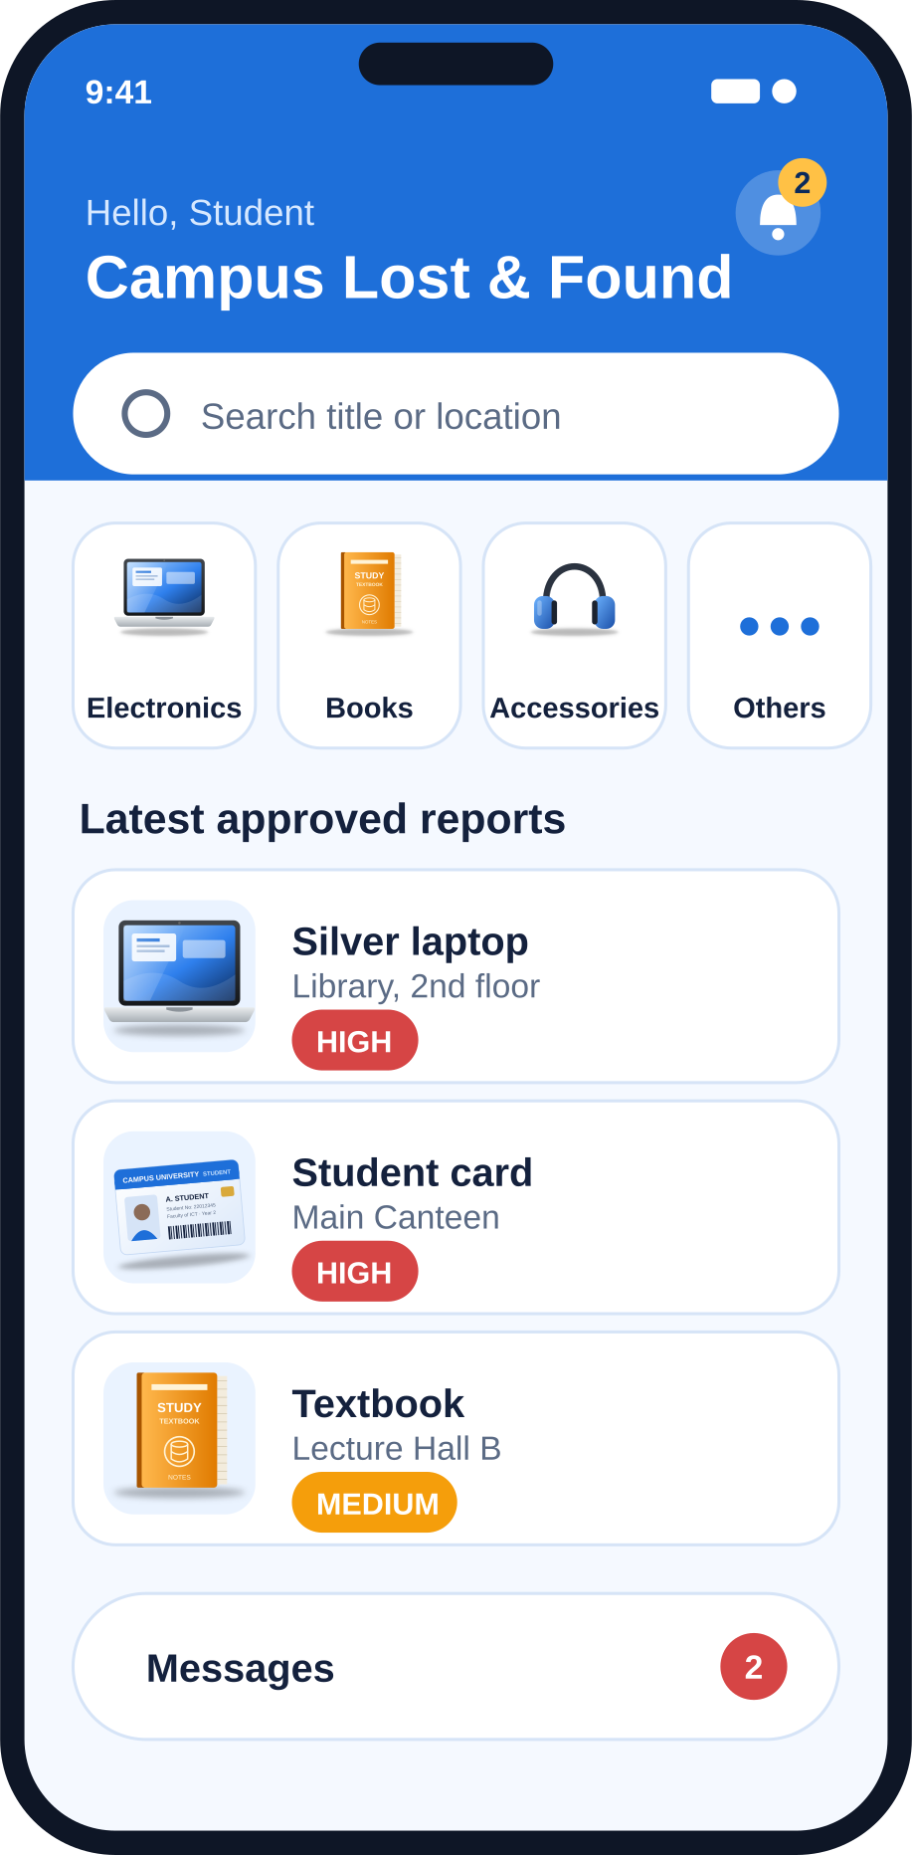
CAMPUS LOST & FOUND
MOSA202 Integrated Project
Native Android application • Java • Firebase
Durban University of Technology
Presenter: ____________________

Slide 2
Presentation Outline
Introduction
What the app is and why it exists
Problem Statement
The gap on campus and our solution
1
2
System Overview
Users, roles and main features
Technology and Tools
Language, libraries and Firebase services
3
4
Implementation
Accounts, reporting and the AI priority classifier
Testing
18 scenarios across the whole app
5
6
Challenges and Limitations
What the current version does not do yet
Where It Can Go Next
Planned features and improvements
7
8

Slide 3




INTRODUCTION
Introduction
Campus Lost & Found is a native Android application, written in Java and connected to Firebase. It helps students at Durban University of Technology report lost items, find items that others have handed in, and get them back to their owners.
In this presentation
The problem it sets out to solve
How the app is built
How its main features were implemented
Where it can go next
Notes:
Good day, everyone. My name is ______, and today I am presenting my MOSA202 Integrated Project: Campus Lost & Found. It is a native Android application, written in Java and connected to Firebase, that helps students at Durban University of Technology report lost items, find items that others have handed in, and get them back to their owners.
In the next ten minutes or so, I will explain the problem I set out to solve, how the app is built, how its main features were implemented, and where it can go next.

Slide 4


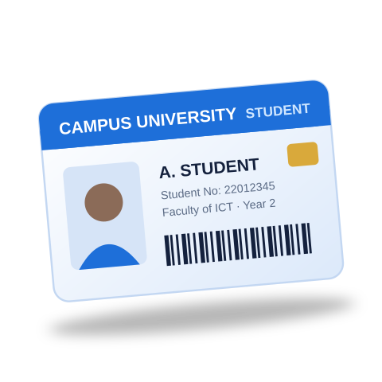

PROBLEM STATEMENT
Problem Statement
There is no central, searchable and moderated system through which students can report lost or found items, and no way of deciding which reports are most urgent.
Not every item is equally urgent
Reports need to be checked
A lost water bottle is an inconvenience, but a lost laptop or student card can stop a student from studying or even entering campus.
If anyone can post anything, nobody can trust what they see. Staff need a controlled way to verify reports before they are shown to everyone.
Notes:
There is no central, searchable and moderated system through which students can report lost or found items, and no way of deciding which reports are most urgent. Items that are critical to a student's studies, such as a laptop or student card, are treated the same as low-impact items, and there is no controlled way for staff to verify reports before they are shown to everyone.
There are two more issues. First, not every item is equally urgent. A lost water bottle is an inconvenience, but a lost laptop or student card can stop a student from studying or even entering campus. Second, if anyone can post anything, nobody can trust what they see, so reports need to be checked.

Slide 5




PROBLEM STATEMENT · OUR SOLUTION
Our Solution: Four Parts
1
2
3
4
Report
AI priority classifier
Live, searchable list
Administrators in control
Students can report lost or found items.
Every report is analysed and given a score, a priority and a reason.
Approved items appear in a live, searchable list that updates in real time.
Admins approve or reject reports, reply to students, and manage who is allowed to be an administrator.
Notes:
My solution has four parts. Students can report lost or found items. Every report is analysed by an AI priority classifier that gives a score, a priority and a reason. Approved items appear in a live, searchable list that updates in real time. And administrators control the system: they approve or reject reports, reply to students, and manage who is allowed to be an administrator.

Slide 6
SYSTEM OVERVIEW
Users and Roles
A role field stored on each user's Firestore document controls what the person may do.
Student (user)
Administrator (admin)
Log in through the Admin Login screen
View all reports, filter by status
Approve, reject, resolve, claim or delete a report
Read student messages and reply
Register, log in, reset a forgotten password
Report Lost or Found items
Browse, search and filter approved reports
View their own approved reports
Open item details; contact a reporter by email
Mark their own report Resolved or Claimed
Read notifications; message administrators
View profile and log out
Pending administrator
Used Create Admin Account
Account exists but cannot log in as admin until approved
Main administrator
Admin whose Firebase user ID is registered in the app
Only this account can open Manage Users, approve pending admins and remove admin rights

Slide 7




SYSTEM OVERVIEW
Main Features (1 of 2)
Welcome screen
Account management
Report an item
Get Started (register), Login (student) and Login as Admin buttons.
Registration with name, student number, email, phone and password; login; password reset by email.
Choose Lost or Found, pick a category, enter title, description and location, then press Analyse & Submit.
AI priority analysis
Home dashboard
My Reports / Browse
Gives priority, score, reason and an “automatically approved” or “sent to admin for review” decision.
Greeting, notification bell, live search bar, category cards (Electronics, Books, Accessories, Others), the latest five approved reports and an unread-messages badge.
Tabbed Lost / Found lists of approved reports; “View all” browses every user's approved reports.

Slide 8






SYSTEM OVERVIEW
Main Features (2 of 2)
Item details
Notifications
Messages
Details, status badge, Contact button (email) and, for the owner, a Mark as Resolved / Claimed button.
List of decisions made by administrators on the student's reports, with unread highlighting.
Chat-style conversation between a student and the administrators.
Admin dashboard
Report moderation
Manage Users
View Reports, Student Messages and Manage Users shortcuts.
Status filter (All, Pending, Approved, Rejected, Resolved, Claimed) and per-report approval actions.
Main administrator approves or revokes administrators.

Slide 9
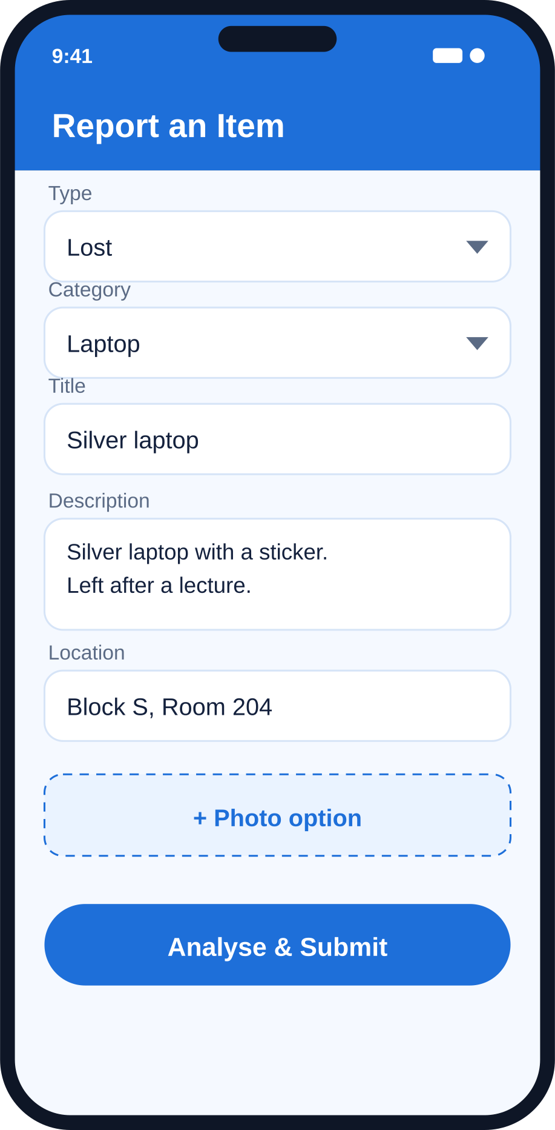
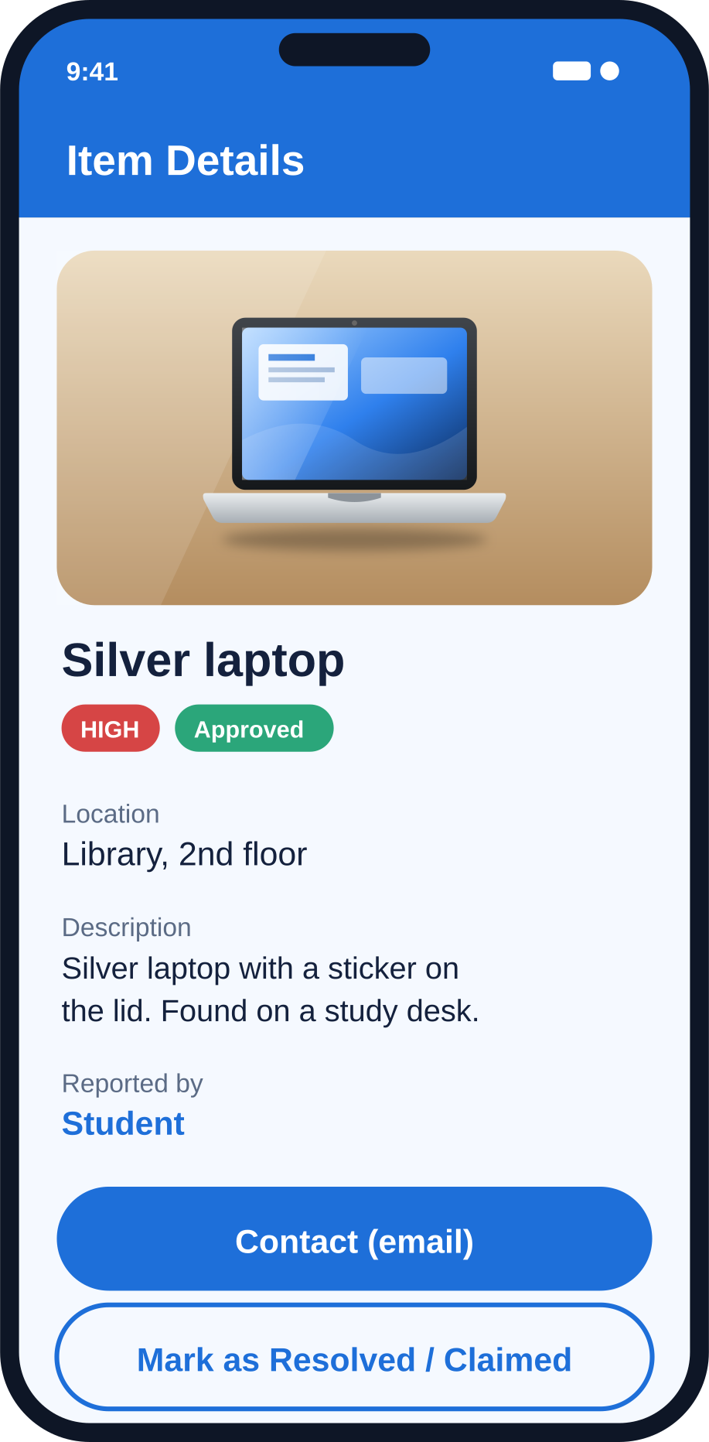
SYSTEM OVERVIEW
Student Screens
Welcome
Home dashboard
Report an item
Item details

Slide 10
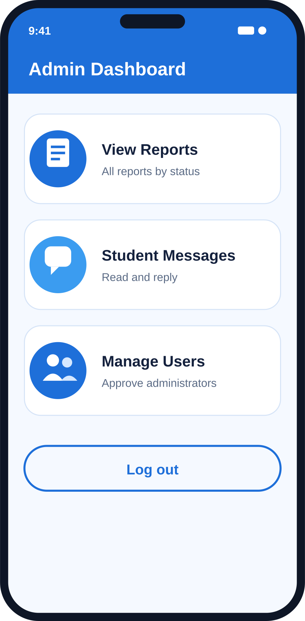
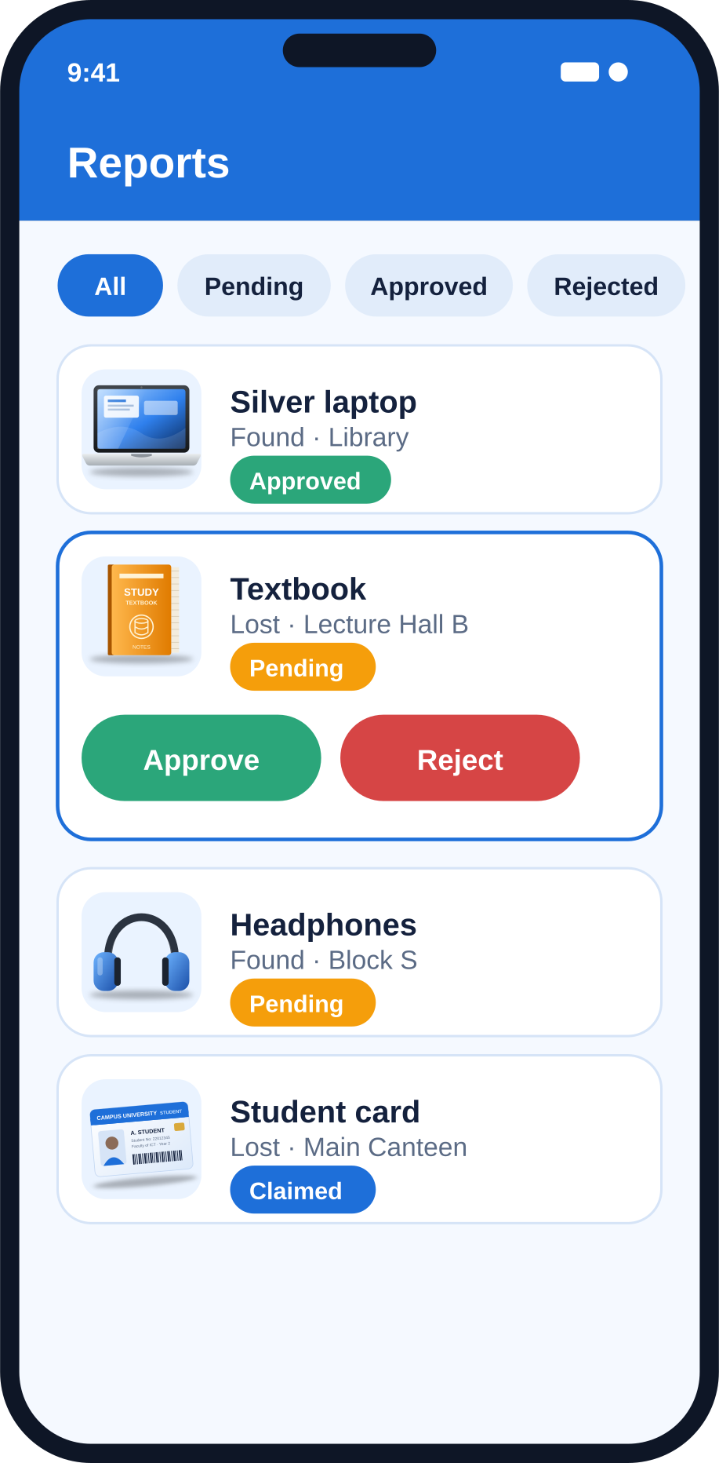
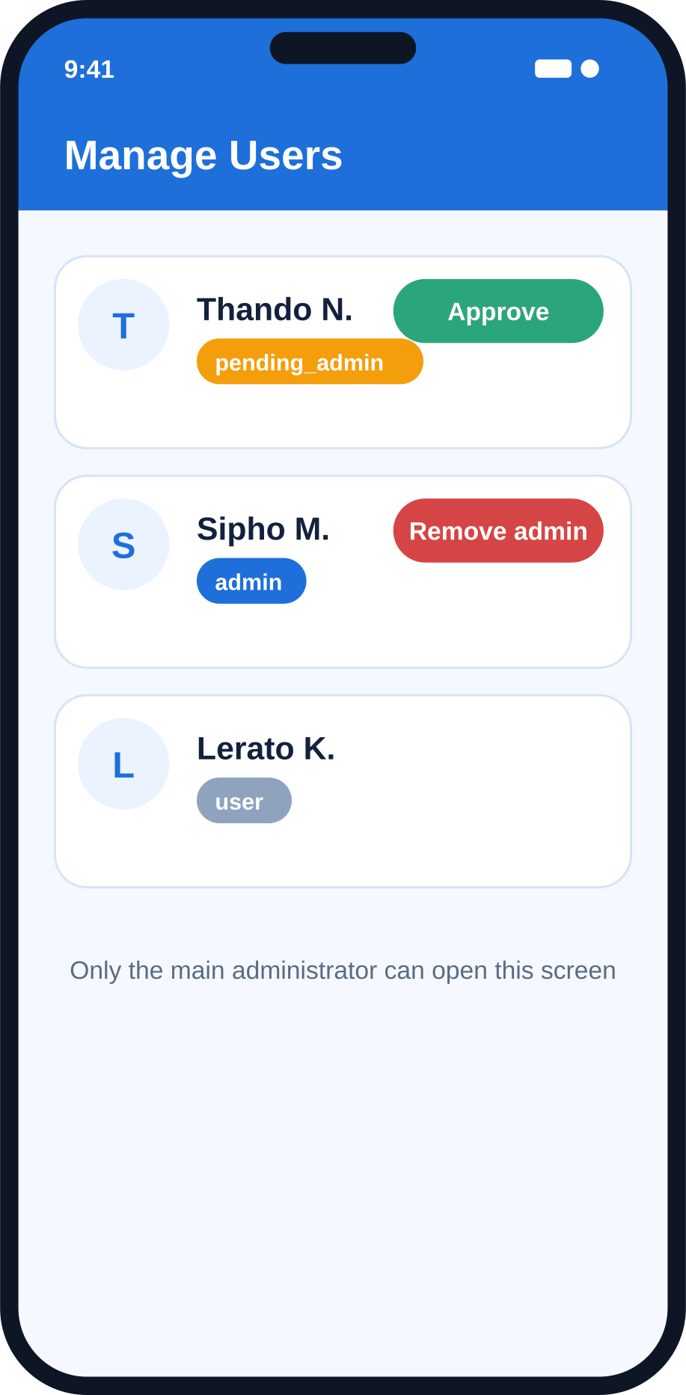
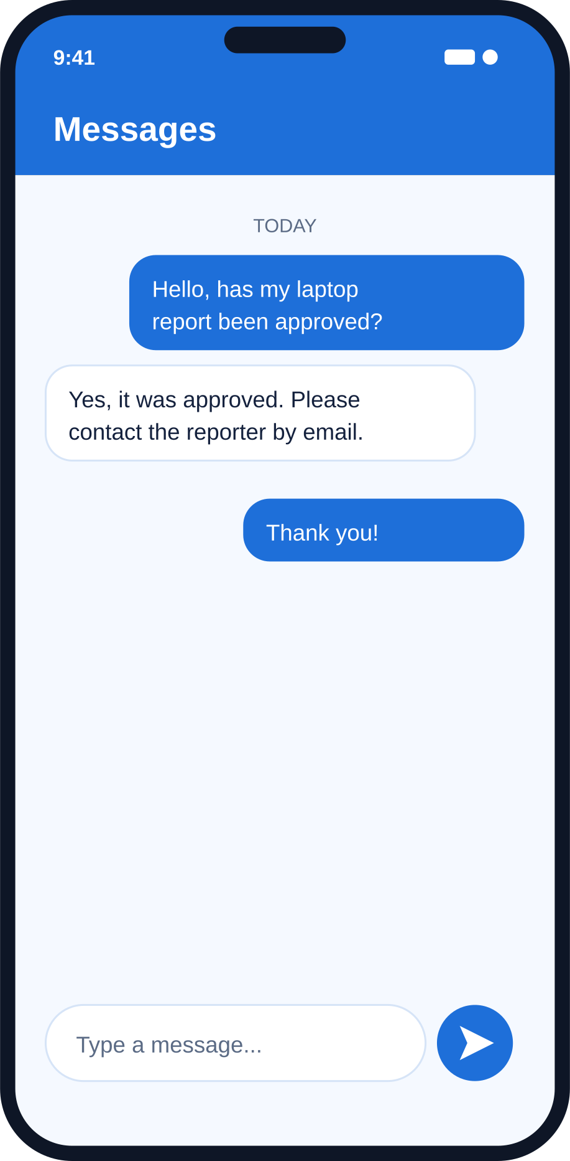
SYSTEM OVERVIEW
Administrator Screens
Admin dashboard
Report moderation
Manage Users
Messages

Slide 11











TECHNOLOGY AND TOOLS
Technology and Tools
Language
IDE / build system
SDK levels
UI libraries
Java (Android SDK)
Android Studio with Gradle; Android Gradle Plugin 8.6.1; Google Services plugin 4.4.2
minSdk 23 (Android 6.0), compileSdk 35, targetSdk 35
AndroidX AppCompat 1.7.0, Material Components 1.12.0, RecyclerView 1.3.2
Theme
Authentication
Database
Session cache
Theme.Material3.DayNight.NoActionBar with a custom blue palette
Firebase Authentication (email and password, password-reset email)
Cloud Firestore with real-time snapshot listeners; collections users, reports and messages
SharedPreferences file “CampusPrefs”
Other Firebase libraries
Permissions
Email contact
Native Android + Java + Firebase
Firebase Storage and Cloud Messaging are included as dependencies for planned features
INTERNET and POST_NOTIFICATIONS
Implicit intent: Intent.ACTION_SENDTO with a mailto: URI

Slide 12
TECHNOLOGY AND TOOLS
How It Fits Together
Campus Lost & Found app (Java)
SharedPreferences
Firebase Authentication
Cloud Firestore
Email app
“CampusPrefs” session cache
Email and password, password-reset email
Real-time snapshot listeners
Implicit intent (mailto:) to contact a reporter
users · reports · messages
Planned: Firebase Storage (photos) and Firebase Cloud Messaging (push notifications) are already included as dependencies.

Slide 13


IMPLEMENTATION
Registration and Login
Registration · RegisterActivity
Validates every field with a clear message
createUserWithEmailAndPassword()
Writes users/{uid}: profile and role “user”
Caches the basics in SharedPreferences
Opens Home, back stack cleared
Login · LoginFormActivity
signInWithEmailAndPassword()
Reads users/{uid} for name and role
Stores them in CampusPrefs
Opens Home
Forgot password · ForgotPasswordActivity
Validates the email address
sendPasswordResetEmail()
Students recover their own accounts
Passwords are handled only by Firebase and are never stored in the app.

Slide 14
IMPLEMENTATION
Administrator Accounts and Roles
Create Admin Account registers a normal Firebase user
Role stored as pending_admin
Person is signed out immediately
AdminLoginActivity signs in and reads the role
pending_admin → shows “waiting for approval”
any role other than admin → is refused
admin → opens AdminHomeActivity
In every refused case the user is signed out.
AdminHomeActivity checks the role again when it opens, so a screen cannot be reached by simply launching it.
ManageUsersActivity is for the main administrator only: it checks the uid and the admin role, then lists every user with a button to approve or revoke.

Slide 15
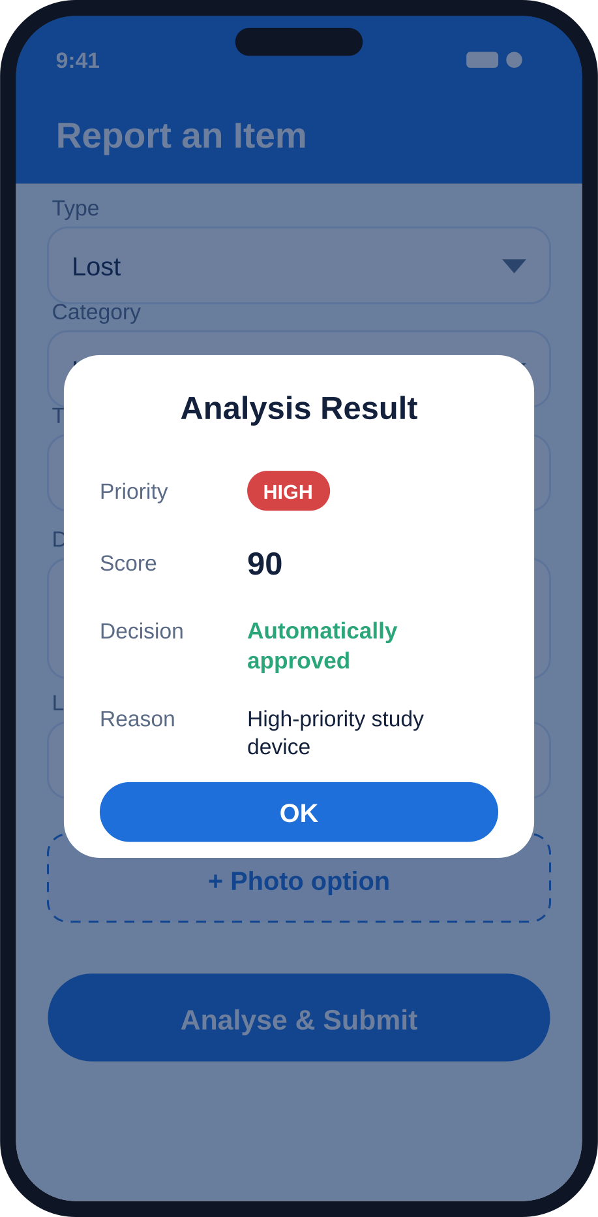
IMPLEMENTATION
Reporting an Item
ReportItemActivity fills two spinners: Lost / Found, and eight categories.
Laptop
Cellphone
Student Card
Book
Tablet
Calculator
Headphones
Other
1
Checks that title, description and location are filled in
2
Calls AiPriorityClassifier.analyse(category, title, description)
3
Reads the student's name and student number from users/{uid}
4
Creates a reports document: generated ID, priority, score, reporter details, timestamp and readable date (e.g. “29 Sep 2026 · 03:15 PM”)
5
Sets status to Approved if auto-approved, otherwise Pending
6
Shows a dialog with the priority, score, decision and reason

Slide 16



IMPLEMENTATION
The AI Priority Classifier
Transparent and rule-based
A scoring engine, so every decision can be explained to the student.
Academic words
assignment
exam
test
Category first
The selected category gives the base score, which prevents mistakes such as “phone” inside “headphones” changing the result.
lecture
class
project
study
Keywords only for “Other”
Only then are the title and description searched, using a regular expression that matches whole words only.
Urgency words
Explanations
Academic and urgency words add sentences to the explanation shown to the student.
urgent
tomorrow
deadline

Slide 17
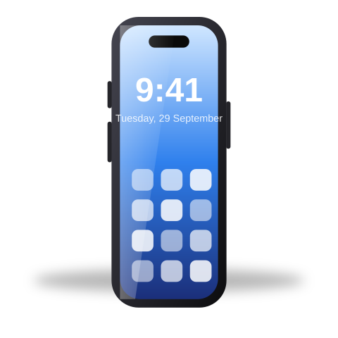


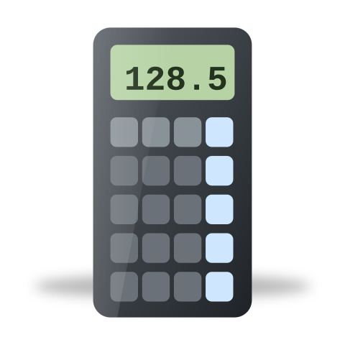


IMPLEMENTATION
Category Scores
Category (or keyword when “Other”)
Score
Reason recorded
Laptop (laptop, computer, notebook)
90
High-priority study device
Cellphone (phone, smartphone)
80
Important for communication and student services
Student Card (student id, id card)
70
Needed for campus access and services
Tablet (tablet, ipad)
60
Possible study device
Book (textbook, notes)
50
Study material
Calculator
50
Needed for coursework and tests
Headphones (earphones, earbuds)
40
Useful for study and communication
Anything else
30
Does not match a higher-priority category

Slide 18
IMPLEMENTATION
Priority Levels and Decisions
HIGH
70 – 100
Automatically approved if title, description and category are present and the category is not “Other”.
MEDIUM
40 – 69
Status Pending: sent to an administrator.
LOW
0 – 39
Status Pending: sent to an administrator.
Approved reports appear on every student's Home in real time, and the reporter receives a notification.

Slide 19



TESTING
Testing the App
18
scenarios
Defined from the behaviour of the code to verify each requirement
6.0+
Android
Emulator or physical device running Android 6.0 or later
Online
internet needed
Scenarios need an internet connection
What the scenarios cover
Accounts and login
Scenarios 1–5
Administrator roles
Scenarios 6–8, 17
Reporting and AI priority
Scenarios 9–12
Search and categories
Scenarios 13–14
Resolve and messaging
Scenarios 15–16
Session and navigation
Scenario 18

Slide 20
TESTING
Test Scenarios 1–9
Scenario
Expected result
1
Register with an invalid email or a phone under 10 digits
A message explains the problem; no account is created.
2
Register with mismatching passwords
“Passwords do not match.”
3
Register with valid details
Firebase account and users/{uid} document created with role user; Home opens.
4
Log in with a wrong password
Error message from Firebase; stays on the login form.
5
Use Forgot password with a valid email
A reset email is sent.
6
Create an admin account, then log in as admin
Message that the account awaits approval; no admin access.
7
Main admin approves the pending admin in Manage Users
Role changes to admin; the person can now log in as admin.
8
Student logs in through Admin Login
“Not an approved administrator account”; signed out.
9
Report a Laptop with all fields filled in
Score 90, HIGH, automatically approved; status Approved and visible on Home.

Slide 21
TESTING
Test Scenarios 10–18
Scenario
Expected result
10
Report a Book or an Other item
Not auto-approved; status Pending and not visible on Home.
11
Admin approves a pending report
Report appears on every student's Home in real time; reporter receives a notification.
12
Admin rejects a pending report
Reporter's notification says it was rejected; report never appears on Home.
13
Type part of a title or location in the search bar
The list narrows instantly.
14
Tap the Books category card
Only Book reports are listed.
15
Owner opens an approved report and presses Mark as Resolved / Claimed
Status changes; report leaves the Home and My Reports lists.
16
Student sends a message; admin replies
Reply appears in the student's Messages screen; unread badge shows on Home until it is read.
17
Open Manage Users with a normal admin account
Access denied and signed out.
18
Log out, then press Back
Login screen remains; signed-in screens are not shown.

Slide 22

CHALLENGES AND LIMITATIONS
Challenges and Limitations
Photos are not yet uploaded
The report form shows a photo option, but this version saves the report without a photo. Firebase Storage is included for a later release.
No push notifications
Notifications are in-app and update in real time while the app runs. Cloud Messaging and its permission are declared, but no messaging service exists yet.
Security relies on the client
Role checks are performed in the app. Firestore security rules must also enforce roles on the server, and the main admin's user ID is written inside the app code.
Reports are looked up by timestamp
The creation time in milliseconds is the identifier passed between screens. It works for a small system; a Firestore document ID would be more reliable.
Rule-based classifier
It depends on categories and keywords and cannot understand free-text descriptions.
Legacy and unused code
DbHelper (SQLite) and AdminPanelActivity remain from earlier versions and are no longer part of the main flow.
No automated tests
Testing is by manual scenarios.
Only 3 DUT campuses
Only 3 DUT campuses are in the app. More campuses will be added soon.

Slide 23







WHERE IT CAN GO NEXT
Where It Can Go Next
Photo upload
Push notifications
Server-side security
Reliable report IDs
Save photos with reports using Firebase Storage, already included as a dependency.
Add a messaging service so Firebase Cloud Messaging can alert users outside the app.
Firestore security rules that enforce roles on the server, not only in the app.
Use a Firestore document ID instead of the creation timestamp.
More campuses
Cleaner code base
Automated tests
Smarter classifier
Only 3 DUT campuses are in the app; more will be added soon.
Remove the legacy DbHelper (SQLite) and AdminPanelActivity.
Add automated tests alongside the manual scenarios.
Go beyond categories and keywords to understand free-text descriptions.

Slide 24

THANK YOU
Questions?

