Slide 1
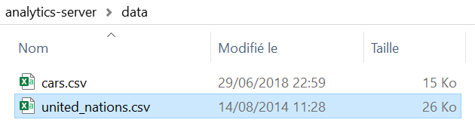
Analytics
Server
[ {"name":"cars.csv", "lastModified":1530305963.4392027855, "filesize":"14K"}, {"name":"united_nations.csv", "lastModified":1408008491.0, "filesize":"25K"} ]
name | lastModified | filesize
cars.csv | 1530305963.4392027855 | 14K
united_nations.csv | 1408008491.0 | 25K

Slide 2
Action | HTTP Verb | URL Path | Description
Create | POST | /api/dataset | Defines a unique URL to create a new dataset
Read | GET | /api/dataset | Defines a unique URL to read a collection of datasets
Read | GET | /api/dataset/{dataset} | Defines a unique URL to read a particular dataset in the dataset collection
Update | PUT | /api/dataset/{dataset} | Defines a unique URL to update an existing order
Delete | DELETE | /api/dataset/{dataset} | Defines a unique URL to delete an existing dataset

Slide 3
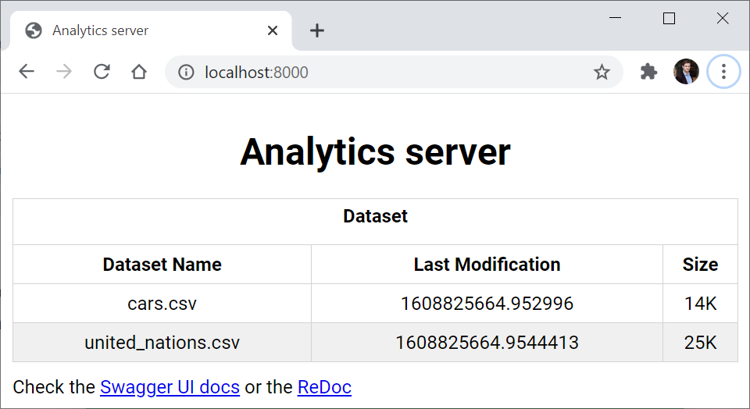
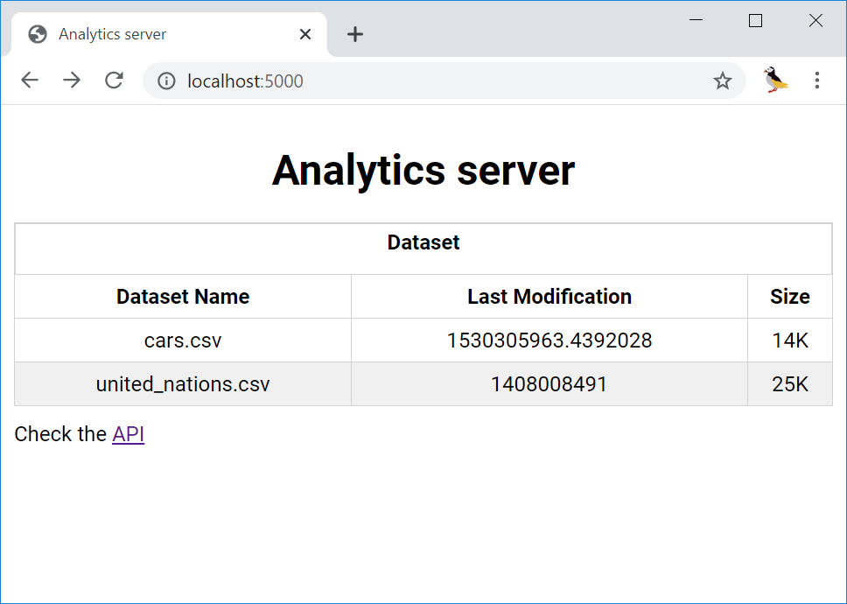

Slide 4
V2
FastAPI

Slide 5
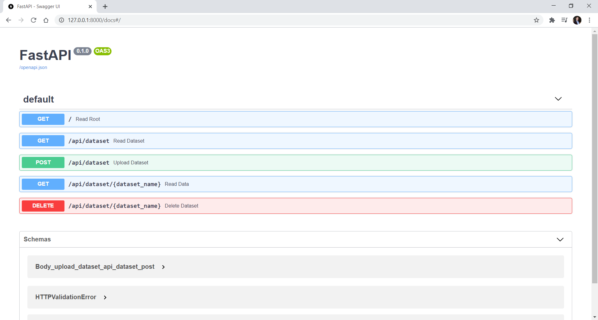
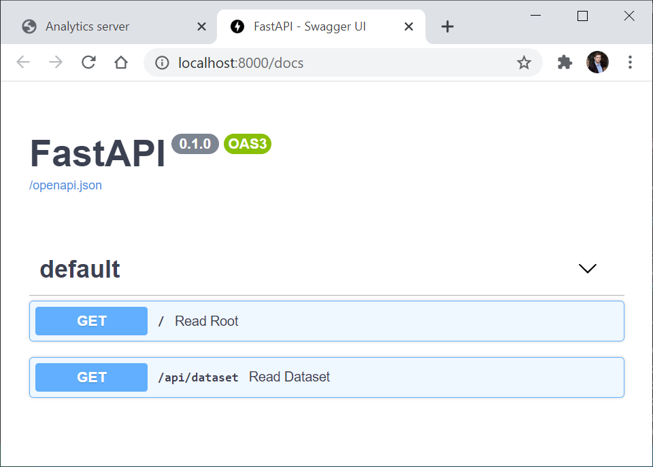

Slide 6
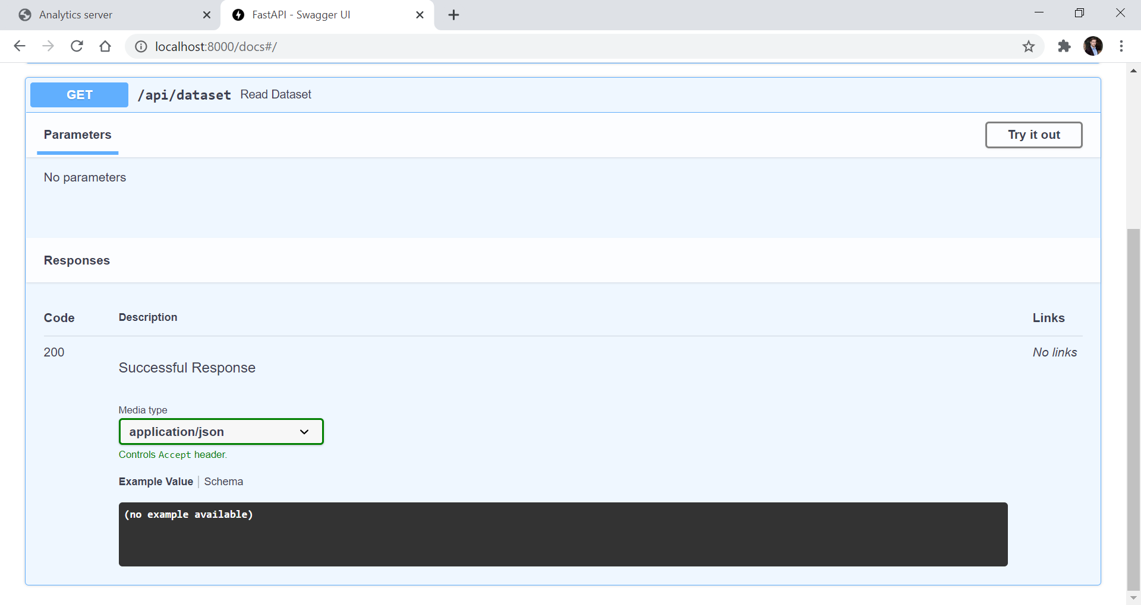

Slide 7
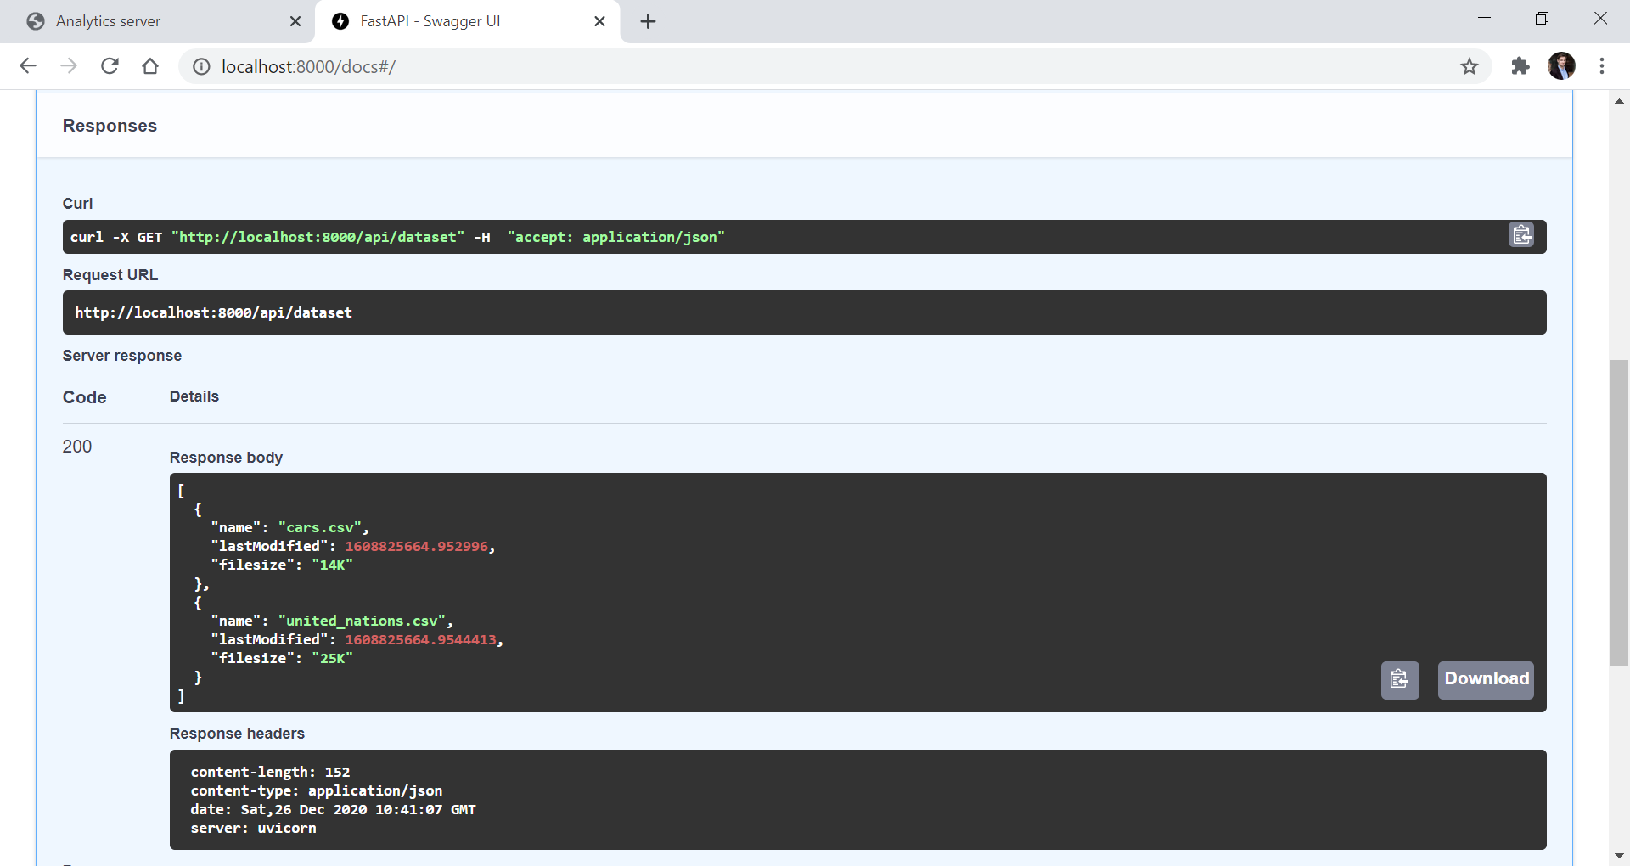

Slide 8
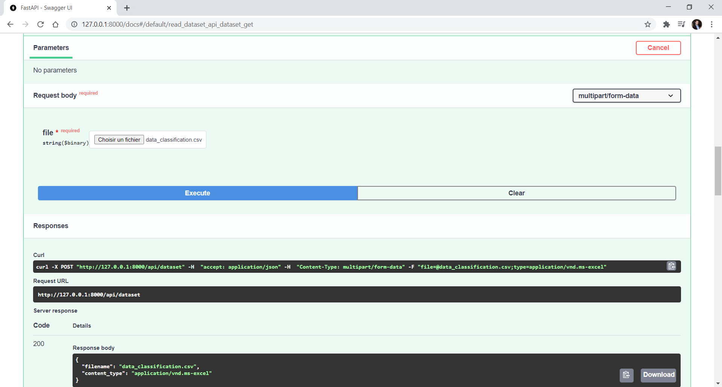

Slide 9
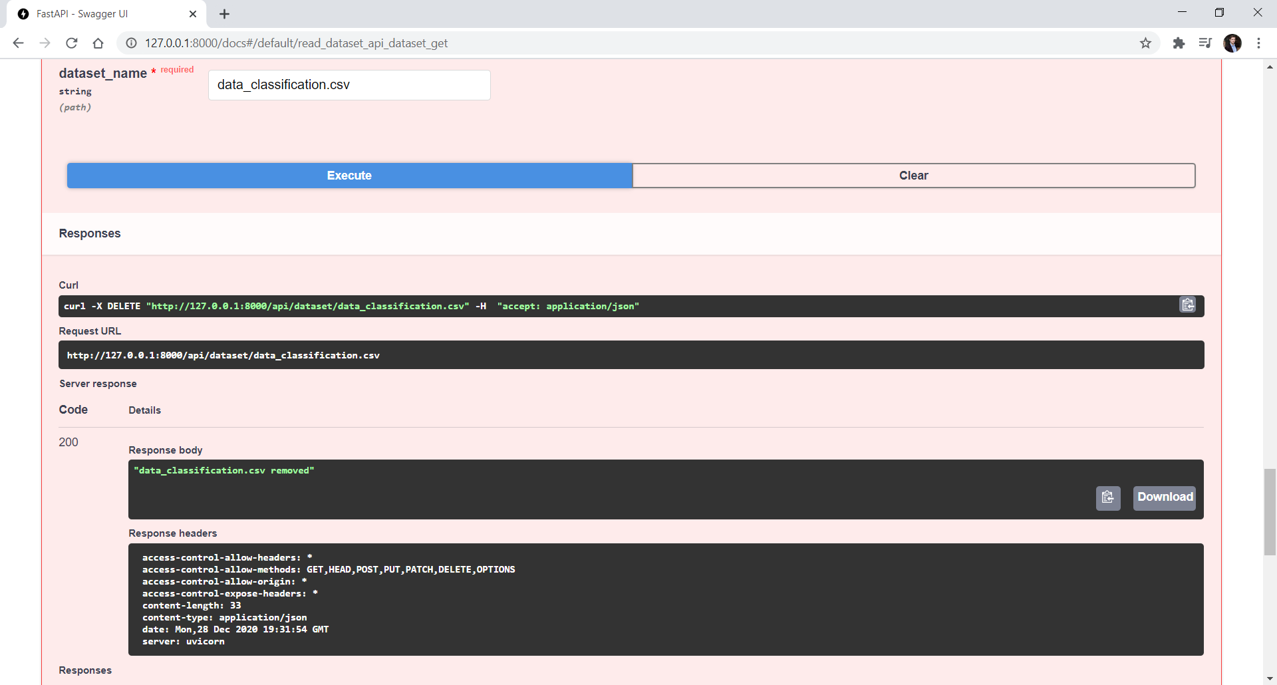

Slide 10
V1
Flask & Connexion

Slide 11
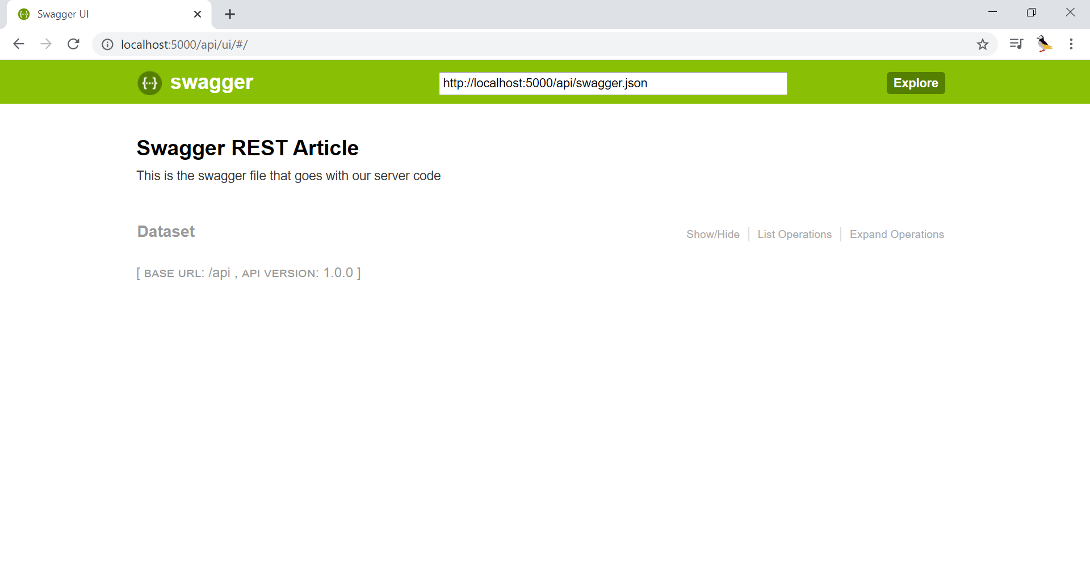

Slide 12
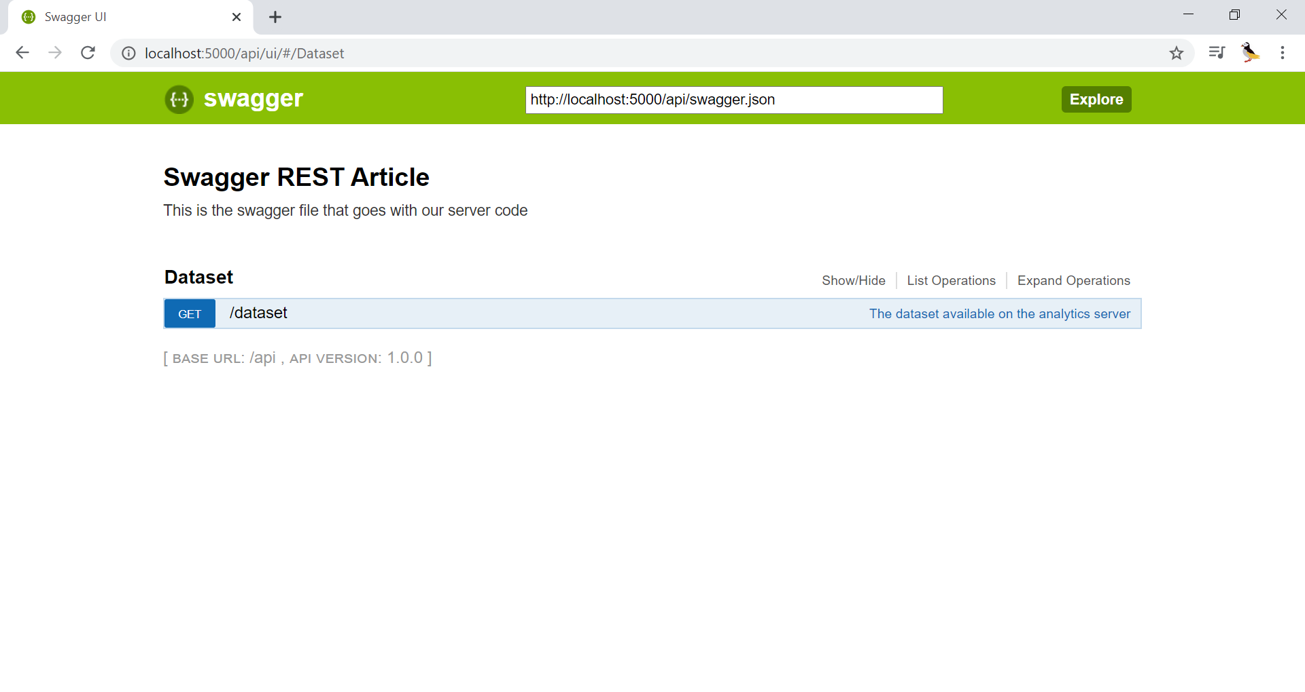

Slide 13
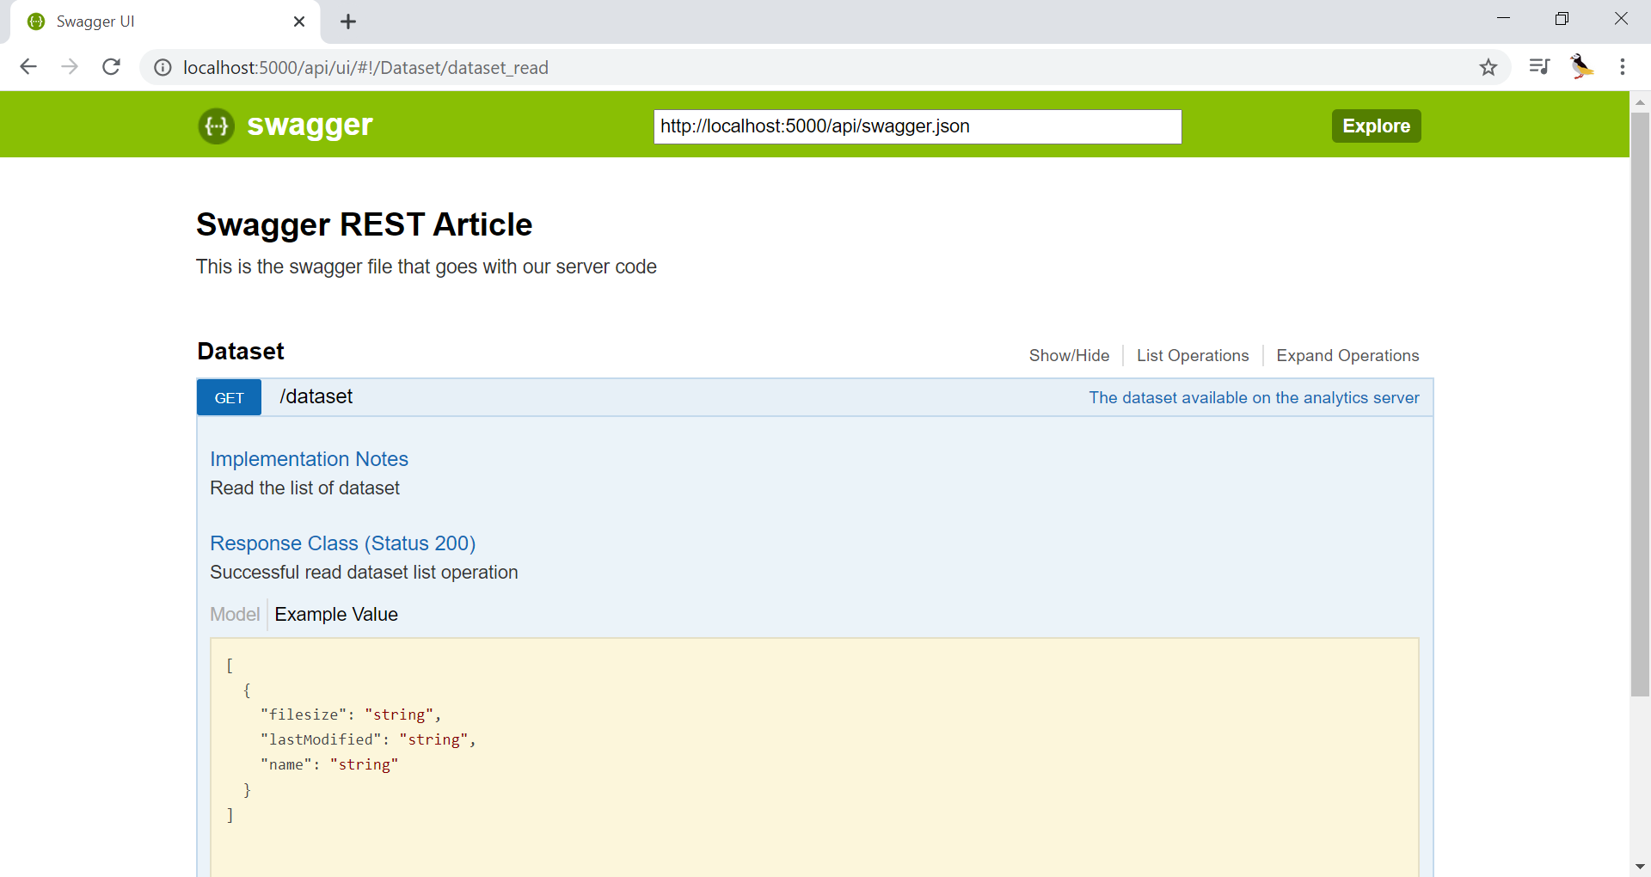
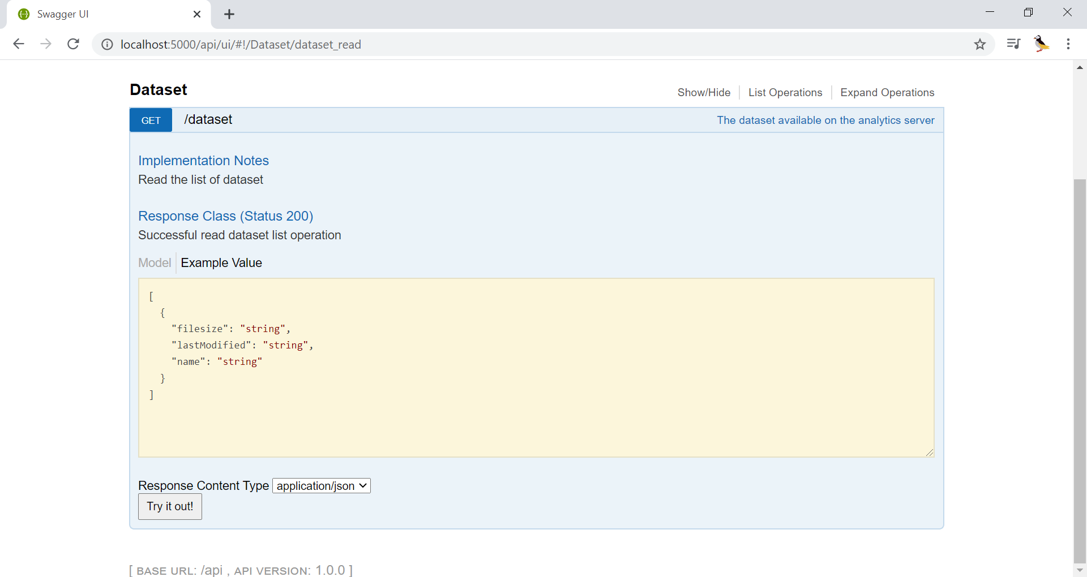

Slide 14
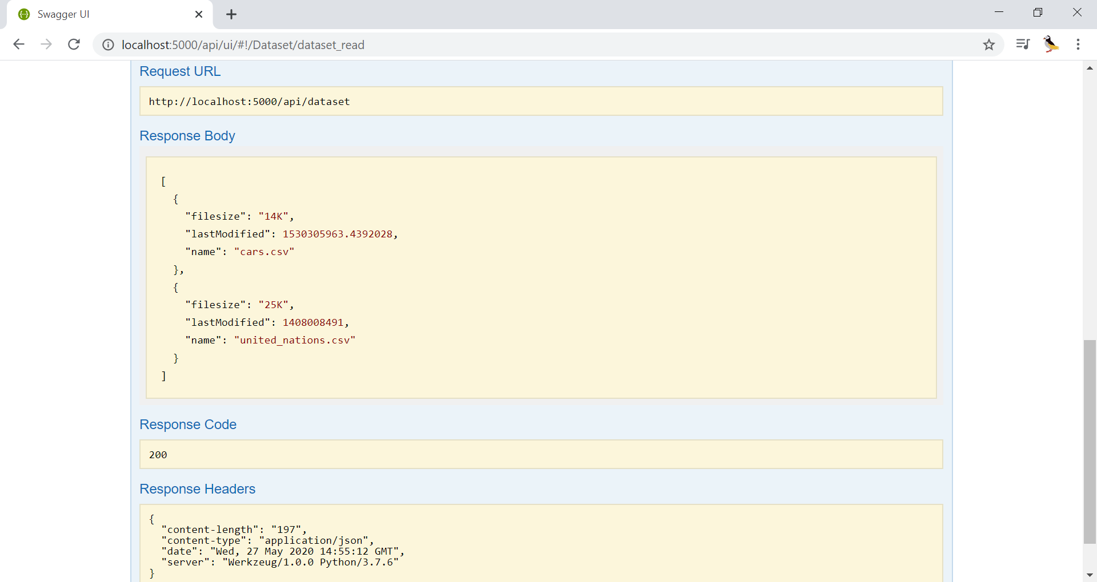

Slide 15
Deployment

Slide 16











CloudDeploy
DB
API
App
Cloud Model management
Analytics
Workspace
Functions
autoload
Data
Memory
Zip
Disk
Local File management
.csv
script

Slide 17
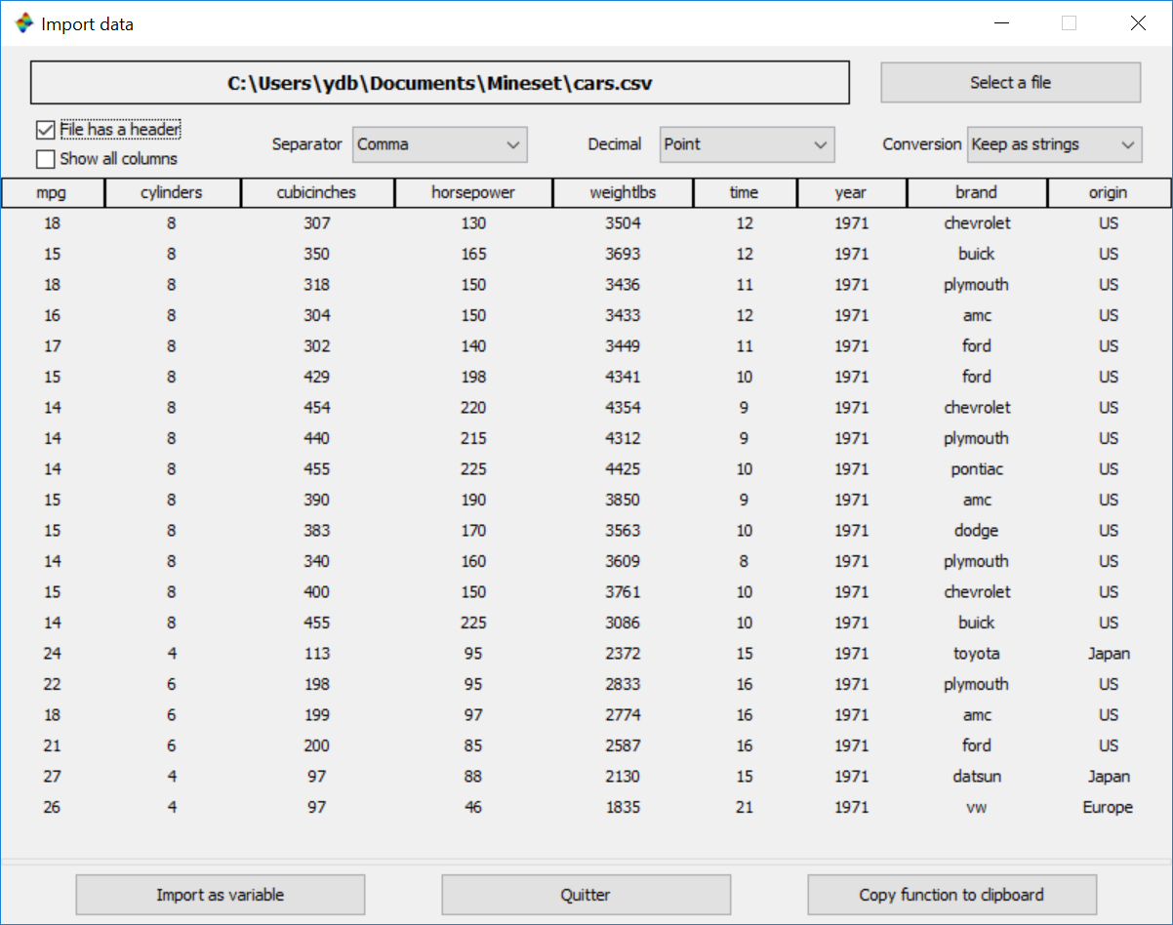


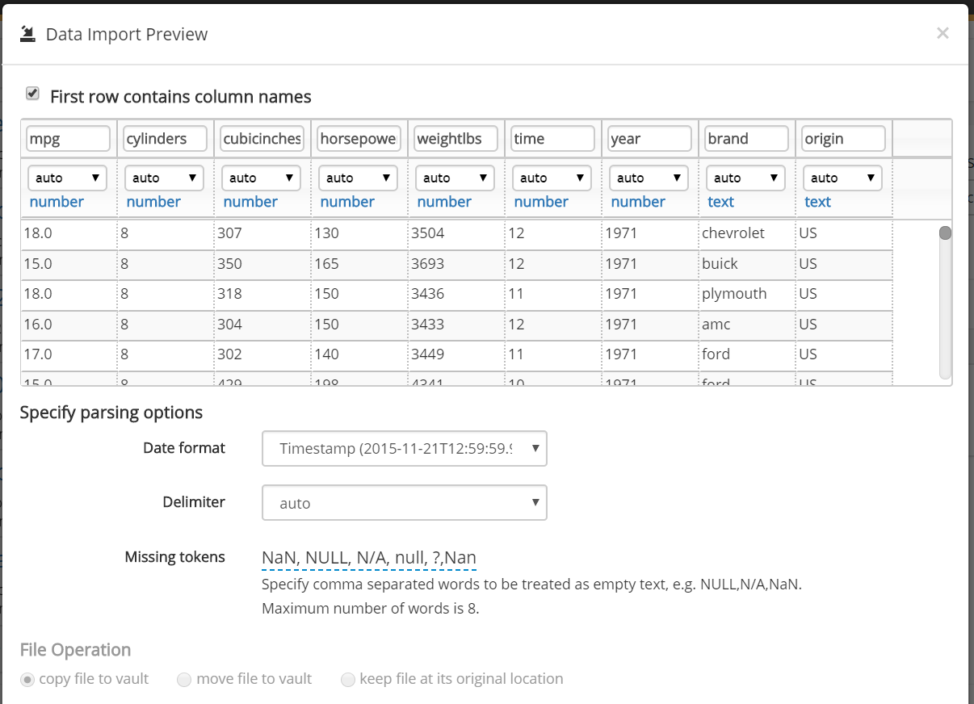

Desktop & Cloud data import
Analytics Server
Analytics

Slide 18
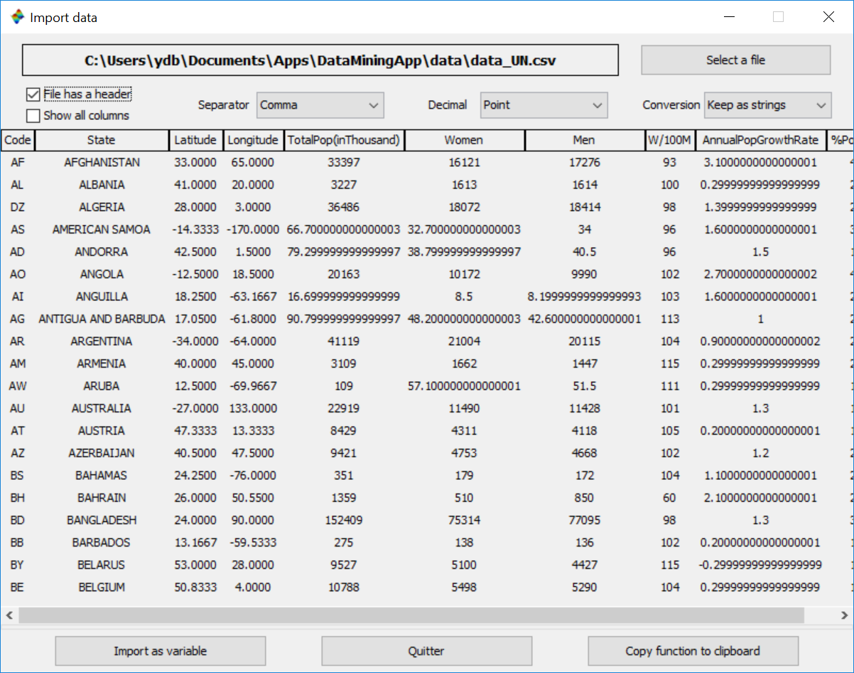
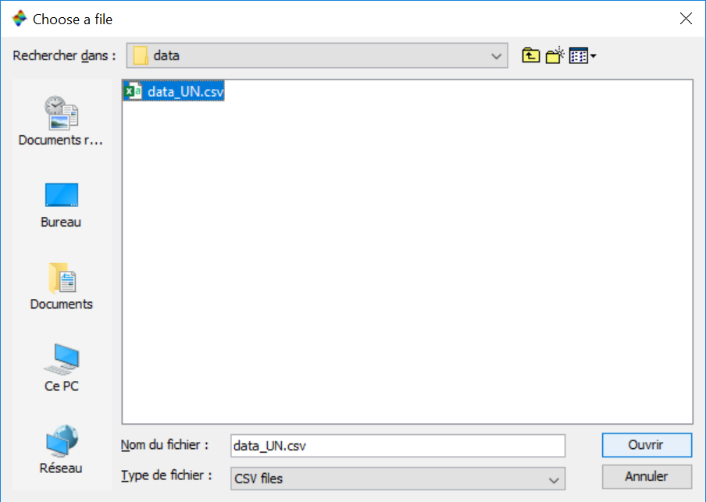
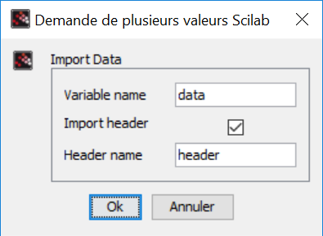
datadeploy
Import data

