Slide 1
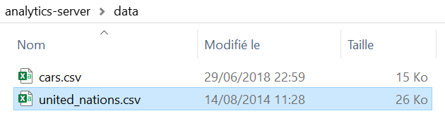
Analytics
Server
[ {"name":"cars.csv", "lastModified":1530305963.4392027855, "filesize":"14K"}, {"name":"united_nations.csv", "lastModified":1408008491.0, "filesize":"25K"} ]
name | lastModified | filesize
cars.csv | 1530305963.4392027855 | 14K
united_nations.csv | 1408008491.0 | 25K

Slide 2
Action | HTTP Verb | URL Path | Description
Create | POST | /api/dataset | Defines a unique URL to create a new dataset
Read | GET | /api/dataset | Defines a unique URL to read a collection of datasets
Read | GET | /api/dataset/cars | Defines a unique URL to read a particular dataset in the dataset collection
Update | PUT | /api/dataset/cars | Defines a unique URL to update an existing order
Delete | DELETE | /api/orders/cars | Defines a unique URL to delete an existing dataset

Slide 3
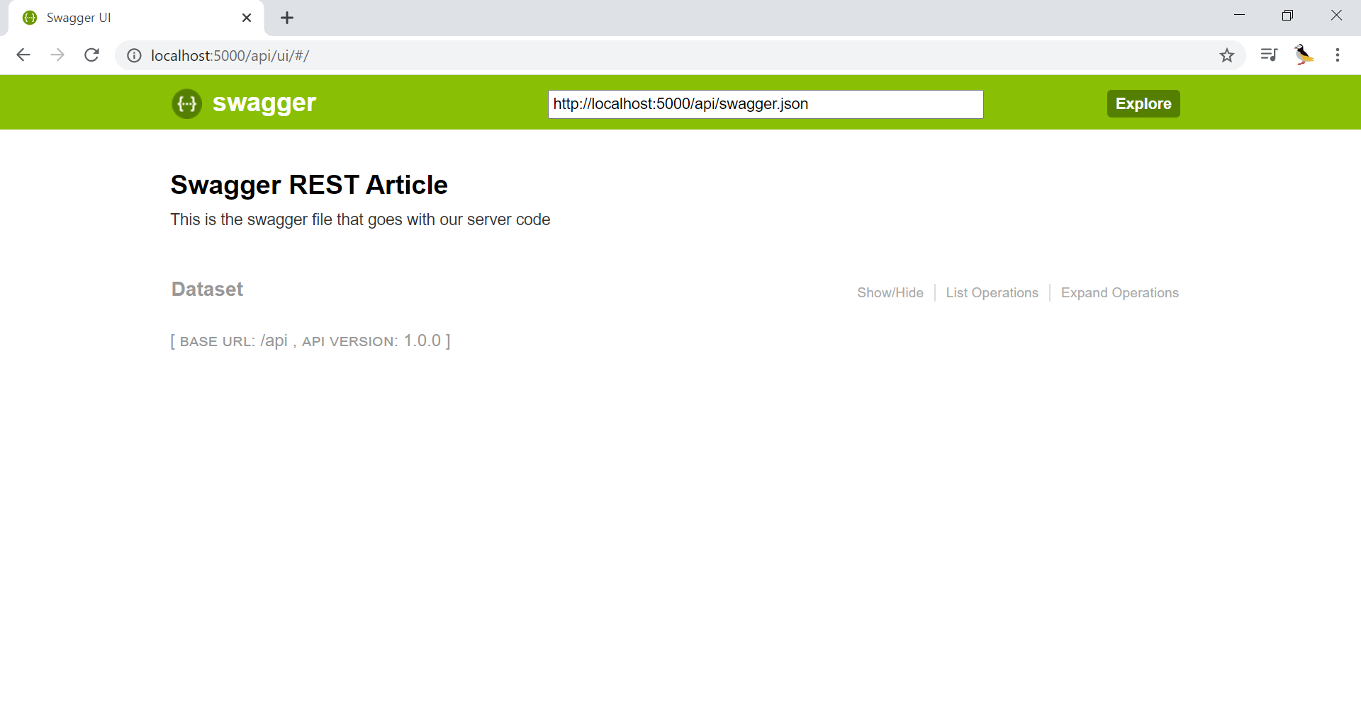

Slide 4
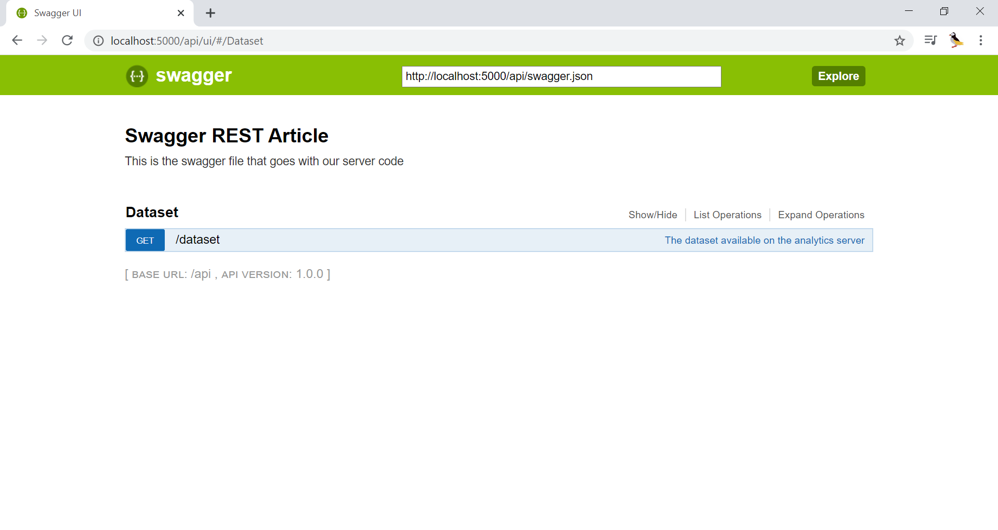

Slide 5
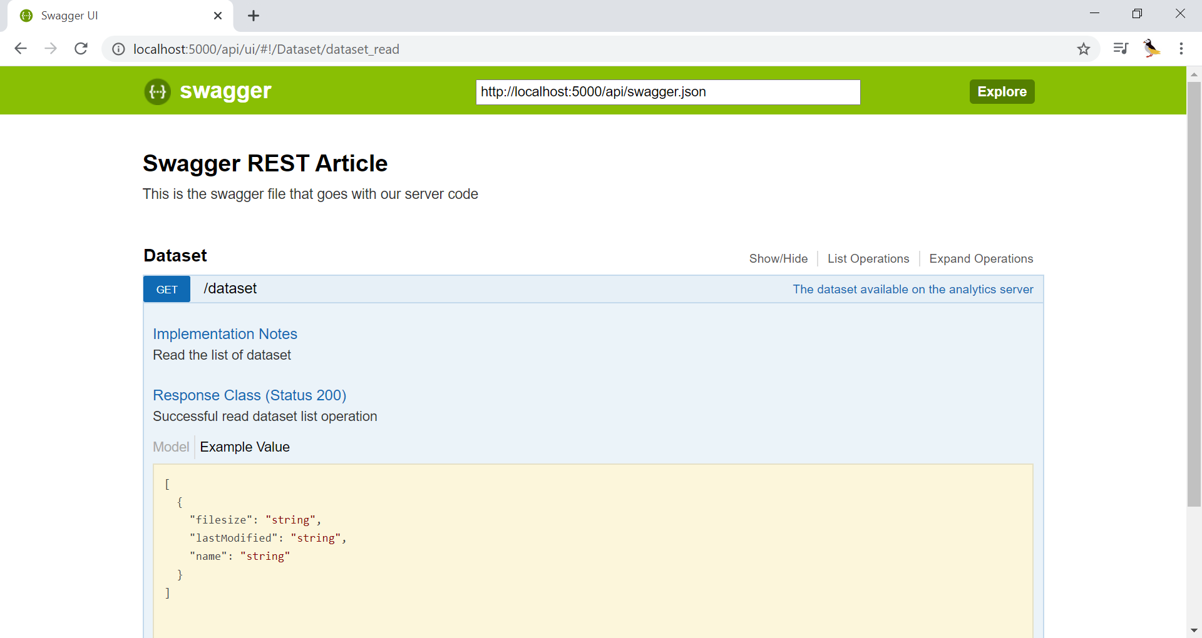
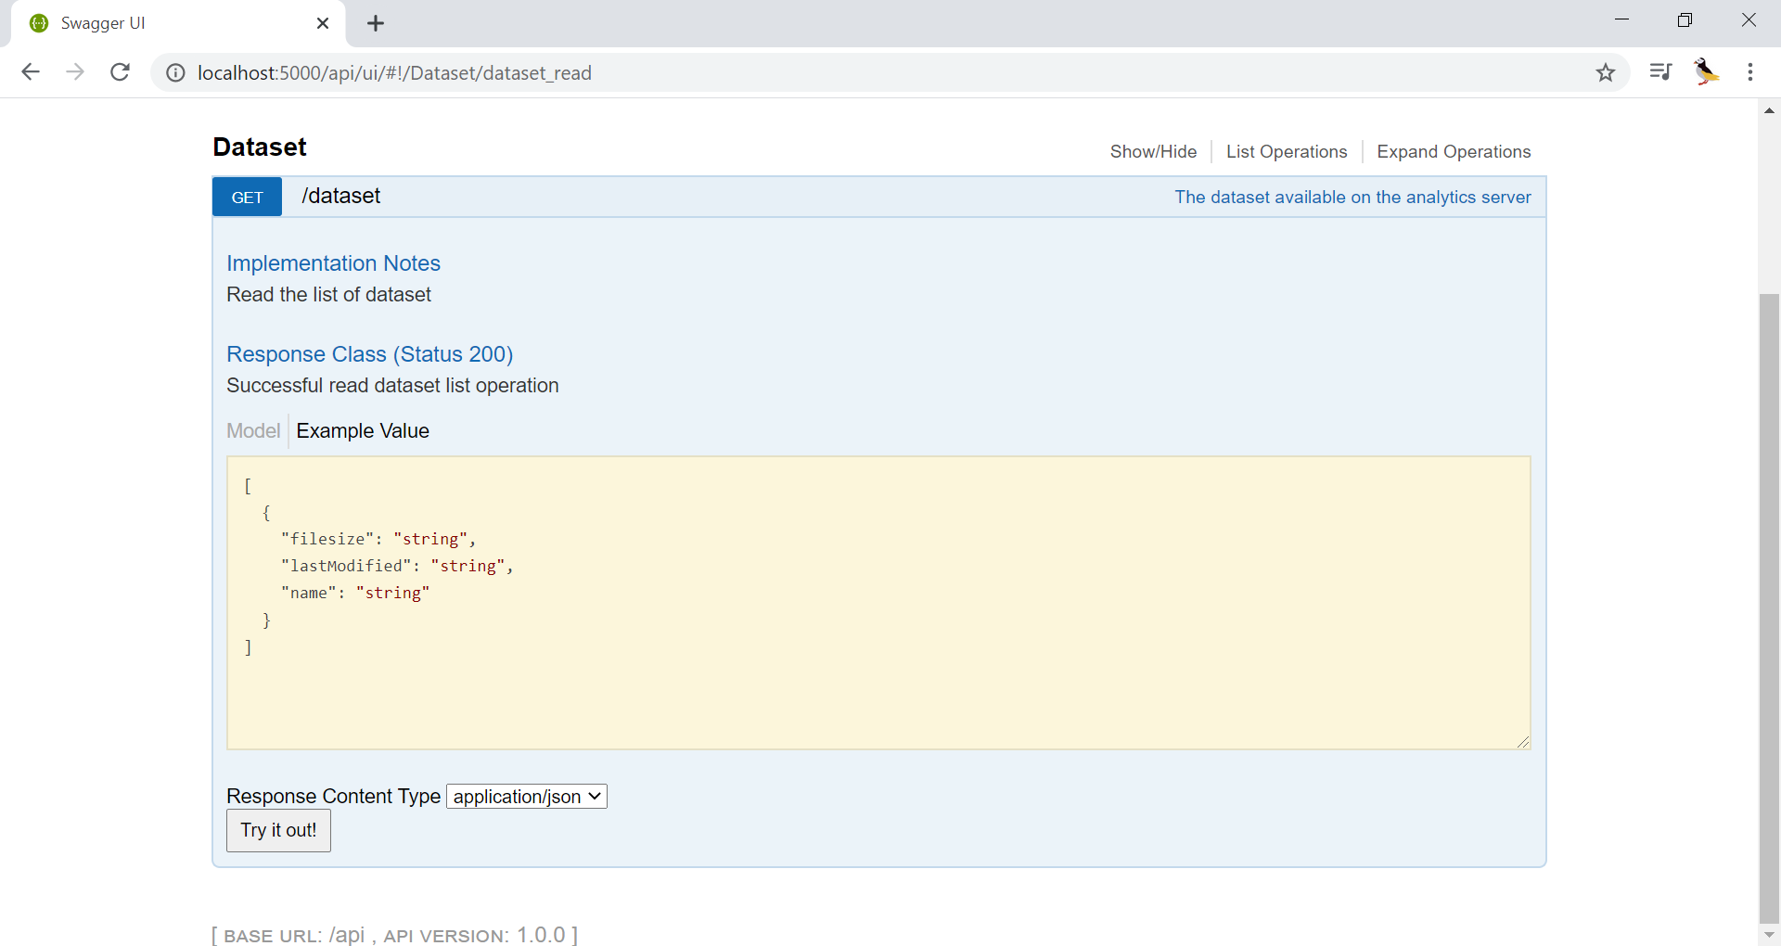

Slide 6
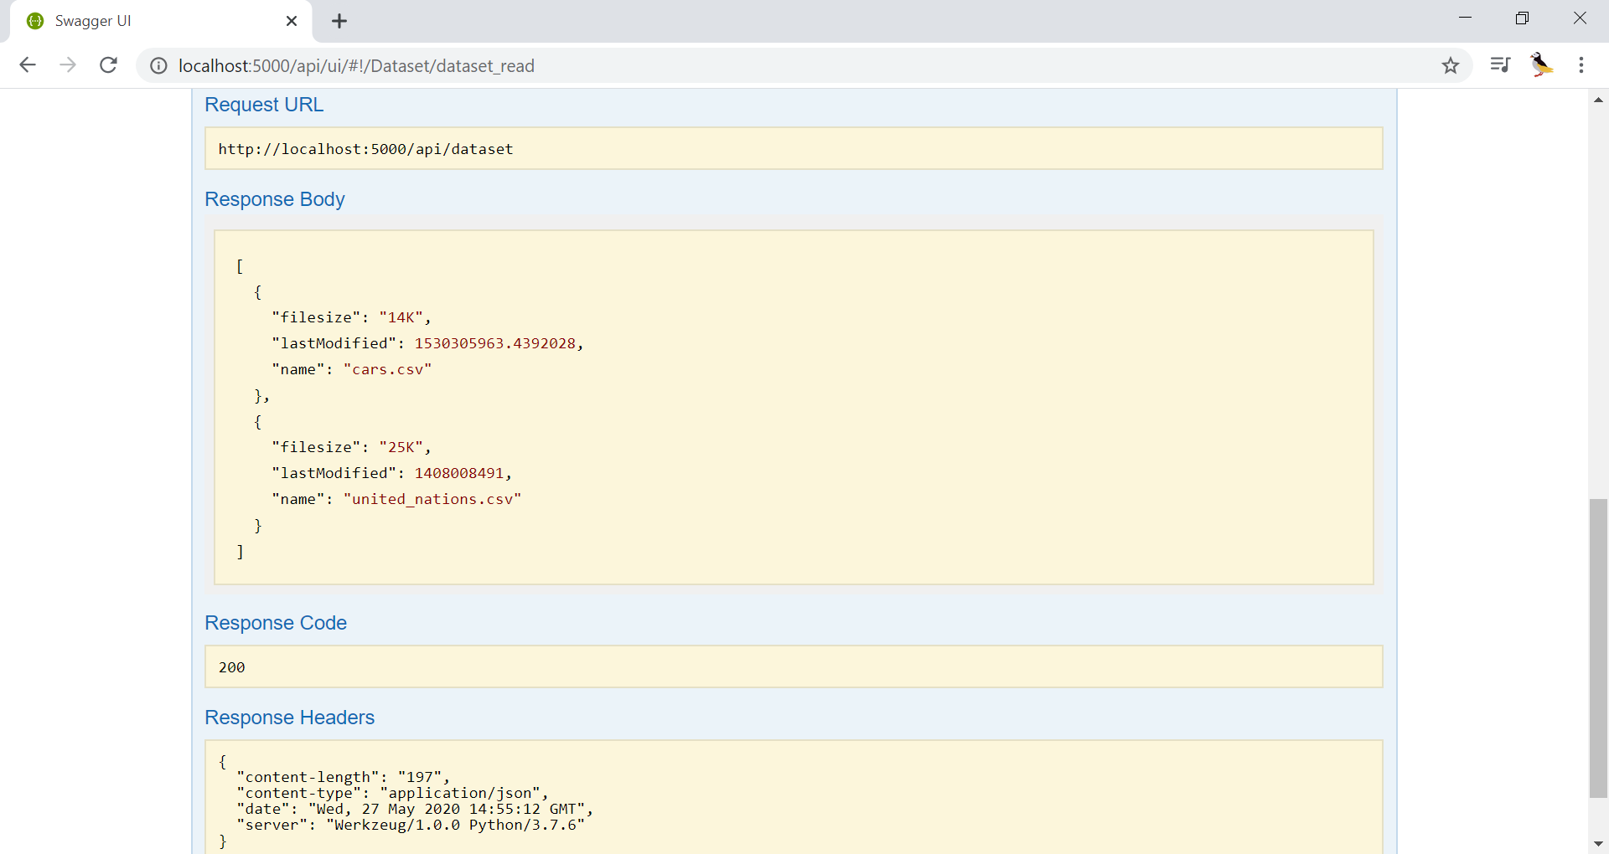

Slide 7
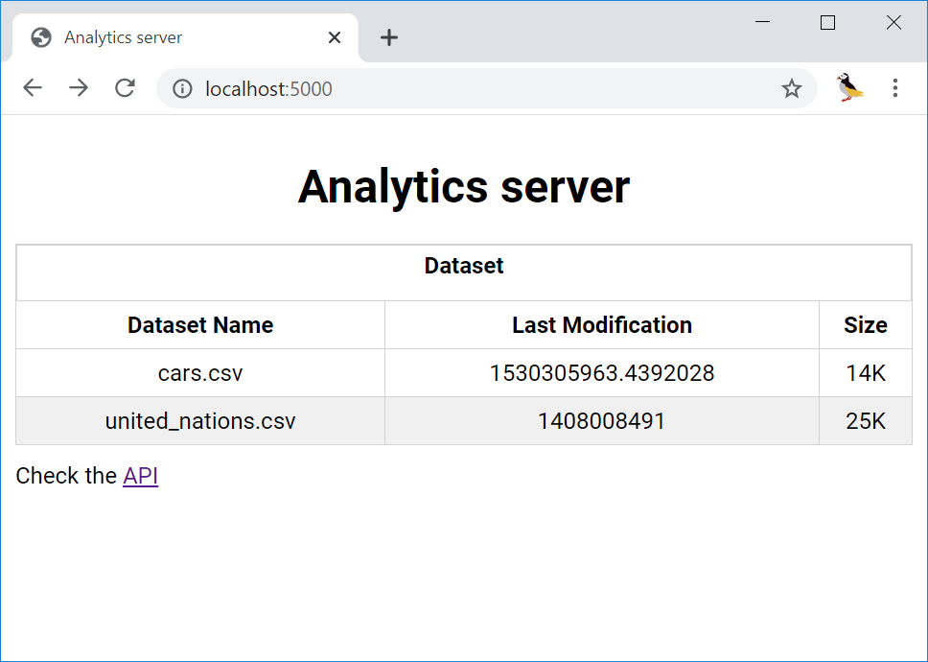

Slide 8











CloudDeploy
DB
API
App
Cloud Model management
Analytics
Workspace
Functions
autoload
Data
.sci
Memory
Zip
Disk
Local File management
.csv
.sce

Slide 9
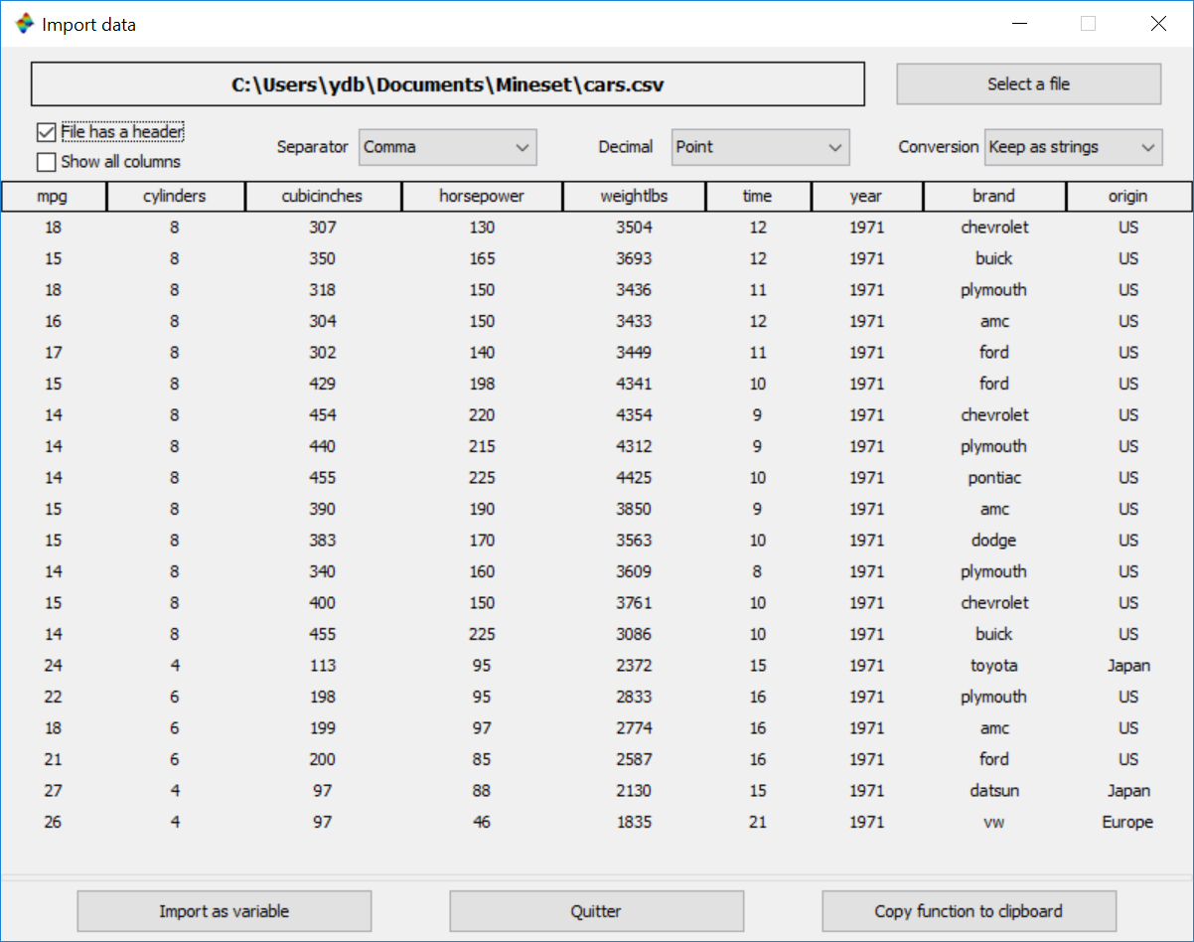


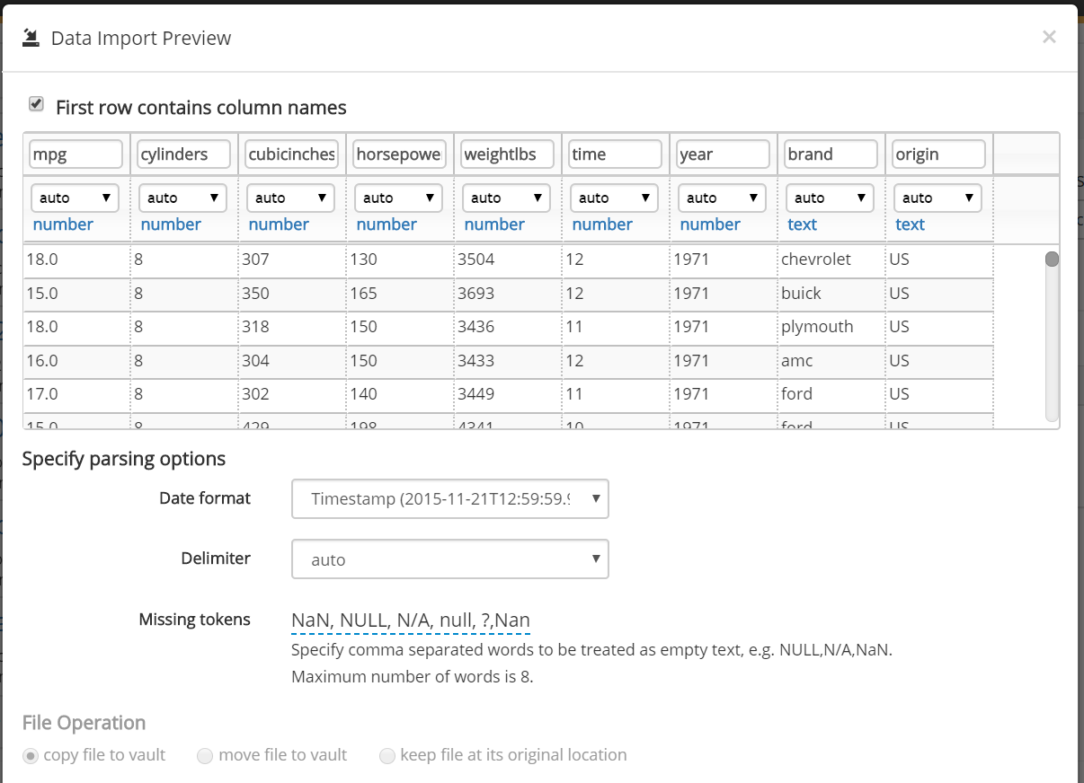

Desktop & Cloud data import
Scilab Cloud Analytics
Analytics

Slide 10
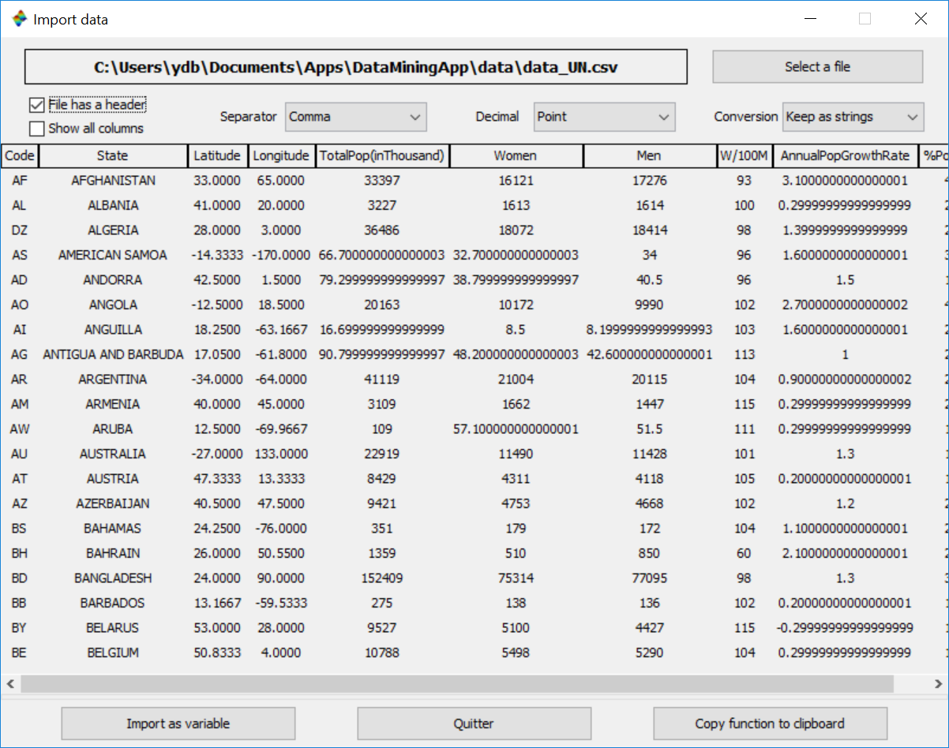
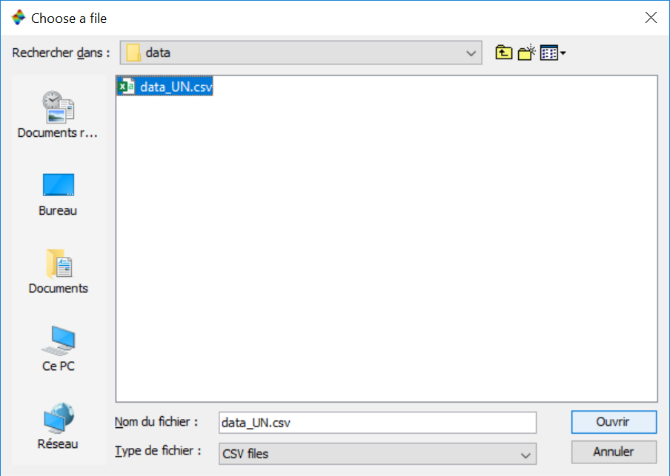
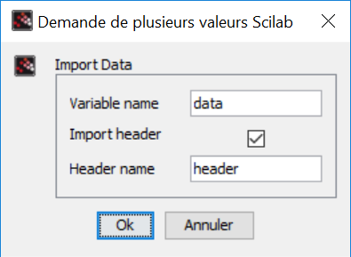
datadeploy
Import data

