Slide 1
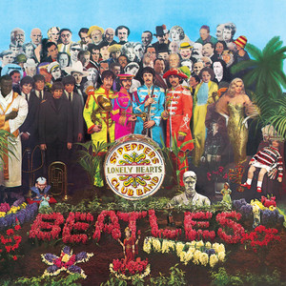
Music.py
Parse Streaming History
Create a dictionary
id
artist name
track name
Music Taste Analysis
Get music features
Plot features
Get recommendation

Slide 2
Music for loop
with open("saved_tracks_20210306.json","r") as f:
results = json.load(f)
tracks = []
for idx, item in enumerate(results['items']):
track = item['track']
tracks.append([idx, track['artists'][0]['name'], track['name']])

Slide 3
Music Dict
trackDict = {"id":[], "artist":[],"name":[]}
for idx, item in enumerate(results['items']):
track = item['track']
trackDict["id"].append(idx)
trackDict["artist"].append(track['artists'][0]['name'])
trackDict["name"].append(track['name'])

Slide 4
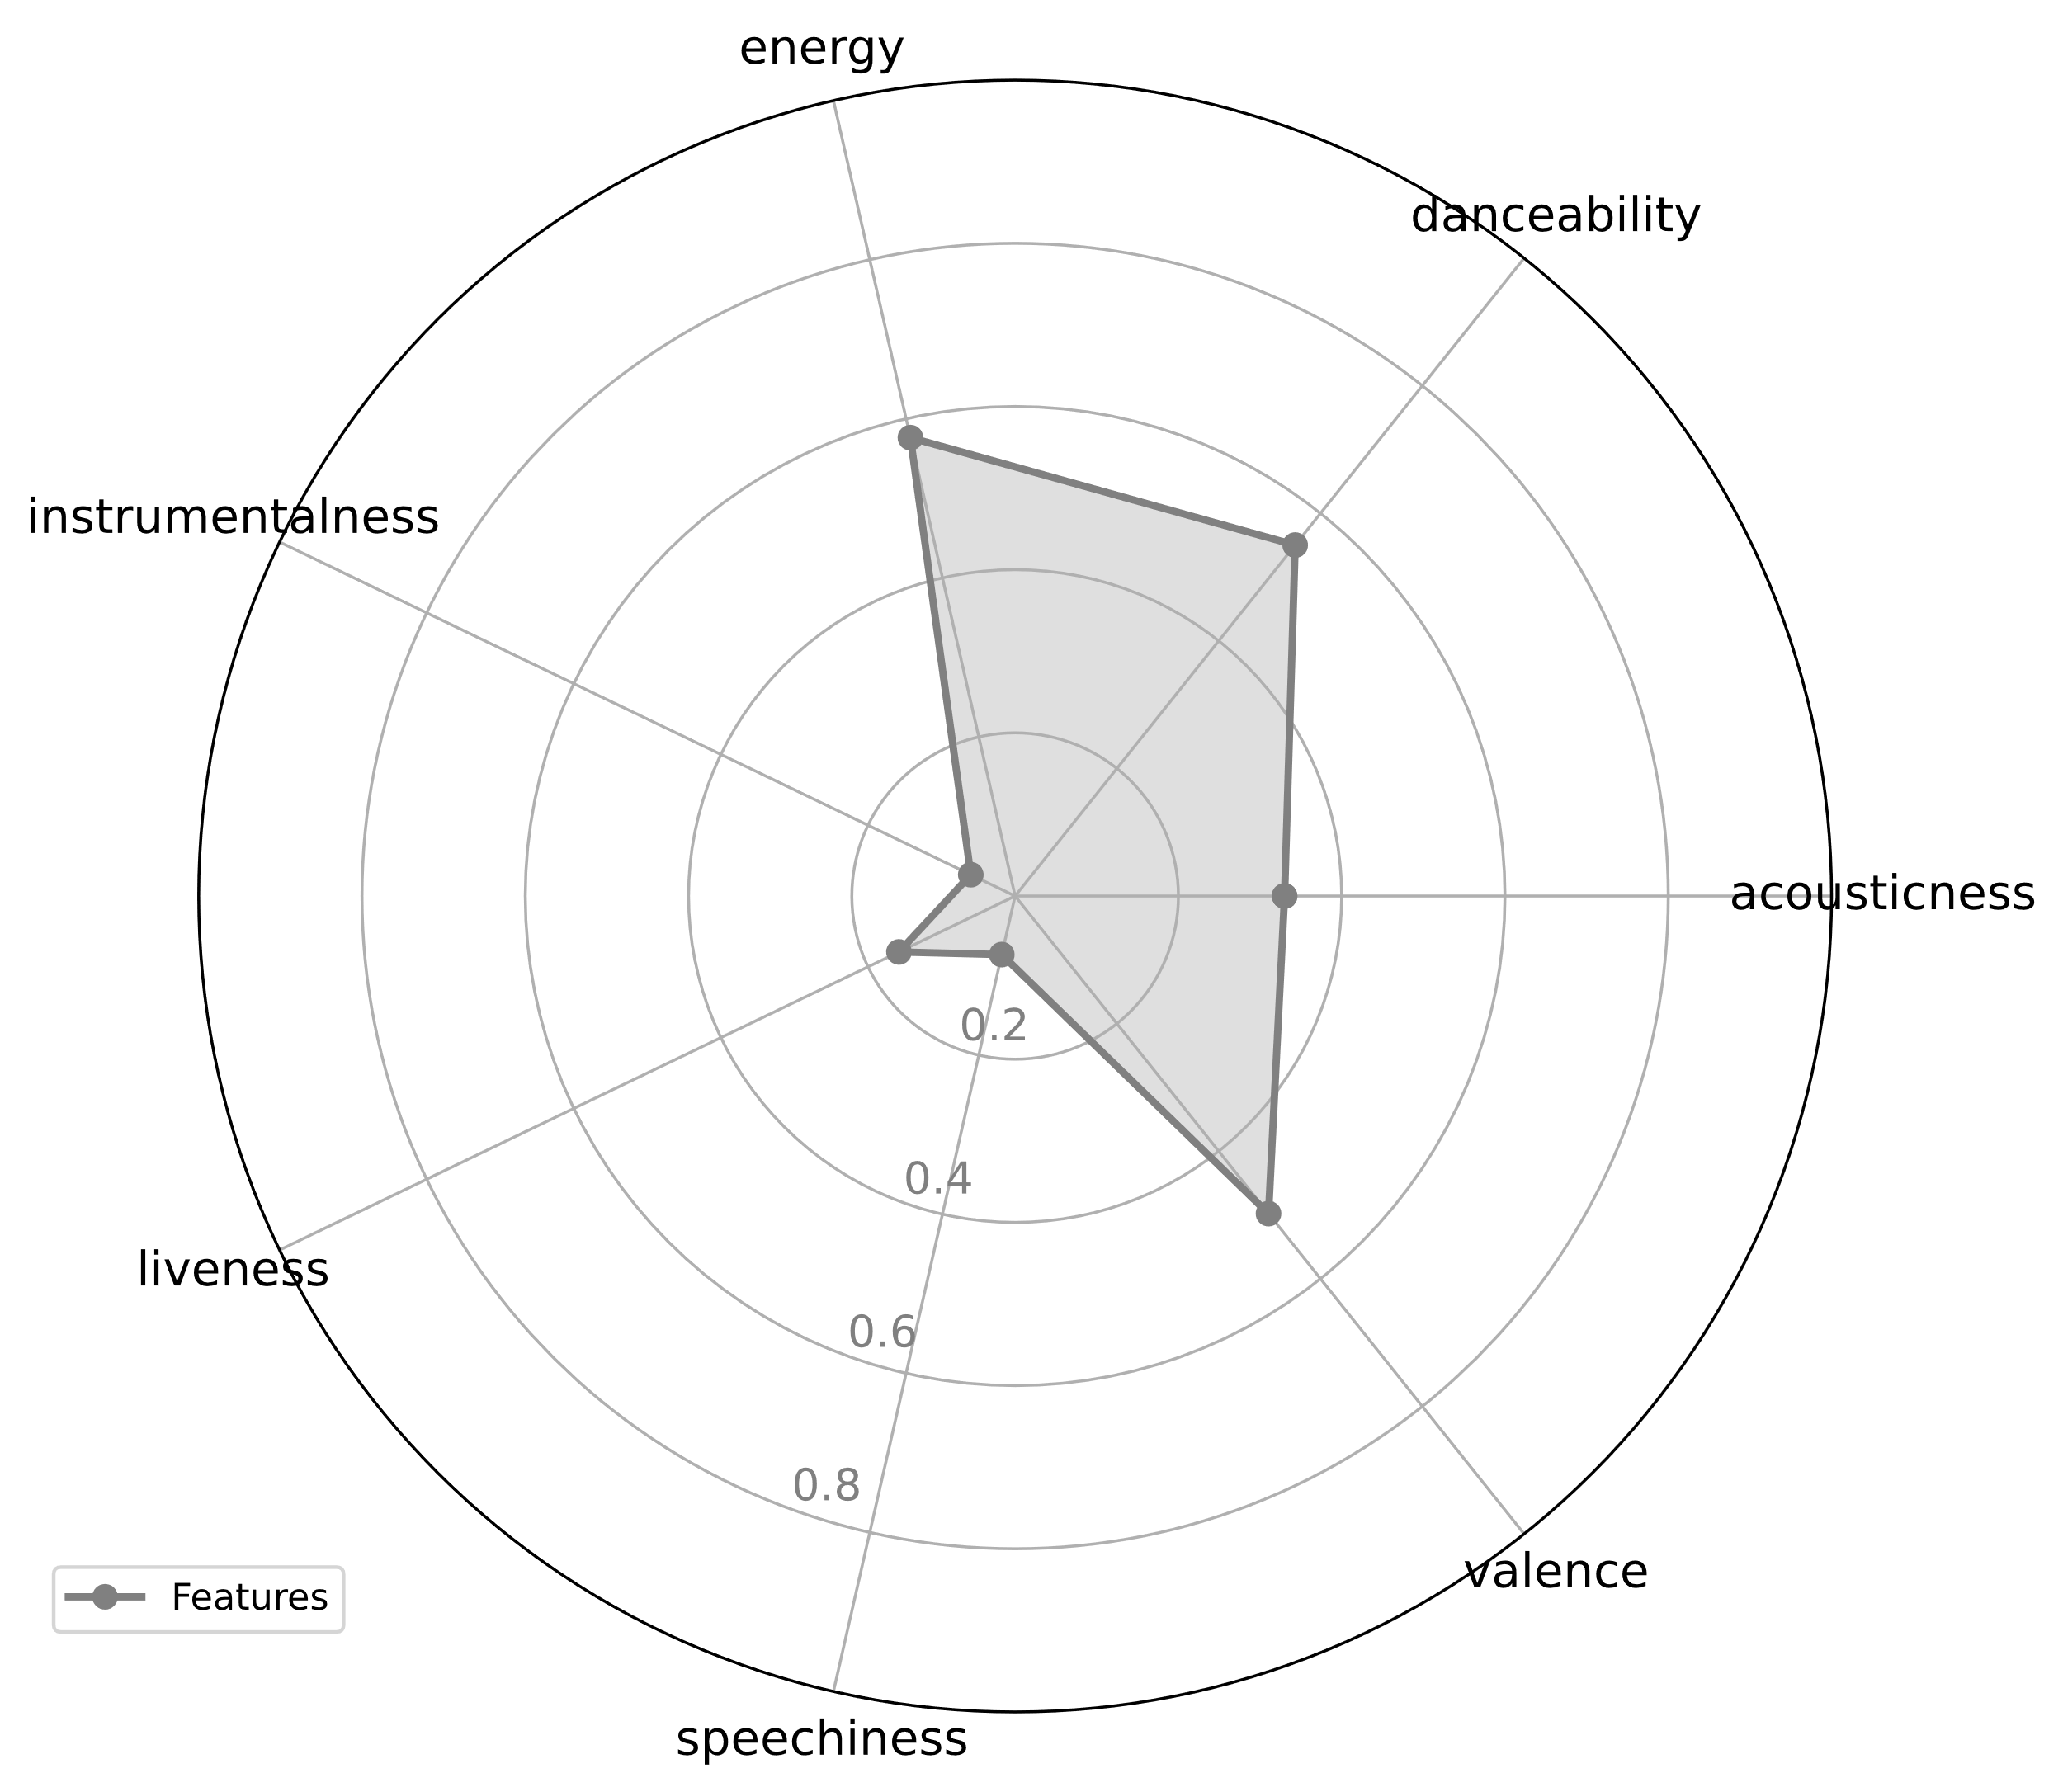
Music taste analysis

Slide 5
Music taste analysis
import spotifyAPI
from secret import clientId,clientSecret token = spotifyAPI.get_token(clientId,clientSecret)
lucy_id = spotifyAPI.get_track_id2('Lucy in the Sky', token, artist = 'The Beatles’)
url = "https://open.spotify.com/track/"+lucy_id
import webbrowser
webbrowser.open(url)

Slide 6
Music taste analysis
import pandas as pd
lucy_features = spotifyAPI.get_features(lucy_id,token)
df = pd.DataFrame(lucy_features, index=[0])
df_features = df.loc[: ,['acousticness', 'danceability', 'energy', 'instrumentalness', 'liveness', 'speechiness', 'valence’]]
spotifyAPI.feature_plot(df_features)

Slide 7
Music recommendation
json_response = spotifyAPI.get_track_reco(lucy_id,token)
uris =[]
for i in json_response['tracks']:
uris.append(i)
print(f"\"{i['name']}\" by {i['artists'][0]['name']}")

