Slide 1
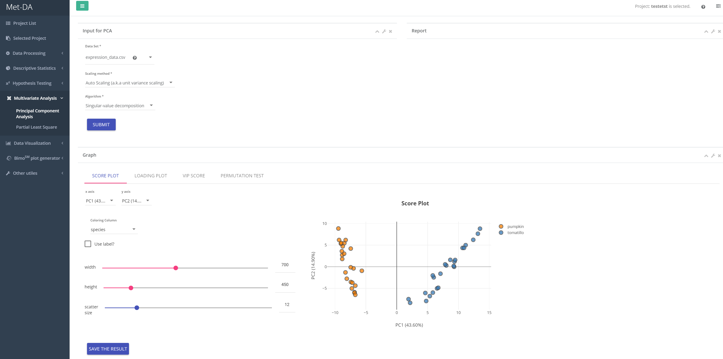
1
2
3

Slide 2
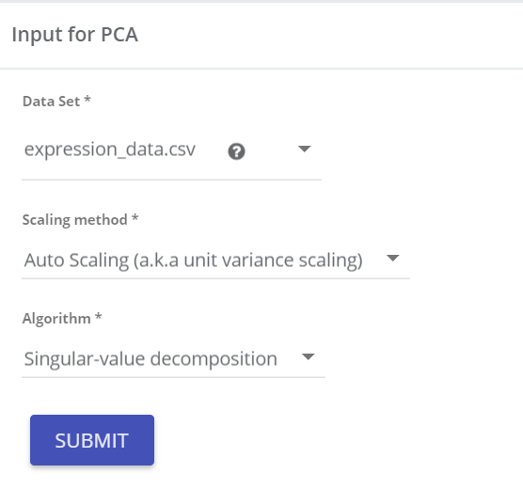
Input parameters
Data matrix for PCA
Scaling data is recommended
PCA algorithm. Usually, does not make difference for small size data (<10000 compounds)
1

Slide 3
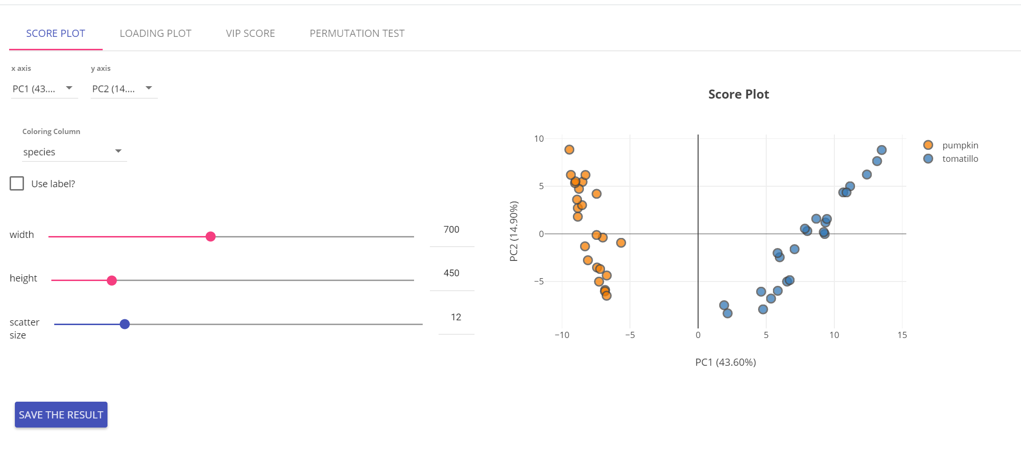
Score plot
Select which PCs to visualize
Color by
Check to add labels
Adjust plot size
2

Slide 4
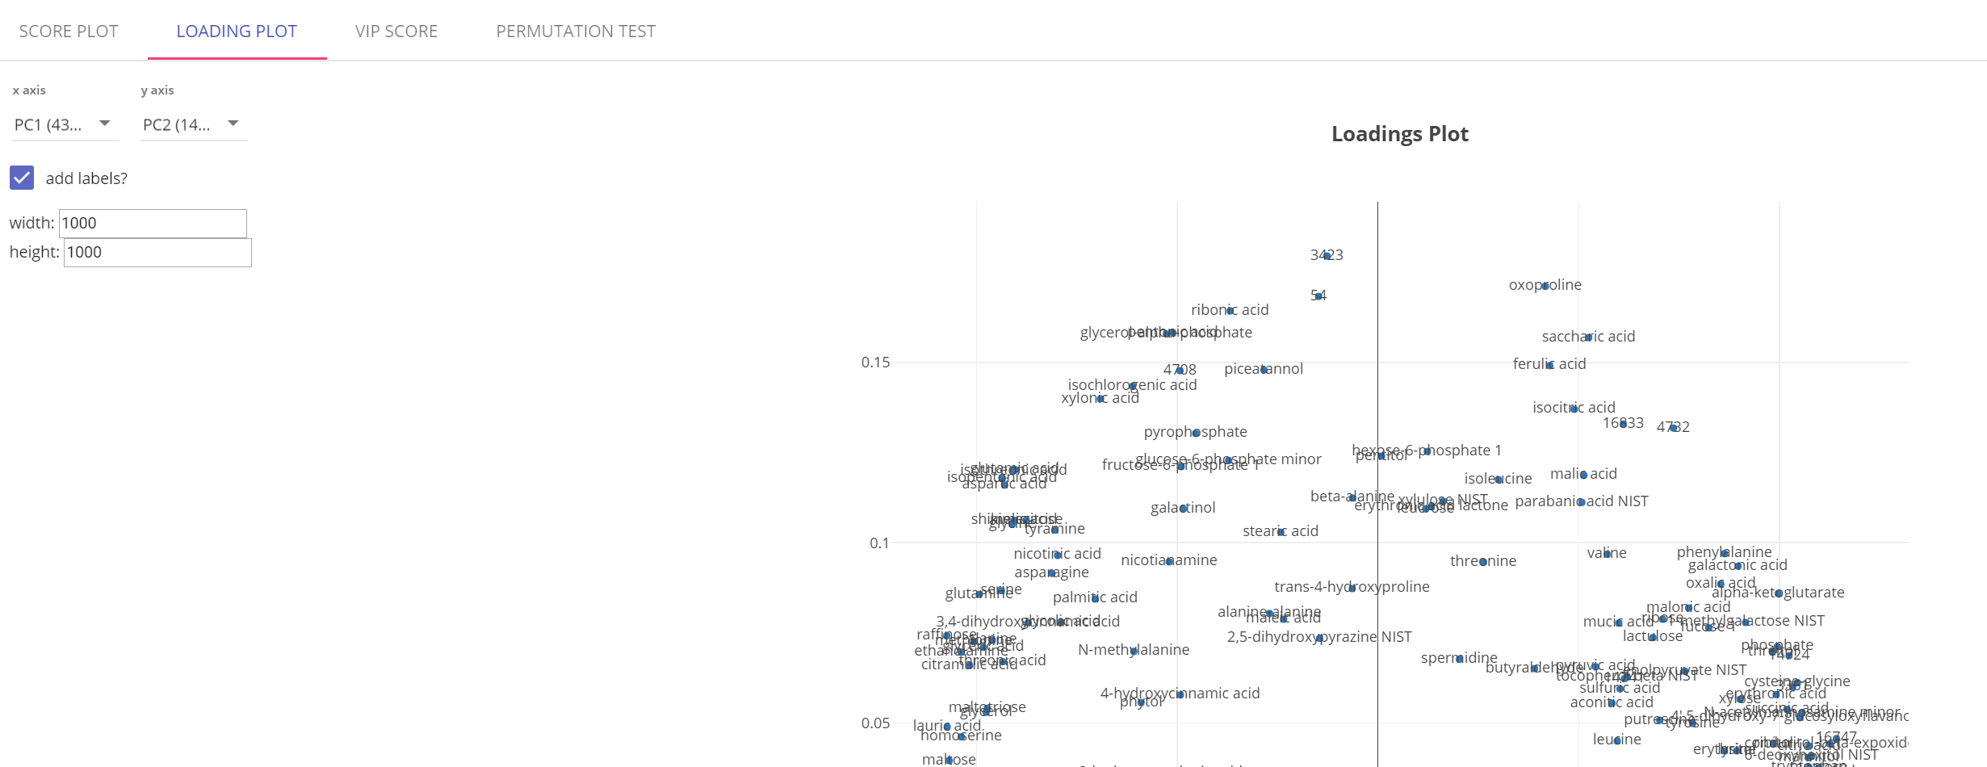
Loadings plot
Select which PCs to visualize
Check to add labels
Adjust plot size
3

