Slide 1
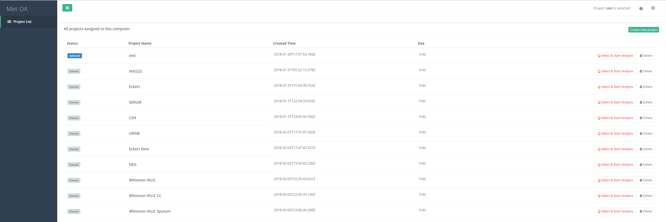
2
1
3

Slide 2
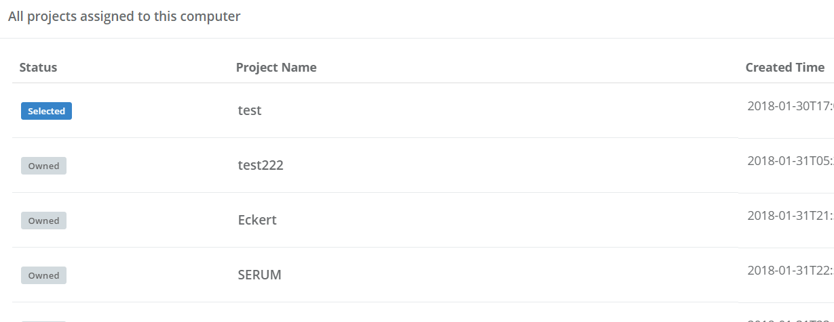
This page list all the projects associated with your computer.
Shutting down or Restarting your computer won’t lost your projects.
Selected is the activated project that is being used for statistical analysis. Only one project is activated each time.
Owned are your projects stored in our database. The uploaded data, statistical analysis results, graphs will be saved in our database. When you delete the project, we erase all the files associated with this project completely.
1

Slide 3
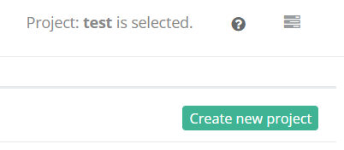
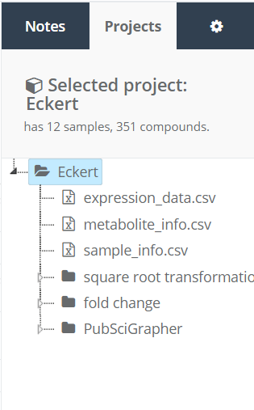

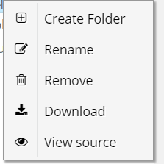
2
This reminds the user which project is being activated for statistical analysis.
Click the question mark to view the text tutorial of “current page”.
Click to view the structure of this project in our database.
The data matrix
The metabolite information
The sample information
Finished statistical analysis
Right click the file/folder to show this menu
You can download statistical analysis result by clicking the download.
Click to create new project

Slide 4
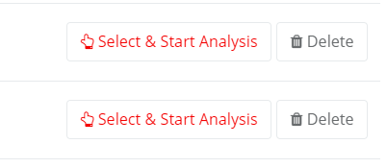
Click to delete the project. A confirmation dialog will pop up. Once confirmed, all the files and graphs in this project will be erased completely and cannot be retrieved.
Click to select and activate a project. Once you click, you will be redirected to the project detail page.
3

