Slide 1
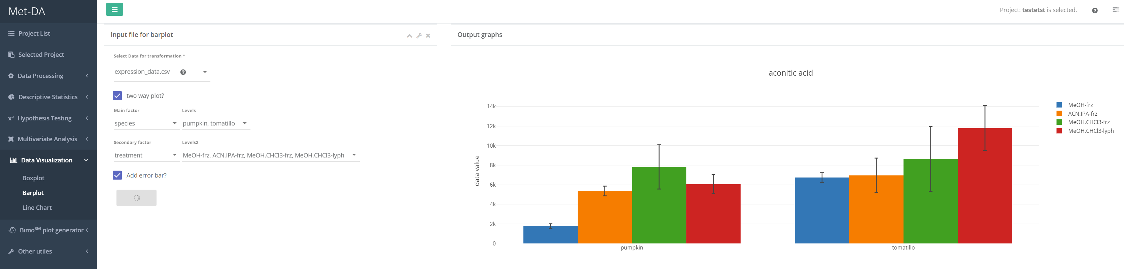
1
2

Slide 2
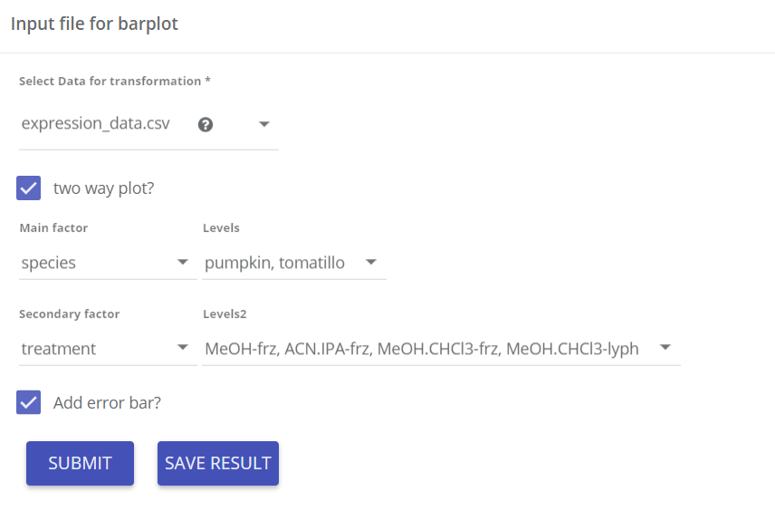
Input parameters
Data matrix for bar plot
One or two factor – bar plot
Factors to visualize using bar plot
Click to add s.e.m (standard error of mean) error bar
1

Slide 3
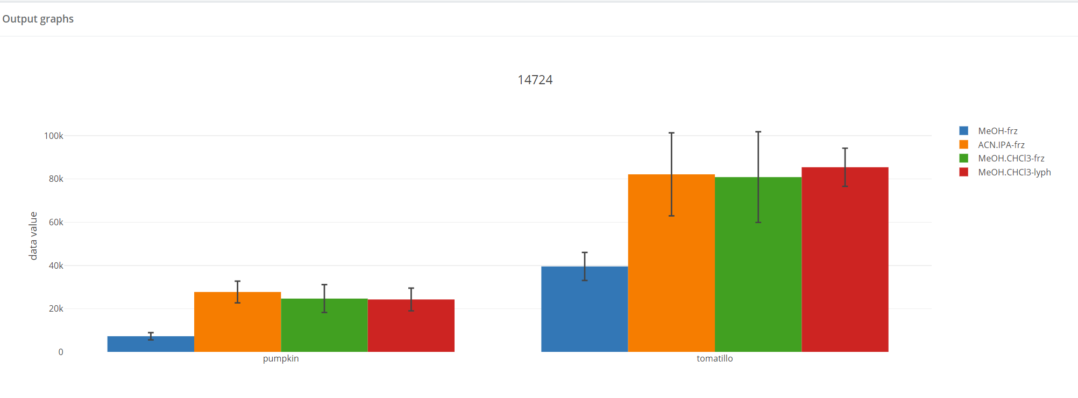

bar plot
Bar plots for each compound are generated. Click save result to put them in the database. You can always download the result form the “project structure”. A publish-ready bar plot styles will be ready by June 2018.
2

