Slide 1
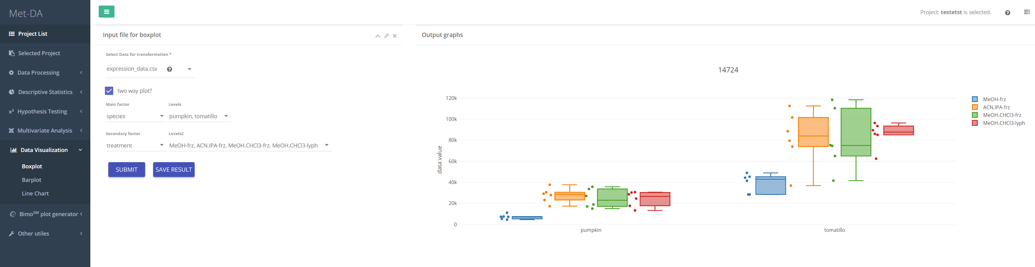
1
2

Slide 2
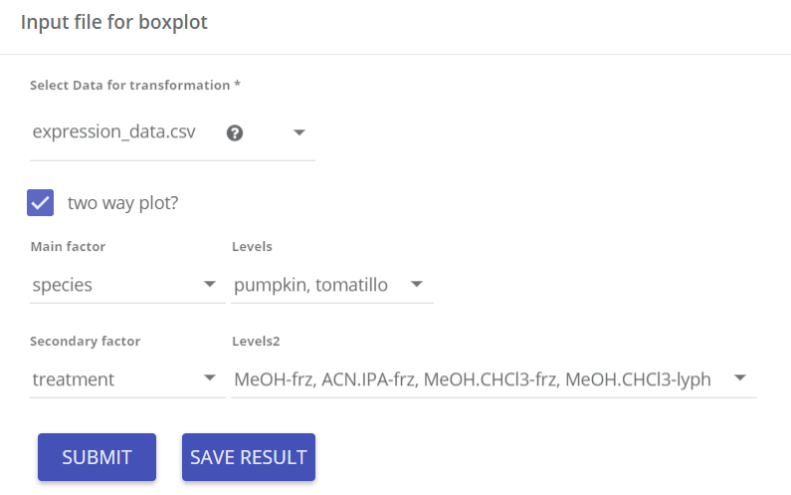
Input parameters
Data matrix for boxplot
One or two factor - boxplot
Factors to visualize using boxplot
1

Slide 3
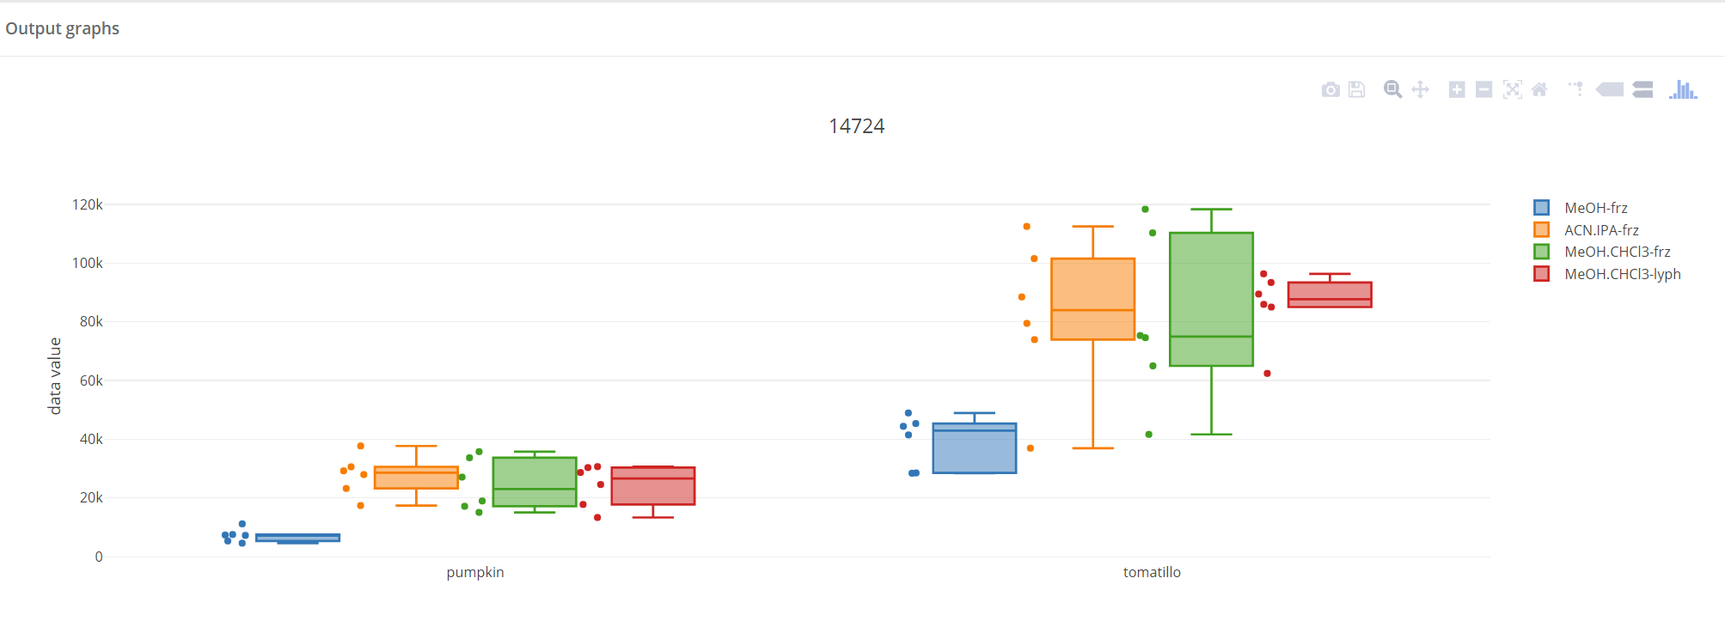

Boxplot
Boxplots for each compound are generated. Click save result to put them in the database. You can always download the result form the “project structure”. A publish-ready boxplot styles will be ready by June 2018.
2

