Slide 1
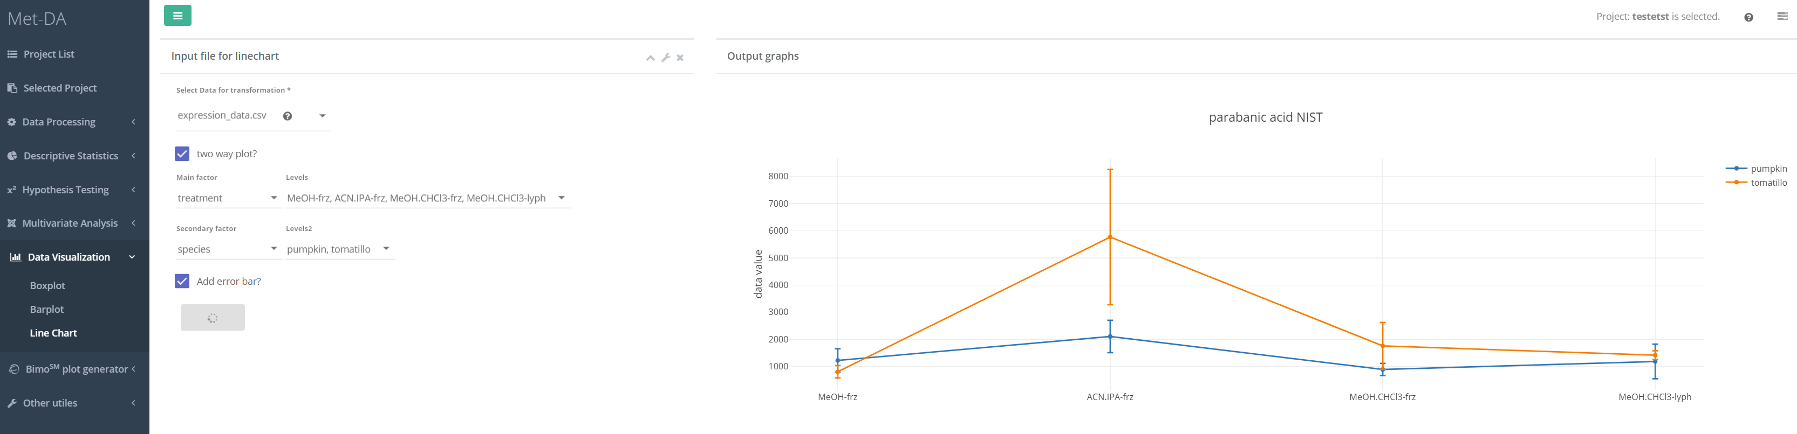
1
2

Slide 2
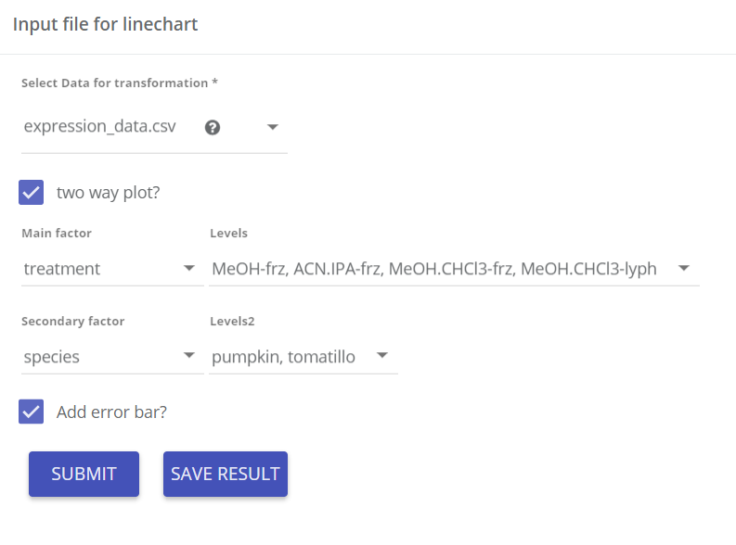
Input parameters
Data matrix for line chart
One or two factor – bar plot
Factors to visualize using line chart
Click to add s.e.m (standard error of mean) error bar
1

Slide 3
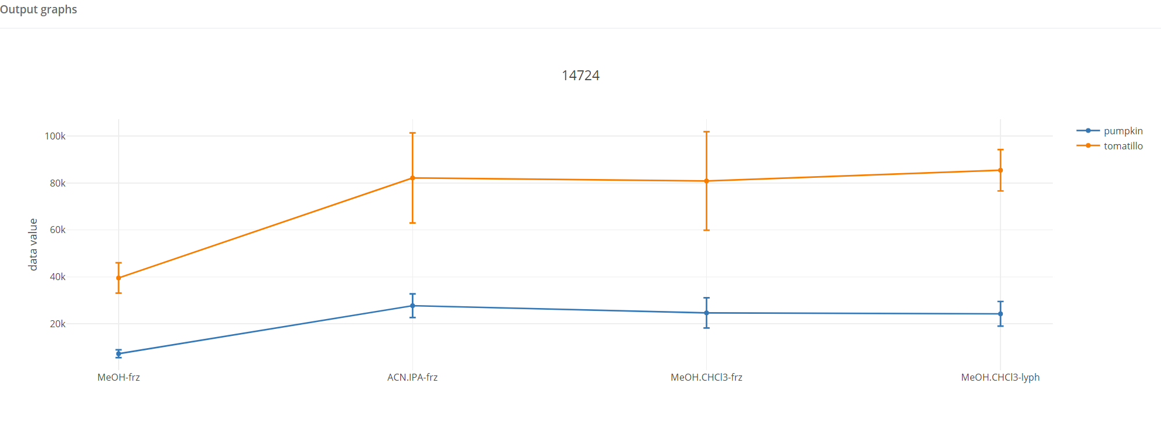

Line charts
Line charts for each compound are generated. Click save result to put them in the database. You can always download the result form the “project structure”. A publish-ready line chart styles will be ready by June 2018.
2

