Slide 1
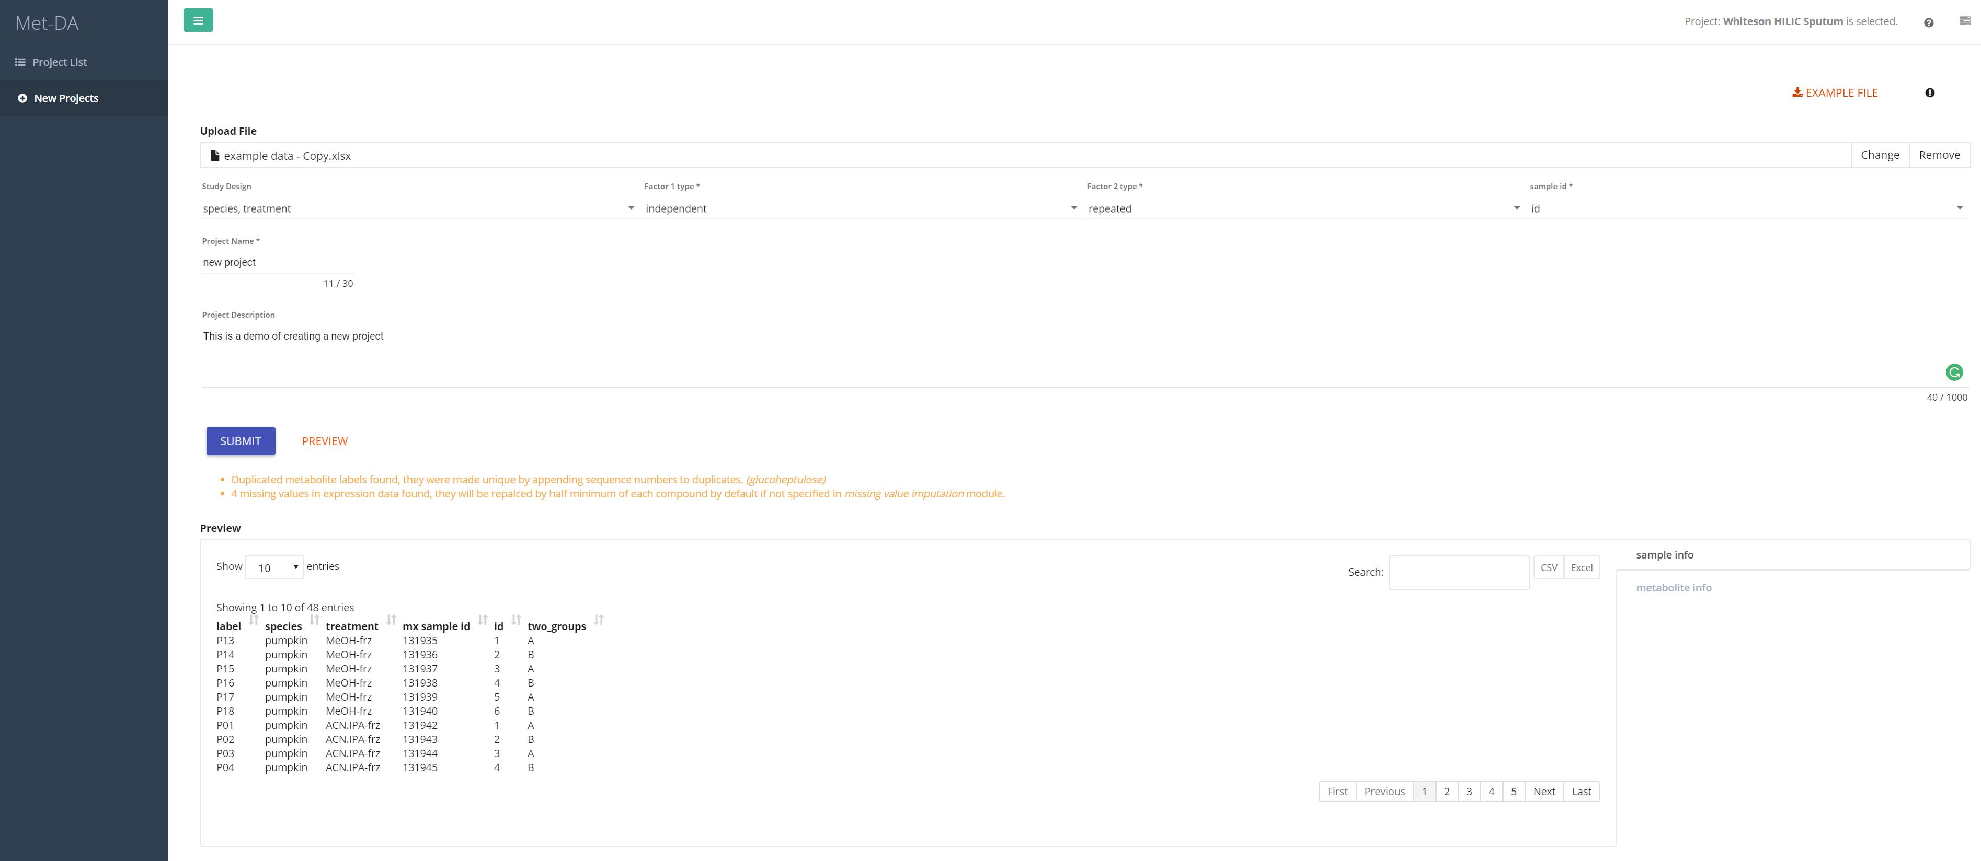
1
2

Slide 2
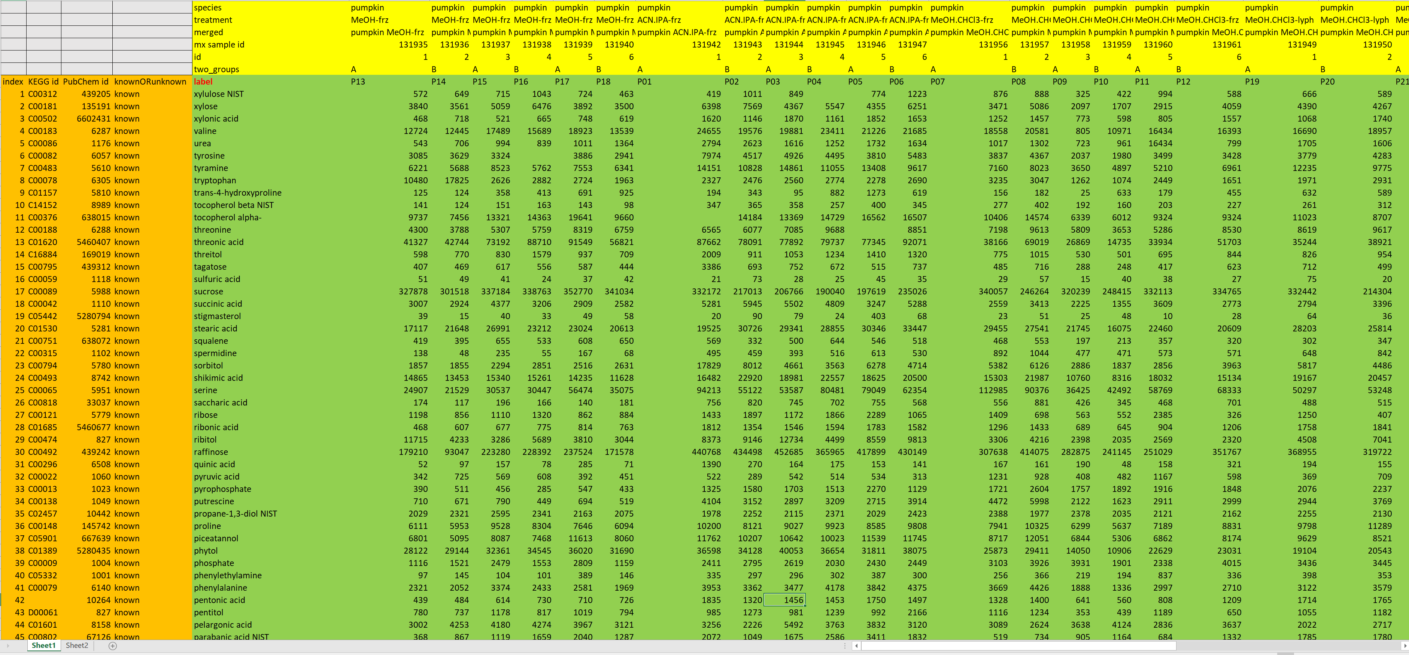
Click to download example data file
Click to upload file.
Data Format requirement is as following:
Data must be in the first sheet of a .xlsx file
Orange is the metabolite information. Yellow is the sample information. Green is the data matrix. Grey must be empty.
label must be included.
You must put at least one column/row in the metabolite information/sample information. Usually, in the sample information, you need to have your study design, e.g. treatment and/or sample id if you study design is paired.
1

Slide 3
Study Design:
You can select one or two factor from sample information as study design. The factors must be categorical, e.g. control vs treatment.
Factor ½ type:
This tells the type (either independent or repeated) for corresponding factor. In this case, the species is independent and treatment is repeated measured.
sample id:
This tells which columns are measured from the same sample. Only shows when the study design involves a repeated factor. Example is given in the example data file “id” column.
2

Slide 4
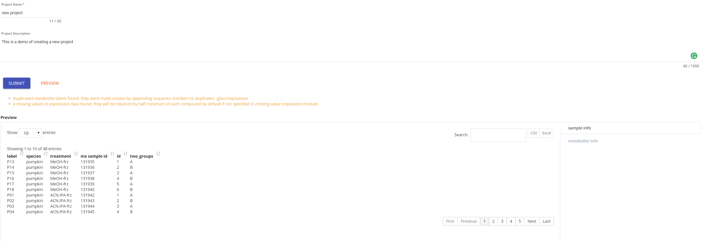
3
Project Name:
Project name has to be unique. Please avoid strange character, e.g. &%$ in the project name.
Project Description:
A few words to describe your project. Will be used in the “REPORT GENERATOR”. Not required.
warning message:
Warning message will appear if MetDA detect any strange things, e.g. missing value, duplicated metabolite names, etc. Warning message does not influent creating new project.
PREVIEW:
You could click PREVIEW to preview the data read in MetDA to validate that the file is correctly read.
If you have question about uploading your file, please feel free to contact us at slfan@ucdavis.edu.

