Slide 1
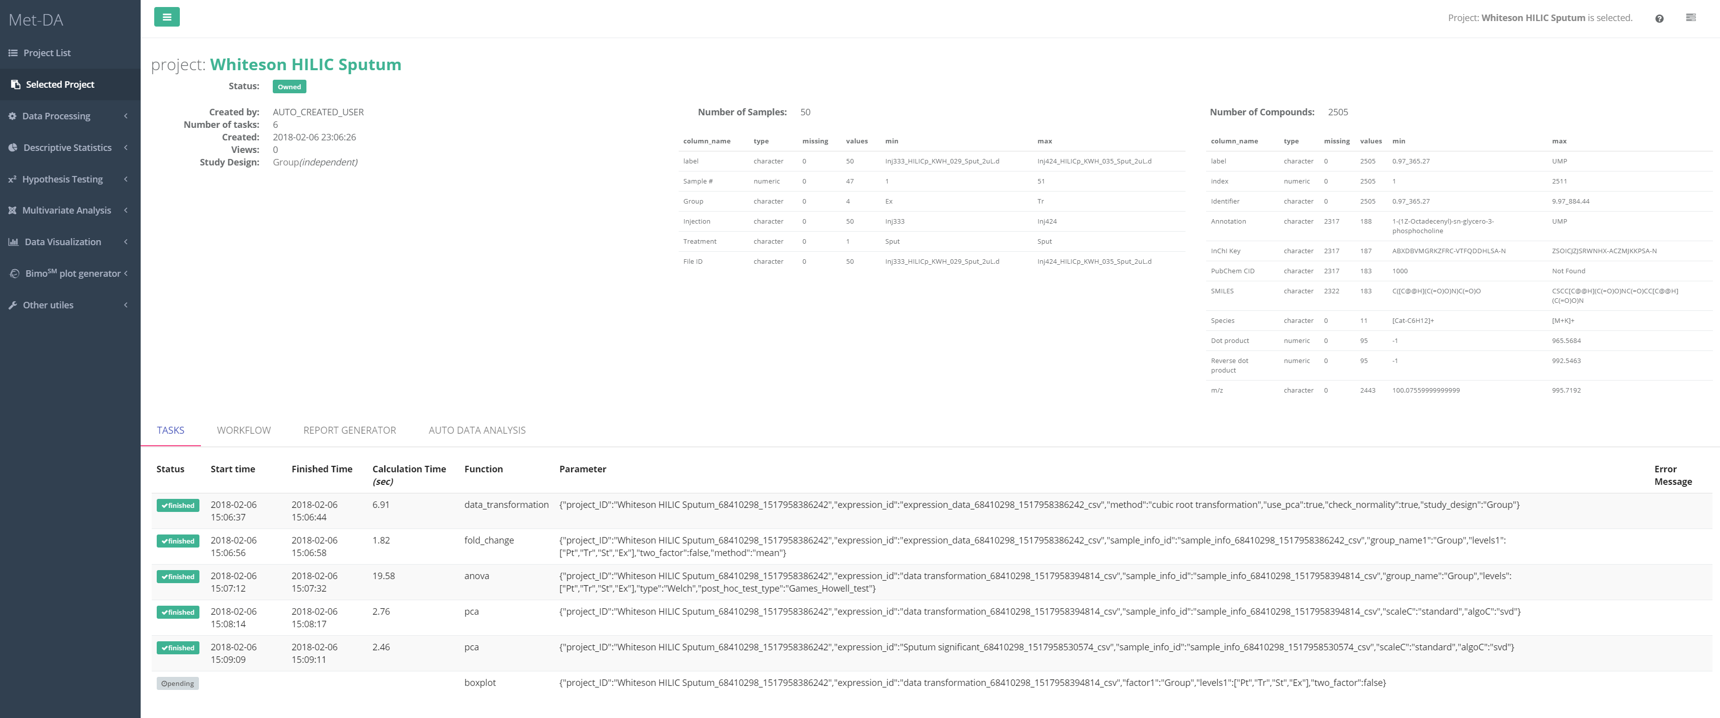
2
1
3

Slide 2
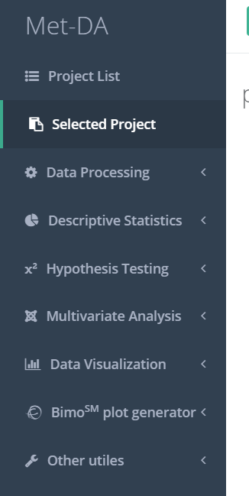
Go back to project list to change activated project
Statistical tool box for the activated project
1
We are still adding new tools to the MetDA. If you would like to request any analysis, please feel free to contact us at slfan@ucdavis.edu. We appreciate your suggestions.

Slide 3
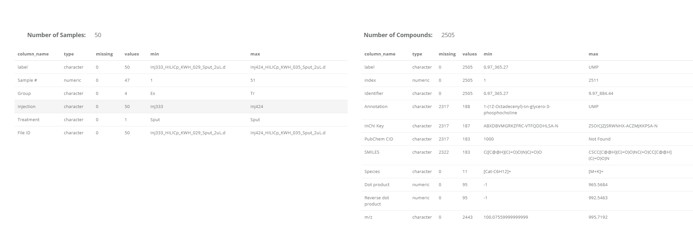
Here shows the sample information and metabolite information extracted from your uploaded data file.
2

Slide 4
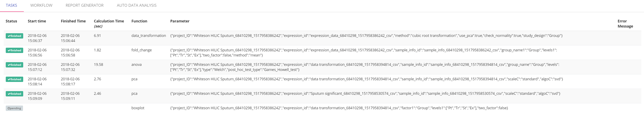
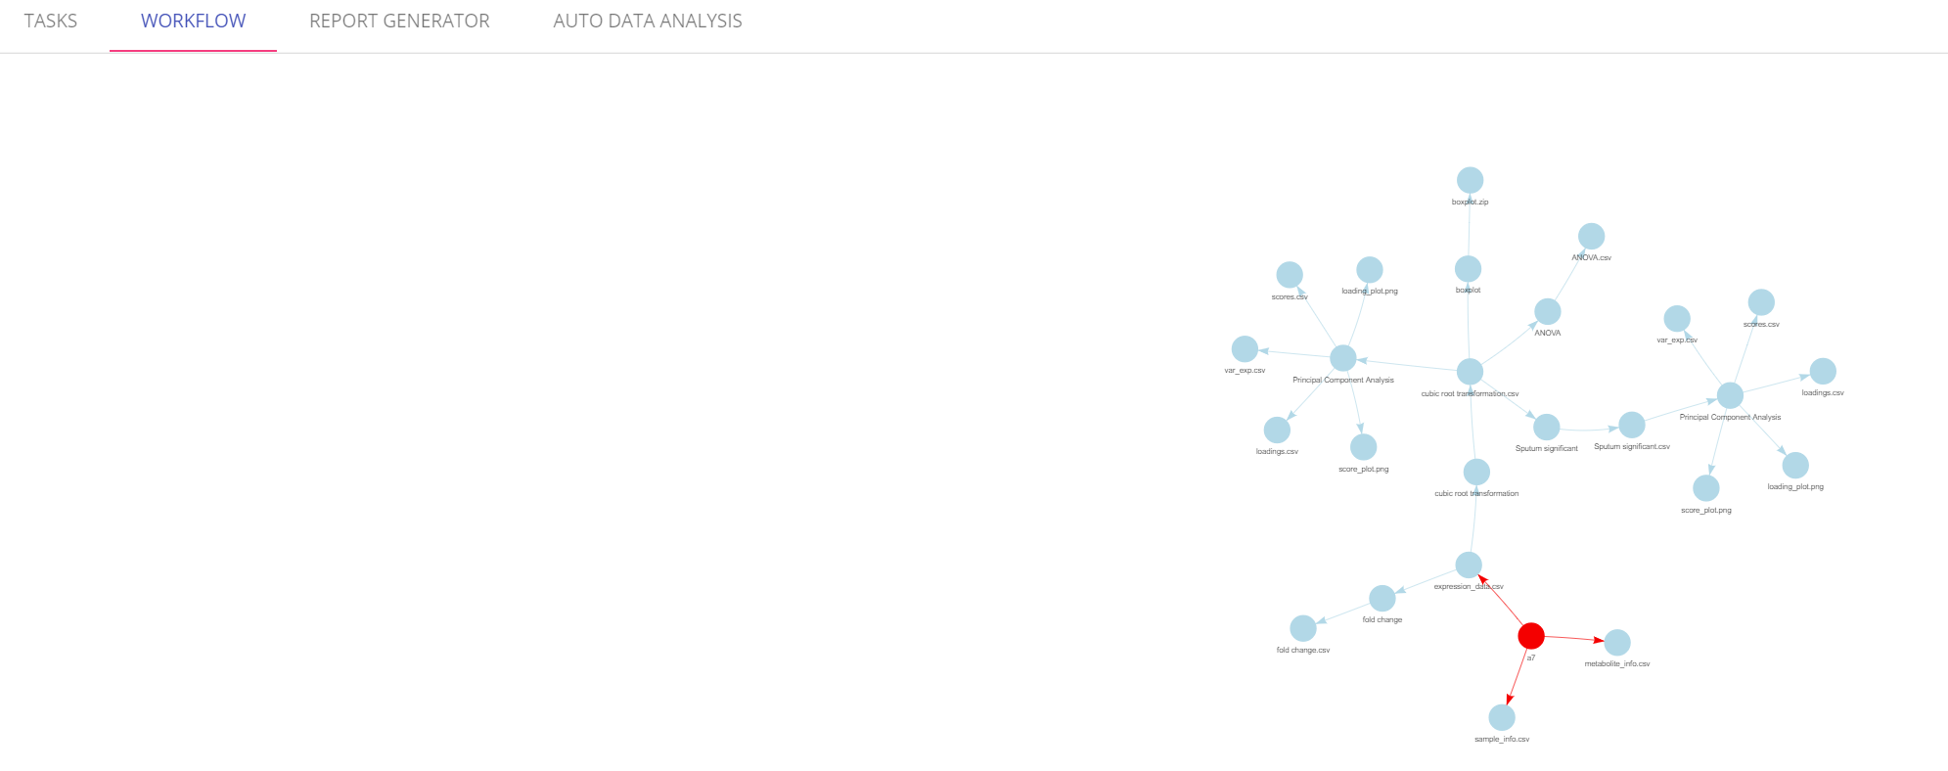
TASKS: This tab shows all the tasks you’ve done on your project. You can see the calculation time of each task and function/parameter you’ve used for each analysis. This helps to track what you’ve done on your project.
WORKFLOW: This helps to track what you’ve done on your project.
REPORT GENERATOR: This will collect all the analysis you’ve done on your project and automatically generate report with text and graphs. UNDER DEVELOPMENT. COMING THIS YEAR.
3
AUTO DATA ANALYSIS: This is designed for a quick analysis at your data. The best analysis pipeline will be automatically selected according to your study design. UNDER DEVELOPMENT. COMING THIS YEAR.

