Slide 1
Energy Transport
& optimization of the solver
Shulin Gao
Teng Wang
Andrea Tagliabue
20th July 2012

Slide 2
Outline
Motivation
Theory
Test case
Implementation
Cases simulation
Optimization
Outlook

Slide 3

Talk about the practical issues..
From the view of economization-of-energy and economization-of-money, we want to find the optimal position for one air conditioning..

Slide 4

Where we have to start?
Heat equation
  Constant thermal diffusivity
  Negligible viscous dissipation
  Heat source q‘‘‘
and now boissinesque approximation….

Slide 5
How to operate in one example
Variable | Value
Coefficient of thermal expansion | ß=2,07e-4[1/K]
Temperature of the water at the beginning:To | To =29 ° C
Temperature of the air at the top | T_C=28 ° C
Temperature of the heat system | T_H=31°C
Minimal temperature at which we have to turn on the heat system | T_on=27°C
Time steps for which the heat system will work | t_work=400

Slide 6
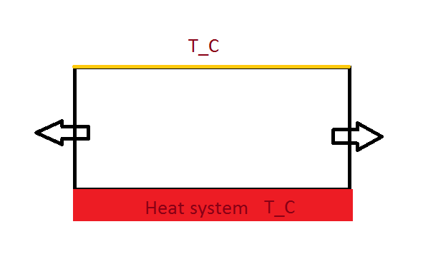
The system

Slide 7

Boundary conditions
Up:T=T_C
Left and right: we calculate
Below we put two different conditions:
  When the system is on: T=T_H
  When the system is off:T[i][0]=T[i][1](adiabatic)

Slide 8




Dimensionless parameters
Buckingham theorem dimensional analysis
  Standard gravity:
  Length x,y:
  Temperature:
  Coefficient thermal expansion:

Slide 9
Why do we have to adimensionalise
To analyze a model is cheaper than to always analyze the main system
To reduce the number of the number of the dimension present in our system
  Es: 3 lengths[m,s,Kg,] ,5 variables[L,h,v,vo,F]
the system can be written with 2 dimensionless variables

Slide 10
New dimensionless values
Variable | Value
Temperature of the at the beginning | To ‘=0.7
Temperature of the air in the top | T_C‘=0.33
Temperature of the heat system: | T_H‘=1.33
Minimal temperature for that we have to turn on the heat system | T_on‘=0
Coefficient of thermal expansion | ß=2,07e-4

Slide 11
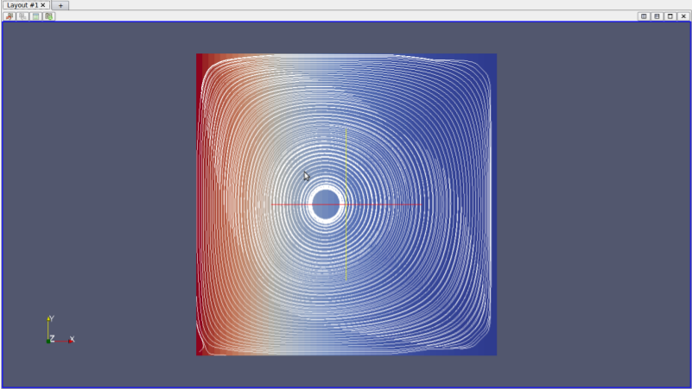
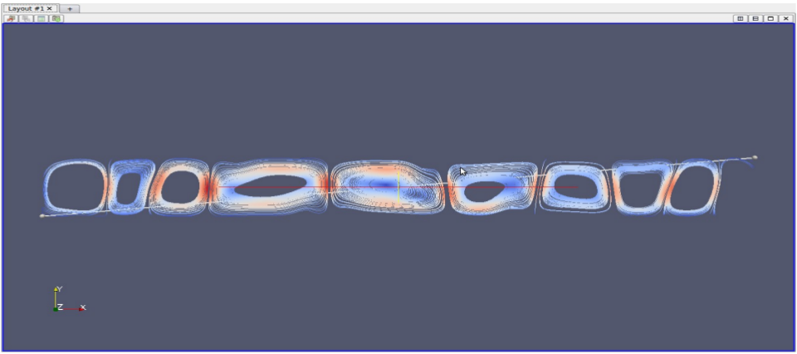
The first step to our success-- Test case
Does the source code work ?
What is the supposed scene?
The reference for final simulations

Slide 12
implementation
Temperature in stagger grid
Flag modification (temperature)
Boundary
Air conditioning simulation
Inner heat resource simulation

Slide 13
Flag modification
Two ways:
Binary as before, but add another digit for temperature
For first two cells
00: fluid(white), 01: obstacle(colour or grey),
11:inner heat resource(black)
Ternary, we get 3 numbers in the center cell,
0 : fluid
1 : obstacle without temperature
2 : obstacle with temperature or inner heat resource
Temp. | center | east | west | south | north

Slide 14
Boundary conditions
Set all the domain boundary adiabatic,then modify in spec_boundary_value() for specific cases
Dirichlet boundary condition:
T=Tp
for the wall the temperature is prescribed
Neumann boundary condition:
T0 =T1
It can describe how much heat passed, but in our case we set no heat is exchanged --adiabatic

Slide 15
Simulating air conditioning
Find the small rectangular fluid cells for “air conditioning”
i.e. i=0~2,j=jmax-10~jmax,that will be the lefttop
Initialize these cells with specific velocity and fixed temperature(in our case in one direction);
In every iteration, set these cells with fixed temperature

Slide 16
Inner heat resource
When drawing the pgm file,set all the colors except black and white as obstacles with temp.
Implemented in Flag modification part, modifiy the function read_pgm().

Slide 17
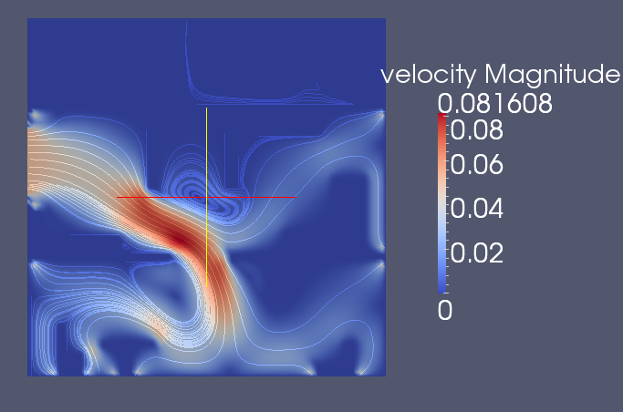

Cases simulation
Scenario 1: air simulation in a two-floor house
Case1: window closed, left wall and left roof heated by sunshine, gravity Gy.
Case 2: window open, a wind with only x-direction velocity, left wall and left roof heated by sunshine, gravity Gy.

Slide 18
Case simulation
Scenario 2: main view of the 2nd floor, gravity Gy,discuss the optimal position of 4 choices.

Slide 19
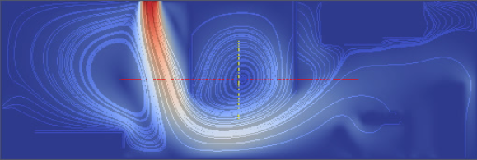
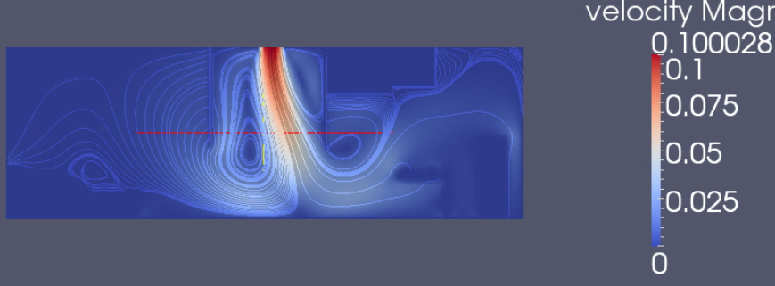
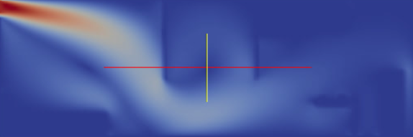
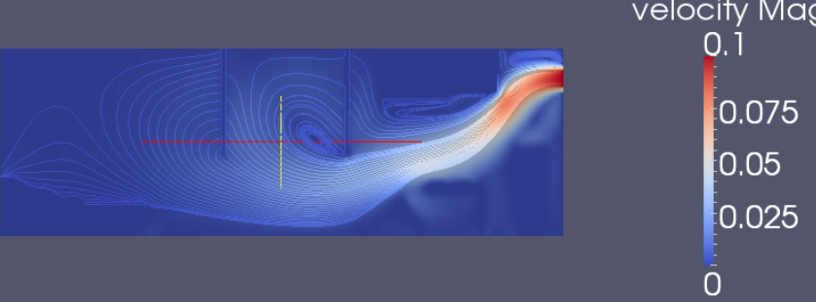
velocities of 4 cases
Lefttop of the bedroom
top of the corridor
top of the bedroom
righttop of the kitchen

Slide 20
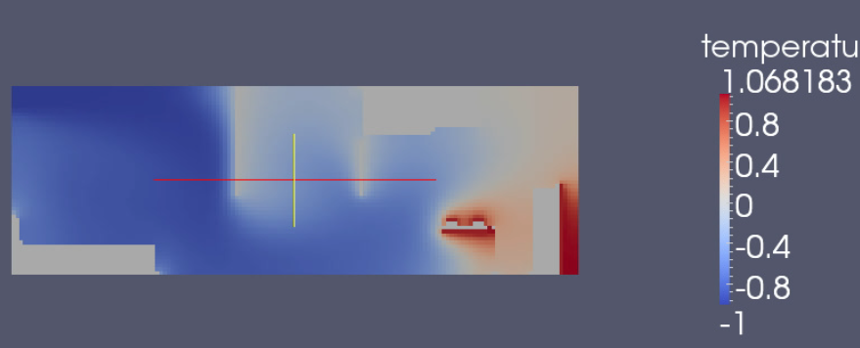
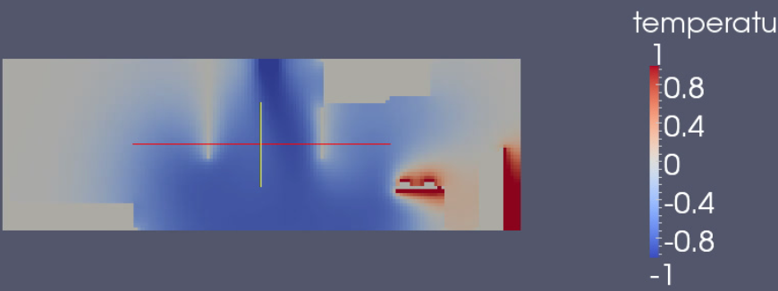
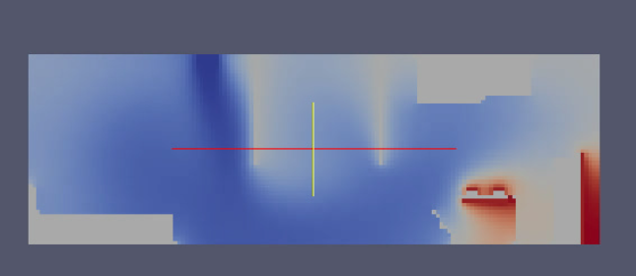

Temperatures of 4 cases

Slide 21

Case simulation
Scenario 3: top view of the 1st floor

Slide 22
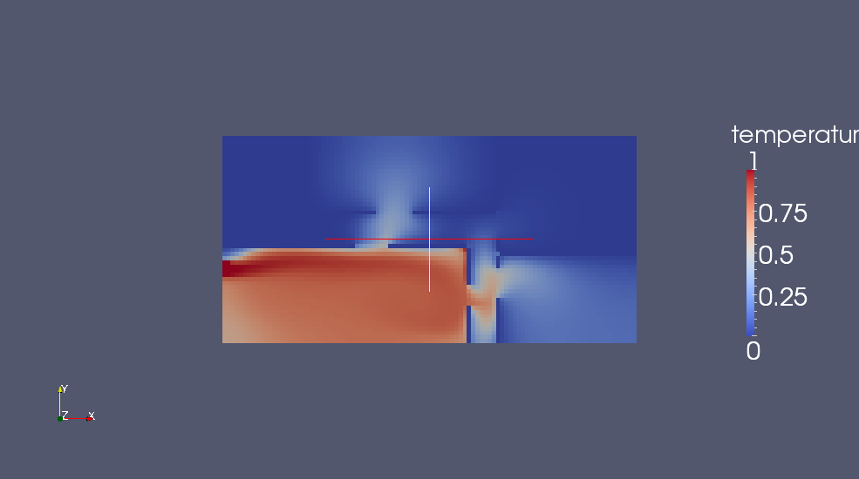
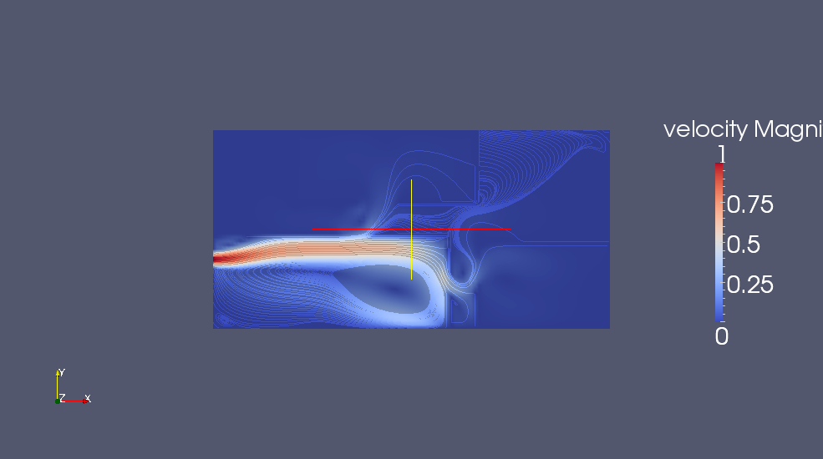
Temperatures and velocities

Slide 23
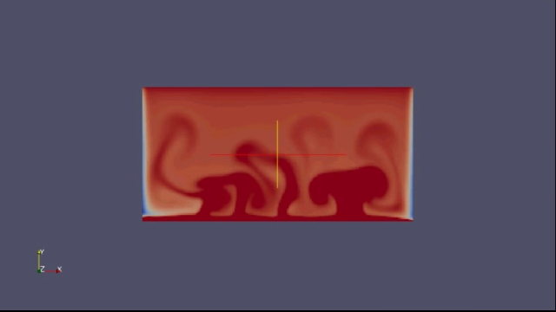
Acquarius(water)
Scenario 4 :
Temperature critical point
Automatically temperature control

Slide 24
Optimization
SOR Solver optimized by multigrid.
1. smooth by GS. Because sor and Jacobi lead to divergence
2. restrict residual Set dirichlet boundary condition after restriction in every iteration.
3. solve coarse grid system
4. interpolation
5. correct fine grid solution

Slide 25
Multigrid & SOR
T_end | T_sor (s) | T_mg (s)
1.0 | 27.52 | 0.41
2.0 | 55.12 | 0.83
4.0 | 106.99 | 1.67
8.0 | 214.44 | 3.25

Slide 26
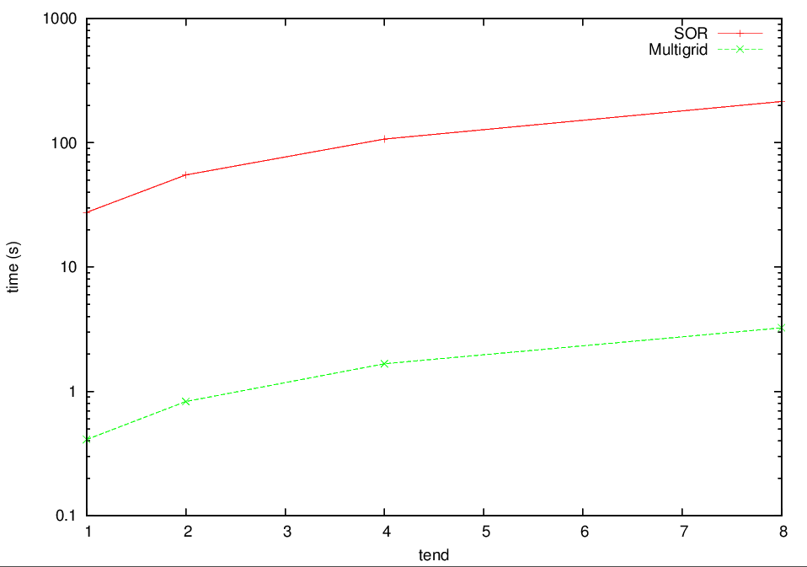

Multigrid & SOR
Speedup = 65.16!!
SOR
Multigrid

Slide 27
Outlook
SO FAR..
Realize arbitrary geometries with inner heat resources
Different kind of temperature and velocity boundaries
Finish the optimization of multigrid method
TOWARDS..
Parallelization
3D case
Chemistry transport
...

