Slide 1
GH-200: Automate your workflow with GitHub Actions Part 2 of 2
GH-200: Automate your workflow with GitHub Actions Part 2 of 2

Slide 2
Module 6: Create and publish custom GitHub actions
GH-200: Create and publish custom GitHub actions

Slide 3
Introduction
In this module, you will learn how to create custom GitHub Actions from scratch, define the necessary metadata and syntax, and publish them to the GitHub Marketplace. You’ll explore both JavaScript-based and container-based action formats, as well as best practices for sharing or consuming actions in your workflows. By the end, you'll be able to build, test, and distribute Actions securely and effectively.
By the end of this unit, you'll be able to:
Define and implement the metadata and syntax required for custom GitHub Actions, including JavaScript-based formats.
Integrate and test custom Actions within workflow files, ensuring correct inputs, outputs, and environment handling.
Publish Actions to the GitHub Marketplace (publicly or privately) following best practices for versioning, documentation, and security.

Slide 4
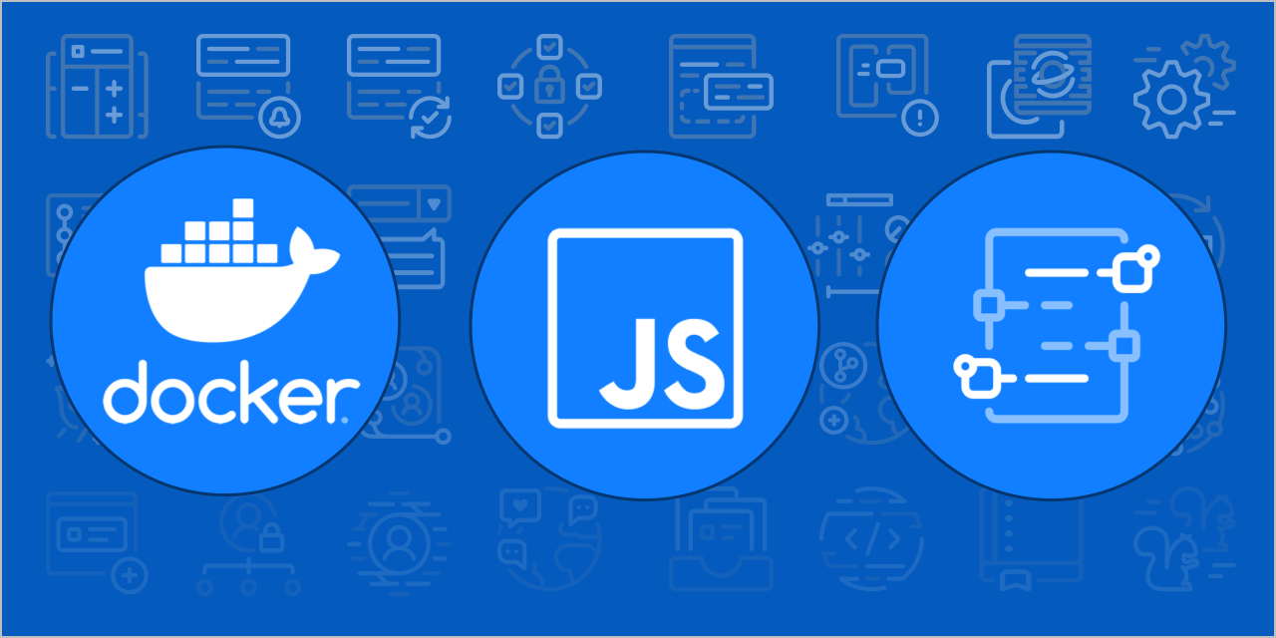
Types of GitHub actions
Actions are individual tasks that you can use to customize your development workflows. You can create your own actions by writing custom code that interacts with your repository to perform custom tasks, or by using actions the GitHub community shares.
Navigating through various actions, you'll notice that there are three different types of actions: Docker container actions, JavaScript actions, and composite run steps actions. Let's take a closer look at each action type.

Slide 5
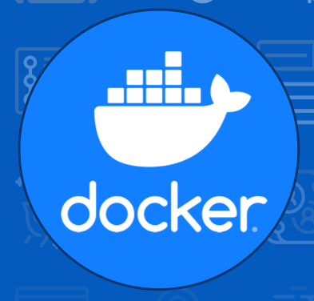
Docker container actions
Docker containers package the environment with the GitHub Actions code. This means that the action runs in a consistent and reliable environment because all of its dependencies are within that container. If the action needs to run in a specific environment configuration, Docker containers are a good way to go because you can customize the operating system and tools. The downside is that because the job has to build and retrieve the container, Docker container actions are often slower than JavaScript actions.
Before building a Docker container action, you should have some basic understanding of how to use environment variables and the Docker container filesystem. The steps to take to build a Docker container action are then minimal and straightforward:
Create a Dockerfile to define the commands to assemble the Docker image.
Create an action.yml metadata file to define the inputs and outputs of the action. Set the runs: using: value to docker and the runs: image: value to Dockerfile in the file.
Create an entrypoint.sh file to describe the docker image.
Commit and push your action to GitHub with the following files: action.yml, entrypoint.sh, Dockerfile, and README.md.

Slide 6

JavaScript actions
JavaScript actions can run directly on the runner machine, and separate the action code from the environment that's used to run the action. Because of this, the action code is simplified and can execute faster than actions within a Docker container.
As a prerequisite for creating and using packaged JavaScript actions, you need to download Node.js, which includes npm. As an optional step (but one that we recommend) is to use GitHub Actions Toolkit Node.js, which is a collection of Node.js packages that allows you to quickly build JavaScript actions with more consistency.
The steps to build a JavaScript action are minimal and straightforward:
Create an action.yml metadata file to define the inputs and outputs of the action, as well as tell the action runner how to start running this JavaScript action.
Create an index.js file with context information about the Toolkit packages, routing, and other functions of the action.
Commit and push your action to GitHub with the following files: action.yml, index.js, node_modules, package.json, package-lock.json, and README.md.

Slide 7

Composite run steps actions
Composite run steps actions allow you to reuse actions by using shell scripts. You can even mix multiple shell languages within the same action. If you have many shell scripts to automate several tasks, you can now easily turn them into an action and reuse them for different workflows. Sometimes it's easier to just write a shell script than using JavaScript or wrapping your code in a Docker container.

Slide 8
Packaged composite action
Packaged composite actions bundle multiple steps into a reusable unit. These actions are defined in a repository and can be referenced in workflows across different repositories. Packaging a composite action simplifies workflows, reduces duplication, and improves maintainability.
When creating a packaged composite action, the steps are defined in a single action.yml file. This file specifies the inputs, outputs, and the sequence of commands or actions to execute. Packaged composite actions are particularly useful for automating repetitive tasks or combining multiple shell commands into a single reusable action.

Slide 9
Create a composite action
1. Set Up a directory for the composite action
You must place your composite action in its own directory inside the repository.
Example directory structure:
.github/actions/my-composite-action/
├── action.yml
└── scripts/
└── my-script.sh

Slide 10
Create a composite action
2. Define the action.yml file
Inside the my-composite-action directory, create an action.yml file. Note: The using: "composite" field indicates that this action is a composite action.
name: "My Composite Action"
description: "A reusable composite action that checks out code and sets up Node.js"
inputs:
node-version:
description: "The Node.js version to use"
required: true
runs:
using: "composite"
steps:
- name: Checkout repository
uses: actions/checkout@v4
- name: Set up Node.js
uses: actions/setup-node@v4
with:
node-version: ${{ inputs.node-version }}

Slide 11
Create a composite action
3. Use the composite action in a workflow
Once the composite action is created, it can be referenced in a GitHub Actions workflow.
jobs:
build:
runs-on: ubuntu-latest
steps:
- name: Use my composite action
uses: ./.github/actions/my-composite-action
with:
node-version: '18’
If your composite action is shared from another repository, reference it like this:
uses: owner/repository/.github/actions/my-composite-action@v1

Slide 12
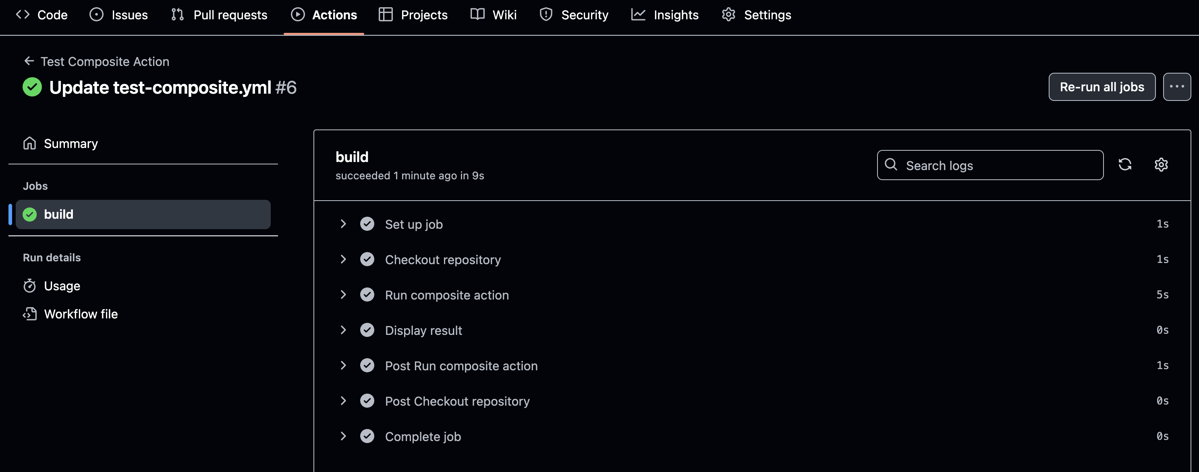
Create a composite action
Check out this example image

Slide 13
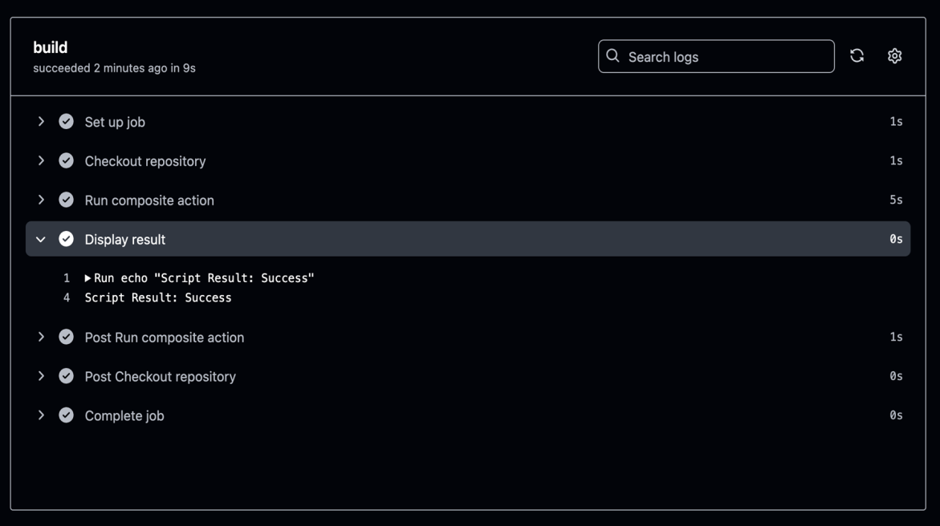
Define an output in action.yml
The action.yml file specifies an output named script-result. This output retrieves its value from the result output of the run-script step. The run-script step runs a Bash command to set the output value.
outputs:
script-result:
description: "Result from the script"
value: ${{ steps.run-script.outputs.result }}
runs:
using: "composite"
steps:
- id: run-script
run: echo "result=Success" >> $GITHUB_OUTPUT
shell: bash

Slide 14
Use the output in a workflow
Once the composite action is created, its output can be accessed in a workflow. Here's an example:
jobs:
test:
runs-on: ubuntu-latest
steps:
- name: Run composite action
id: my-action
uses: ./.github/actions/my-composite-action
- name: Display result
run: echo "Script Result: ${{ steps.my-action.outputs.script-result }}"
In this example:
The composite action is invoked using the uses keyword.
Access the output script-result using the steps.<step-id>.outputs.<output-name> syntax.
Display the result in the workflow logs.
Define outputs in composite actions to create reusable and modular workflows. This approach simplifies data sharing and improves maintainability.

Slide 15
Best practices for composite actions
Best Practice | Description
Use Versioning | Use a v1 tag to reference stable version 1.
Keep Actions Modular | Group related steps inside a composite action.
Document Inputs & Outputs | Add descriptions for inputs/outputs in action.yml.
Test Before Publishing | Validate the composite action in a test repository.

Slide 16
Composite action in a workflow
Composite actions are a powerful way to simplify workflows by bundling multiple steps into a reusable unit. These actions allow you to define a sequence of commands or actions in a single action.yml file, making it easier to maintain and reuse logic across workflows.
Benefits of composite actions:
Reusability - Define actions once and use them in multiple workflows.
Maintainability - Reduce duplication by centralizing logic in a single action.
Modularity - Combine multiple shell commands or other actions into a single unit.

Slide 17
Develop an action to set up a CLI on GitHub Actions runners
Many CI/CD workflows require a specific version of a CLI tool to interact with cloud services, manage infrastructure, or execute scripts. While GitHub-hosted runners come preinstalled with many tools, they may not include the exact version your workflow needs, especially if it's an older or unsupported version. Instead of installing the required CLI version in every workflow, you can create a reusable GitHub Action that:
Ensures consistent installation of the required CLI version across jobs.
Simplifies workflows by centralizing the installation logic.
Optimizes caching for faster workflow execution.

Slide 18
How to develop a CLI setup action
A CLI setup action is a JavaScript-based action that installs and configures a CLI on a GitHub runner.
In this process, you will create a CLI setup action in four concise steps. You’ll organize the action directory, define its metadata, implement the installation script, and validate the action in a workflow.
Steps
Set Up the Action Directory: Create .github/actions/my-cli-action in your repo.
Define action.yml Metadata: Specify name, description, inputs, and runtime (e.g., node16).
Implement the Install Script: Write index.js to fetch and install the CLI using Octokit or shell commands.
Test the Action Locally: Add a workflow under .github/workflows/ that uses your action and verifies the CLI installation.`

Slide 19


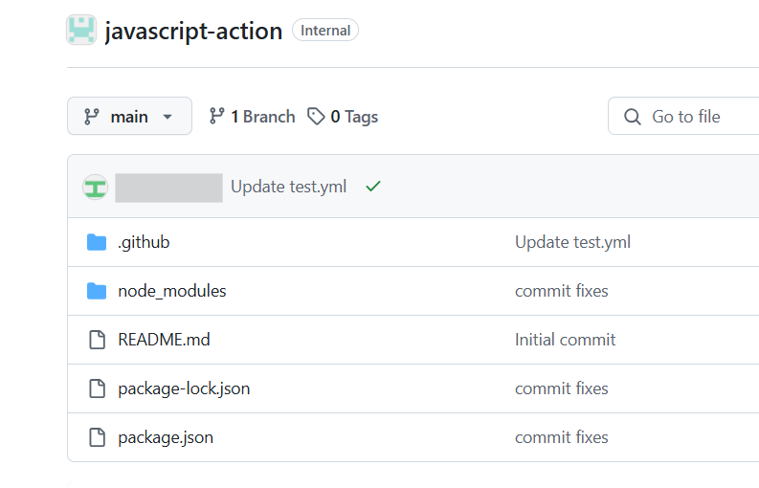
Step 1: Set Up the Action Directory
To manually create the directory for your CLI setup action, follow these steps:
Navigate to your repository
Create a new directory for the action
Create a new directory named my-cli-action inside the .github/actions folder. This ensures your action is organized and follows GitHub's recommended structure for custom actions.

Slide 20



Step 1: Set Up the Action Directory
To manually create the directory for your CLI setup action, follow these steps:
Navigate to the new directory
Verify the directory structure
After creating the directory, your repository structure should look like this:
Change into the newly created directory to start adding files for your action:
your-repository/
├── .github/
│ ├── actions/
│ │ ├── my-cli-action/
Next: You are now ready to proceed with creating the action.yml file and other necessary files for your CLI setup action.

Slide 21
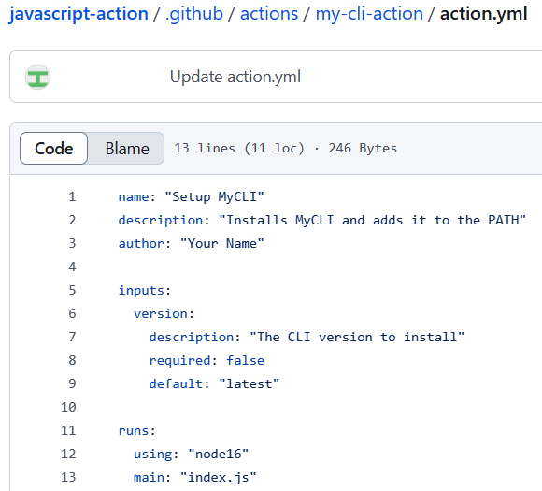
Step 2: Define the action.yml metadata file
Create an action.yml file to describe the action.
name: "Setup MyCLI"
description: "Installs MyCLI and adds it to the PATH"
author: "Your Name"
inputs:
version:
description: "The CLI version to install"
required: false
default: "latest"
runs:
using: "node16"
main: "index.js"
Why use using: node16? This action runs JavaScript code using Node.js 16.

Slide 22
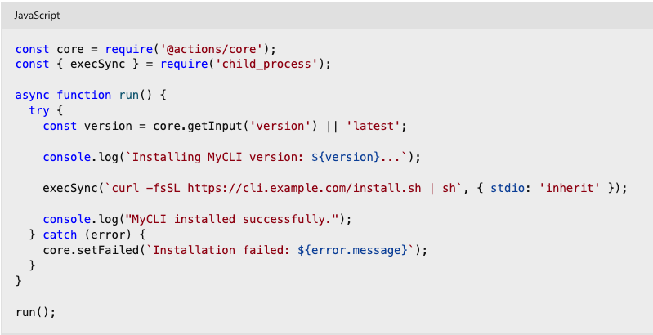
Step 3: Create a JavaScript script to install the CLI
In the same directory, create a file named index.js and add the following code:
The JavaScript code uses core.getInput() to retrieve the CLI version specified as input. It then executes a curl command to download and install the CLI. If the installation process fails, the action uses core.setFailed() to mark the workflow as failed.

Slide 23
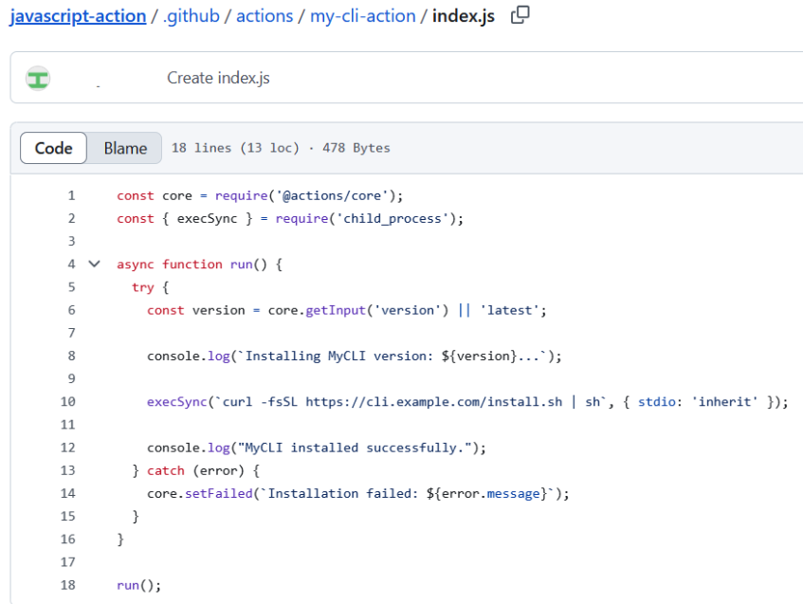
Step 3: Create a JavaScript script to install the CLI
Example:

Slide 24
Step 4: Test the action locally
Before using the action in a workflow, test it on a GitHub-hosted runner.
Create a workflow file (.github/workflows/test.yml) in your repository:
name: Test MyCLI Setup
on:
push:
branches:
- main
- feature/*

Slide 25
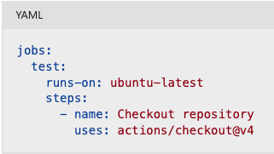
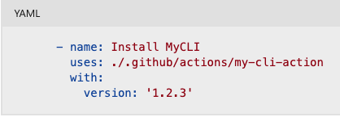
Step 4: Test the action locally
Triggering the workflow
Clone the repository
The workflow is triggered on pushes to the main branch and any branch matching the feature/* pattern. You can adjust this to match your repository's branching strategy.
The actions/checkout@v4 action is used to clone the repository onto the runner. This ensures that the workflow has access to the repository's files.

Slide 26
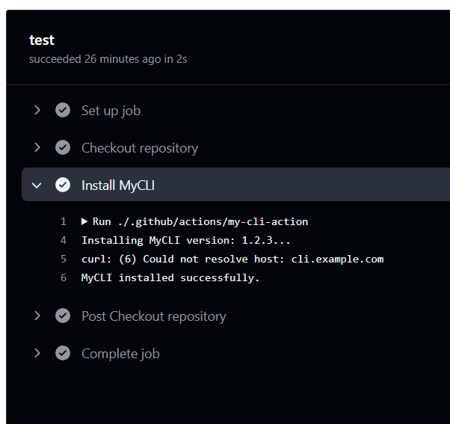
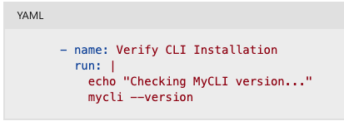
Step 4: Test the action locally
Run the custom action
Verify the CLI installation
This step runs a shell command to verify that the CLI was installed successfully. It
The uses: ./.github/actions/my-cli-action line references the custom action locally. Ensure that the action directory and action.yml file are correctly set up. The version input specifies the CLI version to install—in this case, version 1.2.3.
It checks the version of the installed CLI by running mycli --version.

Slide 27
Test locally
To test this workflow locally, use the act CLI tool:
act -j test
This simulates the GitHub Actions environment on your local machine, allowing you to debug and validate the workflow before pushing changes.
Optimization tip: Caching
To improve workflow performance, cache the CLI installation directory using the actions/cache action:
- name: Cache MyCLI
uses: actions/cache@v4
with:
path: ~/.mycli
key: mycli-${{ runner.os }}-${{ inputs.version }}
This ensures that subsequent runs reuse the cached CLI installation, reducing setup time.

Slide 28
Best practices for CLI setup actions
Best practice | Description
Use Versioning | Allow users to specify a CLI version via inputs.version.
Handle Errors Properly | Use core.setFailed() to exit on errors.
Cache CLI Installation | Optimize workflow performance using actions/cache.
Provide Documentation | Explain usage and inputs in README.md.

Slide 29
Troubleshoot JavaScript actions
When working with JavaScript-based GitHub Actions, you may encounter unexpected behavior, errors, or failures during workflow execution. This unit provides techniques and tools to help you identify and resolve issues in your JavaScript actions.
Common troubleshooting scenarios
Problem | Possible cause | Suggested fix
Action fails with a stack trace | Syntax or runtime error in index.js | Use console.log() and check logs
Inputs are undefined | Incorrect input name or missing input | Verify action.yml and how inputs are passed
Environment variables not set | core.exportVariable or process.env not used properly | Review the code setting the variables
File not found | Missing relative paths | Use __dirname or full paths to files
Cache is not restored | Wrong key or path values | Check cache configuration and keys

Slide 30
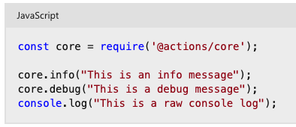


Use Logging for Debugging
Log messages with core.info, core.debug, and console.log
Enable debug logging
You can enable step-level debug logs by setting the following secret:
To enable runner diagnostic logs, set:
✅ Use core.debug for debug logs — these only appear when ACTIONS_STEP_DEBUG is set to true.

Slide 31
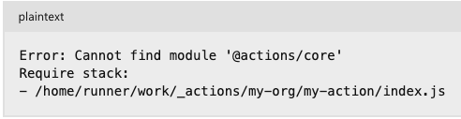
Set secrets for debugging
Inspect workflow logs
Go to your GitHub repository.
Navigate to Settings > Secrets and variables > Actions.
Add new secrets with the following names and values:
ACTIONS_STEP_DEBUG: true
ACTIONS_RUNNER_DEBUG: true
When a workflow fails, click on the failed job in the Actions tab. Expand each step to:
View detailed logs
Check standard output (stdout)
See the exit code of scripts
Identify unhandled exceptions
🔍 Example log Output
✅ Fix: Run npm install @actions/core and commit node_modules (or use ncc to bundle the action).

Slide 32

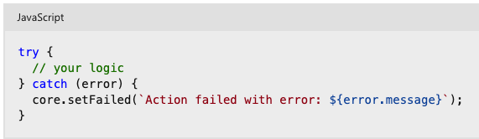
Test your action locally
Handle errors gracefully
Use act — a CLI tool to run GitHub Actions locally. Example:
Catch exceptions and fail with helpful messages:
🛠 Make sure to simulate your GitHub environment properly when testing locally.
🔁 This ensures GitHub stops the workflow on error and provides readable logs.

Slide 33
Best practices for debugging JavaScript actions
Practice | Description
Use core.debug() | Hide verbose logs unless debugging is enabled.
Validate action.yml | Ensure inputs and outputs are correctly defined.
Bundle code | Use @vercel/ncc to compile JavaScript into a single file. This reduces dependencies and ensures all required modules are included, preventing runtime errors caused by missing files.
Test with act | Simulate runs locally for faster iterations.
Use try/catch | Prevent workflows from failing silently.

Slide 34
Troubleshoot Docker container actions
Docker container actions are powerful for encapsulating complex tools and environments in GitHub Actions workflows. However, debugging these actions can be more challenging than JavaScript actions due to their isolated runtime environment.
Common issues in Docker container actions
Problem | Possible cause | Suggested fix
Action fails to start | ENTRYPOINT or CMD misconfigured | Confirm Dockerfile uses ENTRYPOINT correctly
Missing dependencies | Dependencies not installed or misconfigured | Ensure all packages are installed in the image
Inputs not received | INPUT_ environment variables not accessed | Use process.env.INPUT_<INPUT_NAME> (or shell equivalent)
File not found | Incorrect file path inside container | Use absolute paths or validate directory structure
Permission denied | File or script lacks execution permission | Add RUN chmod +x <script> in Dockerfile
Network-related failures | External services not accessible | Validate network settings and retry logic

Slide 35
Understand the Docker action lifecycle
Before troubleshooting, it's helpful to understand how Docker container actions run.
Workflow Trigger
Runner Setup
Action Resolution
A GitHub Actions workflow starts in response to a configured event—such as a push, pull_request, or manual workflow_dispatch.
If the action specifies runs.using: docker in its action.yml file, GitHub recognizes it as a Docker-based action.
GitHub provisions a fresh virtual machine (the runner) to execute the workflow. The runner prepares the environment by downloading action definitions and resolving dependencies.

Slide 36


Understand the Docker action lifecycle
Before troubleshooting, it's helpful to understand how Docker container actions run.
Image Build or Pull
Container Execution
Entrypoint Runs
GitHub builds the Docker image defined in the action’s Dockerfile or pulls a prebuilt image if specified. This image defines the environment in which the action code runs.
The runner launches the Docker container, mounts the workspace, and injects environment variables, including secrets and inputs defined in the workflow.
GitHub executes the entrypoint command from the Dockerfile inside the container. This is where the custom action logic runs, typically a script or application.

Slide 37

Understand the Docker action lifecycle
Before troubleshooting, it's helpful to understand how Docker container actions run.
Result Handling
Any outputs set by the container action are captured by the runner and passed along to subsequent steps in the workflow. Once complete, the container shuts down and the runner is discarded.
Note: Docker container actions run in a clean, isolated environment. File system state, installed tools, and environment variables must all be defined within the Dockerfile.

Slide 38
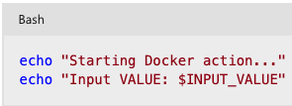
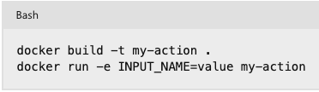

Debugging techniques
Add Logging
Build and test locally
Use the act CLI to simulate GitHub workflows
Use echo, printf, or logging statements in your entrypoint script:
Use Docker on your machine to simulate the container behavior:
Install act to run your GitHub workflows locally:
Log all critical inputs and steps to diagnose where the failure occurs.
Ensure environment variables mimic the ones GitHub sets.
Great for testing Docker actions in workflows without pushing to GitHub.

Slide 39
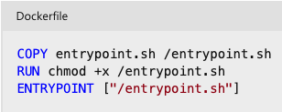
Debugging techniques
Inspect GitHub logs
Validate Dockerfile configuration
Click on a failed workflow run, expand each step, and examine:
Docker build logs
Standard output and standard error from the container
Exit codes and stack traces 🔍 Logs often reveal missing packages, syntax issues, or permission errors.
Ensure you define either ENTRYPOINT or CMD. Copy your scripts into the image and give them execute permission:
Example: Entry point error
Error: container_linux.go:380: starting container process caused "exec: \"/entrypoint.sh\": permission denied"
✅ Fix: Add RUN chmod +x /entrypoint.sh in your Dockerfile.

Slide 40
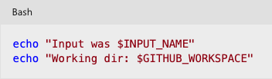
Environment variable mapping
GitHub input | Docker environment variable
with: name: test | INPUT_NAME=test
GITHUB_WORKSPACE | Mapped into /github/workspace
GITHUB_EVENT_NAME | Event that triggered the workflow

Slide 41
Use troubleshooting secrets
Enable additional logging by adding these secrets to your repository or org:
Secret | Description
ACTIONS_STEP_DEBUG | Enables debug logging
ACTIONS_RUNNER_DEBUG | Enables runner diagnostics

Slide 42
Best practices for Docker action debugging
Best Practice | Why
Use logging generously | Helps trace failure points
Always set chmod +x | Avoid permission errors on shell scripts
Validate inputs in your script | Catch missing or malformed inputs early
Minimize container dependencies | Smaller images are easier to debug
Test locally with docker run or act | Faster iterations and immediate feedback

Slide 43
Publish a custom GitHub action
Here, you'll learn about choosing the right visibility for your action, best practices for documenting and versioning your action, and how to publish your action to the GitHub Marketplace.

Slide 44

Choose a location for your action
When creating an action, it's important to first decide where you want that action to live and the visibility of that action, whether it will be public or private. The action's visibility determines which recommendations and requirements are needed to release that action.
Let's take a closer look into these two visibility options.

Slide 45

Public
Workflows in any repository can use public actions. If you're developing an action with the intent to make it open source or make it publicly available through the GitHub Marketplace, we recommend (and in most cases it's required) that the action has its own repository instead of bundling it with other application code. This allows you to version, track, and release the action just like any other piece of software. This makes it easier for the GitHub community to discover the action, narrows the scope of the code base for developers fixing issues and extending the action, and separates the action's versioning from the versioning of other application code.

Slide 46

Private
When an action is in a private repository, only workflows in the same repository can use the action. With private actions, you can store the action's files in any location in your repository. If you plan to combine action, workflow, and application code in a single repository, we recommend storing the action in the .github directory. For example, .github/actions/action-a and .github/actions/action-b.

Slide 47
Document your action
It can be very frustrating to use a new tool or application when the documentation is vague or even missing. It's important to include good documentation with your action so that others can see how it works, whether you plan to make it public or private. The first thing to do is create a good README.md file for your action.
The README.md file is often the first place developers will look at to see how the action works. This is a great place to include all of the important information for the action. The following is a non-exhaustive list of things to include:
A detailed description of what the action does.
Required input and output arguments.
Optional input and output arguments.
Secrets the action uses.
Environment variables the action uses.
An example of how to use your action in a workflow.
As a general rule, the README.md file should include everything a user should know to use the action. If you think it could be useful information, include it in the README.md.

Slide 48
Release and version your action
If you're developing an action for other people to use, whether it's public or private, you should define a release-management strategy to control how updates are distributed. Major version updates including necessary critical fixes and security patches that affect compatibility need to be documented clearly.
Good practices for release and version management
If you're developing an action for other people to use, whether it's public or private, you should define a release-management strategy to control how updates are distributed. Major version updates including necessary critical fixes and security patches that affect compatibility need to be documented clearly.

Slide 49
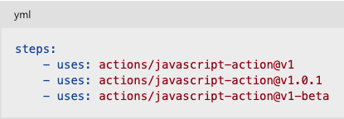
Tags
Tags can be a good way to manage releases for an action. By using tags, users can easily distinguish between major and minor versions. The following is a list of helpful practices to consider when creating releases:
Create and validate a release on a release branch (such as release/v1) before creating the release tag (for example, v1.0.2).
Use semantic versioning.
Move the major version tag (such as v1, v2) to point to the Git ref of the current release.
Introduce a new major version tag (v2) for changes that will break existing workflows.
Release major versions with a beta tag to indicate their status; for example, v2-beta. You can remove the -beta tag when the release is ready.
Here are some examples of each option.

Slide 50
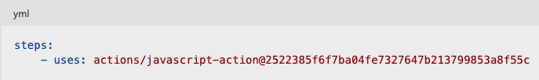
Use a commit's SHA
Tags are useful and widely used, but one downside to using tags is that they can be deleted or moved. With Git, each commit receives a calculated SHA value, which is unique and can't be modified. Using a commit SHA for versioning will give you the most reliable and secure way to version and use an action. However, often in Git you can abbreviate the SHA hash to the first several characters, and Git will recognize the reference. If you're using the commit's SHA for release management, you need to use the full SHA value and not the abbreviated value.

Slide 51
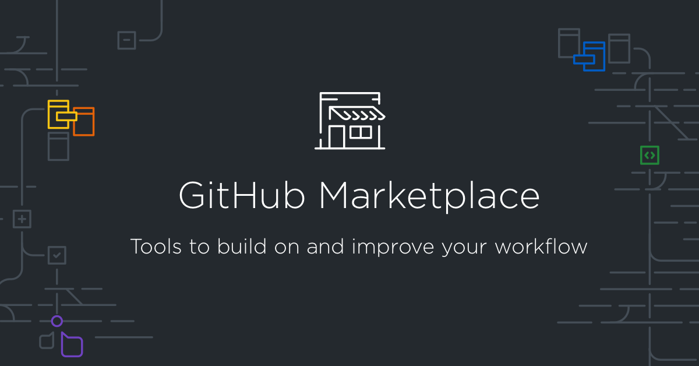
Publish an action to the GitHub Marketplace

Slide 52
Publish an action to the GitHub Marketplace (continued)
Following are the requirements to publish an action to the GitHub Marketplace. They apply to both Docker container-based actions and JavaScript-based actions:
The action must be in a public repository.
Each repository must contain a single action.
The action's metadata file (action.yml or action.yaml) must be in the root directory of the repository.
The name in the action's metadata file must be unique on the GitHub Marketplace.
The name can't match a user or organization on GitHub, unless the user or organization owner is publishing the action. For example, only the GitHub organization can publish an action named github.
The name can't match an existing GitHub Marketplace category.
The name can't match an existing GitHub feature.
You can add the action you've created to the GitHub Marketplace by tagging it as a new release and then publishing it. There are a few guided steps in GitHub that allow you to publish a release of your action.

Slide 53


Exercise - Create a custom JavaScript GitHub action
This exercise will help walk you through writing your own GitHub JavaScript Action and automating customized tasks unique to your workflow.
When you select the Start the exercise on GitHub button, you'll navigate to a public GitHub template repository that prompts you to complete a series of small challenges. Before you can begin the exercise, complete the following tasks:
Select the Start course button or the Use this template feature within the template repository. This prompts you to create a new repository. We recommend creating a public repository, because private repositories will use Actions minutes.
After you make your own repository from the template, wait about 20 seconds and refresh.
Follow the instructions in the repository's README to understand how the exercise works, its learning objectives, and how to successfully complete the exercise.
Note: You don't need to modify any of the workflow files to complete this exercise. Altering the contents in this workflow can break the exercise's ability to validate your actions, provide feedback, or grade the results.
Start the exercise on GitHub.

Slide 54
Knowledge Checks

Slide 55
Knowledge Check: Create and publish custom GitHub actions
1 of 4
You need to create a custom GitHub Action written in Ruby. Which action type would you choose?
JavaScript action
Run step
Docker container action
Bash script
© Copyright Microsoft Corporation. All rights reserved.

Slide 56
Knowledge Check: Create and publish custom GitHub actions
2 of 4
Which keywords are required for a valid action.yml file?
name, runs, composite
name, runs, description
name, description, branding
name, description, composite
© Copyright Microsoft Corporation. All rights reserved.

Slide 57
Knowledge Check: Create and publish custom GitHub actions
3 of 4
Which workflow command would set the debug message to This is an error message?
echo::error::This is an error message
echo error=This is an error message
echo::error::message=This is an error message
echo::error::This is an error message::
© Copyright Microsoft Corporation. All rights reserved.

Slide 58
Knowledge Check: Create and publish custom GitHub actions
4 of 4
Which file is used to define a composite action?
Dockerfile
action.yml
workflow.yml
package.json
© Copyright Microsoft Corporation. All rights reserved.

Slide 59
Summary
In this module, you learned how to create and use custom GitHub Actions by understanding the required metadata, syntax, and best practices for documentation, versioning, and publishing to the Marketplace. You saw how to implement actions that call external APIs and pass their responses as workflow outputs, and how to interact with the repository (for example, creating issues) using packages and @actions/core for error handling. Finally, you practiced consuming and extending Actions in workflows to automate tasks reliably.

