Slide 1
AZ-700T00A Designing and Implementing Azure Networking Solutions

Slide 2
Welcome
Thank you for joining us today
We’ve worked together with the Microsoft Partner Network and Microsoft IT Academies to bring you a world-class learning experience. At the end of class, please complete an evaluation of today’s experience. We value your feedback!
Microsoft Certified Trainers + Instructors
Your instructor is a premier technical and instructional expert who meets ongoing certification requirements
Customer Satisfaction Guarantee
Our partners offer a satisfaction guarantee, and we hold them accountable for it
Certification Exam Benefits
After training, consider pursuing a Microsoft Certification to help distinguish your technical expertise and experience. Ask your instructor about available exam promotions and discounts
We wish you a great learning experience and ongoing career success!

Slide 3

Hello! Instructor Introduction
Instructor: <Name>
<Title or other credentials, e.g., Microsoft Certified Trainer>
<Affiliation/Company>
<A few words about my technical and professional experience

Slide 4
Hello! Student Introductions
Your name
Company affiliation
Title/function
Microsoft Azure experience
Your expectations for the course

Slide 5
Classroom experience (optional – adjust)
Class hours
Messages
Building hours
Smoking
Parking
Internet access
Restrooms
Recycling
Meals
Emergency procedures
Phones
Notes:
Consider altering this slide if you are delivering remote or in a hybrid scenario

Slide 6
About this course: Prerequisites
Successful Azure Network Engineers start this role with fundamental networking experience like network topology, network interfaces, routers, and firewalls.
Understanding of network configuration, including TCP/IP, Domain Name System (DNS), virtual private networks (VPNs), firewalls, and encryption technologies
Understanding hybrid network connectivity methods, such as VPN
Understanding of software defined networking
Understanding resilience and disaster recovery, including high availability and restore operations in regard to networking.
Notes:
Be sure to ask your students about their level of experience. Have they used Azure? Do they prefer command line or GUI for administrative tasks.
Microsoft Learn has a series of Fundamental modules for Azure, networking, and security. More modules are added every day and can help students ramp up on Azure basics. https://docs.microsoft.com/learn/browse/?term=fundamentals

Slide 7
Network Engineer Role
An Azure Network engineer designs and implements core Azure networking infrastructure, hybrid networking connections, routing, load balancing, private access to Azure services, network security and monitoring
The azure network engineer will manage networking solutions for optimal performance, resiliency, scale, and security. Candidates should have a strong understanding of core Azure services and hybrid cloud infrastructure concepts
Azure network engineers use the Azure Portal and other methods, including PowerShell, Azure Command-Line Interface (CLI), and Azure Resource Manager (ARM) templates to implement and manage solutions
Successful Azure network engineers should have expert Azure administration skills, in addition to extensive experience and knowledge of networking, hybrid connections, and network security.
Notes:
Each year Microsoft reviews each role to determine what tasks are included in a typical day. Ask students what areas are most important for their jobs. What are they most interested in?

Slide 8
Microsoft Certifications (optional)
Certifications give you a professional edge by providing globally recognized industry endorsed evidence of skills mastery, demonstrating your abilities and willingness to embrace new technologies
Exam AZ-900: Microsoft Azure Fundamentals
Microsoft Certified: Azure Administrator Associate
Microsoft Certified: Azure Solutions Architect Expert
Designed for candidates looking to demonstrate foundational level knowledge of cloud services and how those services are provided
Designed for Azure Administrators who implement, monitor, and maintain compute, storage, network, and security
Designed for Azure Solutions Architects who create solutions for compute, network, storage, and security

Slide 9
AZ-700 Certification Areas
Study Areas | Weights
Design, Implement, and Manage Hybrid Networking | 10–15%
Design and Implement Core Networking Infrastructure | 20–25%
Design and Implement Routing | 25–30%
Secure and Monitor Networks | 15–20%
Design and Implement Private Access to Azure Services | 10–15%
Percentages indicate the relative weight of each area on the exam
The higher the percentage, the more questions you are likely to see in that area
Notes:
Az-700 exam page: https://docs.microsoft.com/learn/certifications/exams/az-700

Slide 10
About this course: Course Outline
Module 01: Introduction to Azure Virtual Networks
Module 05: Load balance HTTP(S) traffic in Azure
Module 02: Designing and Implementing Hybrid Networking
Module 06: Design and Implement Network Security
Module 03: Designing and Implementing Azure ExpressRoute
Module 07: Design and Implement private access to Azure Services
Module 04: Load balance non-HTTP(S) traffic in Azure
Module 08: Design and Implement Network Monitoring
Notes:
Review the Trainer Prep Guide for general information about how the course was structured.
Also, review the Change Log for anything that may have changed since the last time you taught the course.
Both documents are downloadable from the MCT Download Center.

Slide 11
Course schedule (optional – adjust as needed)
Day 1
0 – Welcome
Day 2
Day 3
Introduction to Azure Virtual Networks
Load balance non-HTTP(S) traffic
Design and Implement private access to Azure Services
Lunch/Lab
Load balance HTTP(S) traffic
Exercises
Design and Implement Hybrid Networking
Lunch/Exercises
Lunch/Exercise
Design and Implement ExpressRoute
Design and Implement Network Security
Design and Implement Network Monitoring
Notes:
Adjust this slide to your teaching schedule. Consider using the last lab of the day as something to complete (homework) before the next training day.

Slide 12
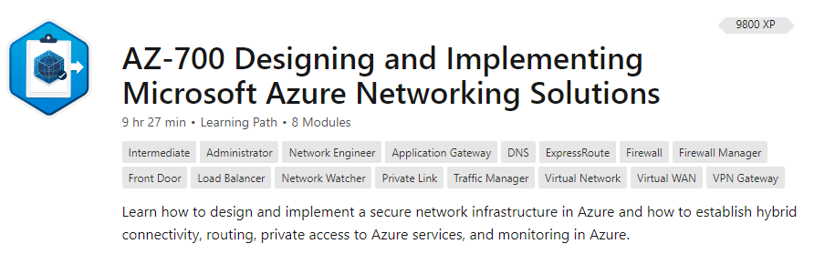
Student materials on Learn (optional)
Notes:
A Learn Collection has been created for the course. Feel free to share the link with your students. This link provides direct access to the student content: https://docs.microsoft.com/learn/paths/design-implement-microsoft-azure-networking-solutions-az-700/
Discuss the self-paced Learning Paths available from the exam page or by searching. Explain the course provides very high-level information. The Summary and Resources page gives links to additional Learn content. To fully prepare for the exam students should go through this additional content as much as possible.

Slide 13
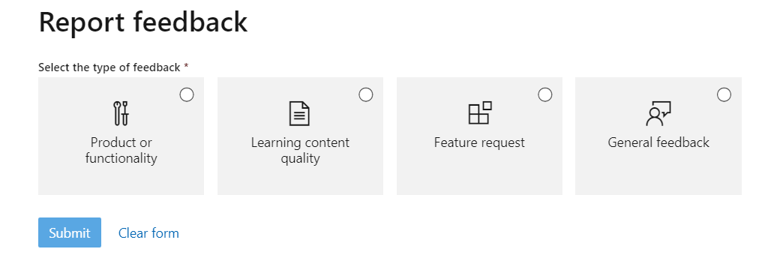
Student content feedback on Learn (optional)
Scroll to the bottom of the online page – be specific
Notes:
Feedback from Learn is logged and tracked. Corrections are made within just a few days. As you review the materials you can provide feedback. The best feedback is specific and actionable. For example, the virtual machine limits have changed and provide the documentation page.

Slide 14
Hands-on Labs (optional)
You will use a Microsoft Learning Azure Pass to provide access to Microsoft Azure
Check the dollar balance of you Azure Pass within Microsoft Azure once you have set up your subscription
Be aware of how much you are consuming and do not allow Microsoft Azure components to run overnight or for extended periods
Lab instructions are in a GitHub repository. For this class use the <your region> location
Each lab creates a new resource group. To minimize costs, remove the resource group at the end of the lab
Notes:
AZ-700 lab repository - https://github.com/MicrosoftLearning/AZ-700-Designing-and-Implementing-Microsoft-Azure-Networking-Solutions
If you find something that needs corrected in the labs, submit an Issue on the repository. Also, you may want to review any recent Issues that have been submitted by other instructors.

Slide 15
Additional Resources (optional)
Microsoft Learn
Azure Fridays with Scott Hanselman
Azure Documentation
Microsoft Azure Blog
Azure Forum
Microsoft Learning Community Blog
Notes:
Microsoft Learn - https://docs.microsoft.com/learn/browse/ There is a summary slide at the end of each lesson with applicable online training modules.
Azure Documentation - https://docs.microsoft.com/azure/
Stay informed on the latest products, tools, and features. Get information on pricing, partners, support, and solutions.
Azure forums https://docs.microsoft.com/answers/products/azure?product=all
The Azure forums are very active. You can search the threads for a specific area of interest. You can also browse categories like Azure Storage, Pricing and Billing, Azure Virtual Machines, and Azure Migrate.
Microsoft Azure Blog - https://azure.microsoft.com/blog/
Keep current on what's happening in Azure, including what's now in preview, generally available, news & updates, and more.
Microsoft Learning Community Blog – https://techcommunity.microsoft.com/t5/microsoft-learn-blog/bg-p/MicrosoftLearnBlog
Get the latest information about the certification tests and exam study groups.

Slide 16
End of presentation

