Slide 1
Data considerations in biological research

Slide 2
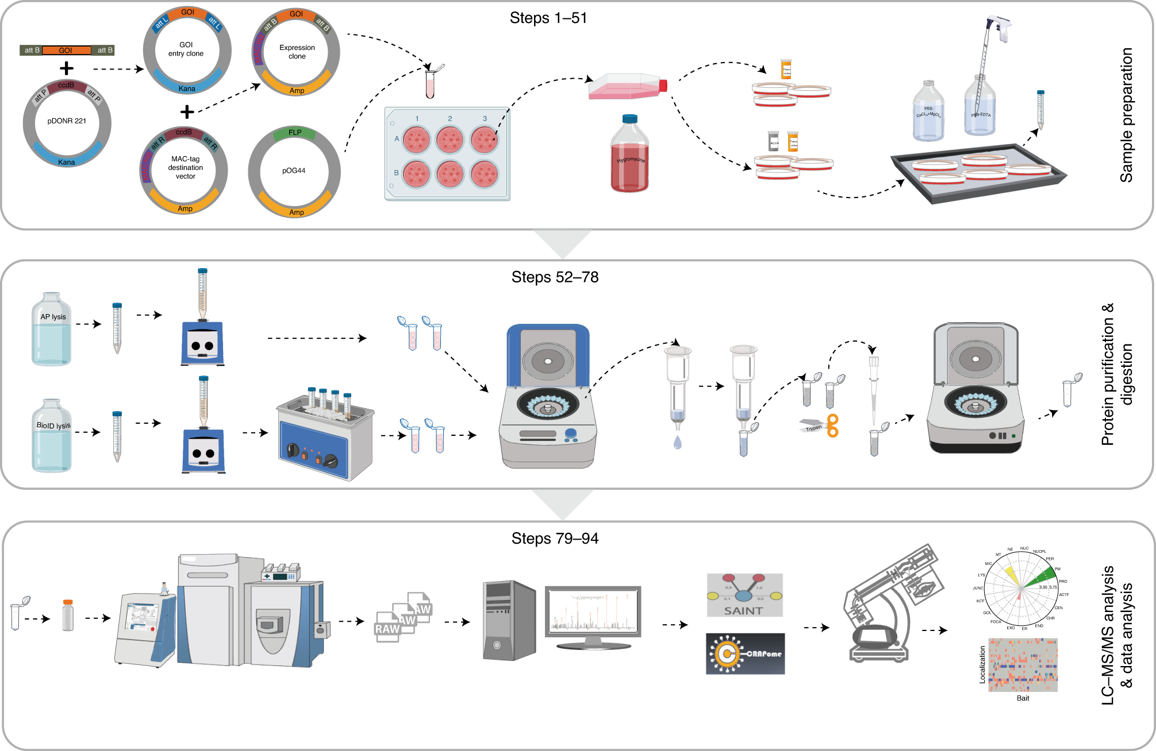
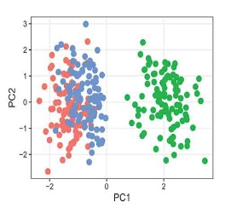
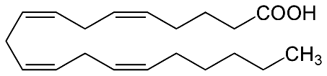
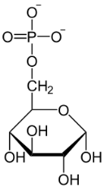
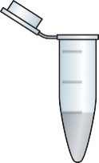
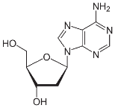

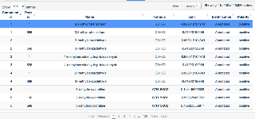
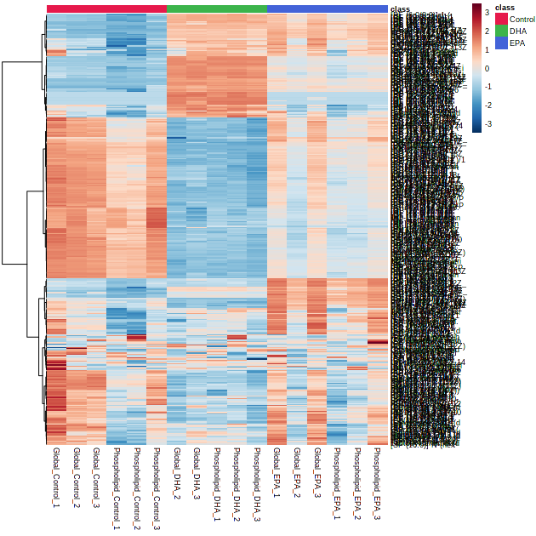

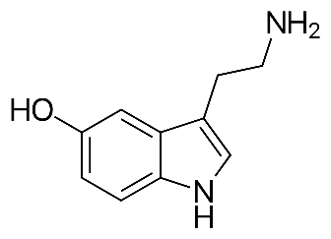

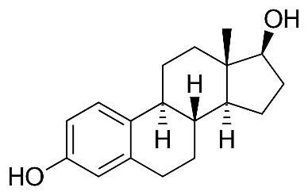
Multi-omics and biological big data
New technologies and innovation in research
Combining mass spectrometry, imaging and sequencing
Much larger, more complex datasets
Driven by improved bioinformatics, software design and analysis
Precision (or personalized) Medicine – QEUH, Glasgow
100
Relative Intensity (%)
0
2
4
6
8
10
12
14
16
18
20
Time (min)
Sample
(Solvent Extract)
High Resolution LC-MS
(Thermo Orbitrap
Platform)
Data Processing
(Polyomics Metabolomics
Pipeline)
Statistical Analysis
(Uni- and Multivariate)
Metabolite Markers

Slide 3

Data challenges and barriers
Advances in technology but integration with medical data is challenging
Translation to clinical outcomes has been slower
Carefully guarded
Siloed in clinics, hospital charts, often without central repository
Complex and not standard, ‘usable’ format
Infrastructure to allow movement, manipulation and management of medical data is not readily available (highlighted in MRC funding round last year)

Slide 4
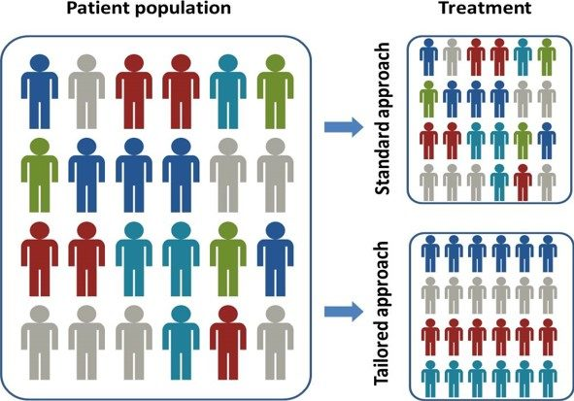
Precision or ‘personalised’ medicine
“approach for disease treatment and prevention that takes into account individual variability in genes, environment, and lifestyle for each person”
The National Institutes of Health (NIH)

Slide 5
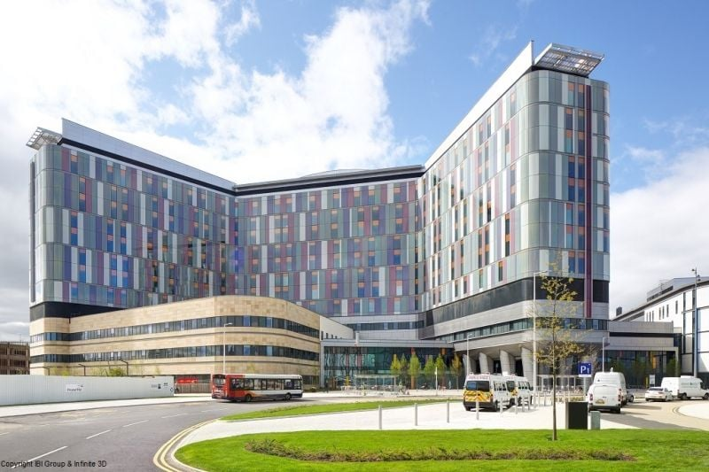
Solutions and frameworks
Scottish Transcriptome Archive Resource – transcript profiling of 30,000 samples
Transcripts are the biologically active part of DNA, providing a ‘molecular snapshot’ of the cell
Combining high throughput technology, disease-related tissue, outcomes and patient history
Safe Havens – trusted research environments for accessing data
Governed by the NHS, 4 in Scotland.
Queen Elizabeth University Hospital – ‘Death Star’

