Slide 1
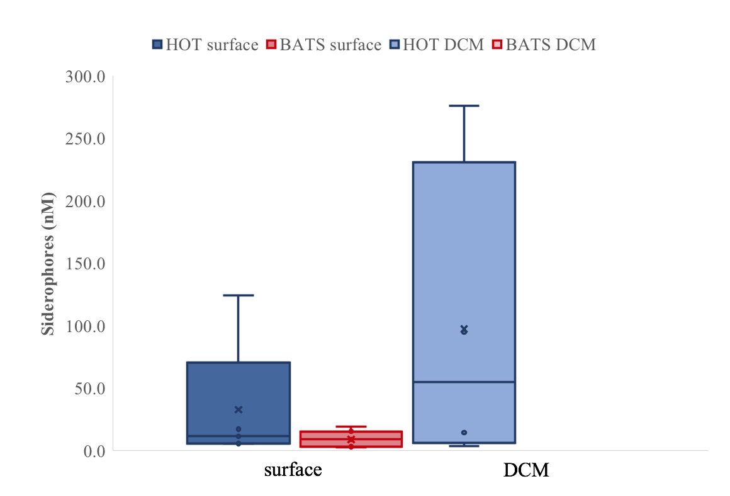
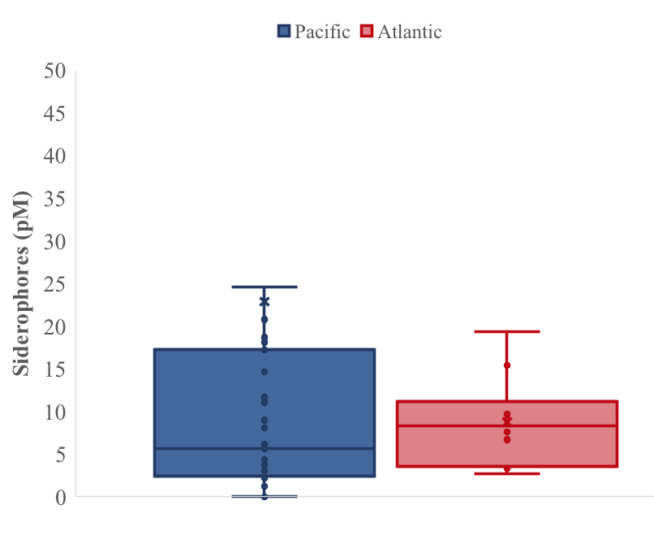
Siderophores (pM)
Surface N. Pacific compared to N. Atlantic

Slide 2
