Slide 1
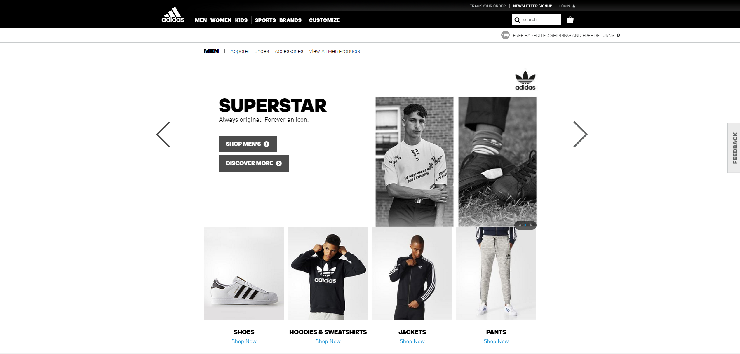

Suzanne Li Bradley Qian Naman Rungta
Our focus is on the e-commerce retailer of Adidas. Adidas is one of the largest sportwear retailers in the world with a focus on shoes, clothing, and accessories. Apparel sold on the e-commerce site include jackets, athletic pants and leggings, and shirts. The shoes include a variety of sneakers and sandals that are categorized differently based on the the sport (track, soccer etc.) or purpose (walking, running etc.). The company is known for many designer clothing and footwear collaborations with celebrities.

Slide 2
Employee
Employee ID (PK)
Last Name
First Name
Warehouse ID
Position
Shipment
Shipment ID(PK)
Warehouse ID (FK)
Supplier ID
Ship Date
Receive Date
Shipment Cost
Shipment Location
Product ID
Orders
Order ID(PK)
Shipped Date MDY
Quantity
Delivered Date MDY
Order Date
Customer ID (FK)
Payment ID (FK)
Product ID (FK)
Order Type
Total Due
Customers
Customer ID (PK)
Customer Last Name
Customer First Name
Customer Email
Payment ID(FK)
Customer Shipping Address
Customer Billing Address
Warehouse
Warehouse ID
Address
State
Zip Code
Order ID
Suppliers
Supplier ID (PK)
Supplier Name
Product ID (FK)
Address
Zip Code
City
Product
Product ID(PK)
Product Name
Product Cost
Manufacturer
Category ID (FK)
Category Name
Price
Payment
Payment ID (PK)
Card Company
Card Number
Card Type
Security Code
One to Many Relationships
Warehouse > Employee
Supplier > Shipment
Warehouse > Shipment
Customer > Orders
Orders > Product
Customer > Order
Customer > Payment

