Slide 1


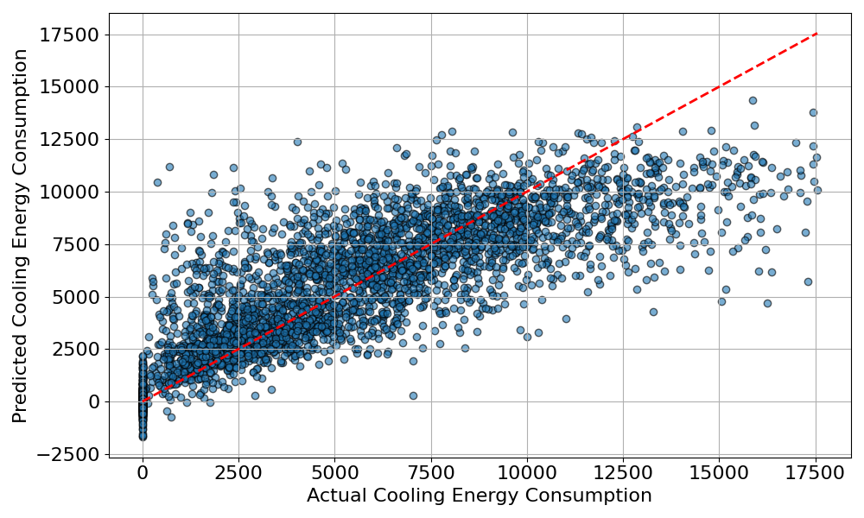
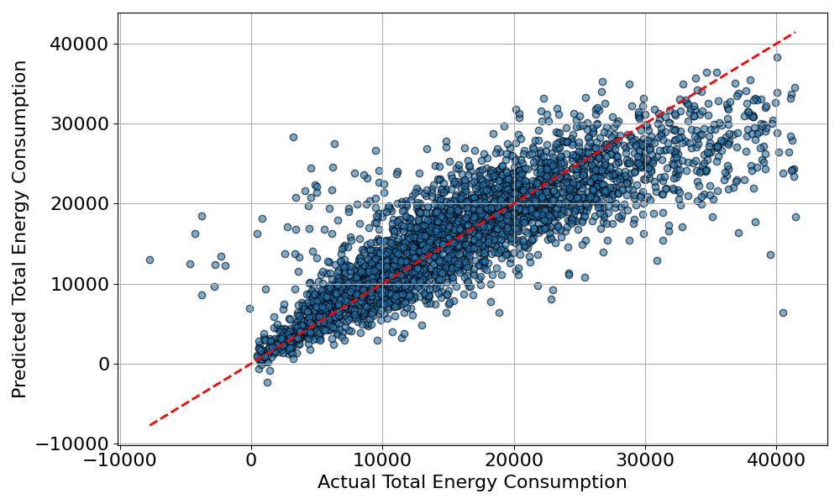
Statistical Modeling of NREL Household Energy with Machine Learning Methods
Sihan Liang ¹, Lauren Janicke ¹, Destine Nock ¹
¹ Carnegie Mellon University, Pittsburgh, PA, USA
Introduction
Methodology
Results
Background: The rising demand for energy, accompanied with constraints in supply and changing energy policies, shows the importance of understanding residential energy consumption. Since households account for a large proportion of national energy use, identifying how energy is consumed at the household level is critical for finding opportunities to reduce demand and promote efficiency. Therefore, constructing a model for the household energy is critical for estimating the minimum household energy needed.
The U.S. National Renewable Energy Laboratory (NREL)^{[1]} has built a residential energy consumption dataset that captures household characteristics, appliance usage, building design, and other influencing factors. The dataset provides a unique opportunity to analyze energy demand patterns and explore consumption by constructing a model.
Objective: This study aims to develop and evaluate statistical models that can reliably estimate household energy consumption using NREL’s residential datasets. By identifying key predictors, the goal is to build interpretable models that improve understanding of energy demand and support smarter, more efficient residential energy planning.
The statistical modeling was conducted using machine learning methods as shown in Figure 1.1. Raw data from the NREL database was preprocessed through operations such as data type transformation and outlier filtration. The processed dataset was then randomly split into 70% for training and 30% for testing. The training subset was used to fit the model, while the testing subset was applied to evaluate performance. Model accuracy was assessed using Mean Squared Error (MSE). Hyperparameter tuning (HT) was implemented to optimize the modeling parameters.
Cooling Energy Modeling
Total Energy Modeling
Table 2.1: Best Model Option with MSE for Cooling Energy Modeling
Table 3.1: Best Model Option with MSE for Total Energy Modeling
Best Model Option | Mean Squared Error (kWh²)
Gradient Boosting Regressor | 5,638,390.12
Best Model Option | Mean Squared Error (kWh²)
Light Gradient Boosting | 20,988,192.43
Raw NREL database (AZ)
Figure 2.2: Actual / Predicted Cooling Energy with GBR
Figure 3.2: Actual / Predicted Total Energy with LGBR
Pre-processing data
Table 2.3: Top 5 Influencing Variables with Importance Values in Cooling Modeling (Total IV = 1)
Table 3.3: Top 5 Influencing Variables with Importance Value in Total Modeling (Total IV = 1)
70/30 Training/Testing split
 | Variable Name | Importance Value (IV)
1 | Building Geometry | 0.314
2 | Geometry Building Type | 0.180
3 | AC Cooling Type | 0.161
4 | Floor Area | 0.100
5 | Income | 0.044
 | Variable Name | Importance Value (IV)
1 | Building Geometry | 0.168
2 | Geometry Floor Area | 0.093
3 | Occupant Count | 0.087
4 | Vintage | 0.080
5 | Temperature of Starting Heating | 0.074
Comparative training
Linear Regression
Discussions and Future Work
Random Forest Regressor
For cooling energy modeling, the Gradient Boosting Regressor demonstrated strong predictive performance with a relatively low MSE ≈ 5.6M kWh² as shown in the Table 2.1. The variable importance analysis shown in Table 2.3 suggests that building geometry plays the dominant role, followed by building type, HVAC cooling type, and floor area. These findings follow expectations, as structural design and cooling systems can highly influence the cooling loads. For total energy modeling, the light Gradient Boosting Regressor showed effectiveness with MSE ≈ 21.0M kWh² as shown in Table 3.1. The importance value analysis shown in Table 3.3 suggests that the features in building structure have the greatest contribution to the total energy consumption to the household, which corresponds to the findings in the cooling energy modeling.
For future work, expanding the dataset to include more granular temporal patterns (e.g., hourly or seasonal loads) could improve model accuracy, particularly for total energy consumption. Finally, exploring hybrid models or deep learning approaches may help understand interactions more effectively, enhancing predictive power and enabling real-time energy management applications in smart building systems.
Gradient Boosting Regressor
Hist Gradient Boosting
Light Gradient Boosting
Neural Network (MLP)
Hyperparameter Tuning
Modeling and Testing
Acknowledgements
Thank you to Lauren, Professor Nock and other SURA participants for providing me with patient guidance, support and insights to my research. Also thank you to SURA program for offering the access and help throughout the research. This work is partially supported by the National Science Foundation Graduate Research Fellowship Program under Grant No. DGE2140739. Any opinions, findings, and conclusions or recommendations expressed in this material are those of the authors and do not necessarily reflect the views of the National Science Foundation.
[1] NREL. ResStock database. https://resstock.nrel.gov/datasets
Figure 1.1 Statistical Modeling Pipeline

