Slide 1
Week 1 Java Intro
ICT221 Object-Oriented Programming
Liang Chapters 1-6!

Slide 3

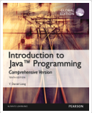
Goal: learn object-oriented programming (OOP)
Subgoals: learn seven important industry skills Weeks
Java (the #1 object-oriented programming language) 1-15
IntelliJ IDEA: a modern IDE for Java 1-13
Unit testing and test-driven development (TDD) 3-12
Event-driven programming for GUI development 5-13
Pair-programming and team skills 1-8
Distributed source-code version control (git) 2-13
Self-learning skills 1-13
10th Edition
11th Edition

Slide 4
Exercise: install JetBrains IntelliJ IDEA
Go to: https://www.jetbrains.com/idea/download
Download and install the Community Edition (426Mb)
Notes:
Wait until most students have *started* this download, then carry on with the lecture.
They can install it later in the lecture, after the download completes.

Slide 5
Weekly readings from text book
("Intro to Java, 11th Edition Brief", by Liang)
Two-hour lecture (second hour: demos and interactive tasks)
Two-hour weekly Lab (pair programming with GIT)
Weeks 1-4: Math quiz game for school students 10%
Weeks 5-8: Garden planner with JavaFX GUI 10% Task 1
Two-hour online programming tutorials (weeks 1-7) 10%
Assignment: JavaFX GUI interface (weeks 9-12) 30% Task 2
Exam 40% Task 3

Slide 6
Pair-Programming?
Defn: two programmers sharing a single workstation
(one screen, keyboard and mouse among the pair).
the programmer at the keyboard is usually called the "driver"
the other, also actively involved in the programming task but focusing more on overall direction is the "navigator";
the programmers swap roles every few minutes or so
Benefits:
increased code quality (eg. ½ the bugs, with 0-15% extra cost)
diffusion of knowledge among the team (shared ownership)
better transfer of skills
improved resiliency to interruptions
See: http://guide.agilealliance.org/guide/pairing.html

Slide 7
Learning Java
You already know how to program in Python
Now you must transfer those skills to Java:
Ideas are the same (loops, functions, etc.)
Syntax is a bit different:
Python: if x == 0: print(“Done”)
Java: if (x == 0) { System.out.println(“Done”); }
Python: size = 0 . . . size += 1
Java: int size = 0; . . . size += 1;
Notes:
Ask students to point out the differences they see.
Discuss especially:
{...} instead of : and indentation.
types when variables are declared
semicolons

Slide 8
Learning to learn
Programmers must often learn new languages
We expect you to teach yourself basic ‘imperative’ programming in Java (Chapters 1-7 of textbook)
(variables, if-else, loops, functions/methods, arrays)
Readings and homework exercises each week
This course will teach you new concepts (in Java):
Object-oriented programming
UML class diagrams
Object association, composition, inheritance
Event-based programming (building GUIs)

Slide 9
Jobs: What do Employers want?
From our recent workshop with local software employers.
Their top requirements for new IT graduates:
soft skills (Can work in a team! Can present solutions confidently)
self-learners (IT is constantly changing. "Go and learn XYZ")
problem solving ability
design skills
Notes:
We have modified ICT221 to address these requirements:
more team work (pair programming) and learning how to collaborate using Git
more self-learning practice, so you become expert at quickly learning new skills online

Slide 10
Self-paced learning
Why is self-learning so important now?
IT changes so fast. Every 3-5 years, you will need to learn new skills...
Employers expect you to be able to self-learn...
Australia AQF level 7 requires self-learning... (see next slide)
It's the best way for you to learn the basics (Java syntax etc.)
while this course teaches you the higher-level skills of OOP
So you must do both concurrently:
self-learn the basics with EdX
plus group-learn the higher-level skills in lectures and workshops
Notes:
Examples of higher-level skills taught in ICT221:
different programming paradigms: batch versus event-driven
unit testing and guidelines for doing it well
GUI design and good use of layouts
object-oriented design – good versus bad use of objects

Slide 11
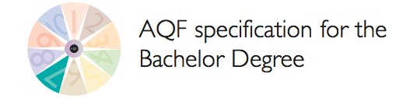
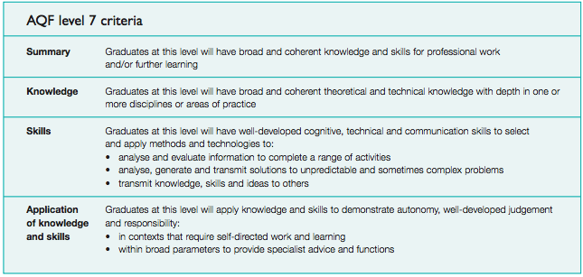
Notes:
Point out the "further learning" in the summary, and the "self-directed work and learning" in the Application section.
Also, point out the emphasis on 'soft skills', such as "communication skills", "transmit knowledge, skills and ideas to others" etc.

Slide 12
Exercise: EdX course for Java (Self-learning)
Register for an EdX account at https://www.edx.org
Email: Use your USC email
Public username: Use "usc19xxxNNN", where xxxNNN is your USC username
Enrol in Microsoft DEV276x "Learn to Program in Java"
Search: Java (and then select 'Self-Paced' to narrow down the options)
Look for Microsoft "Learn to Program in Java"
Click on: View Course Syllabus
Do: Module 2 Control Structures this week
Create a PracticeIT account at https://practiceit.cs.washington.edu
Use your USC email and the same "usc19xxxNNN" username as above.
Notes:
Lecturer:
Demonstrate each of the above steps, and get students to follow you.
Point out how many Java courses there are (but this includes JavaScript too).
Get into Microsoft DEV276x and go through the first few pages of Module 1 as a demo.
Demo:
video (demo the speed and volume control), and the transcript on the right
the textual summary below the video. It is often quicker to read this first, and then only watch/read the video if you want extra explanation.
the self-test questions
When you get to the "Strings and Printlns" page (inside "Basic Java Commands"), demo:
click on "BJP4 Exercise 1.3: WellFormed" - it will take you to your PracticeIT account.
have a go at solving this problem (ask students what to do at each step).

Slide 13

Chapter 1 Introduction to Programs, Compilers, and Java
Week 1 Reading:
Chapter 1, Sections 1.3, 1.7-1.8 (How Java works)
Chapter 3, Sections 3.1-3.6 (if-else in Java)
Chapter 5, Section 5.1-5.2.3 and 5.4 (loops in Java)

Slide 14
Popular High-Level Languages

Slide 15
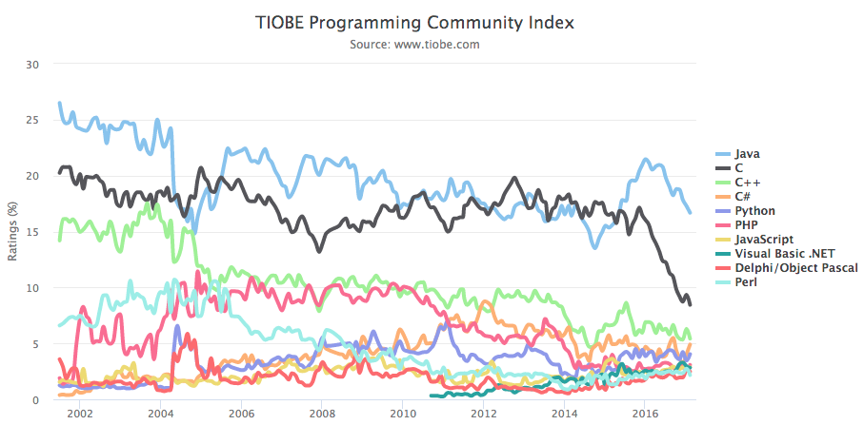
Why Java?
Most popular programming language in the world
& most popular paradigm (object-oriented)

Slide 16
Java (JDK) Versions
JDK 1.02 (1995)
JDK 1.1 (1996)
JDK 1.2 (1998)
JDK 1.3 (2000)
JDK 1.4 (2002)
JDK 1.5 (2004) a. k. a. JDK 5 or Java 5
JDK 1.6 (2006) a. k. a. JDK 6 or Java 6
JDK 1.7 (2011) a. k. a. JDK 7 or Java 7
JDK 1.8 (2014) a. k. a. JDK 8 or Java 8

Slide 17
JDK Editions
Java Standard Edition (J2SE)
J2SE can be used to develop client-side standalone applications or applets.
Java Enterprise Edition (J2EE)
J2EE can be used to develop server-side applications such as Java servlets, Java ServerPages, and Java ServerFaces.
Java Micro Edition (J2ME).
J2ME can be used to develop applications for mobile devices such as cell phones.
This book uses J2SE to introduce Java programming.

Slide 18
Popular Java IDEs (2016)
Eclipse 48%
IntelliJ IDEA (JetBrains) 33%
NetBeans 10%
Others, and Text Editors 9%
Popular text editors: vi/vim, emacs, Notepad++, ...
Notes:
Note: the 2017 Stackoverflow.com survey of ALL developers has IntelliJ (23.0%) higher than Eclipse (20.0%)

Slide 19
A Simple Java Program
Listing 1.1
// This program prints Welcome to Java!
public class Welcome {
public static void main(String[] args) {
System.out.println("Welcome to Java!");
}
}
Animation
Welcome
Run
Notes:
Ask students what is unusual/unfamiliar about this program.

Slide 20

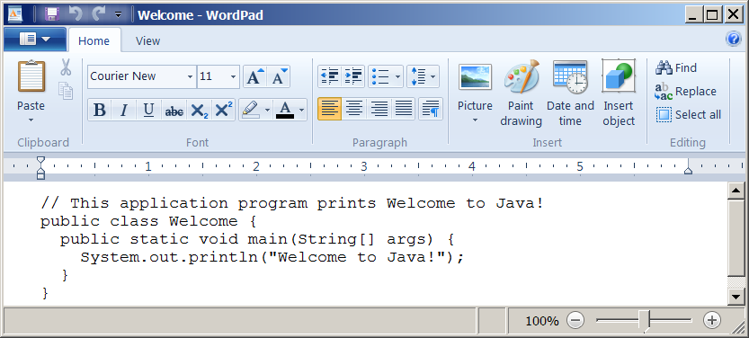
Creating and Editing Using WordPad
To use WordPad, type
write Welcome.java
from the DOS prompt.
For interest only – we will use IntelliJ IDEA IDE, Not WordPad

Slide 21
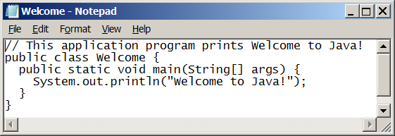
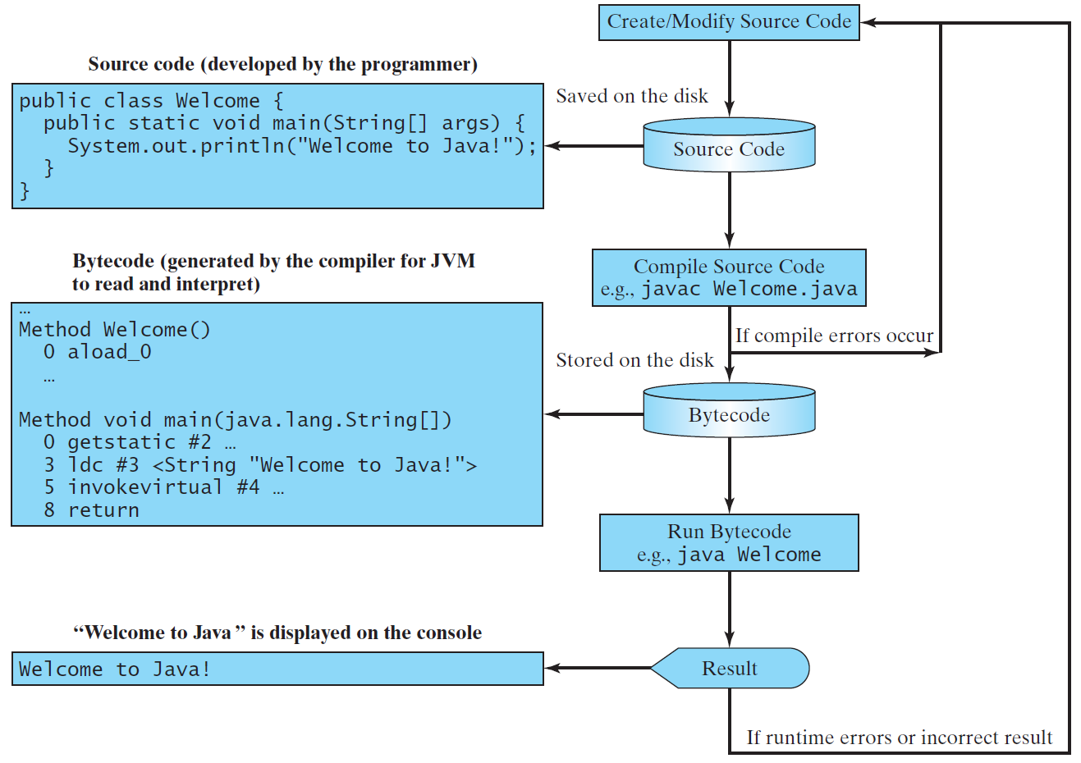
Creating, Compiling, and Running Programs
IntelliJ IDEA does all this automatically…

Slide 22
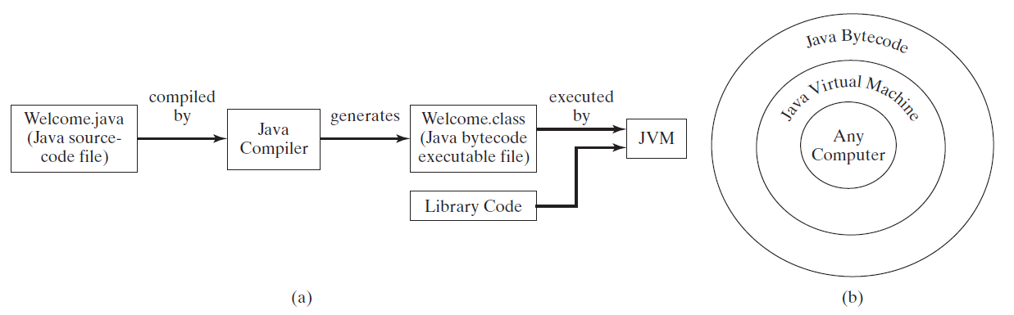
Compiling Java Source Code
You can port a source program to any machine with appropriate compilers. The source program must be recompiled, however, because the object program can only run on a specific machine. Nowadays computers are networked to work together. Java was designed to run object programs on any platform. With Java, you write the program once, and compile the source program into a special type of object code, known as bytecode. The bytecode can then run on any computer with a Java Virtual Machine, as shown below. Java Virtual Machine is a software that interprets Java bytecode.

Slide 23
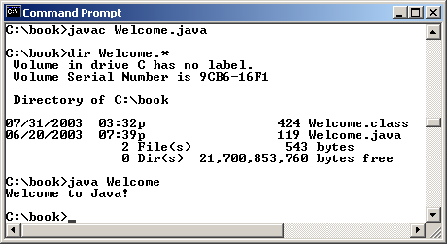
Compiling and Running Java from the Command Window
Companion Website
Set path to JDK bin directory
set path=c:\Program Files\java\jdk1.8.0\bin
Set classpath to include the current directory
set classpath=.
Compile
javac Welcome.java
Run
java Welcome
Again, IntelliJ IDEA does all this automatically…

Slide 24
Anatomy of a Java Program
Class name
Main method
Statements
Statement terminator
Reserved words
Comments
Blocks

Slide 25
Class Name
Every Java program must have at least one class. Each class has a name. By convention, class names start with an uppercase letter. In this example, the class name is Welcome.
// This program prints Welcome to Java!
public class Welcome {
public static void main(String[] args) {
System.out.println("Welcome to Java!");
}
}

Slide 26
Main Method
Line 2 defines the main method. In order to run a class, the class must contain a method named main. The program is executed from the main method.
// This program prints Welcome to Java!
public class Welcome {
public static void main(String[] args) {
System.out.println("Welcome to Java!");
}
}

Slide 27
Statement
A statement represents an action or a sequence of actions. The statement System.out.println("Welcome to Java!") in the program in Listing 1.1 is a statement to display the greeting "Welcome to Java!“.
// This program prints Welcome to Java!
public class Welcome {
public static void main(String[] args) {
System.out.println("Welcome to Java!");
}
}

Slide 28
Statement Terminator
Every statement in Java ends with a semicolon (;).
// This program prints Welcome to Java!
public class Welcome {
public static void main(String[] args) {
System.out.println("Welcome to Java!");
}
}

Slide 29
Reserved words
Reserved words or keywords are words that have a specific meaning to the compiler and cannot be used for other purposes in the program. For example, when the compiler sees the word class, it understands that the word after class is the name for the class.
// This program prints Welcome to Java!
public class Welcome {
public static void main(String[] args) {
System.out.println("Welcome to Java!");
}
}

Slide 30
Blocks
A pair of braces in a program forms a block that groups components of a program.

Slide 31
Special Symbols

Slide 32
{ … }
// This program prints Welcome to Java!
public class Welcome {
public static void main(String[] args) {
System.out.println("Welcome to Java!");
}
}

Slide 33
( … )
// This program prints Welcome to Java!
public class Welcome {
public static void main(String[] args) {
System.out.println("Welcome to Java!");
}
}

Slide 34
;
// This program prints Welcome to Java!
public class Welcome {
public static void main(String[] args) {
System.out.println("Welcome to Java!");
}
}

Slide 35
// …
// This program prints Welcome to Java!
public class Welcome {
public static void main(String[] args) {
System.out.println("Welcome to Java!");
}
}

Slide 36
" … "
// This program prints Welcome to Java!
public class Welcome {
public static void main(String[] args) {
System.out.println("Welcome to Java!");
}
}

Slide 37
Programming Errors
Syntax Errors
Detected by the compiler
(includes type errors, unlike Python)
Runtime Errors
Causes the program to abort
eg. divide by zero
Logic Errors
Program finishes, but produces incorrect output!

Slide 38
Python vs Java summary
Spot the differences…
Python | Java
def square(x): return x * x | int square( int x ) { return x * x; }
sum = 0 | int sum = 0 ;
for i in range(0, 10): sum += square(i) | for (int i = 0; i < 10; i++) { sum += square(i) ; }
Notes:
Ask students what differences they can see.

Slide 39
Demo+Exercise: Java Basics (in IntelliJ IDEA)
Open IntelliJ IDEA
Create New Project (Java program, no additional libraries)
click Next, then choose Java Hello World template
choose a project name 'ict221_mathgame' and note WHERE it will be located
Run your Java program:
open up the project, the 'src' folder, the 'Main' class in the editor
use 'Run' menu, then 'Run Main'.
Notes:
Lecturer: Open up IntelliJ IDEA and get students to do the same on their laptops (in pairs or groups if necessary).
Demonstrate how to create a project and a class, as above.
Demonstrate some features of Java, like declaring and using a local var: String msg = "...";
Then a while loop to print it 10 times.
Then show how the while loop can be written more concisely as a 'for' loop.
Then demonstrate printf. For example: System.out.printf("%4d %s\n", i, msg);

