Slide 1
Eric Winkler Final Presentation
Group #38 – Project Postal
Notes:
Hi this is eric winkler speaking for group 38 and this is my debriefing presentation for Capstone.

Slide 2
Overview
Technical information and skills
Non-technical information and skills
Project work
Project Management
Working in teams
What I would do differently
Notes:
Just a quikc overview before I start

Slide 3
Technical information
JavaScript and TypeScript
Node.js
Electron
Vis.js
Git and Github
Other Web-technologies (HTML, CSS)
Software Design
Asynchronous design
Object oriented Programming
Debugging
Compilers
Using APIs in general
Reading Documentation

Slide 4
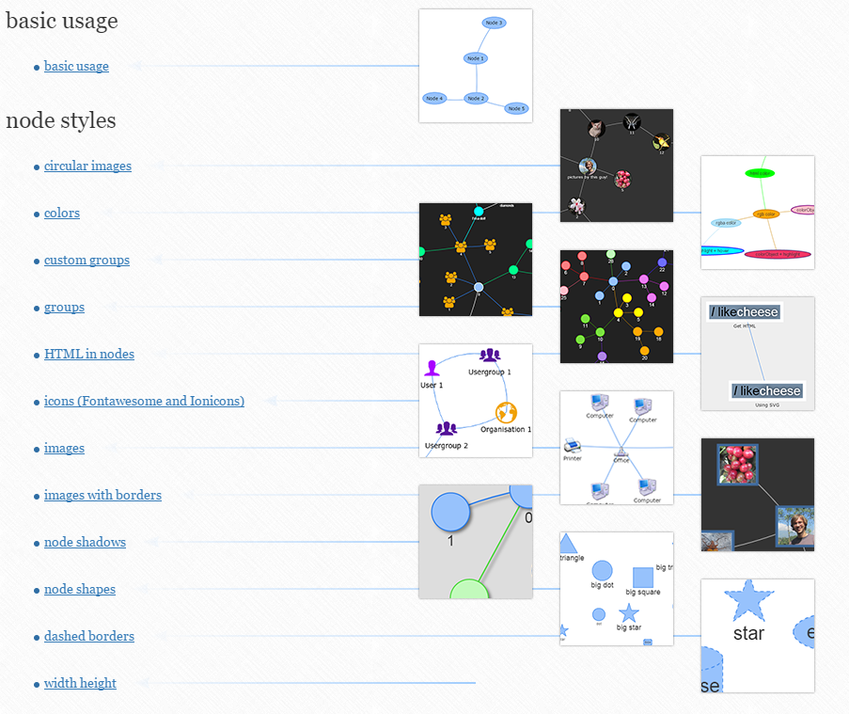
Resources
Vis.js Documentation
Vscode-color git
Regex101.com
JSON Formatter

Slide 5
Non-technical information and skills
Paired programming
New appreciation for classes
Importance of Design

Slide 6
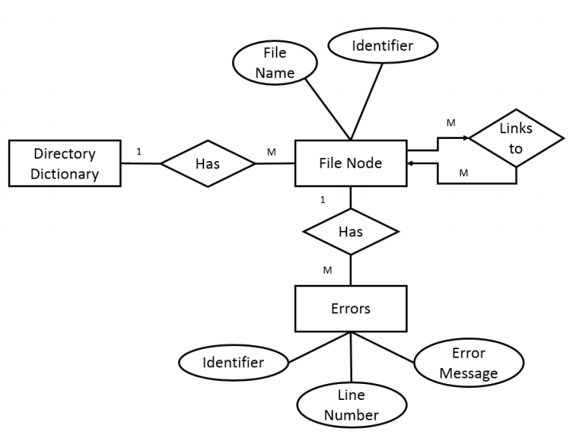
Project work
Design together
Well defined interfaces

Slide 7
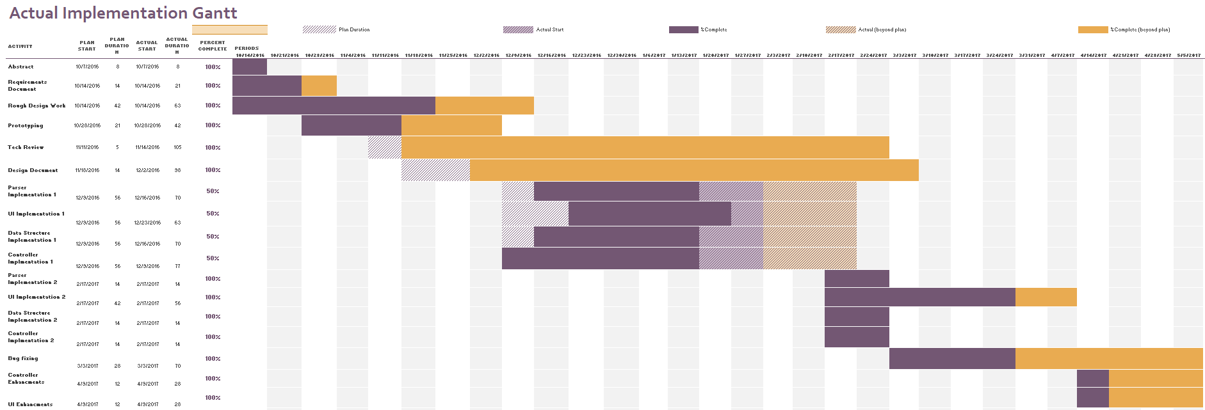
Project Management:
Importance of setting deadlines

Slide 8
Working in teams
Having a project ‘manager’

Slide 9
What I would do differently
More communication with client

