Slide 1
Postal

Slide 2
IFT Introduction

Slide 3
Postal (Super cool code name)
What it does

Slide 4
Postal (Super cool code name)
How it relates to IFT

Slide 5
Design details

Slide 6
VSCode, Postal as an extension
Why vscode
How the extension interfaces
Marketplace

Slide 7
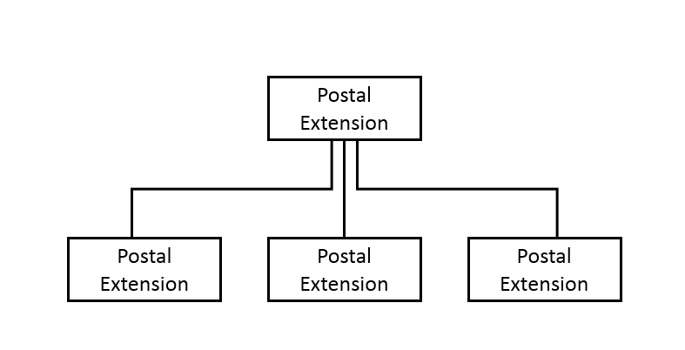
Major Components

Slide 8
Parsers
High level details

Slide 9
Parsers
Implementation details

Slide 10
UIs
High level details

Slide 11
UIs
Implementation details

Slide 12
UIs
Mock ups and interaction

Slide 13
Data Layer
High level details

Slide 14
Data Layer
Implmentation details

Slide 15
Term in review

Slide 16
Time line
August
September
October
November
Dec
Preterm events
Preterm events continued

Slide 17
Time line
August
September
October
November
Dec
Weeks 1-3
ditto

Slide 18
Time line
August
September
October
November
Dec
Weeks 4-7
ditto

Slide 19
Time line
August
September
October
November
Dec
Weeks 8-10
ditto

Slide 20
Team Performance: What’s working
ditto

Slide 21
Team Performance: What needs improvement
ditto

Slide 22
Currently Outstanding issues
ditto

Slide 23
Future Plans

Slide 24
Winter break objectives
ditto

Slide 25
Winter term objectives
ditto

Slide 26
Spring term objectives
ditto

