Slide 1
Postal
A Visual Studio Code extension to help web developers write better code

Slide 2
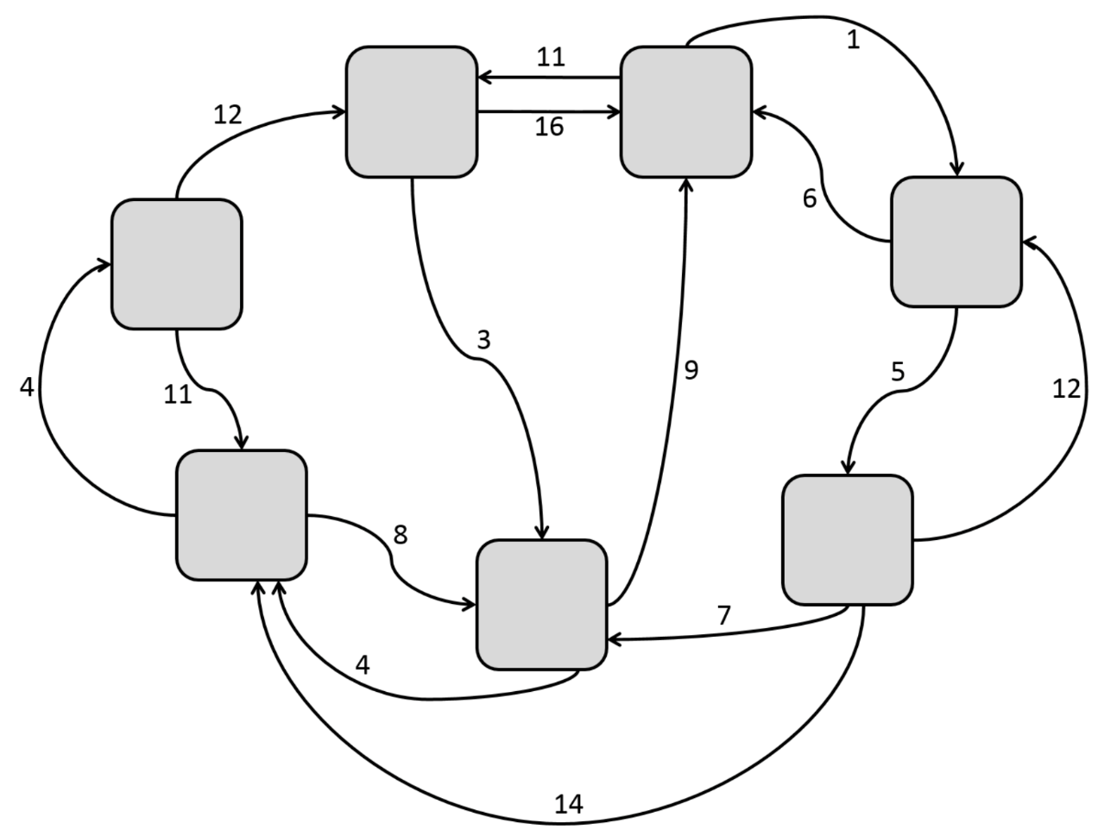
IFT Introduction
Information Foraging Theory is the concept that our project revolves around.
Information foraging theory turns information into topologies.

Slide 3
Postal
Organize Code bases.
With IFT in mind Postal was born.
Scaled back scope to HTML and CSS and possible expandability.

Slide 4
Design details

Slide 5
Why Choose VSCode
Options:
Atom
Brackets
VSCode
Languages
Marketplace Availability

Slide 6
Major Components
The Major Parts of the Extension:
IDE
Parser
Data Structure
Graphical User Interface
Visual Studio Code
Parser
Data Structure
Graphical User Interface

Slide 7
IDE: Visual Studio Code
The Extension will work with VSCode using Event Handlers
The main event handlers:
Parsing:
On Start
On Save
On Close
Open GUI:
On Activate

Slide 8
Parsers
Gathering files in current project (file parser)
Basic HTML parser
Fleshed out parsers to come

Slide 9
Parsers
The parser will be run every time the user saves a file
It will only parse the files that have changed
The parser will be called using a callback in the VSCode IDE
The parser will alert the data layer that it has new data to update the data structure with

Slide 10
Parsers
File parser built in TypeScript using Visual Studio Code API
Prototype HTML parser written in Perl using Simple TokeParser library
More fleshed out parsers to come
Likely to be written in JavaScript to parse all HTML, CSS, and JavaScript

Slide 11
Parsers
The parser class will consist of a general parse function that will take in rules for which to parse
These rules will be taken from a JSON object which we will build
The rules will be separated into sections for each language we need to parse, HTML, CSS, JavaScript, etc.
This will allow us to easily add in support for other languages

Slide 12
User Interface
One GUI consisting of the File Map and the Error List.
Displays all the data picked up by the parsers
The File Map Displays a visualization of the user's project directory in the form of a graph of interconnected nodes.
The error list displays a list of the Broken Rules in the project directory detected by the extension parser.

Slide 13
x
Interdum et malesuada fames ac ante ipsum primis in faucibus. Suspendisse ac efficitur quam. Vestibulum ante
ipsum primis in faucibus orci luctus et ultrices posuere cubilia Curae; Nulla id tristique odio. Maecenas tempor justo eu odio mattis efficitur. Donec fermentum lectus nec
orci mollis pretium. Duis tempor sapien sed urna ultricies, ut porttitor ante rutrum. Class aptent taciti sociosqu ad litora torquent per conubia nostra, per inceptos
himenaeos. Vivamus tempus massa eget ante scelerisque, eu lobortis quam vestibulum. Pellentesque malesuada placerat convallis. Sed vehicula elementum tincidunt. Ut
at enim ac mi congue gravida feugiat non urna.
Aliquam gravida, neque eu pellentesque sodales, augue nunc condimentum orci, in commodo urna enim vitae
JPEG1
PNG2
Masonry
Jquery
PNG1
App.js
Index.php
header.php
Styles.css
About.php
footer.php

Slide 14
x
Interdum et malesuada fames ac ante ipsum primis in faucibus. Suspendisse ac efficitur quam. Vestibulum ante
ipsum primis in faucibus orci luctus et ultrices posuere cubilia Curae; Nulla id tristique odio. Maecenas tempor justo eu odio mattis efficitur. Donec fermentum lectus nec
orci mollis pretium. Duis tempor sapien sed urna ultricies, ut porttitor ante rutrum. Class aptent taciti sociosqu ad litora torquent per conubia nostra, per inceptos
himenaeos. Vivamus tempus massa eget ante scelerisque, eu lobortis quam vestibulum. Pellentesque malesuada placerat convallis. Sed vehicula elementum tincidunt. Ut
at enim ac mi congue gravida feugiat non urna.
Aliquam gravida, neque eu pellentesque sodales, augue nunc condimentum orci, in commodo urna enim vitae
JPEG1
PNG2
Masonry
Jquery
PNG1
App.js
Index.php
header.php
Styles.css
About.php
footer.php

Slide 15
x
ipsum primis in faucibus orci luctus et ultrices posuere cubilia Curae; Nulla id tristique odio. Maecenas tempor justo eu odio mattis efficitur. Donec fermentum lectus nec
orci mollis pretium. Duis tempor sapien sed urna ultricies, ut porttitor ante rutrum. Class aptent taciti sociosqu ad litora torquent per conubia nostra, per inceptos
JPEG1
PNG2
Masonry
PNG1
Index.php
App.js
<div class=“class">
<div>
header.php
About.php
footer.php

Slide 16
x
JPEG1
PNG1
Masonry
PNG1
Index.php
PNG2
App.js
header.php
footer.php
About.php

Slide 17
x
Interdum et malesuada fames ac ante ipsum primis in faucibus. Suspendisse ac efficitur quam. Vestibulum ante
ipsum primis in faucibus orci luctus et ultrices posuere cubilia Curae; Nulla id tristique odio. Maecenas tempor justo eu odio mattis efficitur. Donec fermentum lectus nec
orci mollis pretium. Duis tempor sapien sed urna ultricies, ut porttitor ante rutrum. Class aptent taciti sociosqu ad litora torquent per conubia nostra, per inceptos
himenaeos. Vivamus tempus massa eget ante scelerisque, eu lobortis quam vestibulum. Pellentesque malesuada placerat convallis. Sed vehicula elementum tincidunt. Ut
at enim ac mi congue gravida feugiat non urna.
Aliquam gravida, neque eu pellentesque sodales, augue nunc condimentum orci, in commodo urna enim vitae
header.php

Slide 18
GUI Implementation Details
File Map -> vis.js
Error list -> Advanced News Ticker
GUI window -> Electron application

Slide 19
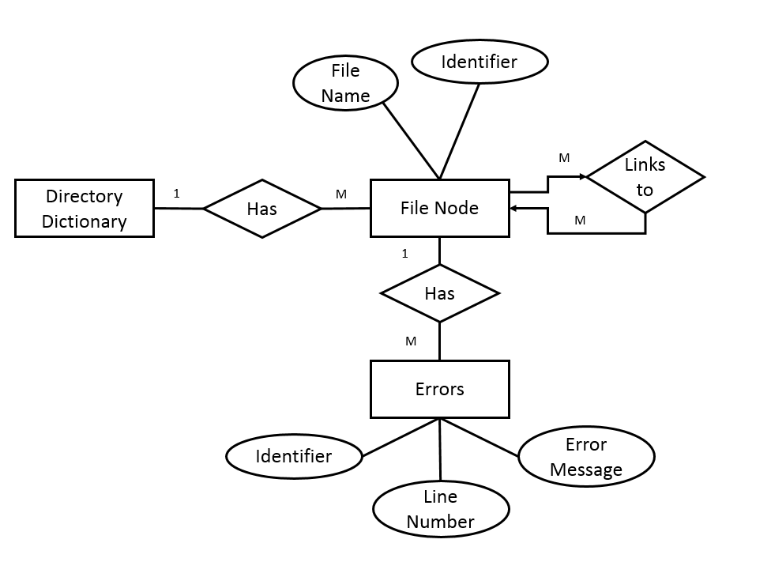
Data Layer
Dictionary of file nodes and links collected by the parser
Nodes in data layer contain info on all the files in the project, as well as error data detected by parser
Data is passed between 3 main processes:
Data Structure
Serializer
Data Storage
Node and error info stored in a file is used by the UI

Slide 20
Data Layer
General data flow:
User Files->Parser->Data Structure->Serializer->Data Storage->UI
Parser outputs JavaScript objects (node dictionary) to data structure
Data structure serialized into JSON file using JSON.stringify() function built into JavaScript language
Parsing and serialization triggered by file save
Deep object compare between updated data structure and JSON file to indicate to UI which files were updated

Slide 21
Term in Review

Slide 22
Timeline
August
September
October
November
Dec
Aug-Became aware of a research opportunity for Prof. Scaffidi
Aug-Wrote proposals for capstone project based on IFT
Aug-Agreed to create developer tool to increase efficiency

Slide 23
Timeline
August
September
October
November
Dec
Week 0,1-Class introductions and team assignments
Week 2-Wrote abstract for Problem Statement
Week 3-Created Problem Statement, began to discuss functionality

Slide 24
Timeline
August
September
October
November
Dec
Week 4-Cramer and Sam began to create “Hello World” program for VS Code
Week 5-Revised Problem Statement for resubmission
Week 5-Worked on and began Requirements Document
Week 6-Completed Requirements Document, solidified ideas behind project

Slide 25
Timeline
August
September
October
November
Dec
Week 7-Nailed down design of UI for prototype presented to client
Week 8-Technology Review completed, designed data structure
Week 9-Sam built prototype HTML parser, Eric built initial FileMap UI
Week 10-Design Document completed, Sam improved parser
Week 11-Created this Progress Report

Slide 26
Team Performance: Positives
Good communication between team members
The team makes time to get together to work
Everyone has a good attitude

Slide 27
Team Performance: What needs improvement
Ensuring 100% clarity with client communication
Planning ahead
Lack of a team leader

Slide 28
Changes to be made
Assigning a team leader responsible for:
double checking client communications
Planning/scheduling tasks for the team/ work assignments

Slide 29
Future Plans

Slide 30
Winter Break Objectives
Unit tests
Extension working on a real project
Finished Parser class
Support for HTML parsing
Get file map view to show up in VSCode

Slide 31
Winter Term Objectives
Finalize CSS and JavaScript parsing rules
Build rules for checking for ”best practices”
Debugging
Corner cases

Slide 32
Spring Term Objectives
Finalize product
Finish up anything that didn’t get finished in previous terms
User testing

