Slide 1
Postal
A Visual Studio Code extension to help web developers write better code

Slide 2
Postal
Visualize Code bases
In the past the Focus of the project was on web project supporting HTML, CSS, PHP and JavaScript
We have now expanded the project to be able to handle almost any language as the user defines it.
Errors

Slide 3
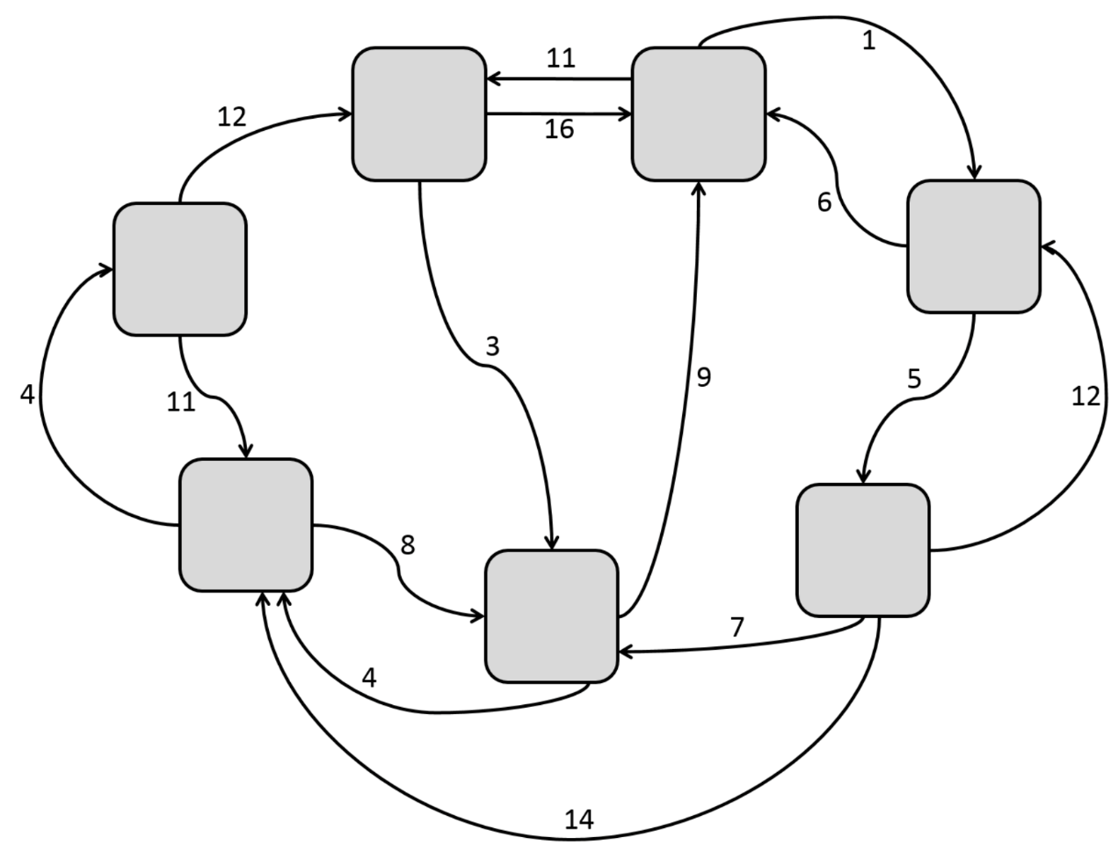
IFT Introduction
Information Foraging Theory is the concept that our project revolves around
Information Foraging Theory turns information into topologies

Slide 4
Design details, Current Features

Slide 5
x
Interdum et malesuada fames ac ante ipsum primis in faucibus. Suspendisse ac efficitur quam. Vestibulum ante
ipsum primis in faucibus orci luctus et ultrices posuere cubilia Curae; Nulla id tristique odio. Maecenas tempor justo eu odio mattis efficitur. Donec fermentum lectus nec
orci mollis pretium. Duis tempor sapien sed urna ultricies, ut porttitor ante rutrum. Class aptent taciti sociosqu ad litora torquent per conubia nostra, per inceptos
himenaeos. Vivamus tempus massa eget ante scelerisque, eu lobortis quam vestibulum. Pellentesque malesuada placerat convallis. Sed vehicula elementum tincidunt. Ut
at enim ac mi congue gravida feugiat non urna.
Aliquam gravida, neque eu pellentesque sodales, augue nunc condimentum orci, in commodo urna enim vitae
JPEG1
PNG2
Masonry
Jquery
PNG1
App.js
Index.php
header.php
Styles.css
About.php
footer.php

Slide 6
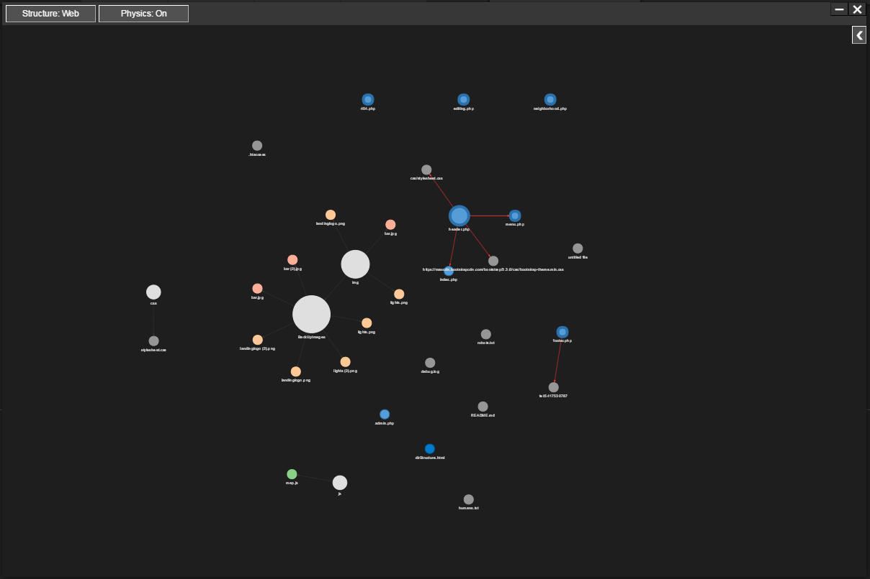

Slide 7
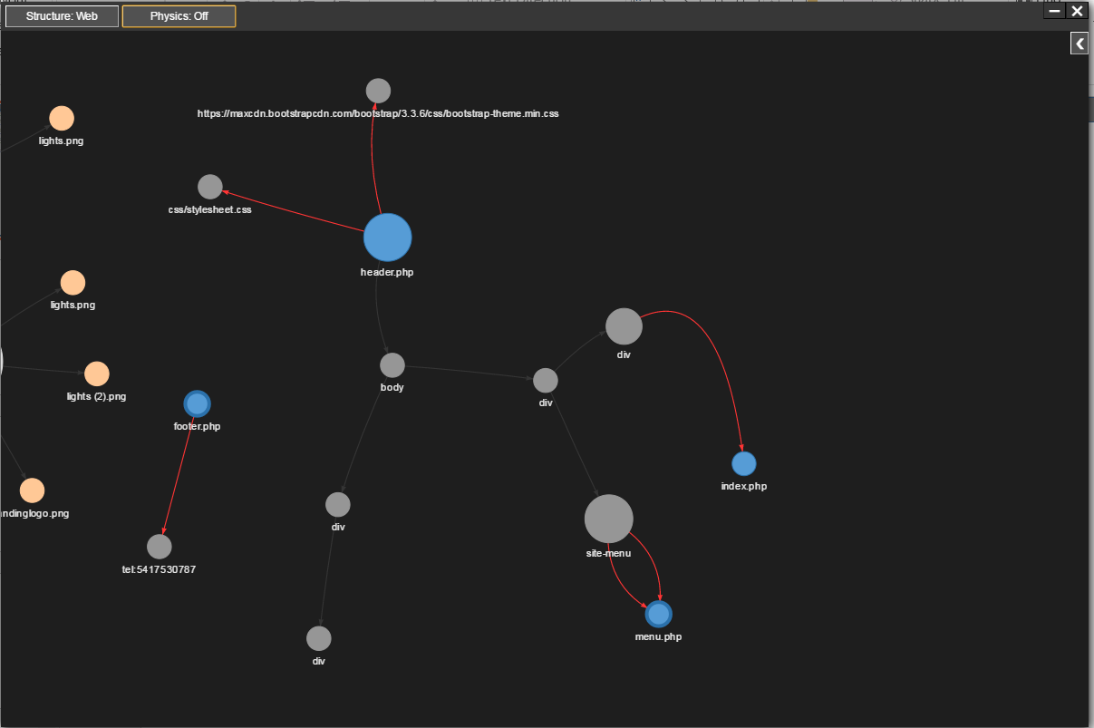

Slide 8
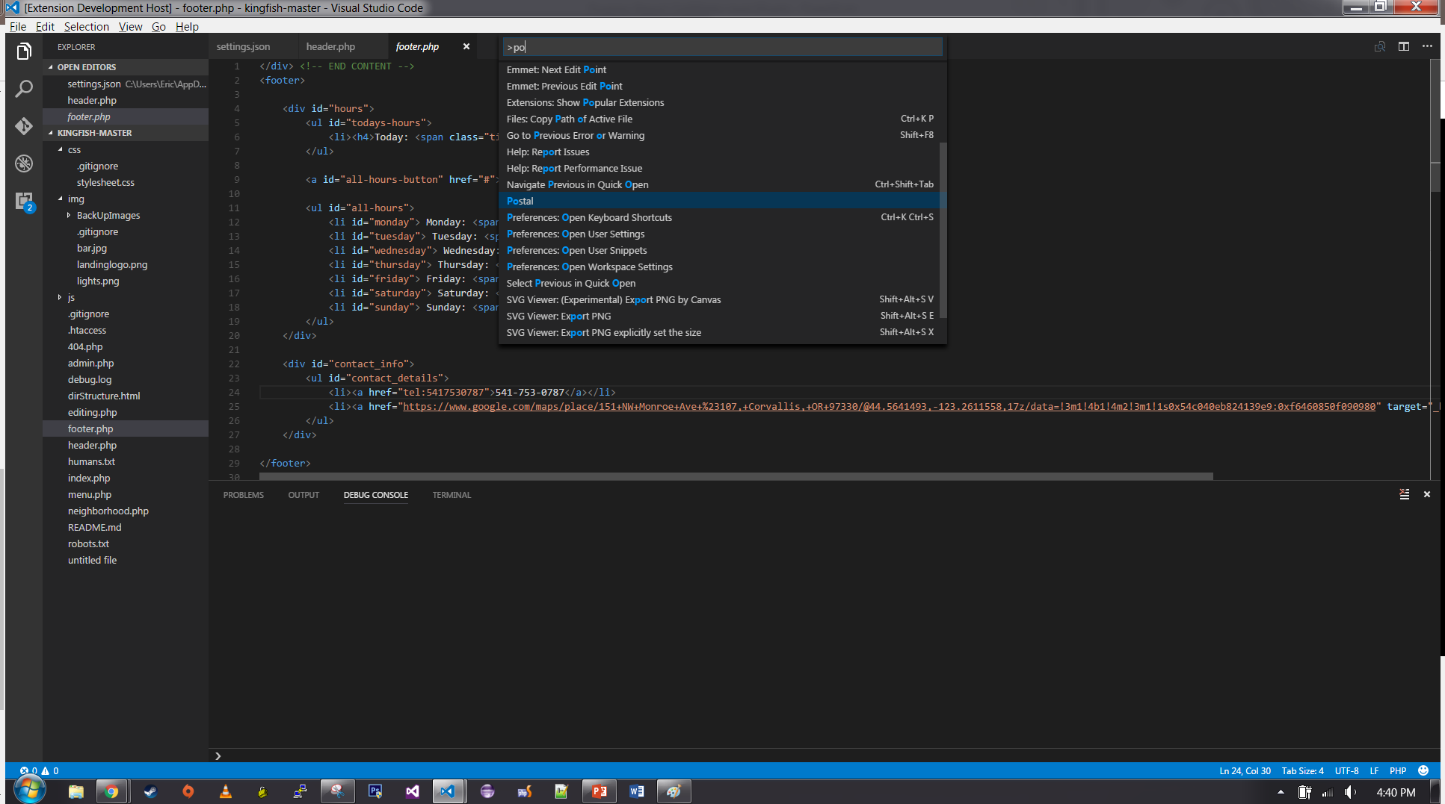

Slide 9
Major Components
The Major Parts of the Extension:
IDE
Controller
Parser
Data Structure
Graphical User Interface
Visual Studio Code
Parser
Controller
Graphical User Interface

Slide 10
Grammar System
Allows users to control what Postal finds and renders in the UI
Stored as JSON structures, Changed in extension configuration file
Current Grammar behvaiors:
Tagged
C-like functions
File links

Slide 11
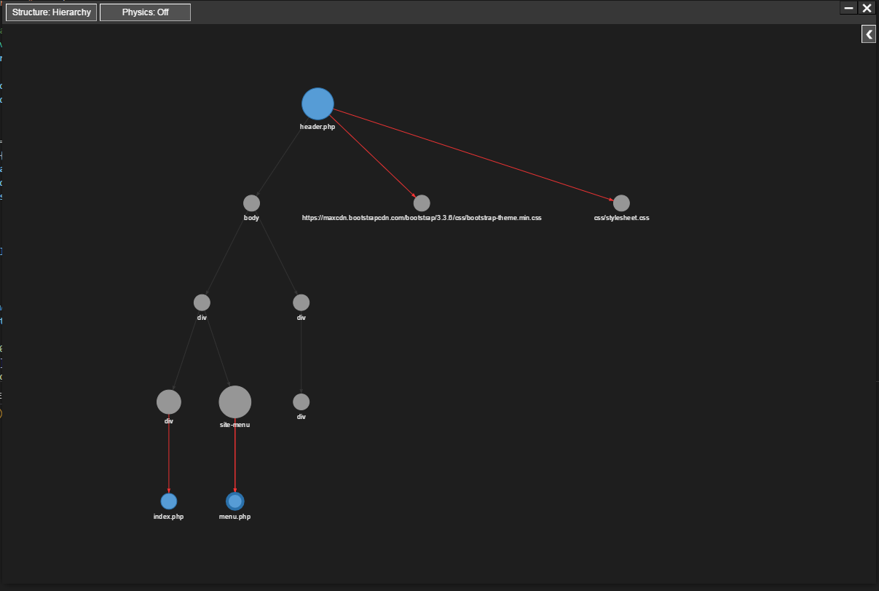
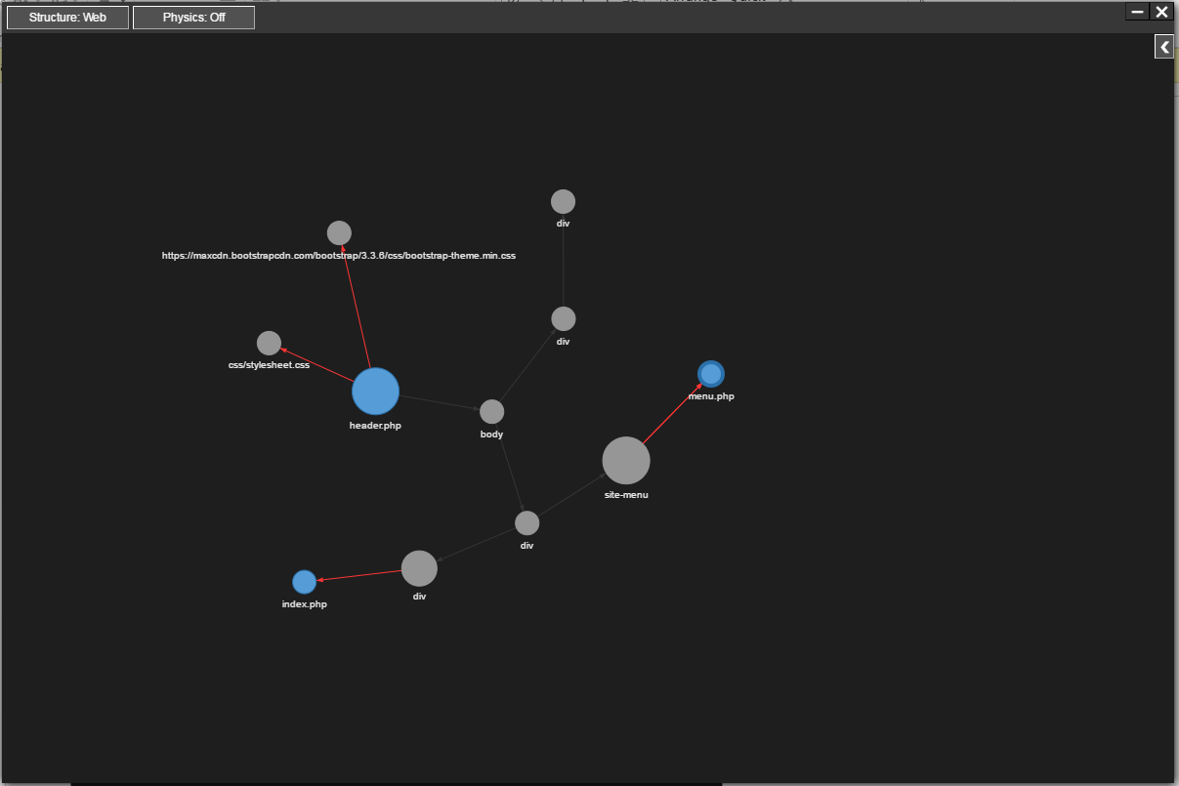
UI Controls
Hierarchy vs web

Slide 12
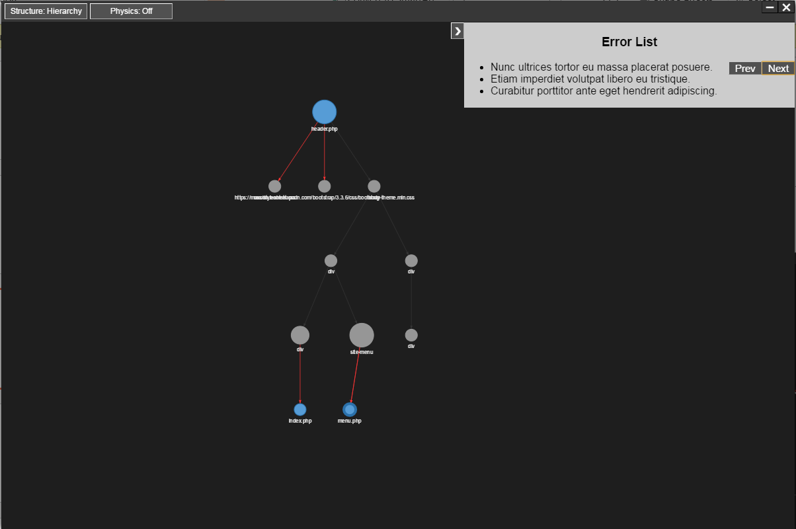
UI Controls
Physics
Expand Notification list (errors) button
Close and minimize buttons

Slide 13
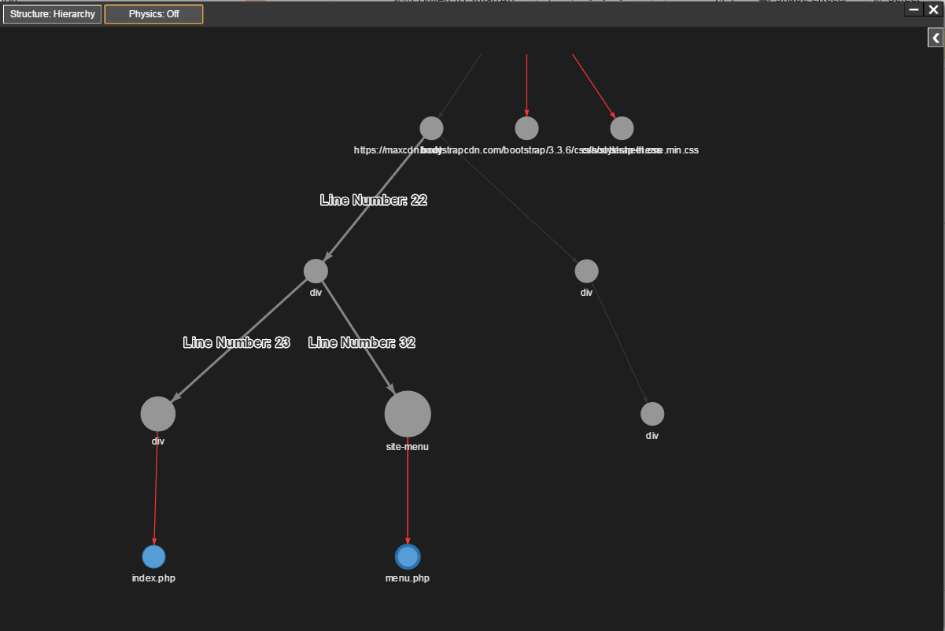
UI Controls
Helpful labels

Slide 14
Quality of life
Camera animation
.postalignore
Disable parsing on comments

Slide 15
Term in Review

Slide 16
Timeline
December
January
February
March
Winter Break- Team got together to discuss distribution of work, got started on individual parts
Week 1- Worked to develop very early prototype, client satisfied with progress, set end of February beta deadline

Slide 17
Timeline
December
January
February
March
Week 2- Continued to tweak early prototype before moving on to major features
Week 3- Worked on small UI changes
Week 4- Began updating documentation, created OneNote “engineering log”, work continued on individual components

Slide 18
Timeline
December
January
February
March
Week 5- Began combining project components, continued to update Technology Review and Design Document
Week 6- Conducted major project rework, rewriting parser to read files line-by-line, switched to MVC design, updated data layer and UI to reflect new parser data

Slide 19
Timeline
December
January
February
March
Week 7-Continued with redesign and published extension to VS Code marketplace
Week 8-Met with client and shifted towards UI from core functionality
Week 9-Continued working on UI, adding network configuration, error list
Week 10-Completed preliminary Expo poster and progress report

Slide 20
Team Performance: Positives
Roles have been more clearly defined
Sam in charge of client communication
Zach in charge of documentation and submission
Cramer in charge of extension publishing
Eric in charge of overall extension design and tasks
Client has been satisfied with progress, suggests shift toward usability
Conducted code reviews to understand all parts of code
Team has met beta release deadline on time

Slide 21
Team Performance: What Needs Improvement
Project completion state needs to be clarified with our client
Individual accountability/communication for project tasks needs to be improved
Decisions need to be made regarding scope creep and whose responsibility remaining features are

Slide 22
Problems/Changes To Be Made
Design Shift: as we focus more on usability and usefulness, we need to make sure we don’t drift too far from the original design
Scope Creep: a focus on usability tends towards adding more and more features. We will opt towards adding minor features that require a proportionate amount of work
Uneven Workload: as some components have been primarily worked on by one individual, responsibilities have become uneven in time/difficulty

Slide 23
Future Plans

Slide 24
Future Plans
Bug Fixes
Implement a Process Bridge
Send information between the UI and the extension logic
C-Like Function Usage Grammar
Navigate To Selected Node
Errors Notifications
Change parser behavior
Build in default grammar support
User Testing

