Slide 1
Postal
A Visual Studio Code extension to help developers write better code
Team 38

Slide 2
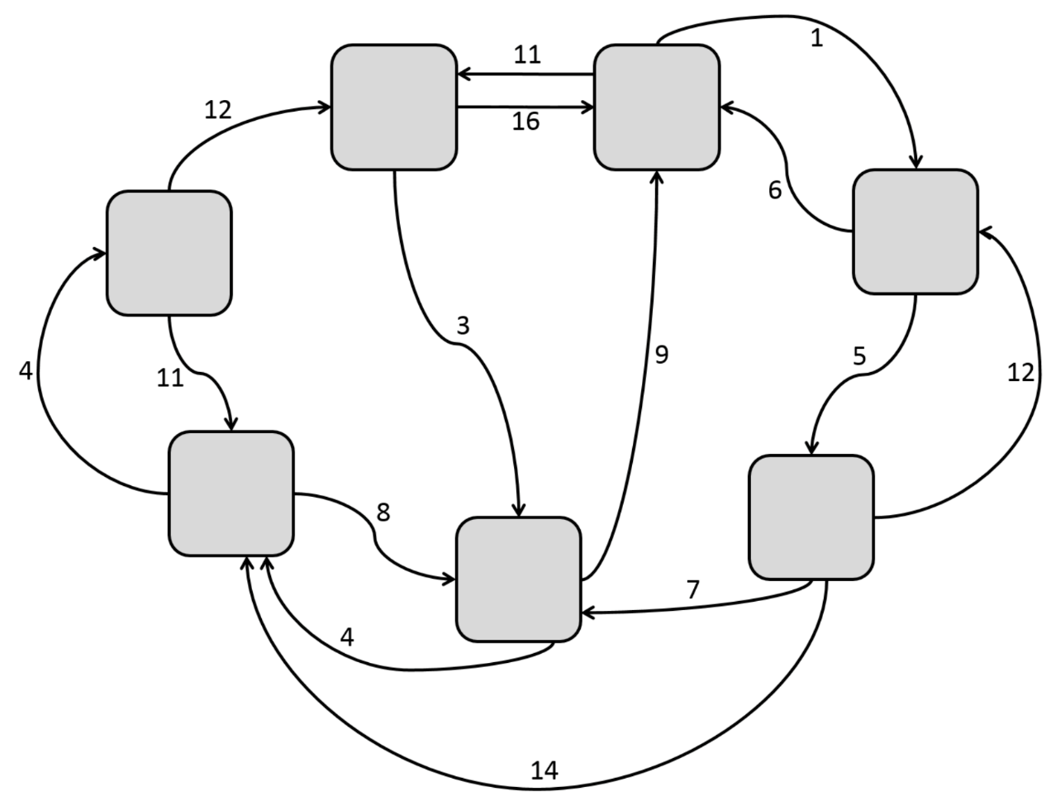
IFT Introduction
Information Foraging Theory studies how humans find and utilize information sources
Developers can use Information Foraging Theory to program more efficiently and improve their code

Slide 3

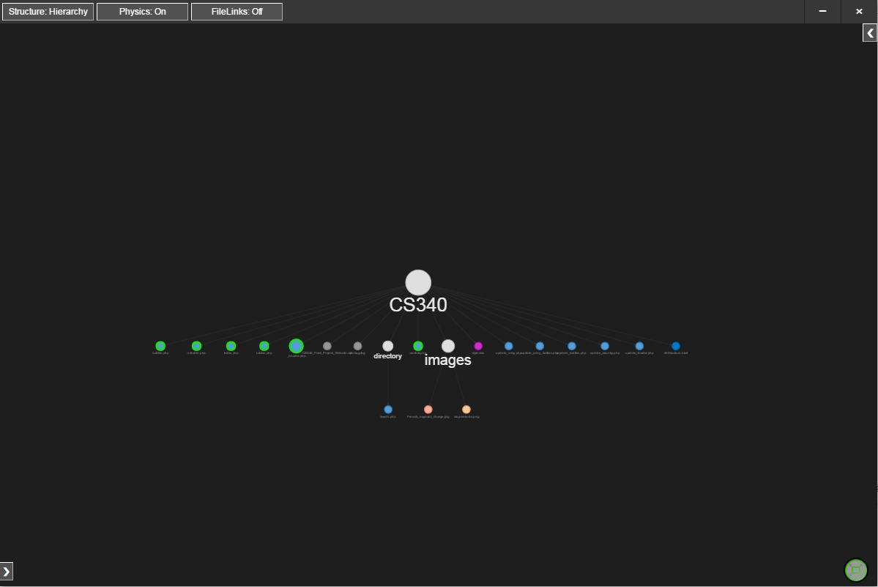
Project Postal
Postal is an extension for Microsoft’s Visual Studio Code
Codebase visualization into an interactive network of file nodes
Use nodes to jump to corresponding location in code
Display file references as visual links to show code dependencies

Slide 4
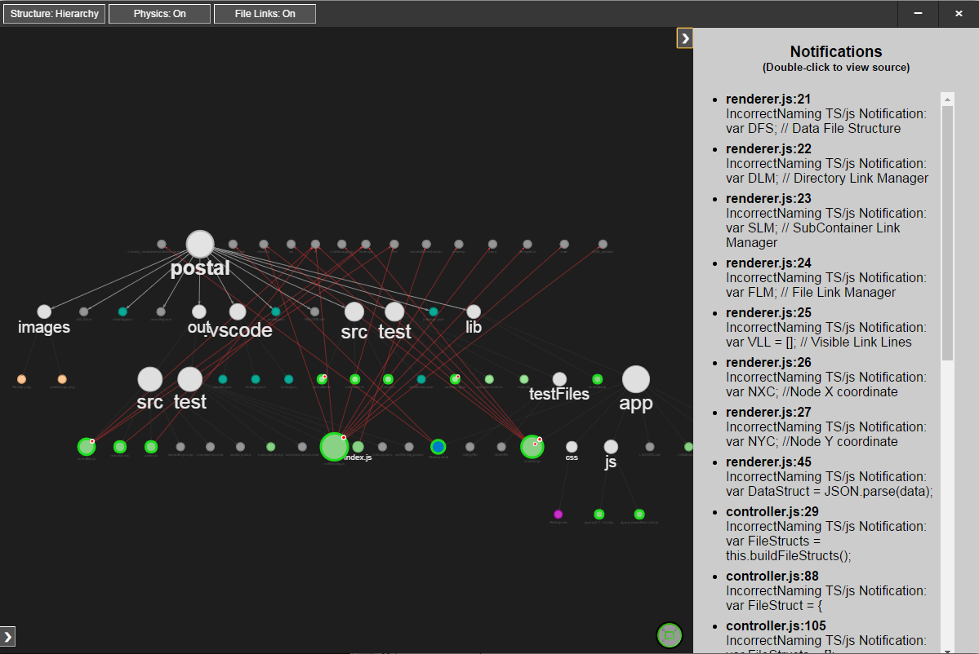
Project Postal
Notification windows helps detect errors and inconsistencies
Jump to code from Notification List
Fully user extensible: search any language for any problem

Slide 5
Project Postal
Tool already used to improve itself
1.0 release available for download on Visual Studio Marketplace

Slide 6
Code Walkthrough

Slide 7
Requirements
Document section II-B “Product Functions”
Offered in a free, cross-platform text editor
Provide the user with a visual perspective of their project
Parse project for bad coding practice/incorrect formatting
Indicate to user when “errors” are parsed
Visually display links between files
Rules defined by W3C by user defined grammars
Ignore lines of code marked in an exception list
Parse projects up to 100,000 LOC with less than one second of lag
Document section III-A “External Interfaces” **More of a design description
Two main elements
File Map UI
Error List
Toolbar for options
Populate File Map with contents of opened solution
Visual indicator of links and errors
“Dig down” into a file to identify “sub-nodes” (divs and links)
Error list displays all errors parsed
User can click error to navigate to corresponding location in code
User can hover over error and will highlight location in File Map
Document section III-B “Functions”
Be able to parse JavaScript, HTML and CSS
Document section III-C “Performance Requirements”
30 HTML, 5 CSS, 10 JS files in less than one second
Document section III-D “Software System Attributes”
Available on VS Code Extension Marketplace

Slide 8
Requirements
Document section II-B “Product Functions”
Offered in a free, cross-platform text editor
Provide the user with a visual perspective of their project
Parse project for bad coding practice/incorrect formatting
Indicate to user when “errors” are parsed
Visually display links between files
Rules defined by W3C by user defined grammars
Ignore lines of code marked in an exception list
Parse projects up to 100,000 LOC with less than one second of lag
Document section III-A “External Interfaces” **More of a design description
Two main elements
File Map UI
Error List
Toolbar for options
Populate File Map with contents of opened solution
Visual indicator of links and errors
“Dig down” into a file to identify “sub-nodes” (divs and links)
Error list displays all errors parsed
User can click error to navigate to corresponding location in code
User can hover over error and will highlight location in File Map
Document section III-B “Functions”
Be able to parse JavaScript, HTML and CSS
Document section III-C “Performance Requirements”
30 HTML, 5 CSS, 10 JS files in less than one second
Document section III-D “Software System Attributes”
Available on VS Code Extension Marketplace

Slide 9
Major Components
The Major Parts of the Extension:
IDE
Grammar System
Controller
Parser
Data Structure
Graphical User Interface
Visual Studio Code
Grammars
Parser
Controller
Graphical User Interface

Slide 10
Data Flow
Visual Studio Code
Grammars
Controller
Parser
Data Structure
Graphical User Interface

Slide 11
Controller
High level logic
Launches Parser and UI modules
Builds data structure
Requirements
Ignore lines of code marked in an exception list

Slide 12
Controller execution
Builds data structure
Calls parser for each file to be parsed
Creates a tree of the files by directory location
Launches the Electron UI
Creates a server for IPC

Slide 13
Parser
Creates a list of tokens that will be formatted into the data structure
Tokens are anything useful and are partially defined in the Grammars
Tokens have
Token Type – node, link, notification
Value Type – int, string
Value – What is the actual information in this token
Line number
Parent token – used for describing nested structure
Requirements
Parse project for bad coding practice/incorrect formatting
Rules defined by user defined grammars
Be able to parse JavaScript, HTML and CSS

Slide 14
Parser execution
Called on a file by controller
Identify information about the file (name, type)
Get all applicable rules from the grammars system and build regexs
Strip commented lines, white space (not exactly)
Get the tokens
Identifies the type of tokens based on the rule and has predefined behavior based on that type
Build tokens and order them by character position in the file to create nested structures

Slide 15
Grammars
Allows users to control what Postal finds and renders in the UI
Stored as JSON structures, Changed in extension configuration file
Current Grammar behaviors:
Tagged – HTML, CSS
C-like functions - JavaScript
File links
Notification Type – “Errors”

Slide 16
Renderer
UI Logic
Builds visual tree from the data structure using vis.js API
Constructs notification list from datastructure
Handles user interaction
Requirements:
Provide the user with a visual perspective of their project
Indicate to user when “errors” are parsed
Visually display links between files
Toolbar for options
Populate File Map with contents of opened solution
Visual indicator of links and errors
“Dig down” into a file to identify “sub-nodes” (divs and links)
Error list displays all errors parsed
User can click error to navigate to corresponding location in code
User can hover over error and will highlight location in File Map

Slide 17
Renderer
UI Logic
Builds visual tree from the data structure using vis.js API
Constructs notification list from datastructure
Handles user interaction
Requirements:
Provide the user with a visual perspective of their project – renderer.js
Indicate to user when “errors” are parsed – 344-357
Visually display links between files – 765-876
Toolbar for options – 593 -682
Populate File Map with contents of opened solution – renderer.js
Visual indicator of links and errors – 123-140
“Dig down” into a file to identify “sub-nodes” (divs and links) – 270- 340
Error list displays all errors parsed – 344-357
User can click error to navigate to corresponding location in code – 684-700
User can hover over error and will highlight location in File Map – 164 - 176

Slide 18
Renderer exectution
Create Link Managers
Modify data structure with local variables
Create initial Node ad edge structures
Set vis.js options and create network
Cluster the network
Build notification list and create error bubbles on the network
Create event listeners for the UI
Extension is ready for use

Slide 19
Current Status
1.0.0
The Extension is feature complete
There are some minor Bugs we continue to find and crunch

Slide 20
Left to do
Bugs
Testing
IRB Approval
Continue Developing Test Cases
Procure Money for Test Incentive
Do the Testing
Write Results

Slide 21
Fall Problems/Solutions
Problem(s): Lack of clarity/direction in design of Postal, where to start
Solution(s): Revising documentation, trying out prototypes to see what was feasible, further discussion with client

Slide 22
Winter Problems/Solutions
Problem(s): Miscommunication with client about expectations, individual team members became specialists leaving some without work to do
Solution(s): Increased communication frequency with client, designation of spokesman, more code reviews and pair programming

Slide 23
Spring Problems/Solutions
Problem(s): Scope creep, when to declare a feature complete uncertain, burnout
Solution(s): Strict adherence to requirements and what is needed for user testing, explicit goals and individual responsibility

Slide 24
Postal
A Visual Studio Code extension to help developers write better code
Team 38

