Slide 1
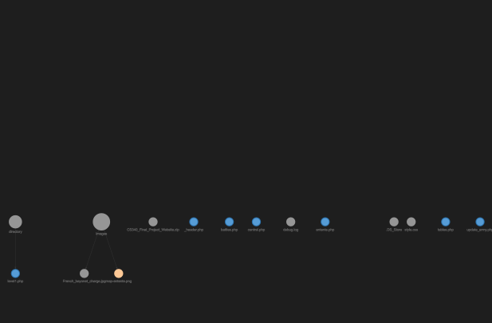

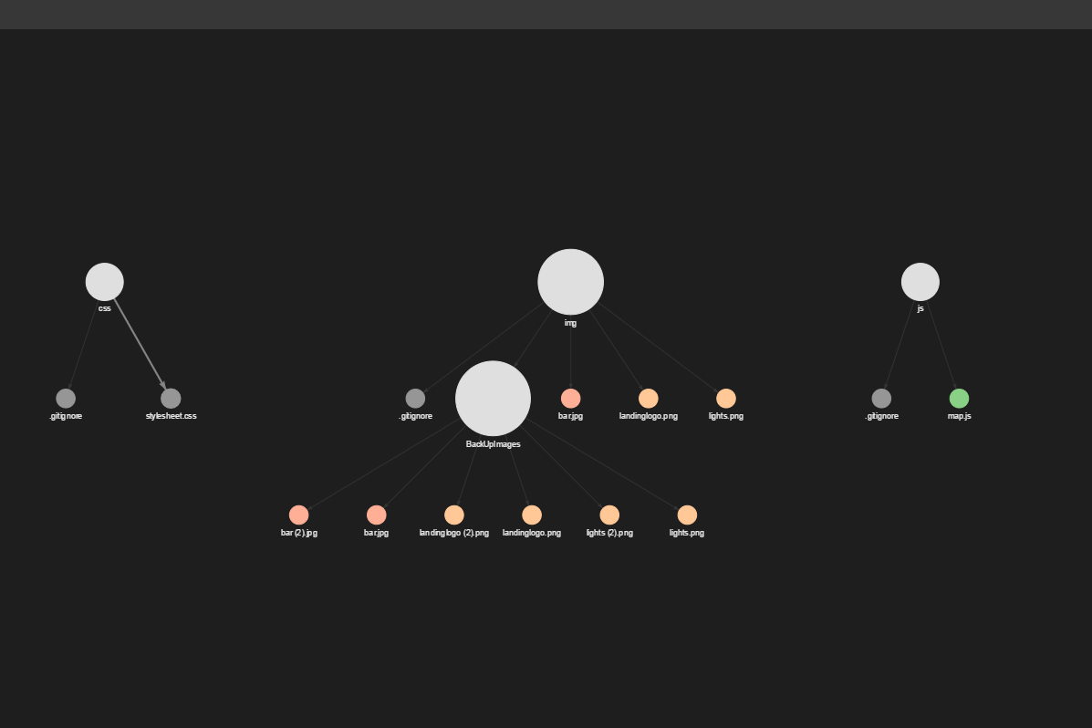
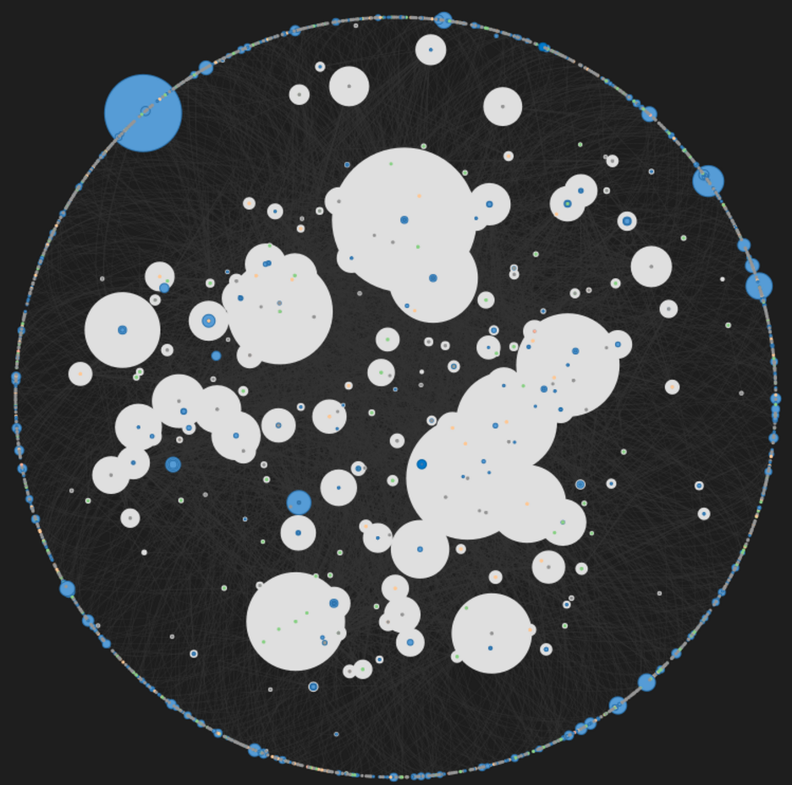
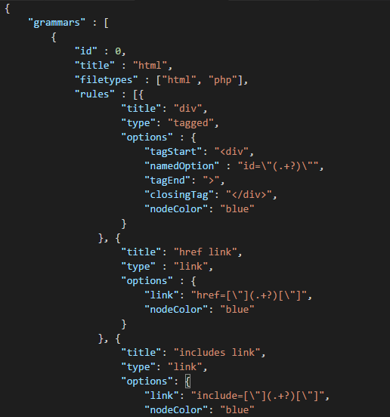
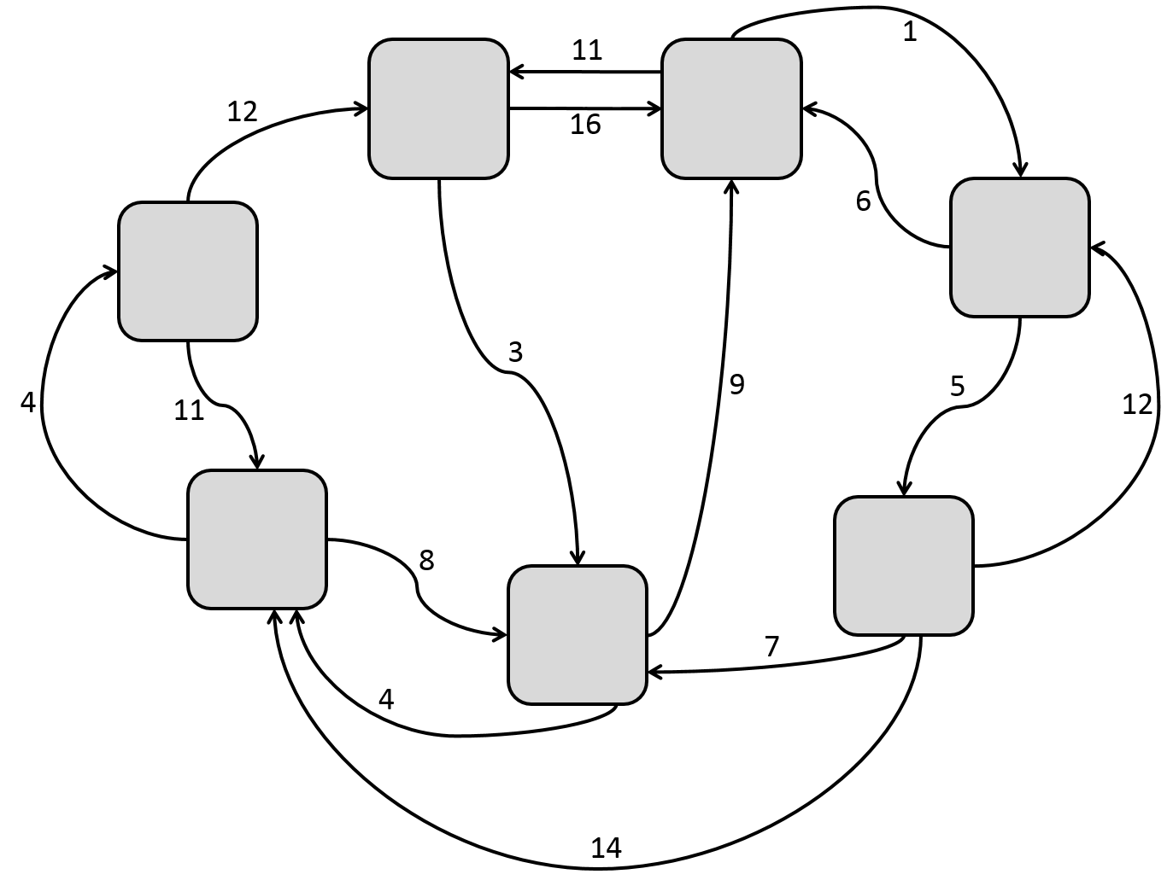
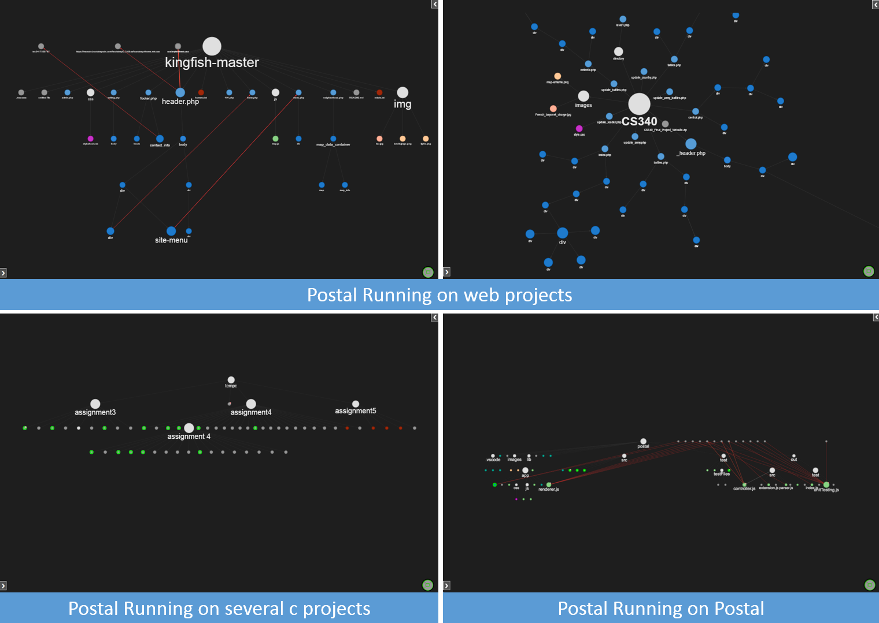

Postal
Senior Capstone Project
CS 461/462/463
Information Foraging Theory
The Problem
Software developers often spend a significant portion of their time seeking information within their development environments. Tasks like re-factoring, debugging and writing correctly organized code can involve the developer spending valuable time scanning through their environments looking for examples, regions or specific functions. The time spent navigating through code or seeking information in an integrated development environment (IDE) is not an efficient use of developer time and could be better spent elsewhere.
Information Foraging Theory
Information Foraging Theory is the theory and math behind the choices people make to maximize the value of the information they find versus the cost of getting that information. Our aim is to develop a tool that will act as a proof of concept to this idea and increase developer efficiency. Implementing multiple IFT design patterns, we will create a developer tool that helps visualize code structure.
Information Topology
In IFT, the information environment is described in terms of a topology. This topology is made up of information patches connected together by traversable links. In our project, information patches will be files and significant code blocks and links will be hierarchical and external relationships.
IFT Goes Postal
Dr. Christopher Scaffidi is a researcher at Oregon State University looking for ways to apply IFT design patterns in software engineering applications. Our team approached Dr. Scaffidi with a proposal to implement IFT as an add on to an existing IDE.
A Visualization of Your Code Structure
About Team Postal
Applications
Postal is a configurable tool with a variety of applications. Through manipulation of Postal's grammars Postal can perform:
TEAM PICTURE
Website Mapping
Postal is capable of mapping websites and displaying links between directory files and external sources.
Visualization of Specific Function Calls
Useful for seeing what code is used where and how frequently it is used.
Project Standards Enforcement
Using the notification system, users can write grammars to find bad practices in code that might not be wanted.
Postal
Postal is a tool to visualize the structure of a codebase using Information Foraging Theory design patterns.
This is displayed as a separate window that shows up alongside the users’ code that they can interact with. Files and blocks (for example: HTML div tags, C++ classes, etc.) show up as nodes and parent-child relationships are shown as edges between those nodes. There are also file links which are a different type of edge that is used to display what files are linked to each to each other, for example if a user called a stylesheet in an HTML page that is within the project directory, this would be displayed as a file link.
Postal is an open source, cross-platform extension that has been tested on Windows 7/10, Ubuntu, and MacOS.
Visual Studio Code
Created by Microsoft
Released April 2015, extension marketplace 2016
Open source, cross platform, free
Creating a VS Code extension allowed our team to focus on the tool itself and not have to worry about how the user would invoke our tool. It also gave us an excellent platform to which to market our extension. Having this tool up on a marketplace meant we didn’t have to distribute it ourselves and we could focus on building the tool and marketing it towards our target audiences.
Team Members (from left to right)
Sam Lichlyter, Computer Science lichlyts@oregonstate.edu
Zach Schneider, Computer Science schneidz@oregonstate.edu
Cramer Smith, Computer Science smithcr@oregonstate.edu
Eric Winkler, Computer Science winkleer@oregonstate.edu
Sponsoring Client
Christopher Scaffidi, Associate Professor, Computer Science Oregon State University scaffidc@eecs.oregonstate.edu
Languages and Technologies
JavaScript
TypeScript
Node.js
Electron
Visual Studio Code
User Testing
IRB approved user testing in progress
Results will determine effectiveness of Postal compared to base VS Code text editor
Notes:
If tri-fold mounting at SMS – make sure no text or image is in-between the two vertical guide lines; this space will be cut away. To view the vertical guide lines: Select “View” from the main menu, select “Guides” from the pull down menu, and lastly select “Static Guides”.

