Slide 1
Postal
A Visual Studio Code extension to help web developers write better code

Slide 2
Postal
Visualize Code bases
In the past the Focus of the project was on web project supporting HTML, CSS, PHP and JavaScript
We have now expanded the project to be able to handle almost any language as the user defines it.
Errors

Slide 3
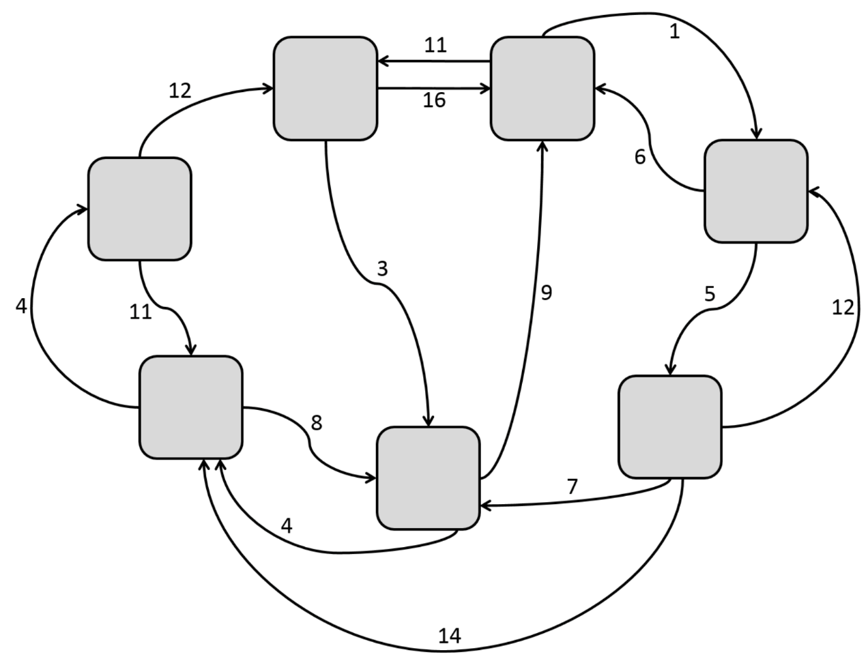
IFT Introduction
Information Foraging Theory is the concept that our project revolves around
Information Foraging Theory turns information into topologies

Slide 4
Design details

Slide 5
Visual Studio Code
Free, cross platform, open-source text editor
Potential support for any language through extensions
Extension marketplace offers unlimited functionality expansion

Slide 6
Major Components
The Major Parts of the Extension:
IDE
Controller
Parser
Data Structure
Graphical User Interface
Visual Studio Code
Parser
Controller
Graphical User Interface

Slide 7
IDE: Visual Studio Code
The Extension will work with VSCode using Event Handlers
The Current Events:
On extension activate
Planned Events to be implemented
On Click error box in the GUI

Slide 8
Controller
Manage subcomponents (Parser, UI, etc)
On Extension Activation:
Recursively retrieve a list of all Files and Directories in the User’s open project directory.
Call the parser for each file.
Serialize returned tokens into JSON File
Launch the UI

Slide 9
VSC Code
Controller
Get Files and Directories
File
Parser
Postal command
Parse Files, Get Tokens
Extension.ts
Tokens
Process Tokens, serialize JSON
Launch UI
Call Controller
Call UI
UI

Slide 10
Parser
Finding all useful information for the file it is provided
What qualifies as useful?
Anything the user defines as such in the grammars file
Return this information as a standardized token:
Line Number
Token Type – Link or a subNode
Type – Div, Class, ect. Null in the case of a Link
Value
Parent Token

Slide 11
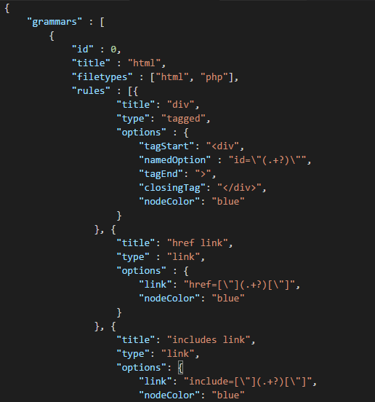
Grammars
Used to Parse for specific tokens
Needs a type as the Hard coded parser behavior needs to be different
Current types: Links and tagged
Documentation will be made available to users

Slide 12
Parsers
The Parser will now run only on activation of the extension.
New Grammars can be created relatively quickly.
Still in need of a few more behaviors (c-like functions)

Slide 13
User Interface -Refresh
One GUI consisting of the File Map and the Error List.
Displays all the data collected in the data structure JSON.
The File Map Displays a visualization of the user's project directory in the form of a graph of interconnected nodes.
The error list displays a list of the ‘Broken Rules’ in the project directory detected by the extension parser.

Slide 14
x
Interdum et malesuada fames ac ante ipsum primis in faucibus. Suspendisse ac efficitur quam. Vestibulum ante
ipsum primis in faucibus orci luctus et ultrices posuere cubilia Curae; Nulla id tristique odio. Maecenas tempor justo eu odio mattis efficitur. Donec fermentum lectus nec
orci mollis pretium. Duis tempor sapien sed urna ultricies, ut porttitor ante rutrum. Class aptent taciti sociosqu ad litora torquent per conubia nostra, per inceptos
himenaeos. Vivamus tempus massa eget ante scelerisque, eu lobortis quam vestibulum. Pellentesque malesuada placerat convallis. Sed vehicula elementum tincidunt. Ut
at enim ac mi congue gravida feugiat non urna.
Aliquam gravida, neque eu pellentesque sodales, augue nunc condimentum orci, in commodo urna enim vitae
JPEG1
PNG2
Masonry
Jquery
PNG1
App.js
Index.php
header.php
Styles.css
About.php
footer.php

Slide 15
x
Interdum et malesuada fames ac ante ipsum primis in faucibus. Suspendisse ac efficitur quam. Vestibulum ante
ipsum primis in faucibus orci luctus et ultrices posuere cubilia Curae; Nulla id tristique odio. Maecenas tempor justo eu odio mattis efficitur. Donec fermentum lectus nec
orci mollis pretium. Duis tempor sapien sed urna ultricies, ut porttitor ante rutrum. Class aptent taciti sociosqu ad litora torquent per conubia nostra, per inceptos
himenaeos. Vivamus tempus massa eget ante scelerisque, eu lobortis quam vestibulum. Pellentesque malesuada placerat convallis. Sed vehicula elementum tincidunt. Ut
at enim ac mi congue gravida feugiat non urna.
Aliquam gravida, neque eu pellentesque sodales, augue nunc condimentum orci, in commodo urna enim vitae
JPEG1
PNG2
Masonry
Jquery
PNG1
App.js
Index.php
header.php
Styles.css
About.php
footer.php

Slide 16
x
ipsum primis in faucibus orci luctus et ultrices posuere cubilia Curae; Nulla id tristique odio. Maecenas tempor justo eu odio mattis efficitur. Donec fermentum lectus nec
orci mollis pretium. Duis tempor sapien sed urna ultricies, ut porttitor ante rutrum. Class aptent taciti sociosqu ad litora torquent per conubia nostra, per inceptos
JPEG1
PNG2
Masonry
PNG1
Index.php
App.js
<div class=“class">
<div>
header.php
About.php
footer.php

Slide 17
x
JPEG1
PNG1
Masonry
PNG1
Index.php
PNG2
App.js
header.php
footer.php
About.php

Slide 18
x
Interdum et malesuada fames ac ante ipsum primis in faucibus. Suspendisse ac efficitur quam. Vestibulum ante
ipsum primis in faucibus orci luctus et ultrices posuere cubilia Curae; Nulla id tristique odio. Maecenas tempor justo eu odio mattis efficitur. Donec fermentum lectus nec
orci mollis pretium. Duis tempor sapien sed urna ultricies, ut porttitor ante rutrum. Class aptent taciti sociosqu ad litora torquent per conubia nostra, per inceptos
himenaeos. Vivamus tempus massa eget ante scelerisque, eu lobortis quam vestibulum. Pellentesque malesuada placerat convallis. Sed vehicula elementum tincidunt. Ut
at enim ac mi congue gravida feugiat non urna.
Aliquam gravida, neque eu pellentesque sodales, augue nunc condimentum orci, in commodo urna enim vitae
header.php

Slide 19
Problems with this approach:
Large Projects (about 100 files) are overwhelming and don’t provide useful information.
No way to intuitively display directors.
Too many links between files. Hard to distinguish what the links mean.

Slide 20
New Approach:
Render nodes in a hierarchy by file location.
Show Links between files only when a node is selected, highlight those links in a bright color
Expanding the nodes into subcomponents produces two new nodes below the parent, maintaining the hierarchy.

Slide 21
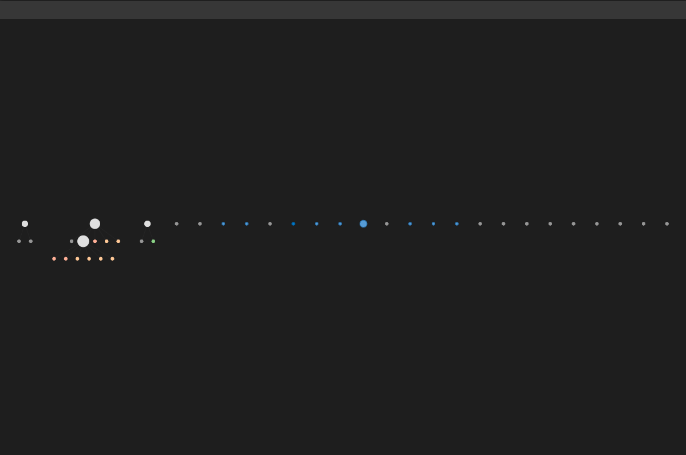

Slide 22
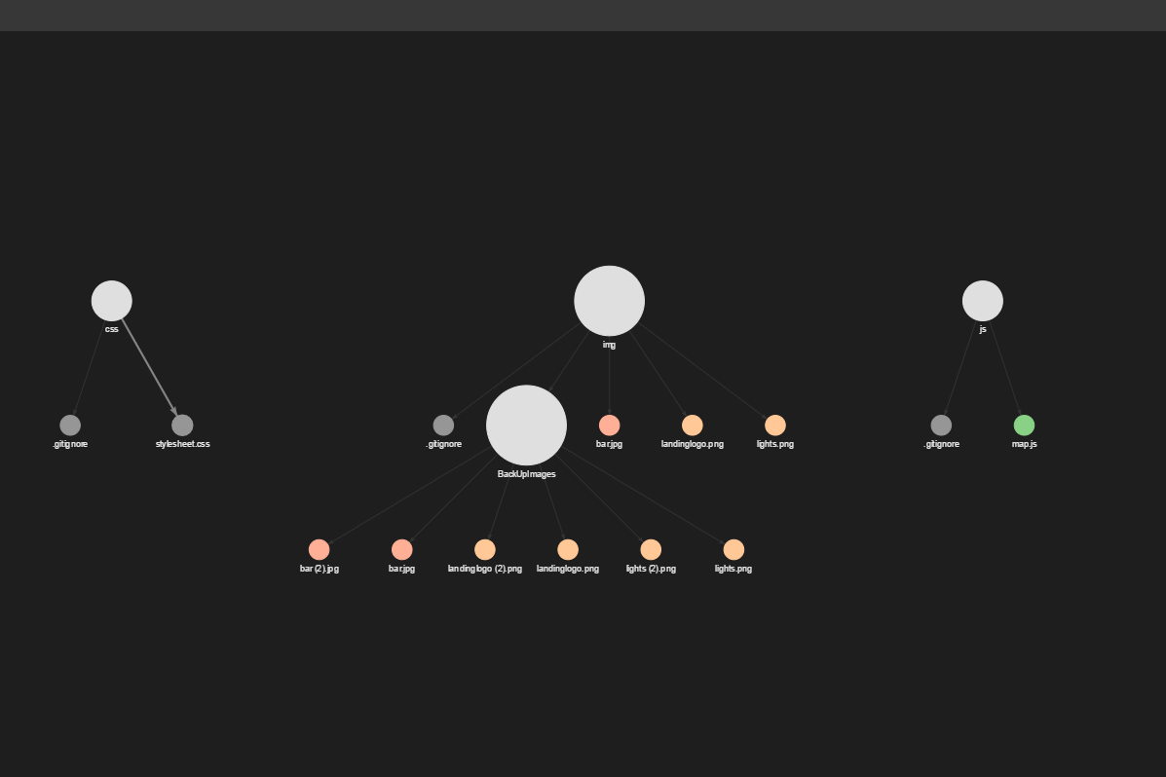

Slide 23
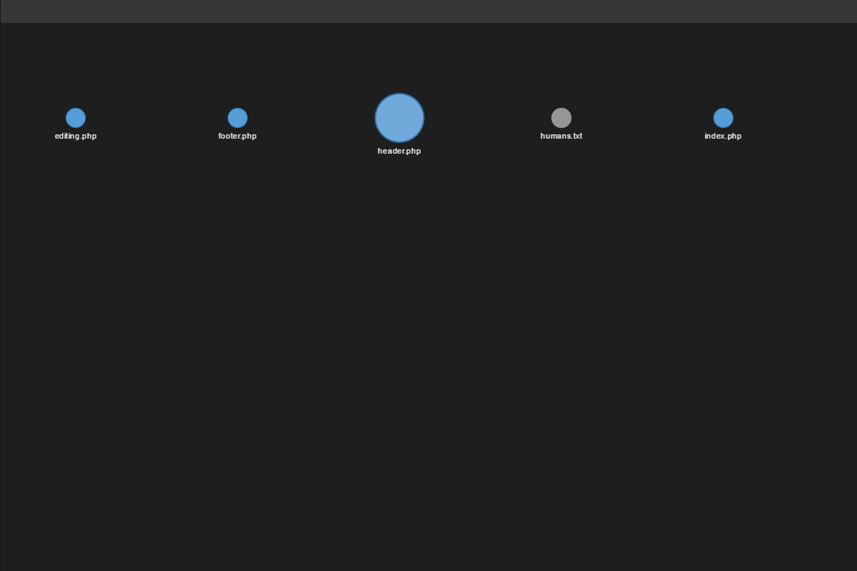

Slide 24
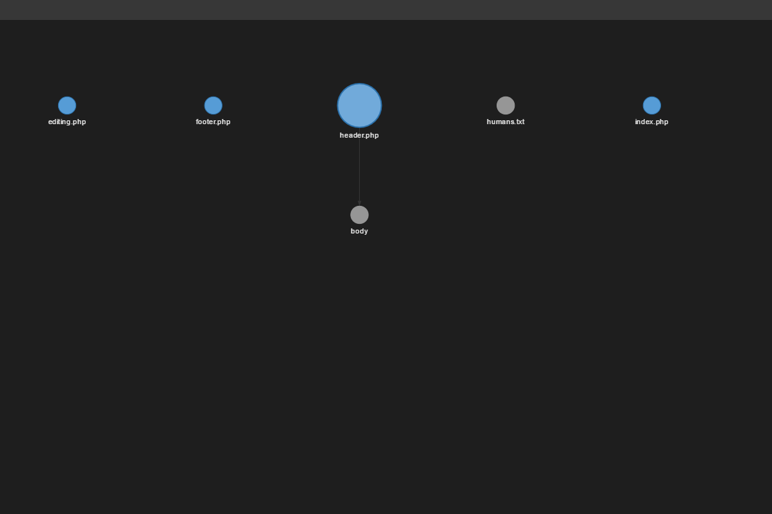

Slide 25
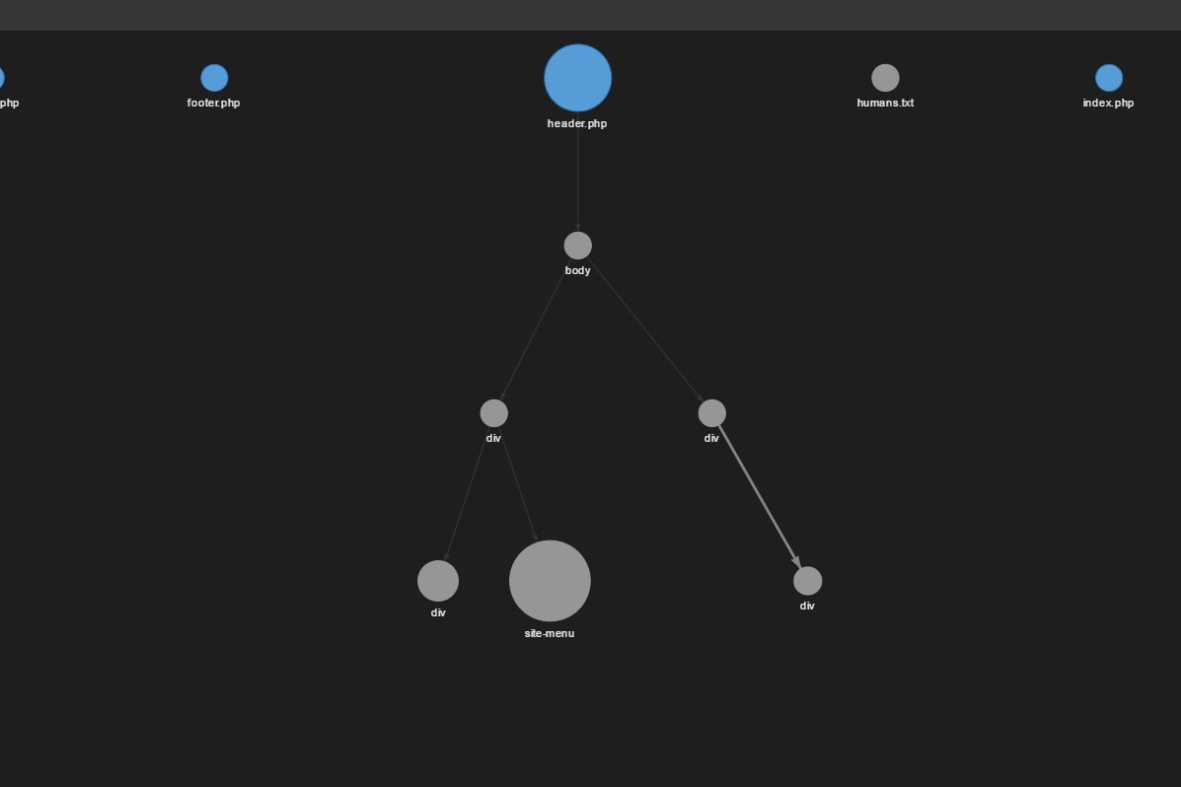

Slide 26
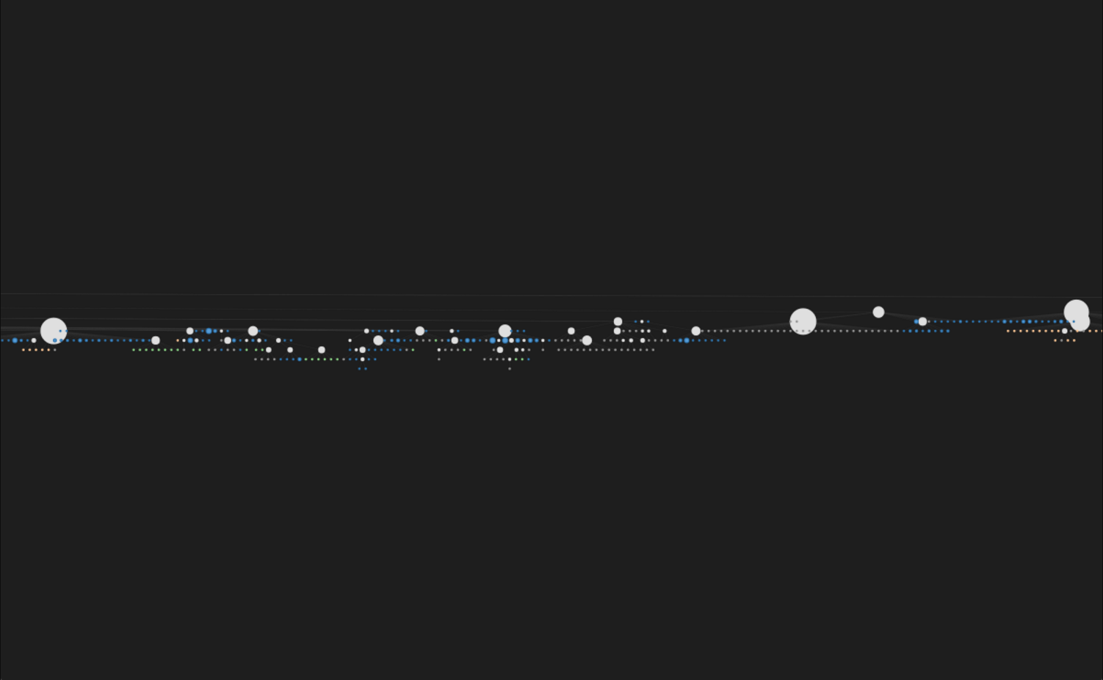

Slide 27
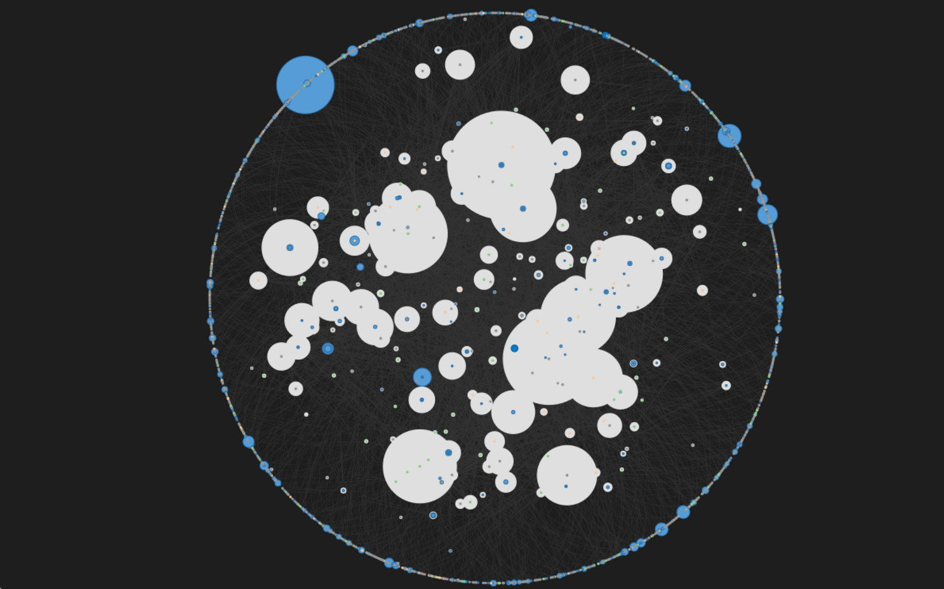

Slide 28
GUI Implementation missing features
Single click links appearing
Error list
Process bridge to communicated between the UI, Parser and VSCode

Slide 29
GUI Implementation Details
File Map -> vis.js
Error list -> Advanced News Ticker
GUI window -> Electron application

Slide 30
Data Layer
Dictionary of file nodes and links collected by the parser
Nodes in data layer contain info on all the files in the project, as well as error data detected by parser
Node and error info stored in a file is used by the UI

Slide 31
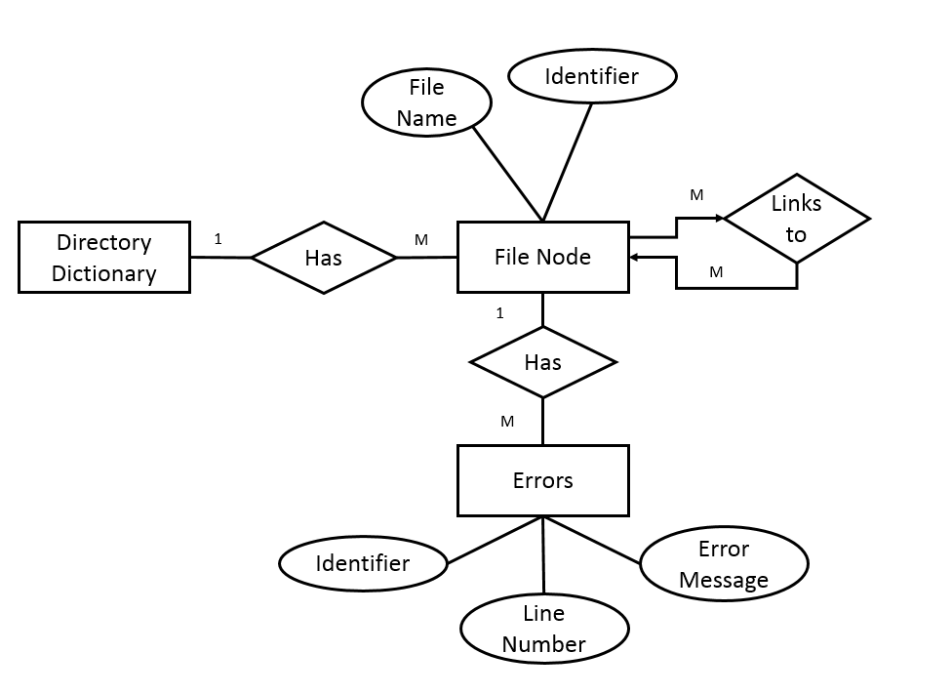
Updated Schema
JSON
ID
Level
M
IsSub
-Container
Node Container
Name
Type
Path
M
M
M
Links
Sub-Container Links
Errors
ID
ID
ID
Destination Node ID
Destination Node ID
Error Message
Line Number
Line Number
Line Number

Slide 32
Term in Review

Slide 33
Timeline
December
January
February
March
Winter Break- During the break some of the team was able to get together and set up some solid goals for the next term as well as work on getting their different parts together.
Week 1- We had a positive meeting with Scaffidi after getting a very early working prototype.

Slide 34
Timeline
December
January
February
March
Week 2- The pace slowed after a hectic week 1. We only on some minor changes to the parser and UI.
Week 3- We continued working on some small changes to the UI and some work on error handling.
Week 4- Started working on changing the documents, and OneNote.

Slide 35
Timeline
December
January
February
March
Week 5- Worked on the updating the tech and design doc.
Week 6- Totally reworked the project, rebuilding all the major parts, this allowed us to finally get all the parts to finally work together in conjunction.

Slide 36
Team Performance: Positives
Roles have been more clearly defined
Sam in charge of client communication
Zach in charge of documentation and submission
Cramer in charge of extension publishing
Eric in charge of overall extension design and tasks
Client has been satisfied with out progress thus far
Conducted code reviews to understand all parts of code
Team has continued to work ahead of class schedule

Slide 37
Team Performance: What Needs Improvement
Deadlines concerning research and user testing need to be clarified with our client
Individual accountability for project tasks needs to be improved
We need to reference and update our documentation more frequently

Slide 38
Changes To Be Made
We will meet with our client to solidify user testing details
We will communicate amongst each other better on what it expected and when it needs to be done
Biweekly documentation checks/meetings will be conducted to evaluate if anything needs to be changed

Slide 39
Future Plans

Slide 40
Future Plans
Bug Fixes
Implement a Process Bridge
Send information between the UI and the extension logic
C-Like Function support for the parser
Change parser behavior
Build in default grammar support
Errors
Change parser behavior
Build in default grammar support
User Testing

