Slide 1
DEVICE DRIVERS USB Keyboard Testing
Tuba Yavuz
EEL 4930/5934 Advanced Systems Programming
University of Florida

Slide 2
Agenda
Making USB host keyboard available to VirtualBox
Finding out which driver is handling the USB host keyboard
Making sure the desired driver is handling the USB host keyboard
And testing the driver!
Getting you ready for Assignment 6

Slide 3
Compiling Kernel Source
Debian is recommended!
Download kernel source
$ apt-get install linux-source-3.2
$ tar xjf /usr/src/linux-source-3.2.tar.bz2
$ cd linux-source-3.2
Configure it
$ make menuconfig
You may need to install libncurses5-dev first!
Compile
$ make clean
$ make deb-pkg
Install the kernel image
$dpkg –I ../linux-image-3.2.19_3.2.19-1_i386.deb
Reboot
shutdown –r now

Slide 4
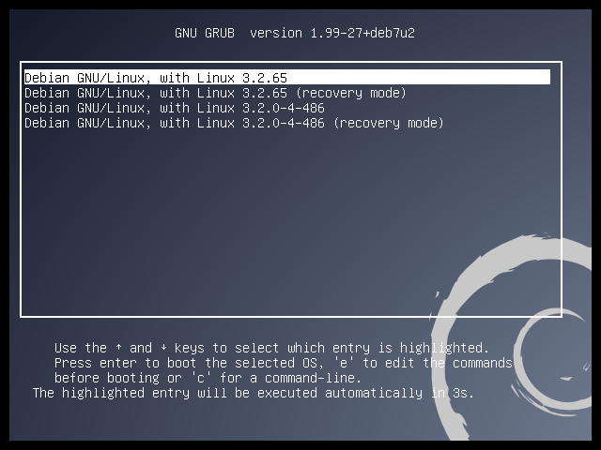
Choose the version you just installed

Slide 5
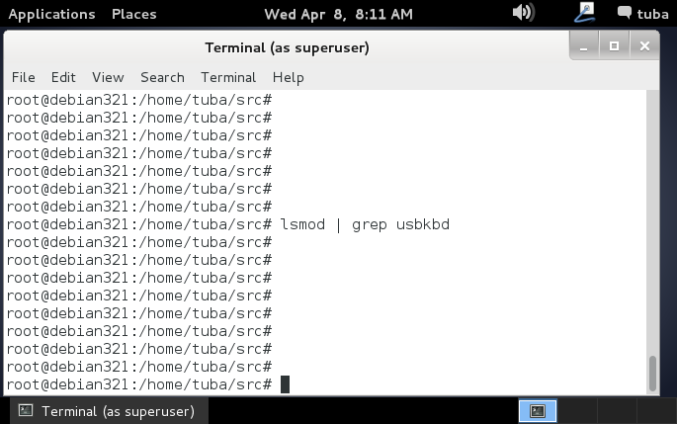
Is usbkbd module already loaded?

Slide 6
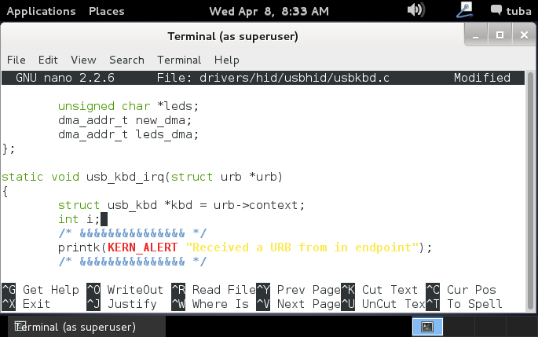
Let’s first add some printk statements

Slide 7
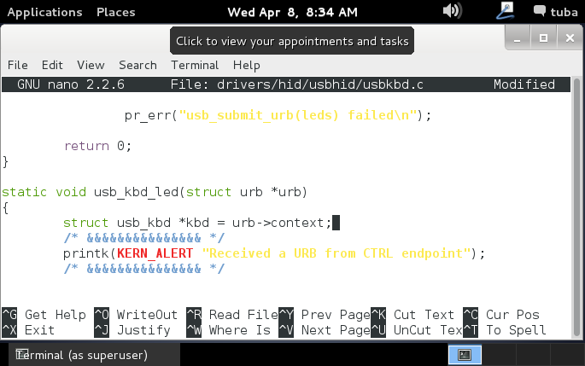
Let’s first add some printk statements

Slide 8
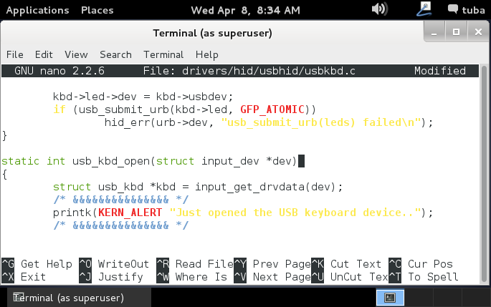
Let’s first add some printk statements

Slide 9
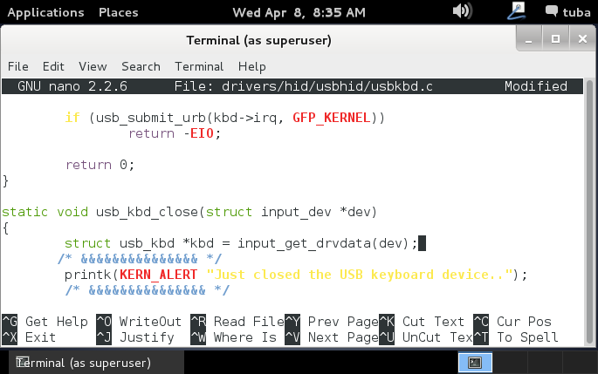
Let’s first add some printk statements

Slide 10
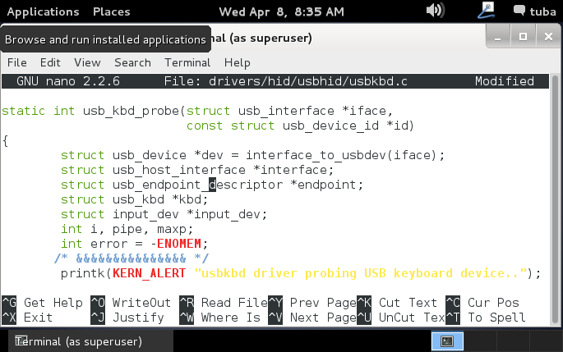
Let’s first add some printk statements

Slide 11
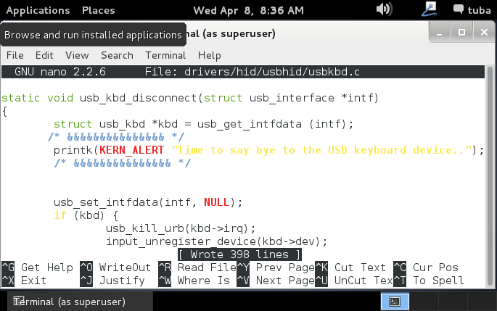
Let’s first add some printk statements

Slide 12
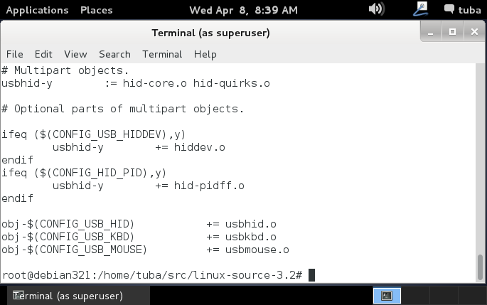
Let’s check Makefile for usbkbd

Slide 13
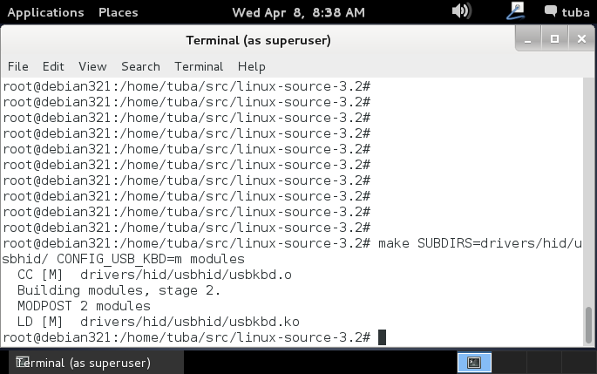
Let’s compile only modules in usbhid

Slide 14
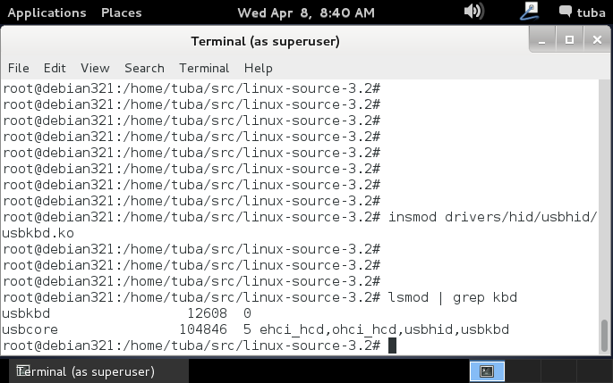
Let’s load usbkdb module & check..

Slide 15
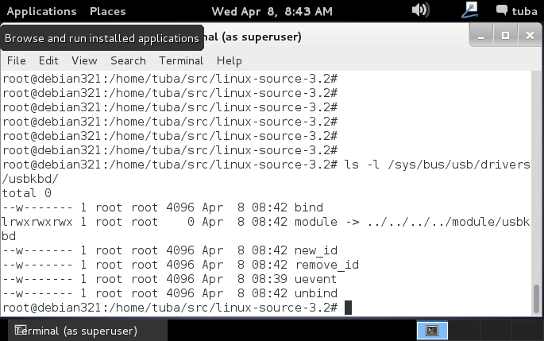
Let’s check usbkbd on sysfs

Slide 16
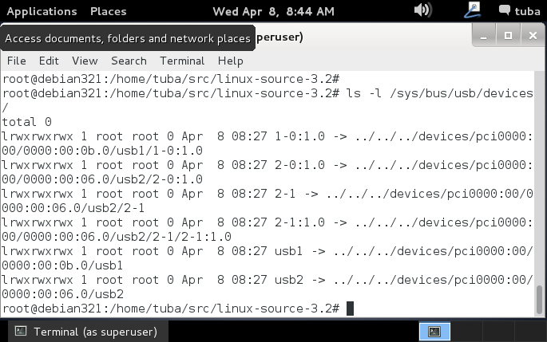
Listing USB devices before making host keyboard accessible by VirtualBox

Slide 17
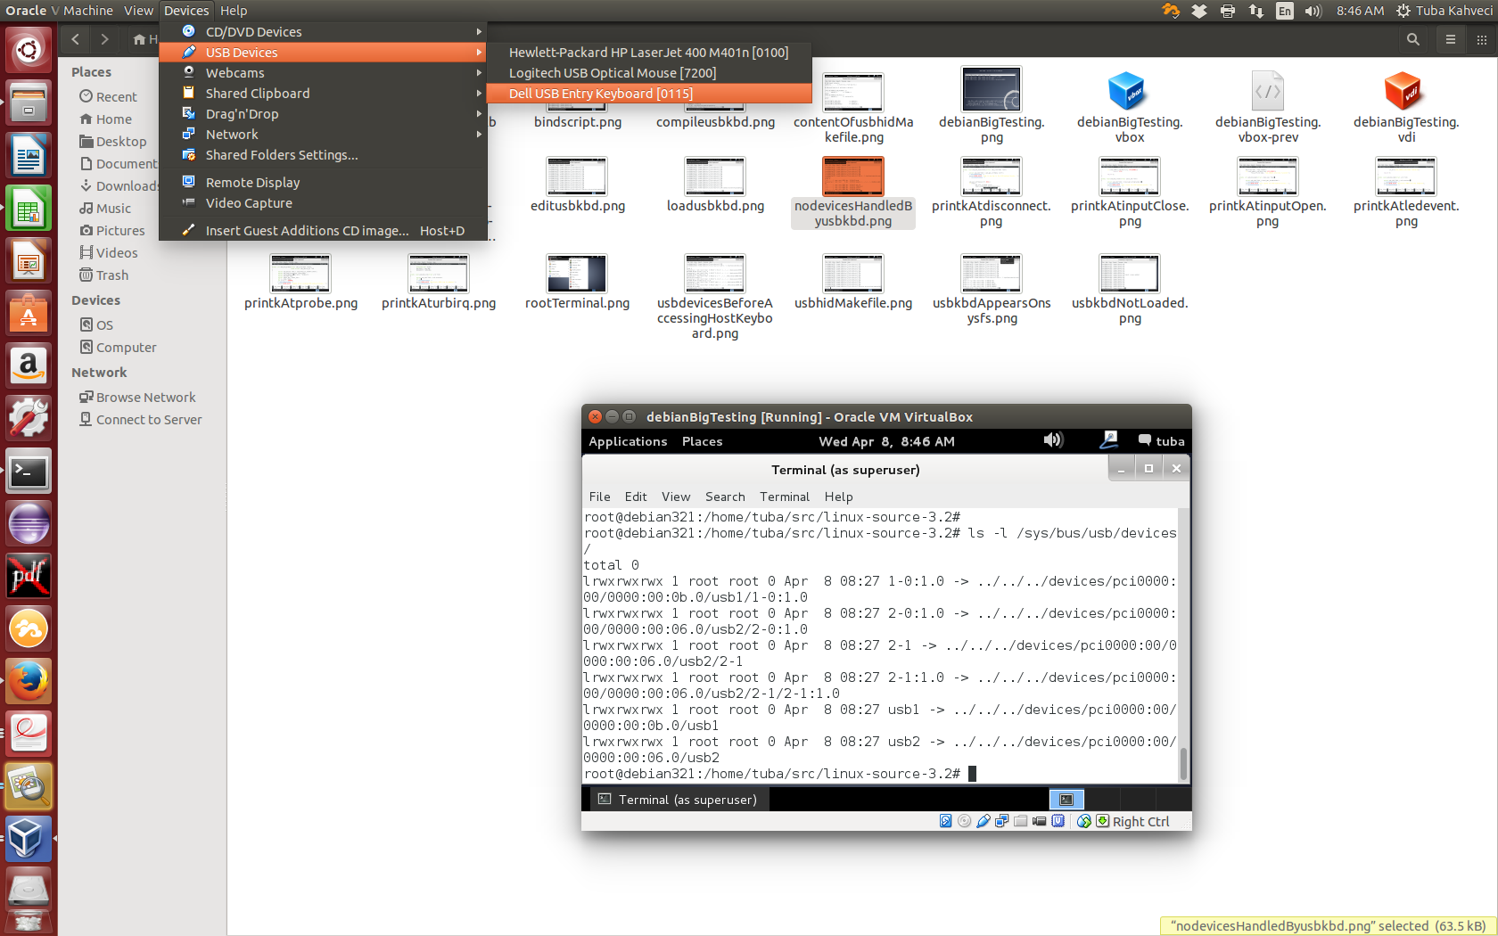
Making host USB keyboard accessible by VirtualBox

Slide 18
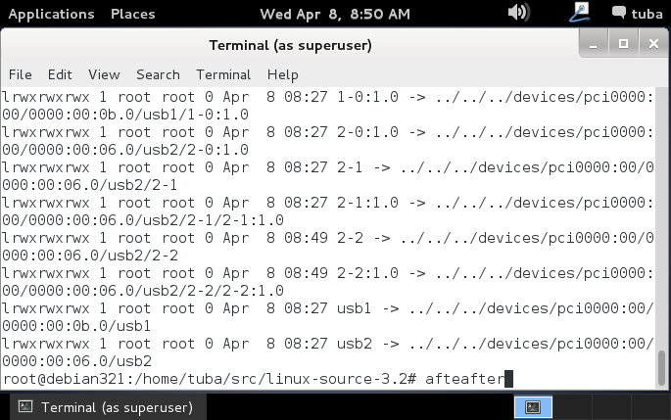
Listing USB devices after making host keyboard accessible by VirtualBox

Slide 19
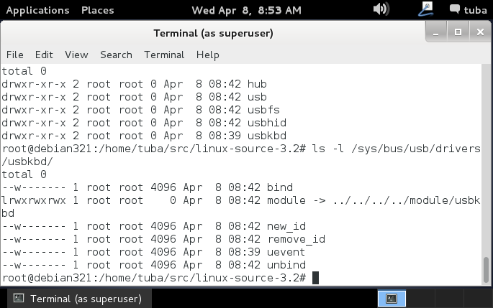
Finding the driver that’s controlling host USB keyboard

Slide 20
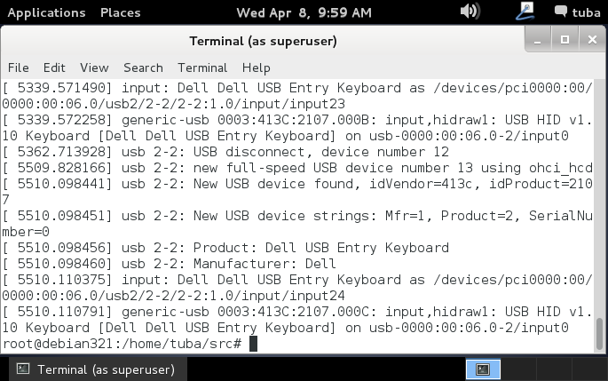
Well, who’s in charge then?

Slide 21
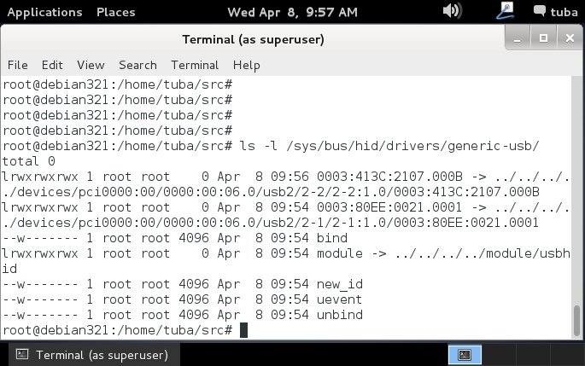
Let’s confirm on sysfs..

Slide 22
Let’s first unbind the keyboard from usbhid
Try the following command (at your own risk!)
echo –n “2-2:1.0” > /sys/bus/usb/drivers/usbhid/unbind
What’s wrong???

Slide 23
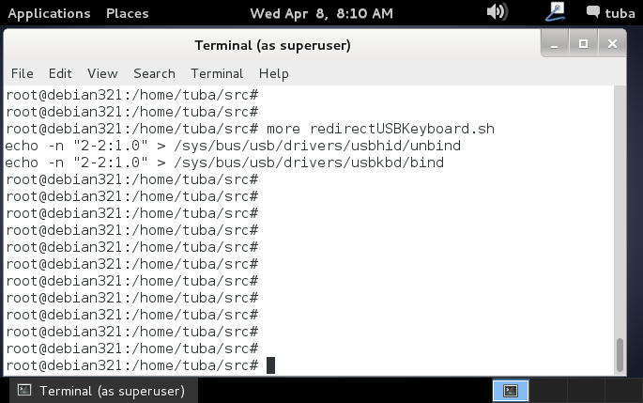
If there’s a will, there’s a way!

Slide 24
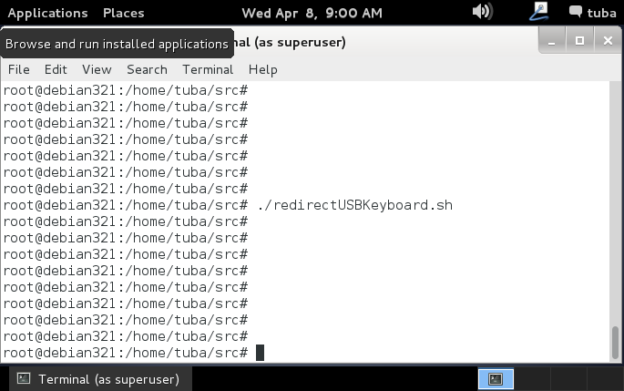
Executing bind script..

Slide 25
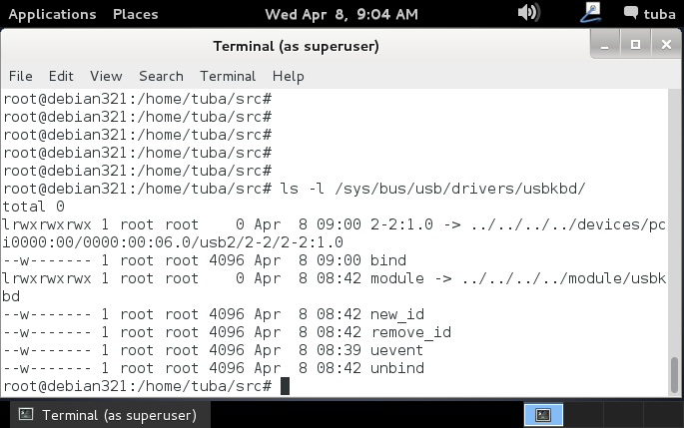
Checking if usbkbd is handling the host keyboard after binding process

Slide 26
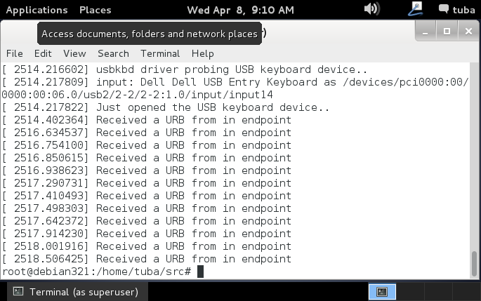
Let’s check kernel logs..

Slide 27
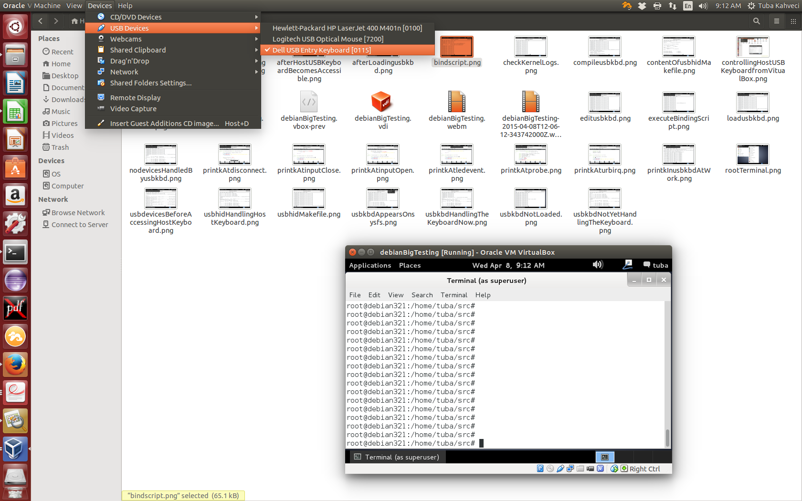
Time to disconnect host keyboard

Slide 28
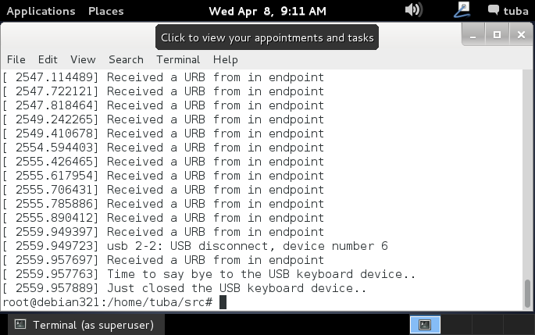
Let’s check kernel logs again..

Slide 29
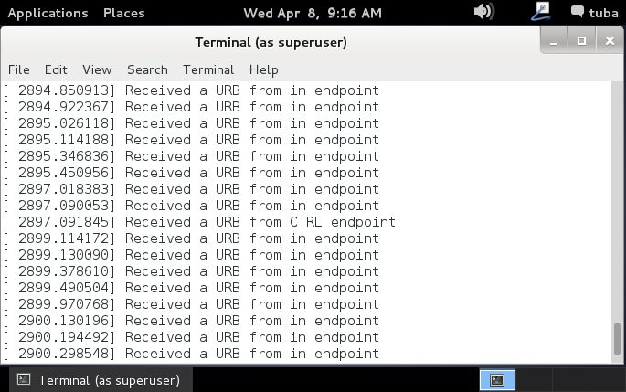
Oh, the led effect.. press CAPSLOCK

