Slide 1

JobTracker is a comprehensive browser extension designed to simplify and streamline the job application process for job seekers. This tool offers a wide range of features to enhance the job search experience.
Rahul Trivedi Vedanshu Joshi Surbhi Sharma

Slide 2
The job search process can be overwhelming
01
Endless job listings to sift through
Problem Statement
02
Difficulty tracking applications
03
Cannot filter jobs or find jobs which are already applied
Job seekers need an efficient solution to these challenges.

Slide 3
Solution - JobTracker
JobTracker is here to provide the solution
A browser extension tailored for job seekers.
It streamlines your job search, making it more efficient and organized.

Slide 4
Functional Requirements
Tracking job listings with a single click Integration with LinkedIn for real-time updates Cross-browser compatibility for convenience
Content detection and adaptation for various websites Bookmarking applied jobs for easy reference
Reminder notifications for pending applications Displaying essential job information based on keywords User-friendly extension management
A static website for guidance
Enhanced job listings with application status tags Option to hide applied jobs
Data deletion for accuracy

Slide 5
Non - Functional Requirements
Scalability: JobTracker will be designed to handle a growing user base efficiently, ensuring smooth performance even with increased traffic.
Performance: The extension delivers quick response times and minimizes page load impact, maintaining efficient resource management through optimized algorithms and data structures. Security: Data encryption, secure authentication, and proper credential storage ensure users' sensitive information remains protected.
Reliability: With a commitment to high uptime, availability, low error rates, and fault tolerance, JobTracker guarantees a dependable job-tracking experience.

Slide 6
User Authentication
Data privacy and security are paramount.
JobTracker implements user authentication through secure methods, ensuring your information remains protected.
Sign in with Google Single-Sign-On or other secure methods.

Slide 7
Job Information Display and Job Listing Updates
JobTracker enhances your job search experience in multiple ways:
Job Information Display: We collect and display crucial job information based on relevant keywords, helping you make informed decisions about which jobs to pursue.
Job Listing Updates: JobTracker enhances job listings with application status tags in the Chrome extension as well as on the LinkedIn job listing view. Simply click on job listings to view details and apply directly from the extension. You can also customize your job listing view by hiding applied jobs for a cleaner search experience.

Slide 8
Job Data Management
Job Data Management is a critical aspect of JobTracker, ensuring that your job search remains organized and efficient:
Centralized Data: All your job application details, including job titles, companies, dates, and notes, are stored in one secure database within the extension.
Easy Access: You can easily access and manage your job application history through the extension's user- friendly interface, providing a clear overview of your job search journey.
Data Accuracy: JobTracker allows you to delete job entries in case of errors, ensuring that your data remains accurate and up to date.
Customization: Customize your job listing view by hiding applied jobs, providing a cleaner view for ongoing job searches.

Slide 9
Job Status Tracking
JobTracker also enables you to track the status of your job applications. Keep tabs on which applications are "In Progress," "Under Review," "Applied," or "Rejected," all within the extension.
With JobTracker's robust job data management and status tracking features, you can stay on top of your job search, maintain data accuracy, and make informed decisions about your next career move.

Slide 10
Reminder Notifications
JobTracker keeps track of pending applications.
Receive timely reminders until you complete your application, ensuring no opportunity is missed.

Slide 11
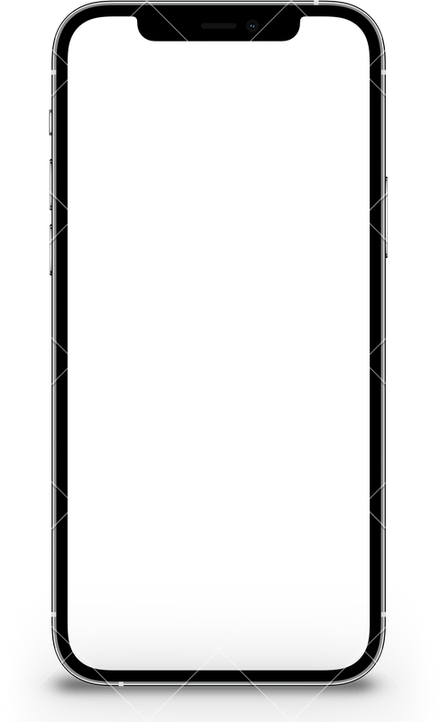
Cross-Browser Compatibility
Your Company Name
01 Clearly articulated benefits as they relate to your target audience.
Smartphone
(Portrait) 02 You can use a features and benefits list or just walk through
Clearly describe your product in terms that _{them.}
your audience will understand.
03 Whatever you do, do not forget the benefits! They may be obvious to you.
JobTracker will be work seamlessly across popular web browsers: Google Chrome
Mozilla Firefox Microsoft Edge Apple Safari

Slide 12
Must-have Requirements
Your Company Name
01 Clearly articulated benefits as they relate to your target audience.
Smartphone
(Portrait) 02 You can use a features and benefits list or just walk through
Clearly describe your product in terms that _{them.}
your audience will understand.
03 Whatever you do, do not forget the benefits! They may be obvious to you.
Ensuring Core Functionality
When developing JobTracker, we identified several Must-Have Requirements that are essential to the core functionality and purpose of the extension:
Job Tracking: JobTracker's primary function is to track job listings, including job titles, companies, and application status.
User Authentication: To protect data, user authentication is a fundamental requirement.
Cross-Browser Compatibility: The extension must work seamlessly across popular web browsers. Data Management: Centralized storage and easy access to job application data are non-negotiable. Job Status Tracking: Tracking the status of job applications is crucial for staying organized.

Slide 13
Nice-to-Have Requirements
Your Company Name
01 Clearly articulated benefits as they relate to your target audience.
Smartphone
(Portrait) 02 You can use a features and benefits list or just walk through
Clearly describe your product in terms that _{them.}
your audience will understand.
03 Whatever you do, do not forget the benefits! They may be obvious to you.
Enhancing the User Experience:
LinkedIn Integration: Integration with LinkedIn for real-time updates on LinkedIn job applications. Content Detection and Adaptation: The ability to adapt to various website structures for a consistent user experience.
Reminder Notifications: Timely reminders for pending applications to prevent missed opportunities. Customization: Customizing the job listing view by hiding applied jobs for a cleaner search experience. Data Deletion: The option to delete job entries for data accuracy.

Slide 14
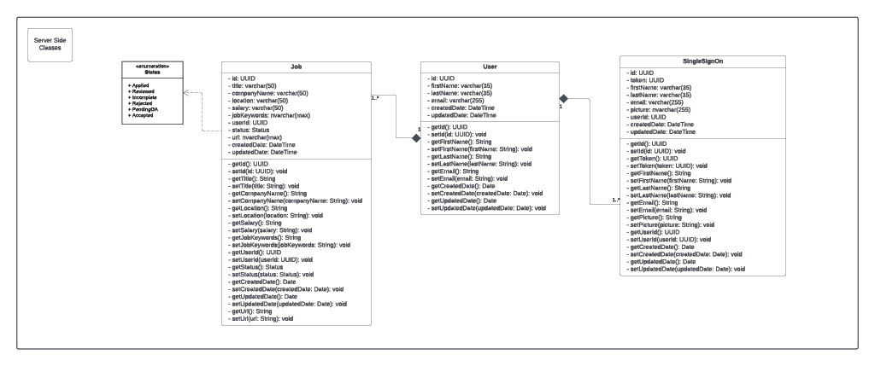
System Models

Slide 15
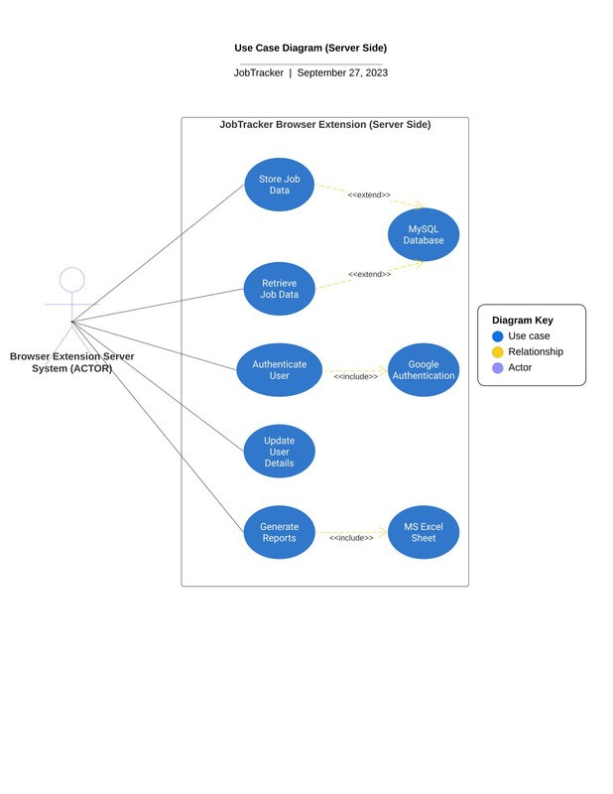
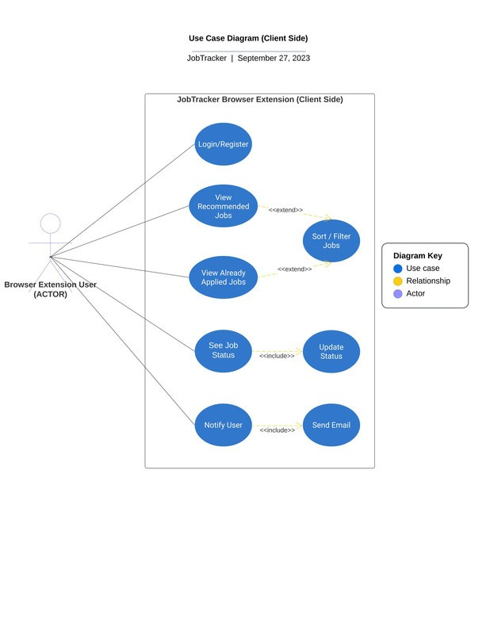
System Models

Slide 16
System Architecture
Your Company Name
01 Clearly articulated benefits as they relate to your target audience.
Smartphone
(Portrait) 02 You can use a features and benefits list or just walk through
Clearly describe your product in terms that _{them.}
your audience will understand.
03 Whatever you do, do not forget the benefits! They may be obvious to you.
Layered Architecture
The Layered Architecture helps maintain a clean and maintainable codebase. The presentation layer handles the user interface elements, the business logic layer manages application functionality, and the data access layer takes care of storing and retrieving job application data. This separation simplifies testing, as each layer can be tested independently, ensuring a robust and reliable extension.

Slide 17
System Architecture
Your Company Name
01 Clearly articulated benefits as they relate to your target audience.
Smartphone
(Portrait) 02 You can use a features and benefits list or just walk through
Clearly describe your product in terms that _{them.}
your audience will understand.
03 Whatever you do, do not forget the benefits! They may be obvious to you.
MVC (Model-View-Controller) Architecture
The MVC Architecture brings a high level of modularity and reusability to the browser extension project. Components within each category (Model, View, and Controller) can often be reused across different parts of the extension.
For instance, a View designed to display job listings can be reused in multiple UI screens, promoting efficiency and consistency in the user interface

Slide 18
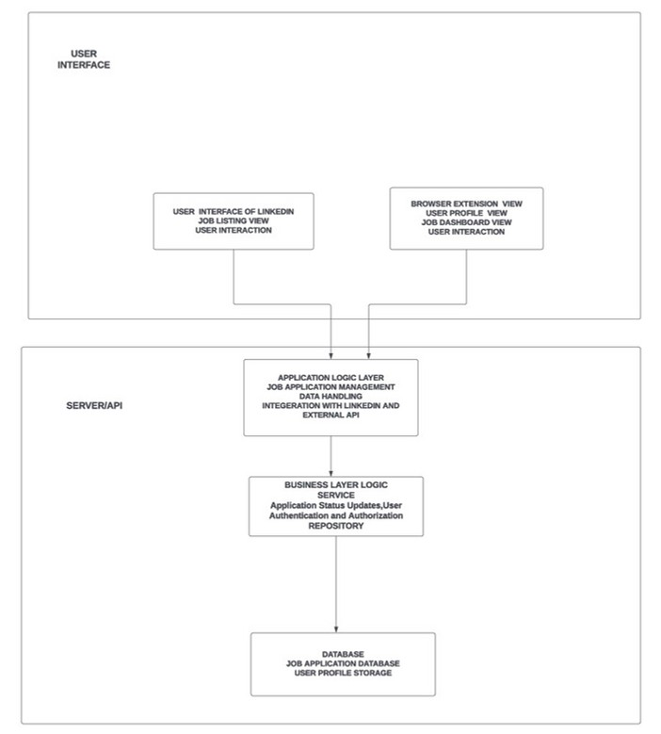
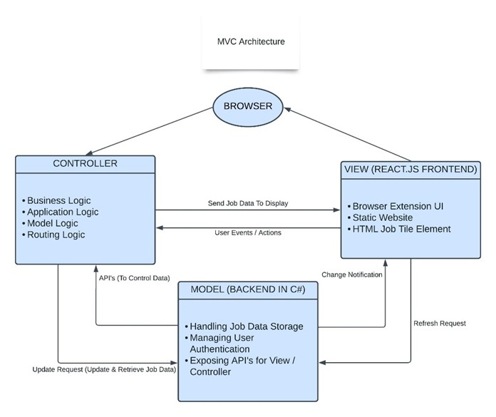
Architecture Flow Diagram
Your Company Name
01 Clearly articulated benefits as they relate to your target audience.
Smartphone
(Portrait) 02 You can use a features and benefits list or just walk through
Clearly describe your product in terms that _{them.}
your audience will understand.
03 Whatever you do, do not forget the benefits! They may be obvious to you.

Slide 19
Technology Stack
Frontend
Backend
C# .NET Webapi
React Js

Slide 20
Q&A

Slide 21
Thank You

