Slide 1
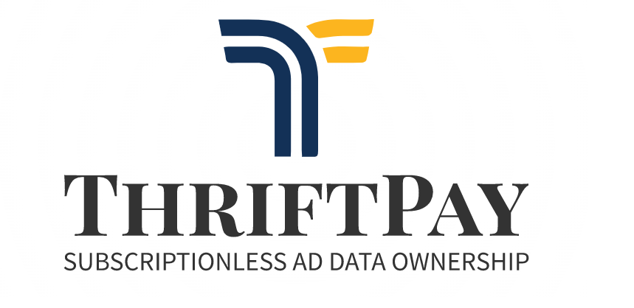

Slide 2
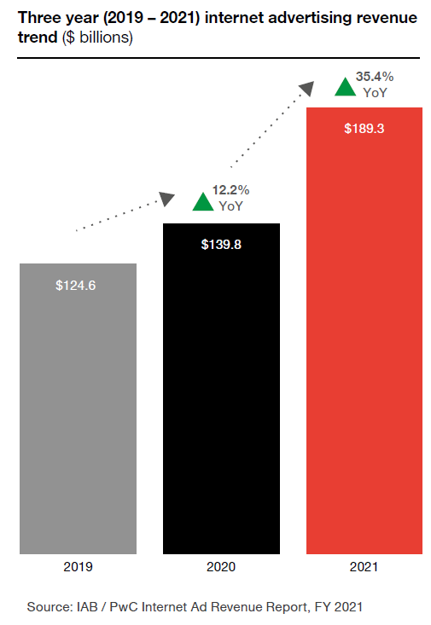
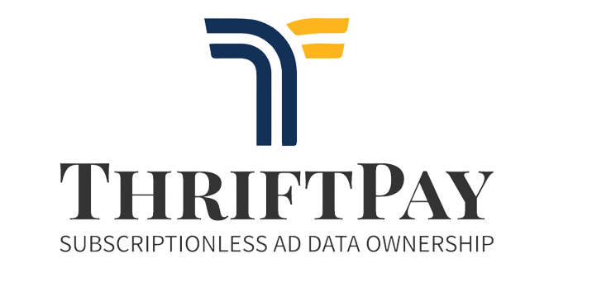
The Advertising Sector
Revenue stats
The Advertising sector is BROKEN.
Total Advertising revenue in 2021 was $189 billion
YoY growth of 35.4% in 2021 vs 12.2% in 2020
e-Commerce grew 50% between 2019 and 2021 to $870 billion
How much do Consumers get?
ZERO | NADA

Slide 3
The System
Current flow of Funds
Advertiser
Pays for Ad space
Creates campaigns and set daily/weekly/monthly budget
Pays per views and consumer interaction
Publishers and Media Platforms
Advertising Platforms
Irish Independent Forbes
Bloggers
…
Google Ads Facebook Ads
…
Purchases products and/or services
Consumer
Shares browsing and personal data with Advertising Platforms
Pays recurring subscriptions to access premium content

Slide 4
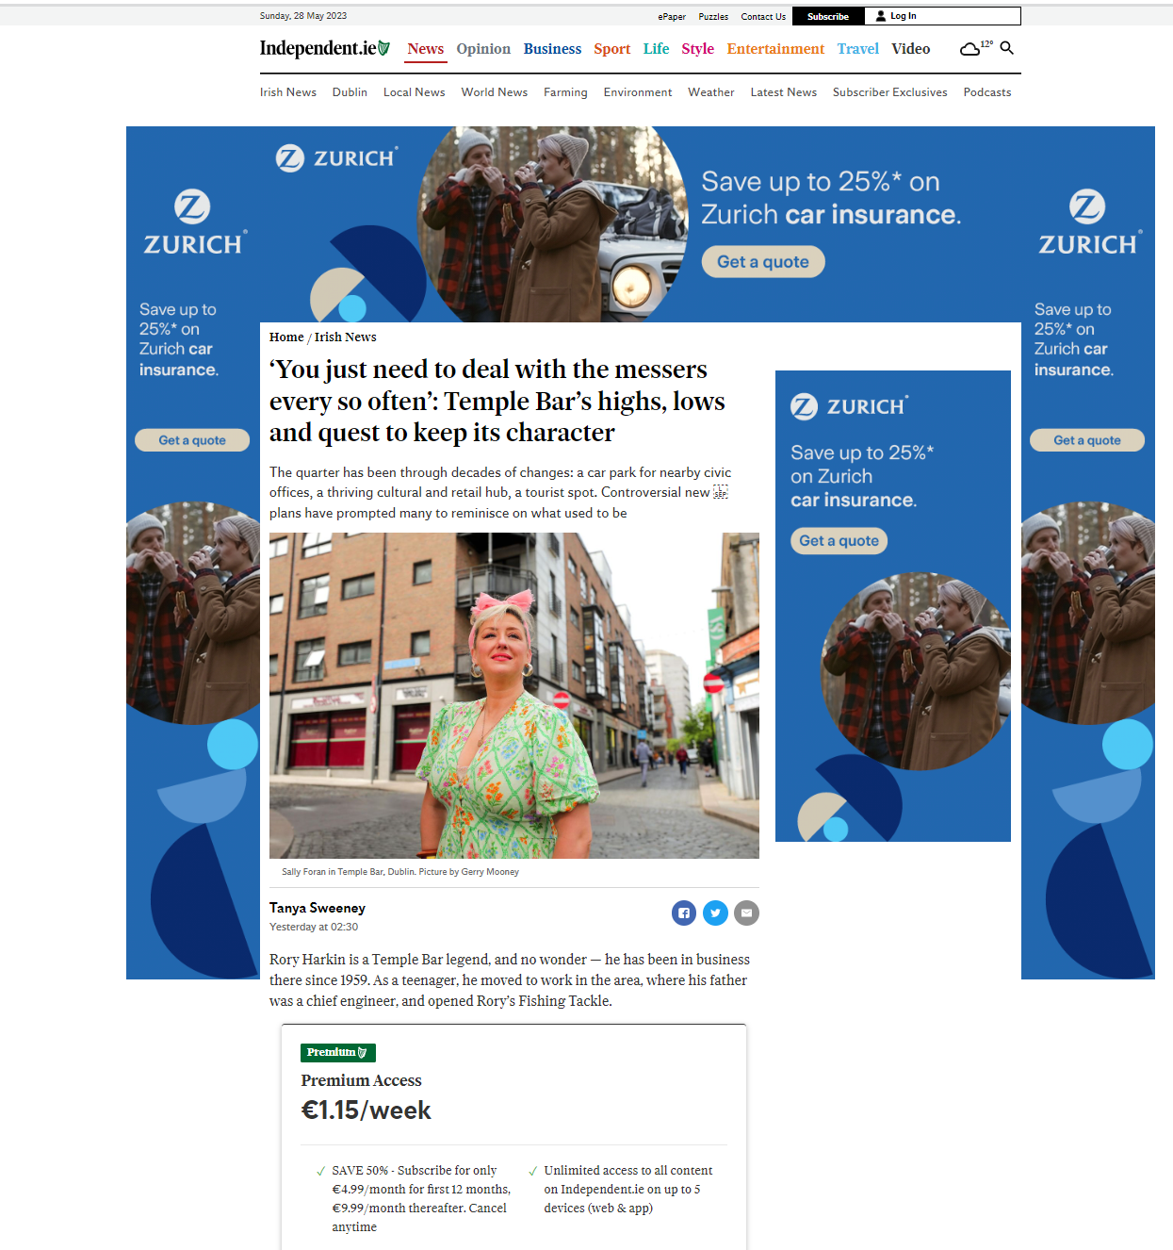
The Problem Publishers and Media Platforms
Publishers/Media Platforms need to attract users through valuable content creation
Monetisation through Ads and Subscriptions.
Problems:
Bad user experience (too many Ads)
Paywalls exclude the less fortunate from access to valuable content.
Notes:
Publishers/Media Platforms need to attract users through valuable content and then monetise their visits.
Their revenue model consists on receiving recurring subscription fees (e.g. weekly/monthly) from consumers and/or through selling advertisement space to Advertisers.
However, paywalls (i.e. subscription fees), make it impossible for the less fortunate to access valuable content. Excluding them based on their lack of resources.

Slide 5
The Problem Consumers
Consumers browse the internet, access content and interact with online Ads.
Problems:
No ownership of their own data
Cannot choose who to share it with
No possibility to monetise it
Notes:
They share their personal data with centralised entities (e.g. Google, Meta, etc) and have limited control over how such entities use such data.

Slide 6
The Problem Advertisers
Budget spent on advertising using Advertising Platforms (i.e. large corporations)
The need for trust and transparency across the digital ad supply chain has never been more important.
Problems:
Advertisers cannot verify the veracity of consumer interactions
They don’t have a direct relationship with their customers.
Notes:
Advertisers specify their target market on platforms and the budget they are willing to spend.
In exchange, they receive stats on users interaction with their Ads and hope that some of those interactions will translate into increased revenue.

Slide 7
The Problem Recap
Consumers get nothing while Large corporations (e.g.: Google, Meta, TikTok…) benefit
Increasing need for transparency across the sector to verify ad sellers, human traffic, viewable impressions, content precision, as well as brand safe and suitable environments.
Premium content only available to a few

Slide 8
The Solution ThriftPay Our Mission is to democratise content, eliminate paywalls and grow the web3 generation
Advertiser
Pays compensation to Consumer
Consumer
Garage
Online retailer
Product Manufacturer
Online user
Pays per article
Uses Ad compensation to access premium content for free
Provides Ad space
Amplifies consumer’s exposure
Publishers and Media Platforms
Irish Independent Forbes
Bloggers
…

Slide 9
Use Cases
Subscriptionless: Thriftpay enables micropayments per article, removing recurring subscriptions while adding value to Media Platforms.
Reward to visit: Advertisers create campaigns to reward users accessing their content/page.
Donations: Consumers can opt to forward compensation to a charity.

Slide 10
The Solution Recap
Privacy: Consumer data ownership
Inclusivity: All visitors can access ALL content
Transparency: On-chain recording
Solidarity: Donations for a good cause
Better user experience: Simplified Advertisement
Direct relationship: Advertiser + Consumer = Value added
Fair Compensation: A circular economy ensures all parties benefit from it
Notes:
Consumer
Data ownership
Compensation for watching Ads
Inclusivity: Can access ALL content
Advertiser
Transparent stats
Direct relationship with consumer
Rewards its customers
Can target valuable users
Publisher
Better user experience
Attracts a wider audience
Gets paid by viewers
Gets paid by advertisers

