Slide 1
Need to add new amino acids to each set:
R neutral ← pKa is pretty high, so may not need this??
H + charge
K neutral
D neutral
E neutral
Adjust to charged/neutral depending on pH, based on pKa’s:
R: 12.48
H: 6.04
K: 10.54
D: 3.90
E: 4.07

Slide 2
Charge
0 for everything except
+1 for R, K
-1 for D, E

Slide 3
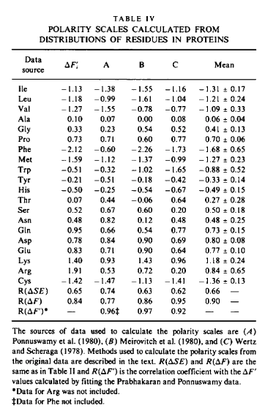
Polarity
From: Guy, Biophysical J. (1985)
https://www.sciencedirect.com/science/article/pii/S0006349585838777
Use first column (delta F_i)
Should be valid for pH = 7
How would change in charge state affect polarity scale?

Slide 4
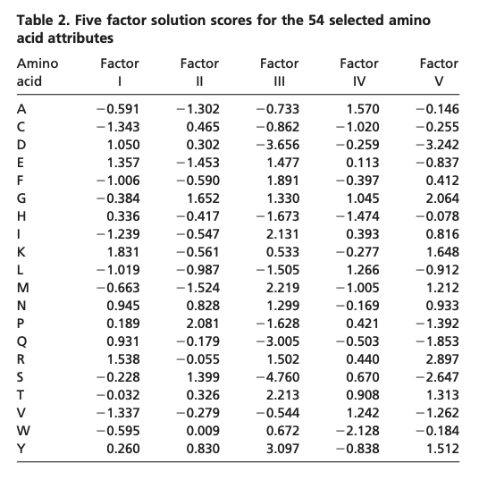
Size
From: Atchley et al. PNAS (2005)
https://www.pnas.org/doi/pdf/10.1073/pnas.0408677102
Use third column (Factor III) as representative of amino acid size (a feature that’s correlated with size)
Assume changes in charge state have no effect on size
Decided not to use this scale; factor III doesn’t correlate with basic intuition regarding size (e.g. glycine)

Slide 5
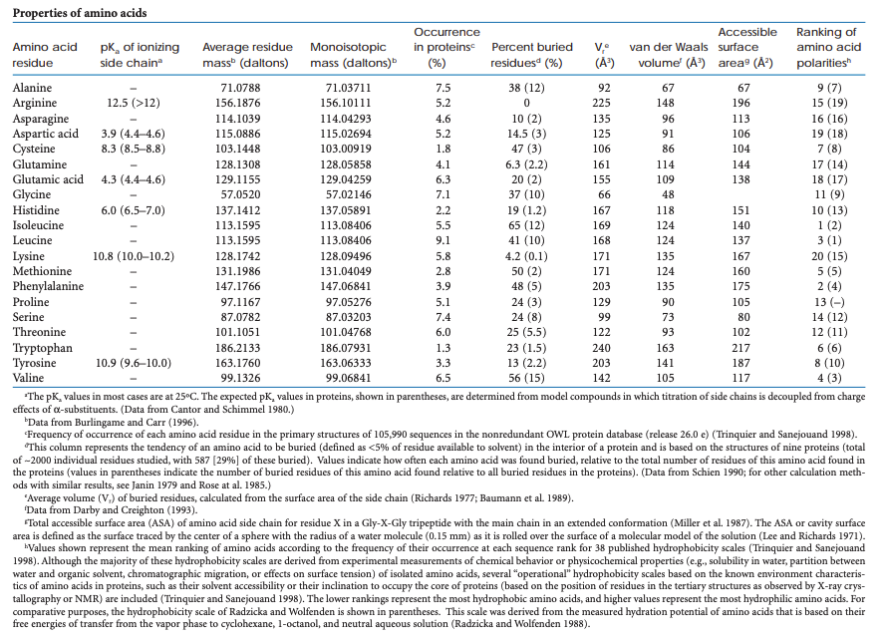
Size
From: Proteins and Proteomics
http://www.proteinsandproteomics.org/content/free/tables_1/table08.pdf
Use column labeled V_r (average volume of buried residues)

Slide 6
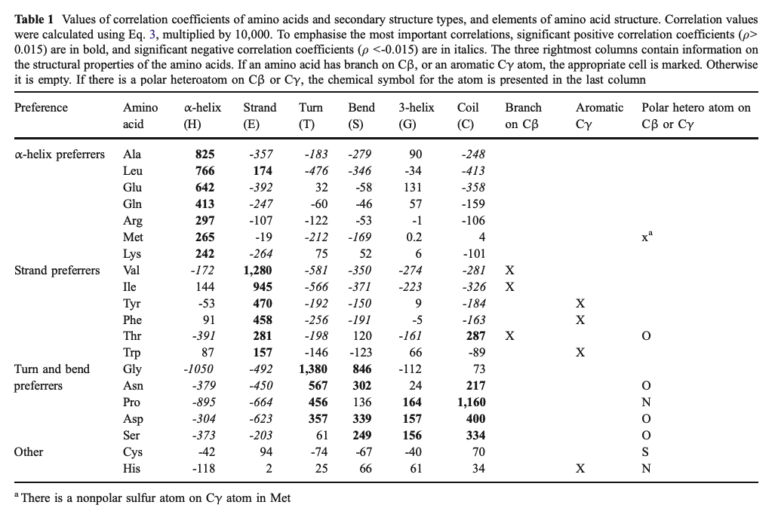
Secondary structure preferences
From: Malkov et al. J Mol Model (2008)
https://link.springer.com/content/pdf/10.1007/s00894-008-0313-0.pdf
Use alpha-helix, strand, and coil columns
More positive → higher propensity
Assume changes in charge state have no effect on secondary structure propensities

