Slide 1
Chapter : Synchronization Tools

Slide 2
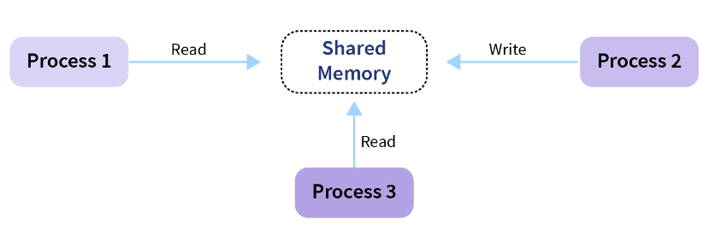
Context 1
Processes can execute concurrently:
May be interrupted at any time, partially completing execution.
Process 1 can Read the data, then interrupted.
Process 2 Write the same data.
Process 1 continue to execute based on a false value of data.
Concurrent access to shared data may result in data inconsistency

Slide 3
Context 1
Race Condition: An undesirable situation that occurs when two or more processes or threads access a shared resource, such as a file or memory location, in an unpredictable order.
This can result in unexpected behavior, such as incorrect data being written to the resource or a deadlock situation where the processes are unable to proceed.

Slide 4
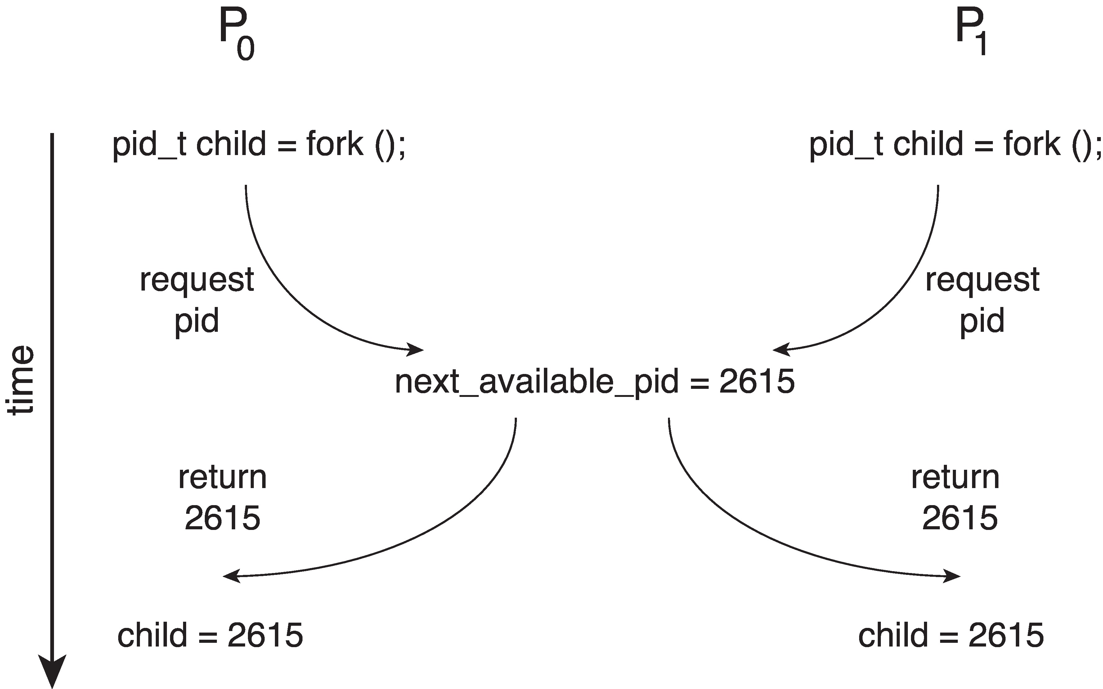
Race Condition: Example 1
Processes P₀ and P₁ are creating child processes using the fork() system call at the same time.
Race condition on kernel variable next_available_pid which represents the next available process identifier (pid)
Unless there is a mechanism to prevent P₀ and P₁ from accessing the variable next_available_pid the same pid could be assigned to two different processes!

Slide 5
Race Condition: Example 2
Ticket booking application : (Many persons can access at the same time),
One process for each person. (The same program will be executed by all the persons).
NBR ticket: Shared resource between all persons' processes.
P1
P2
Variable: NBR ticket
If (NBR >0)
{
Booking_ticket();
NBR - - ;
}

Slide 6
Race Condition: Example 2
Problem ?
Let’s consider the following situation:
NBR =1
P1 execute the if ➔ True returned ➔ P1 interrupted (for a certain reason).
P2 comes, executes the if ➔ True returned ➔ Booking_Ticket() executed➔ NBR decremented➔ NBR =0
P1 returns to execute Booking_Ticket() ➔ NBR decremented ➔ NBR=-1
P1
P2
Variable: NBR ticket
If (NBR >0)
{
Booking_Ticket();
NBR - - ;
}

Slide 7
Critical Section Problem
What I’m supposed to do to avoid this situation?
Each process has critical section segment of code in which process may be changing common variables, updating table, writing file, etc.
When one process enters in critical section, no other may be there: Lock code principal.
It is the role of the programmer to define where the lock must be opened and when it must be retrieved.
If (NBR >0)
{
Booking_Ticket();
NBR - - ;
}
Critical section : The code part that I must protect.

Slide 8
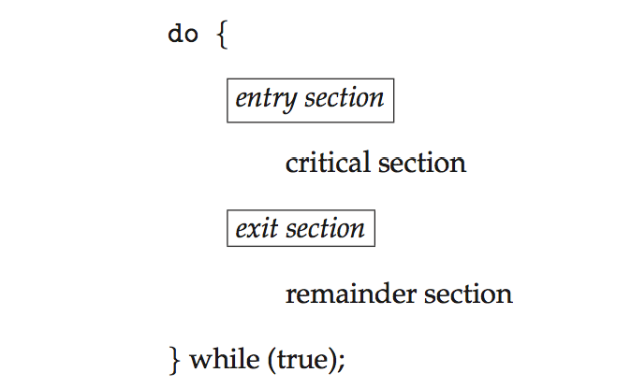
Critical Section
General structure of process P_{i}
Entry section: Each process must ask permission to enter critical section. It tries to acquire the lock,
Critical section where the process accesses shared resources or variables.
After completing the critical section, the process releases the lock in the exit section.
In remainder section where it executes non-critical code or operations

Slide 9
Requirements for Critical-Section Solutions
Requirements for a solution to critical-section problem: Criteria for a perfect synchronization between processes.
Let’s consider the following example in order to explain:
Students in class and many teachers want to enter to teach them.
Students: Shared resource
Teachers: Processes.
Mutual Exclusion: If process P_{i} is executing in its critical section, then no other process can be executing in their critical section.
Two processes can’t be at the critical section at the same time.
If a teacher enter the class, the door is closed, other teachers try to open the door then must wait.

Slide 10
Requirements for Critical-Section Solutions
Requirements for a solution to critical-section problem: Criteria for a perfect synchronization between processes.
Progress: If there is a process outside of the critical section, it can’t prevent other processes to access to the critical section.
If the teacher leaves the class, it mustn't prevent other teachers to enter.
How this can be possible? : The door is kept closed.
The process leaves the critical section and forget to liberate the lock.
Bounded Waiting: A process can’t wait indefinitely to enter the critical section.
The first teacher leaves the class, when a second teacher try to enter a third one comes and enter directly. For example, because the third teacher is older than him, have a higher grade, etc.
The second teacher will wait indefinitely.

Slide 11
Active-Waiting Solutions
Active (busy) waiting: When a process can’t enter to a critical section, it will not be blocked in a waiting state. It will execute.
Active-Waiting solutions vary depending on the code to be written in the entry_section and exit_section functions.

Slide 12
Software Solution 1: Lock variable
The two processes share one variable: int turn;
The variable turn indicates whose turn it is to enter the critical section.
Initially Turn = 1 ; No process uses the critical section.
Entry_section(){
while (Turn = = 0);
Turn --;
}
Verify if the lock is taking; Turn ==0 ➔ Lock taking ➔ while==True➔ process blocked in the while.
If the lock is not taking ➔ Turn !=0 ➔ Turn - - (take the lock)
Exit_section(){
Turn ++;
}
Execution terminated ➔ Process leaves the critical section ➔ Turn + +
➔ (unlock ).

Slide 13
Lock variable solution weakness
Entry_section(){
(1)while(Turn = = 0);
(2)Turn --;
}
Exit_section(){
(3)Turn ++;
}
Turn | P1 | P2 | P3
0 | CS
0 |  | Blocked (1)
0 |  |  | Blocked (1)
1 | (3)
 |  | (1) Passes
1 |  |  | (1) Passes
0 |  |  | (2) Turn - - ➔ CS
- 1 |  | (2) Turn - - ➔ CS
P2 interrupted
Two processes in the CS at the same time
Mutual Exclusion problem

Slide 14
Software Solution 2: Strict alternating
The two processes share one variable: int turn;
The variable turn is an index associated to each process that wants to enter to CS.
Initially Turn = i ; Process i uses the critical section. After that, Process i+1 enter to CS.
Entry_section(int indice){
while (Turn # indice);
}
Exit_section(){
Turn = (Turn + 1)% N ;
}

Slide 15
Strict alternating solution weakness
Entry_section(int indice){
while (Turn # indice);
}
Exit_section(){
Turn = (Turn + 1)% N;
}
Turn | P0 | P1
0 | E_S CS Ex_S | E_S
1 |  | E_S CS
1 | E_S | … (ready queue) CS CS
P0 terminates the execution of CS
P0 wants to enter the CS
The schedular removes the CPU from P1
The turn is given to a process (P1) infinitively.
Starvation problem for P0
Progress problem

Slide 16
Strict alternating solution V2
This solution proposes the use of a flag array: boolean flag[N]; N is the number of processes.
The flag array is used to indicate if a process is ready to enter the critical section.
flag[i] = true implies that process P_{i} is ready!
Example with 2 processes:
Entry_section(int indice){
flag[indice] =1;
While(flag[1- indice]);
}
Exit_section(int indice){
flag[indice] =0;
}

Slide 17
Strict alternating solution V2 ; Weakness
Entry_section(int indice){
(1) flag[indice] =1;
(2) While(flag[1- indice]);
}
Exit_section(int indice){
(3)flag[indice] =0;
}
P0 | P1 | Flag[0] 0 | Flag[1] 0
(1) |  | 1 | 0
 | (1) | 1 | 1
(2) |  | 1 | 1
 | (2) | 1 | 1
P0 blocked
P1 blocked
➔Inter-block
➔Bounded Waiting problem

Slide 18
Software Solution -- Peterson’s Algorithm
This solution proposes the use of two variables:
int turn;
boolean flag[N];
The variable turn indicates whose turn it is to enter the critical section.
The flag array is used to indicate if a process is ready to enter the critical section.
flag[i] = true implies that process P_{i} is ready!
Entry_section(int process){
int autre;
autre=1-process;
flag[process] =true;
turn=process;
While(flag[autre] && turn ==process);
}
Process is interested
Process demand the turn
Exit_section(int indice){
flag[process] =false;
}

Slide 19
Software Solution -- Peterson’s Algorithm
Provable that the three CS requirement are met:
1. Mutual exclusion is preserved
P_{i} enters CS only if:
either flag[j] = false or turn = i
2. Progress requirement is satisfied
3. Bounded-waiting requirement is met

Slide 20
Peterson’s Algorithm: Illustrative example
We propose to synchronize the passage of people on a bridge that supports only one person going from one side to another.
You are asked to write a program for a person that will allow him to pass from one side to the other across the bridge.
You must use the Peterson’s Algorithm to synchronize between the people.

Slide 21
Peterson’s Algorithm: Illustrative example
Pass (int numPerson){
Enter_SC( );
Passing( );
Exit_SC( );
}

Slide 22
Peterson’s Solution
Solution works for 2 process.
What about modifying it to handle 10 processes?
Solution requires busy waiting
Processes waste CPU cycles to ask if they can enter the critical section

