Slide 1
Chapter : Synchronization Tools

Slide 2
Synchronization : Review
The role of the synchronization is to manage shared resources between concurrently processes.
Many algorithms: Active Waiting ; Passive waiting.

Slide 3
Mutual exclusion with passive waiting
The idea is that a process that cannot enter the critical section will go to the blocked state instead of consuming CPU time unnecessarily.
The process moves to the blocked state instead of the ready state until the resource in the critical section is available.
Sleep and Wakeup primitives
the operating system offers two system calls:
Sleep which blocks the calling process.
Wakeup which wakes up the process given in argument.

Slide 4
Mutual exclusion with passive waiting
Lock=0
Entry_section(){
If (lock ==N) Sleep ()
lock ++;
}
CS
Exit_section(){
lock --;
Wakeup()
}

Slide 5
Mutual exclusion with passive waiting
If many resources are blocked , who will wakeup first?
It depends on the operating system.
Generally, there is no rule. The procedure is done randomly.

Slide 6
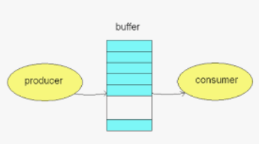
Producer-Consumer model
Application of Sleep and Wakeup primitives to resolve the Producer-Consumer problem.
Two type of processes (Producers and Consumers), They cooperate by sharing the same buffer:
Producer produces items and puts them in the buffer.
Consumer retrieves items from the buffer and consumes them.

Slide 7
Producer-Consumer model
Possible anomalies for the Producer-Consumer model:
Shared resources in this example are items. It is possible that the speed of the consumption is greeter then the production speed.
A possible situation : Consumers don’t find items.
The buffer is bounded.
A possible situation : Producers can’t find free places to store their produced items.
Anomalies between producers / consumers are possible.
A possible situation: Producers /consumers store/retrieve their item in/from the same address.

Slide 8
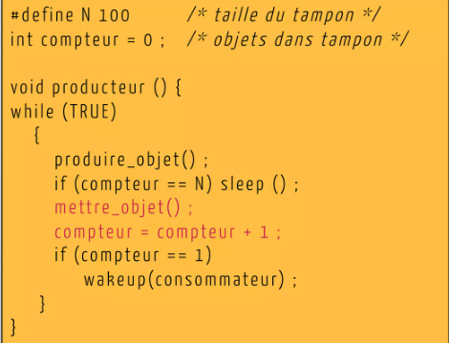
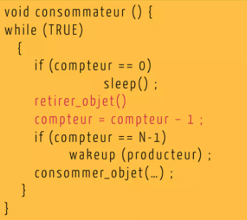
Producer-Consumer model
3
1
4
2
1- The producer sleep if the buffer is full.
3- The consumer sleep if the buffer is empty.
2- if compteur != 0 ; a new item is produced➔ a consumer must wakeup.
4- There is a free place in the buffer ➔ a producer wakeup.

Slide 9
Producer-Consumer model
The solution’s drawback
Consider the scenario where a preemption takes place between the if and the sleep() of the producer (the only producer).
A wakeup signal sent to a process that is not sleeping (yet) is lost (Lost wakeups).
Consumer continues to consume until the buffer is empty.
The producer returns and directedly sleep.
An interlock situation.

Slide 10
Producer-Consumer model
The solution’s drawback
An interruption that occurs after the if test leads to mutual exclusion problem.
As long as the instructions inside the if are non atomic, the exclusion problem persists.
Entry_section(){
If (lock ==N-1)Sleep ()
lock ++;
}

Slide 11
Semaphore
To solve the problem of lost wakeups, the idea is to use a specific variable called: Semaphore.
A semaphore is the implementation of the verrou technique in a unique assembly instruction: The interruption is impossible.
A semaphore is
An Integer with a value >=0
A waiting queue

Slide 12
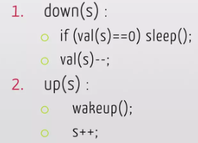
Semaphore
A semaphore S is manipulated by only the following atomic operations:
3. init : semaphore s= ?
Atomic operation
Atomic operation

Slide 13
Semaphore
To ensure mutual exclusion a semaphore can be programmed in the following way:
S=1 # Initialization all times to 1
Down(S)
<critical section>
Up(S)
This semaphore is called mutex :
init to 1 ➔ D(s) ➔ SC ➔ Up (s)

Slide 14
Semaphore
Others, are called count semaphore : Are not usually initialized to 1 and the call for D(S) and Up(S) functions can be in a different order.
Semaphore S=3
D(S)
P1 SC : Imprim_Code () printer_1
P2 UP(S) printer_2
P3 printer_3
P4
P5

Slide 15
Semaphore: producer/consumer problem
Application of the count semaphore to The producer/consumer problem.
For the first issue: Reading and writing in the buffer: At the same time only one process can access the CS.
A Mutex is needed: ensures that the producer and the consumer never access to the buffer space at the same time. It is initialized to 1.
The producer wants to produce and the buffer is full.
The consumer wants to consume and the buffer is empty.
An unordinary semaphore is needed: Count the number of occupied places.
An unordinary semaphore is needed: Count the number of free places.

Slide 16
Mutex M=1
S_empty = N //size of the buffer
S_full = 0
Producer() {
While true {
D(S_empty)
D(M)
Insert_object() //CS
Up(M)
UP(S_full)
}}
Consumer() {
While true {
D(S_full)
D(M)
Retreive_object() //CS
Up (M)
Up(S_empty)

Slide 17
Semaphore: producer/consumer problem
Number of needed semaphore depends on the wakeup : I want to wakeup any process or a specific one. For each specific process, a semaphore must be defined.
Mutex=1 //Manipulate the same resource for producers/consumers.
S1= N // For the first time, if a producer comes, will succeed to pass.
//Possible to execute N producer before the buffer becomes full
S2=0 // For the first time, if a consumer comes before a producer, will
//be blocked. The buffer is empty.
While true {
If … sleep → D (S1)
D(mutex)
Insert_object() //CS
UP (mutex)
Wakeup → UP (S2)
While true {
If … sleep → D (S2)
D(mutex)
Retreive_object() //CS
UP (mutex)
Wakeup → UP (S1)

Slide 18
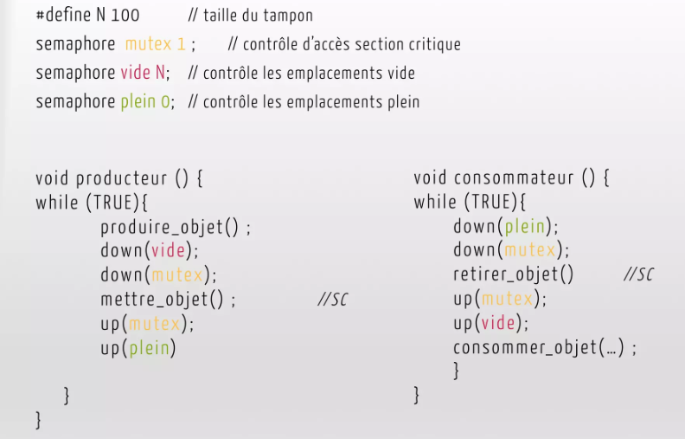
Semaphore: producer/consumer problem

Slide 19
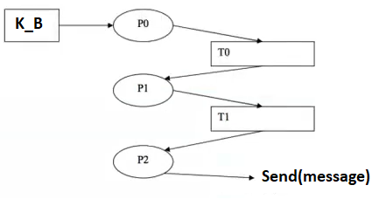
Semaphore: Application
Lets consider a multi-task system composed by three layers P0,P1,P2. Layers are concurrent processes that communicate using two buffers T0 and T1 having the same size N:
P0 and P1 share the buffer T0.
P1 and P2 share the buffer T1.

Slide 20
Semaphore: Application
Each layer has a particular treatment:
P0 reads messages from the key-board, treats them, then transfer them to the buffer T0. The function Read_message() is used to read a message from the key-board.
The treatment of a message by the layer P1 consists to encrypt it. It is realized by the function EncryptMessage(message).
The process P1 is charged to transfer messages from the buffer T0 to the buffer T1.
The process P2 retrieves messages from T1 and transfer them to a destination. The function Send(message) is used.

