Slide 1
Chapter 2 How Computers Find Each Other on Networks
Dr. Sayonnha Mandal
Notes:
Network+ Guide to Networks 7th Edition
Chapter 1
An Introduction to Networking

Slide 2
Objectives
Describe how computers and other devices are addressed on a network
Explain how host names and domain names work
Identify how ports and sockets work at the OSI Transport layer
Demonstrate how IP addresses are assigned and formatted at the OSI Network layer
Use command-line tools to troubleshoot problems with network addresses
Notes:
Objectives
Describe how computers and other devices are addressed on a network
Explain how host names and domain names work
Identify how ports and sockets work at the OSI Transport layer
Demonstrate how IP addresses are assigned and formatted at the OSI Network layer
Use command-line tools to troubleshoot problems with network addresses

Slide 3
An Overview of Addressing on Networks
Four addressing methods:
Application layer FQDNs, computer names, and host names
Transport layer port numbers
Network layer IP address
IPv4 addresses have 32 bits and are written as four decimal numbers called octets
IPv6 addresses have 128 bits and are written as eight blocks of hexadecimal numbers
Data Link layer MAC address
Also called physical address
Notes:
An Overview of Addressing on Networks
Four addressing methods:
Application layer FQDNs, computer names, and host names
Transport layer port numbers
Network layer IP address
IPv4 addresses have 32 bits and are written as four decimal numbers called octets
IPv6 addresses have 128 bits and are written as eight blocks of hexadecimal numbers
Data Link layer MAC address
Also called physical address

Slide 4
MAC Addresses
Traditional MAC addresses contain two parts
First 24 bits are known as the OUI (Organizationally Unique Identifier) or block ID or company-ID
Assigned by the IEEE
Last 24 bits make up the extension identifier or device ID
Manufacturer’s assign each NIC a unique device ID
Notes:
MAC Addresses
Traditional MAC addresses contain two parts
First 24 bits are known as the OUI (Organizationally Unique Identifier) or block ID or company-ID
Assigned by the IEEE
Last 24 bits make up the extension identifier or device ID
Manufacturer’s assign each NIC a unique device ID

Slide 5
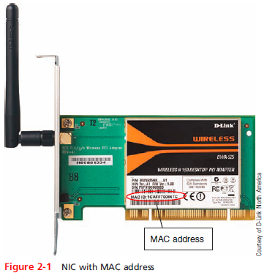
MAC Addresses
Notes:
MAC Addresses

Slide 6
How Host Names and Domain Names Work
Character-based names are easier to remember than numeric IP addresses
Last part of an FQDN is called the top-level domain (TLD)
Domain names must be registered with an Internet naming authority that works on behalf of ICANN
ICANN restricts what type of hosts can be associated with .arpa, .mil, .int, .edu, and .gov
Name resolution is the process of discovering the IP address of a host when you know the FQDN
Notes:
How Host Names and Domain Names Work
Character-based names are easier to remember than numeric IP addresses
Last part of an FQDN is called the top-level domain (TLD)
Domain names must be registered with an Internet naming authority that works on behalf of ICANN
ICANN restricts what type of hosts can be associated with .arpa, .mil, .int, .edu, and .gov
Name resolution is the process of discovering the IP address of a host when you know the FQDN

Slide 7
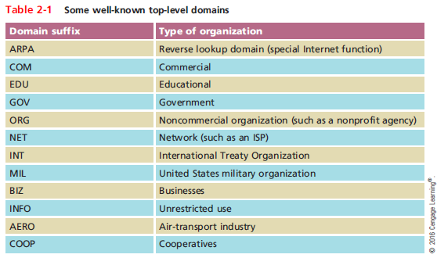
How Host Names and Domain Names Work
Notes:
How Host Names and Domain Names Work

Slide 8
DNS (Domain Name System)
DNS is an Application layer client-server system of computers and databases made up of these elements:
namespace - the entire collection of computer names and their associated IP addresses stored in databases on DNS name servers around the globe
name servers - hold databases, which are organized in a hierarchical structure
resolvers - a DNS client that requests information from DNS name servers
Notes:
DNS (Domain Name System)
DNS is an Application layer client-server system of computers and databases made up of these elements:
namespace - the entire collection of computer names and their associated IP addresses stored in databases on DNS name servers around the globe
name servers - hold databases, which are organized in a hierarchical structure
resolvers - a DNS client that requests information from DNS name servers

Slide 9
How Name Servers Are Organized
DNS name servers are organized in a hierarchical structure
At the root level, 13 clusters of root server hold information used to locate top-level domain (TLD) servers
TLD servers hold information about authoritative servers
The authority on computer names and their IP address for computer in their domains
Notes:
How Name Servers Are Organized
DNS name servers are organized in a hierarchical structure
At the root level, 13 clusters of root server hold information used to locate top-level domain (TLD) servers
TLD servers hold information about authoritative servers
The authority on computer names and their IP address for computer in their domains

Slide 10
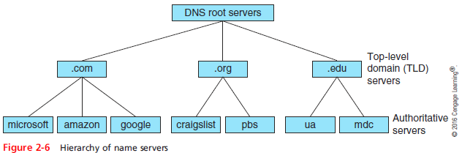
How Name Servers Are Organized
Notes:
How Name Servers Are Organized

Slide 11
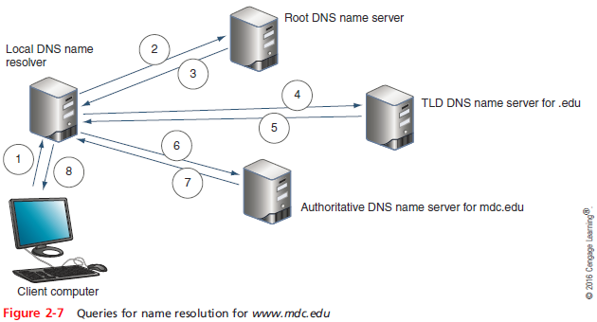
How Name Servers Are Organized
Notes:
How Name Servers Are Organized

Slide 12
How Name Servers Are Organized
Ways the resolution process can get more complex:
Caching-only server - when it receives a request for information that is not stored in its DNS cache, it will first query the company’s authoritative name server
Name servers within a company might not have access to root servers
A TLD name server might be aware of an intermediate name server rather than the authoritative name server
Notes:
How Name Servers Are Organized
Ways the resolution process can get more complex:
Caching-only server - when it receives a request for information that is not stored in its DNS cache, it will first query the company’s authoritative name server
Name servers within a company might not have access to root servers
A TLD name server might be aware of an intermediate name server rather than the authoritative name server

Slide 13
Recursive and Iterative Queries
Two types of DNS requests:
Recursive - a query that demands a resolution or the answer “It can’t be found”
Iterative - a query where the local server issues queries to other servers
Other servers only provide information if they have it
Do not demand a resolution
Notes:
Recursive and Iterative Queries
Two types of DNS requests:
Recursive - a query that demands a resolution or the answer “It can’t be found”
Iterative - a query where the local server issues queries to other servers
Other servers only provide information if they have it
Do not demand a resolution

Slide 14
DNS Zones and Zone Transfers
DNS follows a distributed database model
Data is distributed over thousands of server so that DNS will not fail if one or a handful of servers experience errors
DNS zone - the domains an organization is responsible for managing
Primary DNS server holds the authoritative DNS database for the organization
Zone transfer - the process where a secondary DNS server makes a request to the primary server for a database update
Notes:
DNS Zones and Zone Transfers
DNS follows a distributed database model
Data is distributed over thousands of server so that DNS will not fail if one or a handful of servers experience errors
DNS zone - the domains an organization is responsible for managing
Primary DNS server holds the authoritative DNS database for the organization
Zone transfer - the process where a secondary DNS server makes a request to the primary server for a database update

Slide 15
DNS Server Software
BIND (Berkeley Internet Name Domain) - most popular DNS server software
Open source - the term for software whose code is publicly available for use and modification
Microsoft DNS Server - built-in DNS service in the Windows Server OS
Split DNS design - Internal and external DNS queries are handled by different DNS servers
Also called a split-horizon DNS
Notes:
DNS Server Software
BIND (Berkeley Internet Name Domain) - most popular DNS server software
Open source - the term for software whose code is publicly available for use and modification
Microsoft DNS Server - built-in DNS service in the Windows Server OS
Split DNS design - Internal and external DNS queries are handled by different DNS servers
Also called a split-horizon DNS

Slide 16
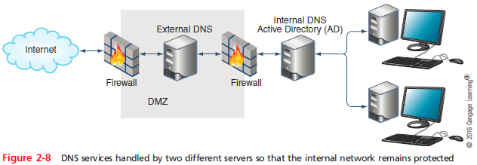
DNS Server Software
Notes:
DNS Server Software

Slide 17
How a Namespace Database is Organized
Several types of records, called resource records are kept in a DNS database:
A (Address) record - stores the name-to-address mapping for a host
AAAA (Address) record - holds the name-to-address mapping, the IP address is an IPv6 type IP address
CNAME (Canonical Name) record - holds alternative names for a host
PTR (Pointer) record - used for reverse lookups
MX (Mail Exchanger) record - identifies a mail server and is used for email traffic
Notes:
How a Namespace Database is Organized
Several types of records, called resource records are kept in a DNS database:
A (Address) record - stores the name-to-address mapping for a host
AAAA (Address) record - holds the name-to-address mapping, the IP address is an IPv6 type IP address
CNAME (Canonical Name) record - holds alternative names for a host
PTR (Pointer) record - used for reverse lookups
MX (Mail Exchanger) record - identifies a mail server and is used for email traffic

Slide 18
DDNS (Dynamic DNS)
DDNS - a protocol used along with monitoring software to monitor the IP addresses dynamically assigned to your home network by your ISP
Manages dynamic updates to its DNS records for domain names for home Web sites
Home routers sometimes provide the monitoring software embedded in the router firmware
Notes:
DDNS (Dynamic DNS)
DDNS - a protocol used along with monitoring software to monitor the IP addresses dynamically assigned to your home network by your ISP
Manages dynamic updates to its DNS records for domain names for home Web sites
Home routers sometimes provide the monitoring software embedded in the router firmware

Slide 19
How Ports and Sockets Work
Port numbers - ensure data is transmitted to the correct application
Socket - consists of host’s IP address and the port number of an application running on the host
Colon separates the two values
Example - 10.43.3.87:23
Port numbers are divided into three types:
Well-known ports - 0 to 1023
Registered ports - 1024 to 49151
Dynamic and private ports - 49152 to 65535
Notes:
1109 – Kerberos authentication protocol
1293 – IPSec encryption protocol

Slide 20
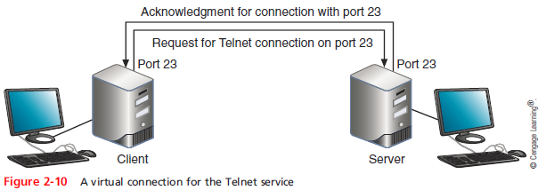
How Ports and Sockets Work
Notes:
When the host receives a request to communicate on port 23, it establishes or opens a session for communication with the Telnet service and the socket is said to be open. When the TCP session is complete, the socket is closed or dissolved. You can think of. Socket as a virtual circuit between a server and client.

Slide 21
How IP Addresses Are Formatted and Assigned
Two types of IP addresses:
IPv4 - a 32-bit address
IPv6 - a 128-bit address
Notes:
How IP Addresses Are Formatted and Assigned
Two types of IP addresses:
IPv4 - a 32-bit address
IPv6 - a 128-bit address

Slide 22
How IPv4 Addresses Are Formatted and Assigned
IPv4 addresses
32-bit address organized into four groups of 8 bits each (known as octets)
Each of the four octets can be any number from 0 to 255
Some IP addresses are reserved
Notes:
How IPv4 Addresses Are Formatted and Assigned
IPv4 addresses
32-bit address organized into four groups of 8 bits each (known as octets)
Each of the four octets can be any number from 0 to 255
Some IP addresses are reserved

Slide 23
Classes of IP Addresses
IPv4 addresses are divided into five classes:
Class A, Class B, Class C, Class D, and Class E
When class licenses were available from IANA:
Class A license was for a single octet
Class B license was for the first two octets
Class C license was for the first three octets
Class D and Class E addresses were not available for general use
Class D begin with 224-239 and are used for multicasting and Class E begin with octets 240-254 and are used for research
Notes:
Classes of IP Addresses
IPv4 addresses are divided into five classes:
Class A, Class B, Class C, Class D, and Class E
When class licenses were available from IANA:
Class A license was for a single octet
Class B license was for the first two octets
Class C license was for the first three octets
Class D and Class E addresses were not available for general use
Class D begin with 224-239 and are used for multicasting and Class E begin with octets 240-254 and are used for research

Slide 24
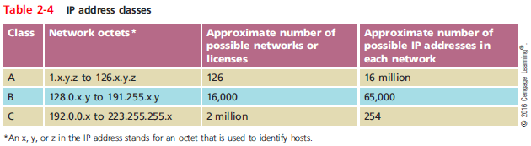
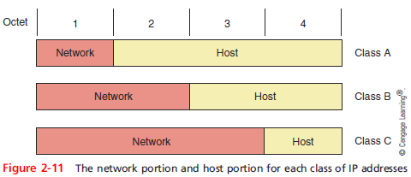
Classes of IP Addresses
Notes:
Classes of IP Addresses

Slide 25
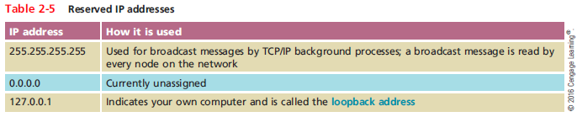
Classes of IP Addresses
Notes:
Classes of IP Addresses

Slide 26
How a DHCP Server Assigns IP Addresses
Static IP addresses are assigned manually by the network administrator
Dynamic IP addresses are automatically assigned by a DHCP server
If a computer configured to use DHCP is unable to lease an IPv4 address from the DHCP server
It uses an Automatic Private IP Addressing (APIPA) address in the address range 169.254.0.1 through 169.254.255.254
Notes:
How a DHCP Server Assigns IP Addresses
Static IP addresses are assigned manually by the network administrator
Dynamic IP addresses are automatically assigned by a DHCP server
If a computer configured to use DHCP is unable to lease an IPv4 address from the DHCP server
It uses an Automatic Private IP Addressing (APIPA) address in the address range 169.254.0.1 through 169.254.255.254

Slide 27
Public and Private IP Addresses
Class A, B, and C licensed IP addresses are available for use on the Internet
Called public IP addresses
A company can use private IP addresses on its private networks
IEEE recommends the following IP addresses be used for private networks:
10.0.0.0 through 10.255.255.255
172.16.0.0 through 172.31.255.255
192.168.0.0 through 192.168.255.255
Notes:
Public and Private IP Addresses
Class A, B, and C licensed IP addresses are available for use on the Internet
Called public IP addresses
A company can use private IP addresses on its private networks
IEEE recommends the following IP addresses be used for private networks:
10.0.0.0 through 10.255.255.255
172.16.0.0 through 172.31.255.255
192.168.0.0 through 192.168.255.255

Slide 28
Address Translation, NAT, and PAT
Network Address Translation (NAT) - a technique designed to conserve public IP addresses needed by a network
Address translation - process where a gateway device substitutes the private IP addresses with its own public address
When these computers need access to other networks or Internet
Port Address Translation (PAT) - process of assigning a TCP port number to each ongoing session between a local host and Internet host
Notes:
Address Translation, NAT, and PAT
Network Address Translation (NAT) - a technique designed to conserve public IP addresses needed by a network
Address translation - process where a gateway device substitutes the private IP addresses with its own public address
When these computers need access to other networks or Internet
Port Address Translation (PAT) - process of assigning a TCP port number to each ongoing session between a local host and Internet host

Slide 29
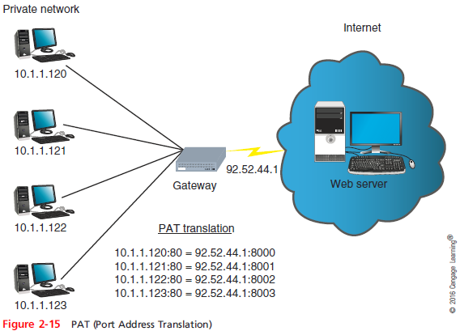
Address Translation, NAT, and PAT
Notes:
Address Translation, NAT, and PAT

Slide 30
Address Translation, NAT, and PAT
Two variations of NAT to be aware of:
SNAT (Static Network Address Translation) - the gateway assigns the same public IP address to a host each time it makes a request to access the Internet
DNAT (Dynamic Network Address Translation) - the gateway has a pool of public address that it is free to assign to a local host when it makes a request to access the Internet
Notes:
Address Translation, NAT, and PAT
Two variations of NAT to be aware of:
SNAT (Static Network Address Translation) - the gateway assigns the same public IP address to a host each time it makes a request to access the Internet
DNAT (Dynamic Network Address Translation) - the gateway has a pool of public address that it is free to assign to a local host when it makes a request to access the Internet

Slide 31
How IPv6 Addresses Are Formatted and Assigned
An IPv6 address has 128 bits written as eight blocks of hexadecimal numbers separated by colons
Ex: 2001:0000:0B80:0000:0000:00D3:9C5A:00CC
Each block is 16 bits
Leading zeros in a four-character hex block can be eliminated
If blocks contain all zeroes, they can be written as double colons (::), only one set of double colons is used in an IP address
Therefore, above example can be written:
2001:0000:B80::D3:9C5A:CC
Notes:
How IPv6 Addresses Are Formatted and Assigned
An IPv6 address has 128 bits written as eight blocks of hexadecimal numbers separated by colons
Ex: 2001:0000:0B80:0000:0000:00D3:9C5A:00CC
Each block is 16 bits
Leading zeros in a four-character hex block can be eliminated
If blocks contain all zeroes, they can be written as double colons (::), only one set of double colons is used in an IP address
Therefore, above example can be written:
2001:0000:B80::D3:9C5A:CC

Slide 32
How IPv6 Addresses Are Formatted and Assigned
IPv6 terminology:
Link (sometimes called local link) - any LAN bounded by routers
An interface is a node’s attachment to a link
Tunneling - a method used by IPv6 to transport IPv6 packets through or over an IPv4 network
Interface ID - the last 64 bits or four blocks of an IPv6 address that identify the interface
Neighbors - two or more nodes on the same link
Notes:
How IPv6 Addresses Are Formatted and Assigned
IPv6 terminology:
Link (sometimes called local link) - any LAN bounded by routers
An interface is a node’s attachment to a link
Tunneling - a method used by IPv6 to transport IPv6 packets through or over an IPv4 network
Interface ID - the last 64 bits or four blocks of an IPv6 address that identify the interface
Neighbors - two or more nodes on the same link

Slide 33
Types of IP Addresses
Unicast address - specifies a single node on a network
Global unicast address - can be routed on the Internet
Link local unicast address - can be used for communicating with nodes in the same link
Multicast address - packets are delivered to all nodes on a network
Anycast address - can identify multiple destinations, with packets delivered to the closest destination
Notes:
Types of IP Addresses
Unicast address - specifies a single node on a network
Global unicast address - can be routed on the Internet
Link local unicast address - can be used for communicating with nodes in the same link
Multicast address - packets are delivered to all nodes on a network
Anycast address - can identify multiple destinations, with packets delivered to the closest destination

Slide 34
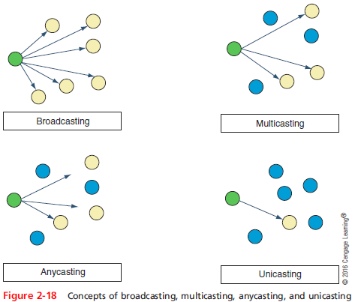
Types of IP Addresses
Notes:
Types of IP Addresses

Slide 35
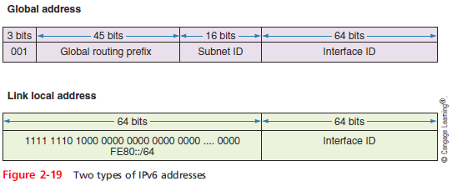
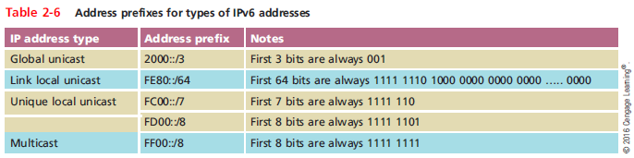
Types of IP Addresses
Notes:
Types of IP Addresses

Slide 36
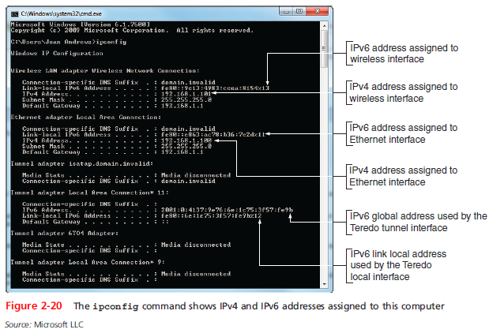
Types of IP Addresses
Notes:
Types of IP Addresses

Slide 37
IPv6 Autoconfiguration
IPv6 addressing is designed so that a computer can autoconfigure its own link local IP address
Similar to how IPv4 uses an APIPA address
Step 1 - The computer creates its IPv6 address
Uses FE80::/64 as the first 64 bits
Last 64 bits can be generated in two ways:
Randomly generated
Generated from the network adapter’s MAC address
Step 2 - The computer checks to make sure its IP address is unique on the network
Notes:
IPv6 Autoconfiguration
IPv6 addressing is designed so that a computer can autoconfigure its own link local IP address
Similar to how IPv4 uses an APIPA address
Step 1 - The computer creates its IPv6 address
Uses FE80::/64 as the first 64 bits
Last 64 bits can be generated in two ways:
Randomly generated
Generated from the network adapter’s MAC address
Step 2 - The computer checks to make sure its IP address is unique on the network

Slide 38
IPv6 Autoconfiguration
Step 3 - The computer asks if a router on the network can provide configuration information
If a router responds with DHCP information, the computer uses whatever information this might be
Such as the IP addresses of DNS server or the network prefix
If the network prefix is supplied, this will become the first 64 bits of its own IP address
Process is called prefix discovery
Notes:
IPv6 Autoconfiguration
Step 3 - The computer asks if a router on the network can provide configuration information
If a router responds with DHCP information, the computer uses whatever information this might be
Such as the IP addresses of DNS server or the network prefix
If the network prefix is supplied, this will become the first 64 bits of its own IP address
Process is called prefix discovery

Slide 39
Tunneling
Dual stacked - term given when a network is configured to use both IPv4 and IPv6 protocols
If packets on this network must traverse other networks where dual stacking is not used, tunneling is used
Three tunneling protocols:
6to4
ISATAP (Intra-Site Automatic Tunnel Addressing)
Teredo
Notes:
Tunneling
Dual stacked - term given when a network is configured to use both IPv4 and IPv6 protocols
If packets on this network must traverse other networks where dual stacking is not used, tunneling is used
Three tunneling protocols:
6to4
ISATAP (Intra-Site Automatic Tunnel Addressing)
Teredo

Slide 40
Tunneling Contd.
6to4:
Most common
Always begins with same 16bit prefix (called fixed bits), which is 2002
Prefix written as 2002::/16
Next 32 bits are the 32 bits of the IPv4 address of the sending host
ISATAP:
works only on single organization’s intranet
By default enabled in Windows 7 and 8.1
Teredo:
named after teredo worm (bores holes in wood)
Address always begins with 2001
Prefix written as 2001::/32
Enabled by default in Windows 7. not 8.1
Unix and Linux supports Miredo (third party software)

Slide 41
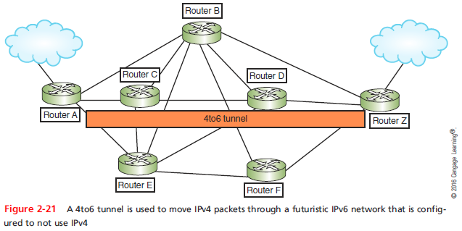
Tunneling
Notes:
Routers A, C, D and Z are configured to use the 4to6 protocol to tunnel IPv4 packets that arrive from outside the intranet at gateway routers A or Z and are routed through the 4to6 tunnel to the other side of the intranet.

Slide 42
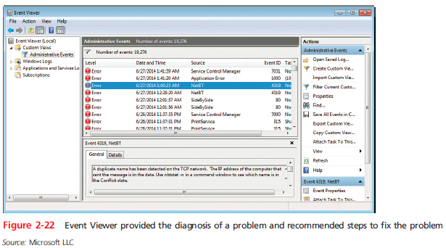
Tools for Troubleshooting IP Address Problems
Event Viewer - one of the first places to start looking for clues when something goes wrong
Notes:
Provides lot of valuable information about the problems the computer is experiencing and even make suggestions for what to do next.

Slide 43
ping
ping (Packet Internet Groper) - used to verify that TCP/IP is installed, bound to the NIC, configured correctly, and communicating with the network
The ping utility sends out a signal called an echo request to another device (request for a response)
Other computer responds in the form of an echo reply
ICMP - protocol used by the echo request/reply to carry error messages and information about the network
Notes:
ping
ping (Packet Internet Groper) - used to verify that TCP/IP is installed, bound to the NIC, configured correctly, and communicating with the network
The ping utility sends out a signal called an echo request to another device (request for a response)
Other computer responds in the form of an echo reply
ICMP - protocol used by the echo request/reply to carry error messages and information about the network

Slide 44
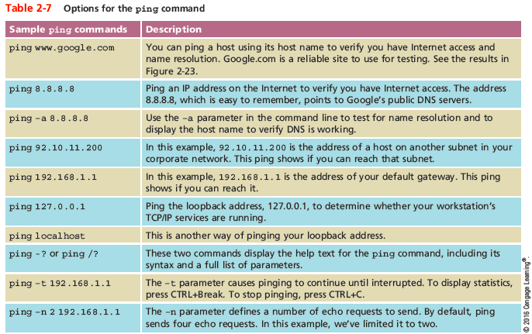
ping

Slide 45
ping
IPv6 networks use a version of ICMP called ICMPv6
ping6 - on Linux computers running IPv6, use ping6 to verify whether an IPv6 host is available
ping -6 - on Windows computers, use ping with the -6 switch to verify connectivity on IPv6 networks
For the ping6 and ping -6 commands to work over the Internet, you must have access to the IPv6 Internet
Notes:
ping
IPv6 networks use a version of ICMP called ICMPv6
ping6 - on Linux computers running IPv6, use ping6 to verify whether an IPv6 host is available
ping -6 - on Windows computers, use ping with the -6 switch to verify connectivity on IPv6 networks
For the ping6 and ping -6 commands to work over the Internet, you must have access to the IPv6 Internet

Slide 46
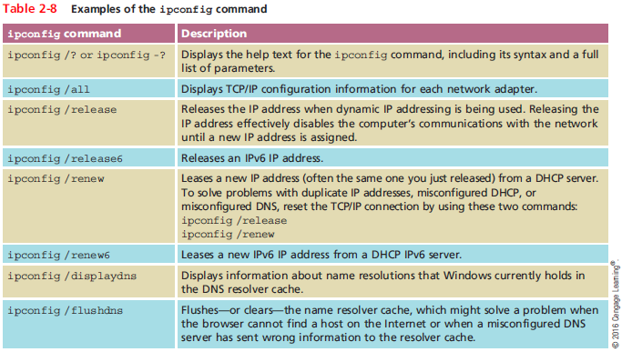
ipconfig
Notes:
ipconfig

Slide 47
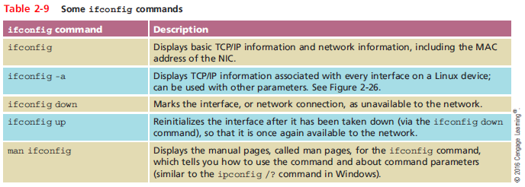
ifconfig
ifconfig - utility to view and manage TCP/IP settings
If your Linux or UNIX system provides a GUI
Open a shell prompt, then type ifconfig
Notes:
ifconfig
ifconfig - utility to view and manage TCP/IP settings
If your Linux or UNIX system provides a GUI
Open a shell prompt, then type ifconfig

Slide 48
nslookup
nslookup (name space lookup) - allows you to query the DNS database from any computer on a network
To find the host name of a device by specifying its IP address, or vice versa
Useful for verifying a host is configured correctly or for troubleshooting DNS resolution problems
Reverse DNS lookup - to find the host name of a device whose IP address you know
Two modes:
Interactive - to test multiple DNS servers at one time
Noninteractive - test a single DNS server
Notes:
nslookup
nslookup (name space lookup) - allows you to query the DNS database from any computer on a network
To find the host name of a device by specifying its IP address, or vice versa
Useful for verifying a host is configured correctly or for troubleshooting DNS resolution problems
Reverse DNS lookup - to find the host name of a device whose IP address you know
Two modes:
Interactive - to test multiple DNS servers at one time
Noninteractive - test a single DNS server

Slide 49
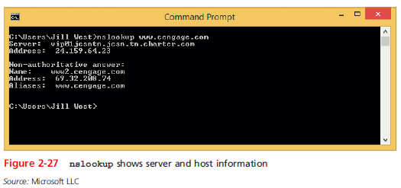
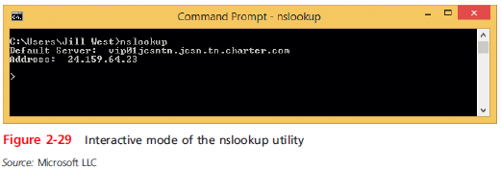
nslookup
Notes:
nslookup

Slide 50
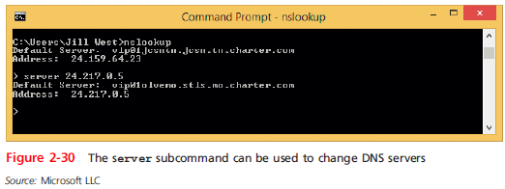
nslookup
You can change DNS servers from within interactive mode with the server subcommand and specifying the IP address of the new DNS server
To exit nslookup’s interactive mode, enter exit
Notes:
nslookup
You can change DNS servers from within interactive mode with the server subcommand and specifying the IP address of the new DNS server
To exit nslookup’s interactive mode, enter exit

Slide 51
Summary
Hosts on a network are assigned host names
Applications are assigned one or more port numbers to communicate with other applications
IPv4 addresses have 32 bits and are written as four decimal numbers called octets
IPv6 addresses have 128 bits and are written as eight blocks of hexadecimal numbers
Every NIC is assigned a unique 48-bit MAC address
Use the ipconfig command to view IP configuration information
Notes:
Summary
Hosts on a network are assigned host names
Applications are assigned one or more port numbers to communicate with other applications
IPv4 addresses have 32 bits and are written as four decimal numbers called octets
IPv6 addresses have 128 bits and are written as eight blocks of hexadecimal numbers
Every NIC is assigned a unique 48-bit MAC address
Use the ipconfig command to view IP configuration information

Slide 52
Summary
A FQDN includes both a host name portion and a domain name portion
Name resolution is the process of matching an FQDN to its IP address
DNS is an automated name resolution service that operates at the Application layer
DNS data is spread throughout the globe in a distributed database model
An IP address and a port number written together is called a socket
Notes:
Summary
A FQDN includes both a host name portion and a domain name portion
Name resolution is the process of matching an FQDN to its IP address
DNS is an automated name resolution service that operates at the Application layer
DNS data is spread throughout the globe in a distributed database model
An IP address and a port number written together is called a socket

Slide 53
Summary
Well-known ports range from 0 to 1023 and are assigned by IANA
You can define a range of available IP addresses in DHCP, or assign a static IP address as a DHCP reservation
NAT is used to allow devices that have private IP addresses access to the Internet
Tunneling protocols are used to allow IPv6 packets to travel over or through an IPv4 network
Three types of IPv6 addresses are unicast, multicast, and anycast addresses
Notes:
Summary
Well-known ports range from 0 to 1023 and are assigned by IANA
You can define a range of available IP addresses in DHCP, or assign a static IP address as a DHCP reservation
NAT is used to allow devices that have private IP addresses access to the Internet
Tunneling protocols are used to allow IPv6 packets to travel over or through an IPv4 network
Three types of IPv6 addresses are unicast, multicast, and anycast addresses

Slide 54
Summary
The ping utility uses ICMP to verify that TCP/IP is installed, bound to the NIC, configured correctly, and communicating with the network
ipconfig is useful for viewing and adjusting a Windows computer’s TCP/IP settings
On UNIX and Linux systems, the ifconfig utility is used to view and manage TCP/IP settings
The nslookup utility allows you to query the DNS database from any computer on the network
Notes:
Summary
The ping utility uses ICMP to verify that TCP/IP is installed, bound to the NIC, configured correctly, and communicating with the network
ipconfig is useful for viewing and adjusting a Windows computer’s TCP/IP settings
On UNIX and Linux systems, the ifconfig utility is used to view and manage TCP/IP settings
The nslookup utility allows you to query the DNS database from any computer on the network

