Slide 1
Chapters 4 and 5

Slide 2
NAS (Network Attached Storage)
Fault tolerance - techniques that allow data storage or other operations to continue in the event of a failure or fault of one its components
NAS - a specialized storage device or group of storage devices that provides centralized fault tolerant data storage for a network
Contains its own file system optimized for saving and serving files
Reads and writes from its disk significantly faster than other types of servers
Can be easily expanded without interrupting service
Notes:
NAS (Network Attached Storage)
Fault tolerance - techniques that allow data storage or other operations to continue in the event of a failure or fault of one its components
NAS - a specialized storage device or group of storage devices that provides centralized fault tolerant data storage for a network
Contains its own file system optimized for saving and serving files
Reads and writes from its disk significantly faster than other types of servers
Can be easily expanded without interrupting service

Slide 3
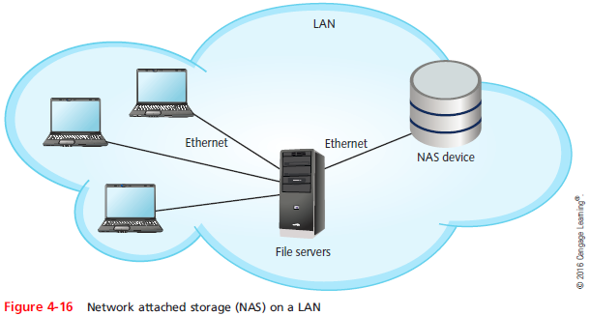
NAS (Network Attached Storage)
A NAS device cannot communicate directly with clients
Clients go through a file server, which communicates with the NAS device
Notes:
NAS (Network Attached Storage)
A NAS device cannot communicate directly with clients
Clients go through a file server, which communicates with the NAS device

Slide 4
SANs (Storage Area Networks)
A SAN is a network of storage devices that communicate directly with each other and with other networks
Uses a type of architecture that is similar to mesh topology, which is very fault-tolerant
SANS use one of two types of Transport layer protocols:
Fibre Channel (FC) – transport layer protocol used on fiber-optic media instead of TCP or UDP. Fiber channel connects devices within the SAN and also connects the SAN to other networks.
iSCSI – (Internet SCSI) is a transport layer protocol that runs on top of TCP to allow fast transmissions over LANs, WANs and the Internet. It can work on a twisted pair Ethernet network with ordinary Ethernet NICs.
Notes:
SANs (Storage Area Networks)
A SAN is a network of storage devices that communicate directly with each other and with other networks
Uses a type of architecture that is similar to mesh topology, which is very fault-tolerant
SANS use one of two types of Transport layer protocols:
Fibre Channel (FC)
iSCSI

Slide 5
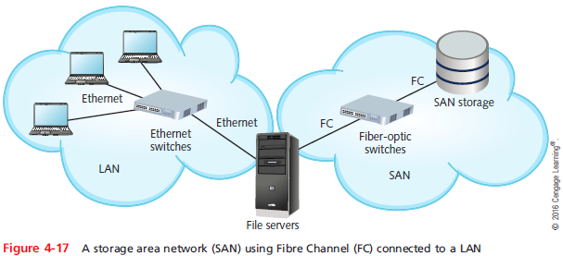
SANs (Storage Area Networks)
Notes:
SANs (Storage Area Networks)

Slide 6
SANs (Storage Area Networks)
A SAN can be installed in a location separate from the LAN it serves
SANs are highly scalable and have:
A very high fault tolerance
Massive storage capabilities
Fast data access
SANs are best suited to environments with huge quantities of data that must always be quickly available
Notes:
SANs (Storage Area Networks)
A SAN can be installed in a location separate from the LAN it serves
SANs are highly scalable and have:
A very high fault tolerance
Massive storage capabilities
Fast data access
SANs are best suited to environments with huge quantities of data that must always be quickly available

Slide 7
NICs and Ethernet
Each workstation, server, printer, connectivity device, or other device on a network uses a NIC
On local networks, a NIC uses Ethernet standards for communication
Notes:
NICs and Ethernet
Each workstation, server, printer, connectivity device, or other device on a network uses a NIC
On local networks, a NIC uses Ethernet standards for communication

Slide 8
Characteristics of NICs
The NIC contains a transceiver that transmits and receives data signals over network media
NICs belong to both the Physical and Data Link layer because they:
Issue data signals and assemble/disassemble data frames
Interpret physical addressing information
Perform routines that determine which node has the right to transmit data
Can also perform prioritization, network management, buffering, and traffic-filtering functions
Notes:
Characteristics of NICs
The NIC contains a transceiver that transmits and receives data signals over network media
NICs belong to both the Physical and Data Link layer because they:
Issue data signals and assemble/disassemble data frames
Interpret physical addressing information
Perform routines that determine which node has the right to transmit data
Can also perform prioritization, network management, buffering, and traffic-filtering functions

Slide 9
Characteristics of NICs
NICs come in a variety of types depending on:
Connection type
Maximum network transmission speed
Connector interfaces
Number of connector interfaces, or ports
Manufacturer
Support for enhanced features, such as PoE+, buffering, or traffic management
Method of interfacing with the computer’s motherboard and interface standards
Notes:
Characteristics of NICs
NICs come in a variety of types depending on:
Connection type
Maximum network transmission speed
Connector interfaces
Number of connector interfaces, or ports
Manufacturer
Support for enhanced features, such as PoE+, buffering, or traffic management
Method of interfacing with the computer’s motherboard and interface standards

Slide 10
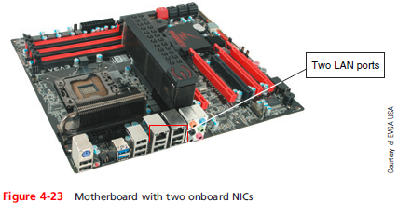
Characteristics of NICs
A NIC interfaces with a computer’s motherboard by one of the following methods:
Integrated into the motherboard
Installed in an expansion slot on the motherboard
Installed as a peripheral device
Notes:
Characteristics of NICs
A NIC interfaces with a computer’s motherboard by one of the following methods:
Integrated into the motherboard
Installed in an expansion slot on the motherboard
Installed as a peripheral device

Slide 11
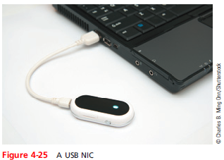
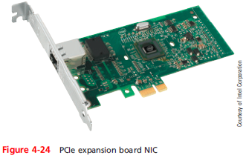
Characteristics of NICs
Notes:
Characteristics of NICs

Slide 12
Characteristics of NICs
General tips when installing NICs:
Install hardware and software
Install a peripheral NIC
Install an expansion card NIC
Install multiple NICs in servers and other high-powered computers
Notes:
Characteristics of NICs
General tips when installing NICs:
Install hardware and software
Install a peripheral NIC
Install an expansion card NIC
Install multiple NICs in servers and other high-powered computers

Slide 13
Simplex, Half-Duplex, and Duplex
Methods of transmission:
Full-duplex, also called duplex - signals are free to travel in both directions over a medium simultaneously
Half-duplex - signals may travel in both directions over a medium but in only one direction at a time
Simplex - signals may travel in only one direction
Sometimes called one-way or unidirectional
Many network devices allow you to specify whether the device should use half- or full-duplex
Modern NICs use full-duplex by default
Notes:
Simplex, Half-Duplex, and Duplex
Methods of transmission:
Full-duplex, also called duplex - signals are free to travel in both directions over a medium simultaneously
Half-duplex - signals may travel in both directions over a medium but in only one direction at a time
Simplex - signals may travel in only one direction
Sometimes called one-way or unidirectional
Many network devices allow you to specify whether the device should use half- or full-duplex
Modern NICs use full-duplex by default

Slide 14
Simplex, Half-Duplex, and Duplex
Auto Negotiation - allows the NIC to select the best link speed and duplex that is also supported by the neighboring device
If you specify a particular speed and duplex that is not supported by a neighboring device
The result is a speed and duplex mismatch and transmission will fail
Using UNIX or Linux, the ethtool utility allows you to view and change NIC settings
Notes:
Simplex, Half-Duplex, and Duplex
Auto Negotiation - allows the NIC to select the best link speed and duplex that is also supported by the neighboring device
If you specify a particular speed and duplex that is not supported by a neighboring device
The result is a speed and duplex mismatch and transmission will fail
Using UNIX or Linux, the ethtool utility allows you to view and change NIC settings

Slide 15
Co-axial cable
Co-axial cable has a central metal core (often copper) surrounded by an insulator, a braided metal shielding called braiding or shield and an outer cover called the sheath or jacket.
The core can have a solid metal wire or several thin strands of metal wire and carries the electromagnetic signal.
The shielding protects the signal against noise and is a ground for the signal.
The plastic insulator can be PVC (polyvinyl chloride) or Teflon and protects the code from the metal shielding because if the two made contact, the wire would short-circuit.

Slide 16
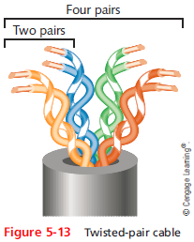
Twisted-Pair Cable
Color-coded insulated copper wire pairs
0.4 to 0.8 mm diameter
Encased in a plastic sheath
Every two wires are twisted
together
Notes:
Twisted-Pair Cable
Color-coded insulated copper wire pairs
0.4 to 0.8 mm diameter
Encased in a plastic sheath
Every two wires are twisted
together

Slide 17
Twisted-Pair Cable
More wire pair twists per foot
More resistance to cross talk
Higher-quality
More expensive
Twist ratio
Twists per meter or foot
High twist ratio
Greater attenuation
Notes:
Twisted-Pair Cable
More wire pair twists per foot
More resistance to cross talk
Higher-quality
More expensive
Twist ratio
Twists per meter or foot
High twist ratio
Greater attenuation

Slide 18
Twisted-Pair Cable
Hundreds of different designs
Twist ratio, number of wire pairs, copper grade, shielding type, shielding materials
1 to 4200 wire pairs possible
Wiring standard specification
TIA/EIA 568
Most common twisted pair types
Category (cat) 3, 5, 5e, 6, 6a, 7
CAT 5e or higher used in modern LANs
Notes:
Twisted-Pair Cable
Hundreds of different designs
Twist ratio, number of wire pairs, copper grade, shielding type, shielding materials
1 to 4200 wire pairs possible
Wiring standard specification
TIA/EIA 568
Most common twisted pair types
Category (cat) 3, 5, 5e, 6, 6a, 7
CAT 5e or higher used in modern LANs

Slide 19
Twisted-Pair Cable
Advantages
Relatively inexpensive
Flexible
Easy installation
Spans significant distance before requiring repeater
Accommodates several different topologies
Two categories
Shielded twisted pair (STP)
Unshielded twisted pair (UTP)
Notes:
Twisted-Pair Cable
Advantages
Relatively inexpensive
Flexible
Easy installation
Spans significant distance before requiring repeater
Accommodates several different topologies
Two categories
Shielded twisted pair (STP)
Unshielded twisted pair (UTP)

Slide 20
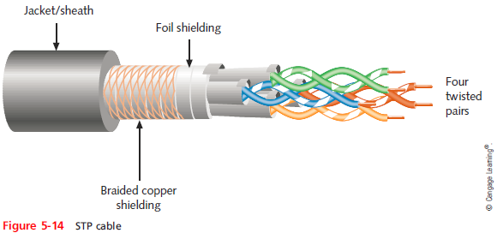
STP (Shielded Twisted Pair)
Individually insulated
Surrounded by metallic substance shielding (foil)
Barrier to external electromagnetic forces
Contains electrical energy of signals inside
May be grounded
Notes:
STP (Shielded Twisted Pair)
Individually insulated
Surrounded by metallic substance shielding (foil)
Barrier to external electromagnetic forces
Contains electrical energy of signals inside
May be grounded

Slide 21
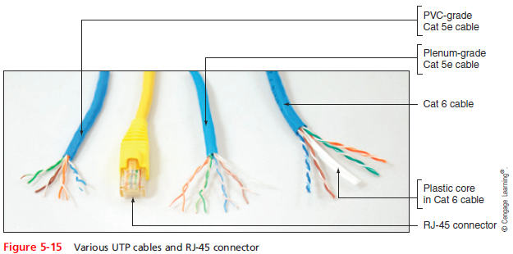
UTP (Unshielded Twisted Pair)
One or more insulated wire pairs
Encased in plastic sheath
No additional shielding
Less expensive, less noise resistance
Notes:
UTP (Unshielded Twisted Pair)
One or more insulated wire pairs
Encased in plastic sheath
No additional shielding
Less expensive, less noise resistance

Slide 22
Comparing STP and UTP
Throughput
STP and UTP can transmit the same rates
Cost
STP and UTP vary in cost
Connector
STP and UTP use Registered Jack 45
Noise immunity
STP more noise resistant
Size and scalability
Maximum segment length for both: 100 meters
Notes:
Comparing STP and UTP
Throughput
STP and UTP can transmit the same rates
Cost
STP and UTP vary in cost
Connector
STP and UTP use Registered Jack 45
Noise immunity
STP more noise resistant
Size and scalability
Maximum segment length for both: 100 meters

Slide 23
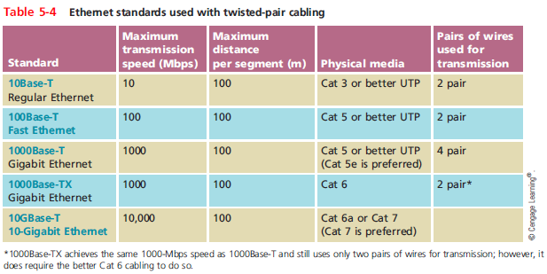
Ethernet Standards for Twisted-Pair Cabling
Notes:
Ethernet Standards for Twisted-Pair Cabling

Slide 24
Cable Pinouts
Proper cable termination is a requirement for two nodes on a network to communicate
TIA/EIA specifies two methods of inserting wires into RJ-45 plugs
TIA/EIA 568A
TIA/EIA 568B
No functional difference between the two standards
Just make sure you use the same standard on every RJ-45 plug and jack
Notes:
Cable Pinouts
Proper cable termination is a requirement for two nodes on a network to communicate
TIA/EIA specifies two methods of inserting wires into RJ-45 plugs
TIA/EIA 568A
TIA/EIA 568B
No functional difference between the two standards
Just make sure you use the same standard on every RJ-45 plug and jack

Slide 25
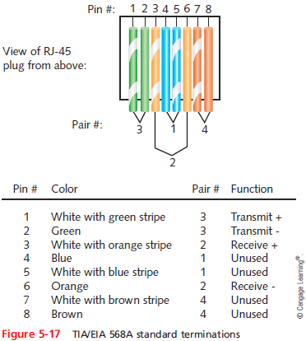
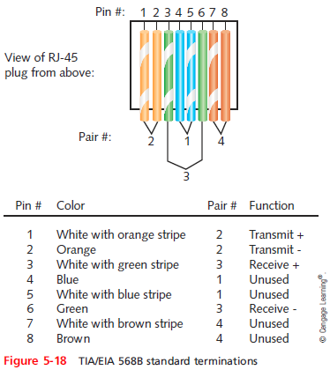
Cable Pinouts
Notes:
Cable Pinouts

Slide 26
Cable Pinouts
Straight-through cable
Terminate RJ-45 plugs at both ends identically
Crossover cable
Transmit and receive wires on one end reversed
Rollover cable
All wires are reversed
Terminations are a mirror image of each other
Also called Yost cables or Cisco console cables
Used to connect a computer to the console port of a router
Notes:
Cable Pinouts
Straight-through cable
Terminate RJ-45 plugs at both ends identically
Crossover cable
Transmit and receive wires on one end reversed
Rollover cable
All wires are reversed
Terminations are a mirror image of each other
Also called Yost cables or Cisco console cables
Used to connect a computer to the console port of a router

Slide 27
Fiber-Optic Cable
Fiber-optic cable (fiber)
One or more glass or plastic fibers at its center (core)
Data transmission
Pulsing light sent from laser or light-emitting diode (LED) through central fibers
Cladding
Layer of glass or plastic surrounding fibers
Different density from glass or plastic in strands
Reflects light back to core
Allows fiber to bend
Notes:
Fiber-Optic Cable
Fiber-optic cable (fiber)
One or more glass or plastic fibers at its center (core)
Data transmission
Pulsing light sent from laser or light-emitting diode (LED) through central fibers
Cladding
Layer of glass or plastic surrounding fibers
Different density from glass or plastic in strands
Reflects light back to core
Allows fiber to bend

Slide 28
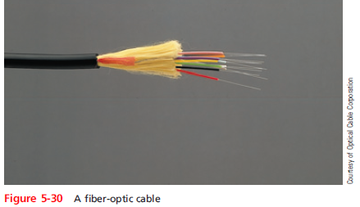
Fiber-Optic Cable
Plastic buffer outside cladding
Protects cladding and core
Opaque to absorb escaping light
Surrounded by Kevlar (polymeric fiber) strands
Plastic sheath covers Kevlar strands
Notes:
Fiber-Optic Cable
Plastic buffer outside cladding
Protects cladding and core
Opaque to absorb escaping light
Surrounded by Kevlar (polymeric fiber) strands
Plastic sheath covers Kevlar strands

Slide 29
Fiber-Optic Cable
Benefits over copper cabling
Extremely high throughput
Very high noise resistance
Excellent security
Able to carry signals for longer distances
Industry standard for high-speed networking
Drawbacks
More expensive than twisted pair cable
Requires special equipment to splice
Notes:
Fiber-Optic Cable
Benefits over copper cabling
Extremely high throughput
Very high noise resistance
Excellent security
Able to carry signals for longer distances
Industry standard for high-speed networking
Drawbacks
More expensive than twisted pair cable
Requires special equipment to splice

Slide 30
Fiber-Optic Cable
Throughput
Proven reliable in transmitting data at rates that can reach 100 gigabits per second per channel
Cost
Most expensive transmission medium
Noise immunity
Unaffected by EMI
Size and scalability
Segment lengths vary from 150 to 40,000 meters
Depends on the light’s wavelength and type of cable
Notes:
Fiber-Optic Cable
Throughput
Proven reliable in transmitting data at rates that can reach 100 gigabits per second per channel
Cost
Most expensive transmission medium
Noise immunity
Unaffected by EMI
Size and scalability
Segment lengths vary from 150 to 40,000 meters
Depends on the light’s wavelength and type of cable

Slide 31
SMF (Single Mode Fiber)
Consists of narrow core (8-10 microns in diameter)
Laser-generated light travels over one path
Little reflection
Light does not disperse as signal travels
Can carry signals many miles:
Before repeating is required
Rarely used for shorter connections
Due to cost
The Internet backbone depends on SMF
Notes:
SMF (Single Mode Fiber)
Consists of narrow core (8-10 microns in diameter)
Laser-generated light travels over one path
Little reflection
Light does not disperse as signal travels
Can carry signals many miles:
Before repeating is required
Rarely used for shorter connections
Due to cost
The Internet backbone depends on SMF

Slide 32
MMF (Multimode Fiber)
Contains a core with a larger diameter than single mode fiber
Common sizes: 50 or 62.5 microns
Laser or LED generated light pulses travel at different angles
Greater attenuation than single-mode fiber
Common uses
Cables connecting router to a switch
Cables connecting server on network backbone
Notes:
MMF (Multimode Fiber)
Contains a core with a larger diameter than single mode fiber
Common sizes: 50 or 62.5 microns
Laser or LED generated light pulses travel at different angles
Greater attenuation than single-mode fiber
Common uses
Cables connecting router to a switch
Cables connecting server on network backbone

Slide 33
Transmission Flaws
Noise
Any undesirable influence degrading or distorting signal
Types of noise
EMI (electromagnetic interference)
Example: radio frequency interference
Cross-talk
Signal on one wire infringes on adjacent wire signal
Alien cross-talk occurs between two cables
Near end cross-talk (NEXT) occurs near source
Far end cross-talk (FEXT) occurs at the far end
Notes:
Transmission Flaws
Noise
Any undesirable influence degrading or distorting signal
Types of noise
EMI (electromagnetic interference)
Example: radio frequency interference
Cross-talk
Signal on one wire infringes on adjacent wire signal
Alien cross-talk occurs between two cables
Near end cross-talk (NEXT) occurs near source
Far end cross-talk (FEXT) occurs at the far end

Slide 34
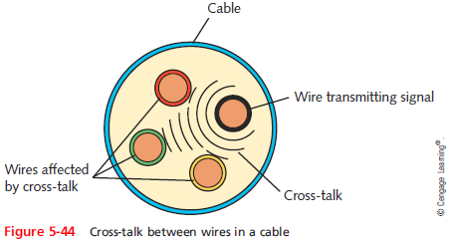
Transmission Flaws
Notes:
Transmission Flaws

Slide 35
Transmission Flaws
Attenuation
Loss of signal’s strength as it travels away from source
Two ways analog and digital signals are boosted:
Amplifier - increases the voltage, or strength, of signals
Can also boot the noise that has accumulated in the signal
Repeater - regenerates a digital signal in its original form
Without noise previously accumulated
Notes:
Transmission Flaws
Attenuation
Loss of signal’s strength as it travels away from source
Two ways analog and digital signals are boosted:
Amplifier - increases the voltage, or strength, of signals
Can also boot the noise that has accumulated in the signal
Repeater - regenerates a digital signal in its original form
Without noise previously accumulated

Slide 36
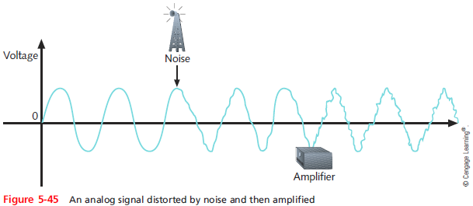
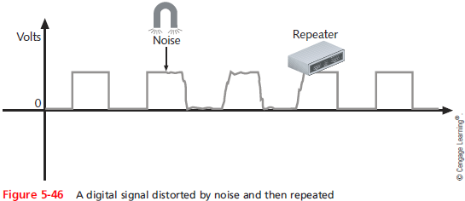
Transmission Flaws
Notes:
Transmission Flaws

Slide 37
Transmission Flaws
Latency
Delay between signal transmission and receipt
May cause network transmission errors
Latency causes
Cable length
Intervening connectivity device
Round trip time (RTT)
Time for packet to go from sender to receiver, then back from receiver to sender
Notes:
Transmission Flaws
Latency
Delay between signal transmission and receipt
May cause network transmission errors
Latency causes
Cable length
Intervening connectivity device
Round trip time (RTT)
Time for packet to go from sender to receiver, then back from receiver to sender

Slide 38
Transmission Flaws
Common Fiber Cable Problems:
Fiber type mismatch
More of a fiber core mismatch
Even same-mode cables can be mismatched if the cores have different widths
Wavelength mismatch
SMF, MMF, and POF (Plastic Optical Fiber) use different wavelengths
Dirty connectors
Signal loss and other errors can start to cause problems
Notes:
Transmission Flaws
Common Fiber Cable Problems:
Fiber type mismatch
More of a fiber core mismatch
Even same-mode cables can be mismatched if the cores have different widths
Wavelength mismatch
SMF, MMF, and POF (Plastic Optical Fiber) use different wavelengths
Dirty connectors
Signal loss and other errors can start to cause problems

