Slide 1
Chapter 6
Wireless Networking
Dr. Sayonnha Mandal
Notes:
Network+ Guide to Networks
7th Edition
Chapter 1
An Introduction to Networking

Slide 2
Objectives
Explain how nodes exchange wireless signals
Identify potential obstacles to successful wireless transmissions and their repercussions, such as interference and reflection
Understand WLAN (wireless LAN) architecture
Specify the characteristics of popular WLAN transmission methods, including 802.11 a/b/g/n/ac
Notes:
Objectives
Explain how nodes exchange wireless signals
Identify potential obstacles to successful wireless transmissions and their repercussions, such as interference and reflection
Understand WLAN (wireless LAN) architecture
Specify the characteristics of popular WLAN transmission methods, including 802.11 a/b/g/n/ac

Slide 3
Objectives
Install and configure wireless access points and their clients
Explore wireless security concerns
Evaluate common problems experienced with wireless networks
Notes:
Objectives
Install and configure wireless access points and their clients
Explore wireless security concerns
Evaluate common problems experienced with wireless networks

Slide 4
Characteristics of Wireless Transmission
Wireless networks (WLANs)
  Networks that transmit signals through the air via radio frequency (RF) waves
Wired and wireless signals share many similarities
  Use of the same Layer 3 and higher protocols
The nature of the atmosphere makes wireless transmission different from wired transmission
Notes:
Characteristics of Wireless Transmission
Wireless networks (WLANs)
Networks that transmit signals through the air via radio frequency (RF) waves
Wired and wireless signals share many similarities
Use of the same Layer 3 and higher protocols
The nature of the atmosphere makes wireless transmission different from wired transmission

Slide 5
The Wireless Spectrum
The wireless spectrum is a continuum of electromagnetic waves used for data/voice communication
  Arranged by frequencies
    Lowest to highest
  Spans 9 KHz and 300 GHz
Wireless services associated with one area
FCC oversees United States frequencies
ITU oversees international frequencies
  Air signals propagate across borders
Notes:
The Wireless Spectrum
The wireless spectrum is a continuum of electromagnetic waves used for data/voice communication
Arranged by frequencies
Lowest to highest
Spans 9 KHz and 300 GHz
Wireless services associated with one area
FCC oversees United States frequencies
ITU oversees international frequencies
Air signals propagate across borders

Slide 6
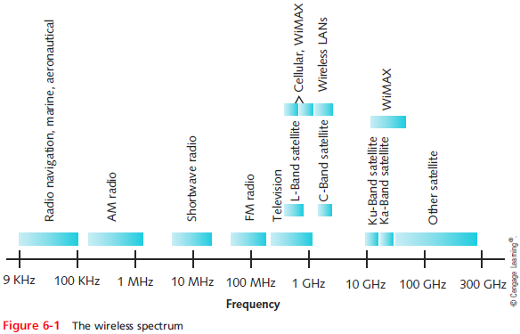
The Wireless Spectrum
Notes:
The Wireless Spectrum

Slide 7
Antennas
Radiation pattern
  Relative strength over three-dimensional area
    Of all electromagnetic energy that antenna sends, receives
Unidirectional (directional antenna)
  Issues wireless signals along single direction
Omnidirectional antenna
  Issues, receives wireless signals
    Equal strength, clarity in all directions
Range
  Reachable geographical area
Notes:
Antennas
Radiation pattern
Relative strength over three-dimensional area
Of all electromagnetic energy that antenna sends, receives
Unidirectional (directional antenna)
Issues wireless signals along single direction
Omnidirectional antenna
Issues, receives wireless signals
Equal strength, clarity in all directions
Range
Reachable geographical area

Slide 8
Signal Propagation
LOS (line-of-sight)
  Signal travels in straight line directly from transmitter to receiver
When obstacles are in a signal’s way, the signal may:
  Pass through them
  Be absorbed into them
  Be subject to three phenomena
    Reflection: bounce back to source
    Diffraction: splits into secondary waves
    Scattering: diffusion in multiple different directions
Notes:
Signal Propagation
LOS (line-of-sight)
Signal travels in straight line directly from transmitter to receiver
When obstacles are in a signal’s way, the signal may:
Pass through them
Be absorbed into them
Be subject to three phenomena
Reflection: bounce back to source
Diffraction: splits into secondary waves
Scattering: diffusion in multiple different directions

Slide 9
Signal Propagation
Multipath signals
  Wireless signals follow different paths to destination
  Caused by reflection, diffraction, scattering
  Advantage
    Better chance of reaching destination
  Disadvantage
    Signal delay will result in data errors
Notes:
Signal Propagation
Multipath signals
Wireless signals follow different paths to destination
Caused by reflection, diffraction, scattering
Advantage
Better chance of reaching destination
Disadvantage
Signal delay will result in data errors

Slide 10
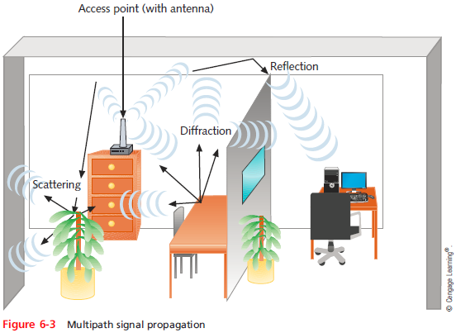
Signal Propagation
Notes:
Signal Propagation

Slide 11
Signal Degradation
Fading
  Variation in signal strength as a result of some of the electromagnetic energy scattered, reflected, or diffracted
  Multipath signaling is a cause of fading
  Goodput is the throughput experience at the application level
  Some Web sites, called speed test sites, can measure your upload and download speeds
    To see how your connection’s throughput is affecting your good put
Notes:
Signal Degradation
Fading
Variation in signal strength as a result of some of the electromagnetic energy scattered, reflected, or diffracted
Multipath signaling is a cause of fading
Goodput is the throughput experience at the application level
Some Web sites, called speed test sites, can measure your upload and download speeds
To see how your connection’s throughput is affecting your good put

Slide 12
Signal Degradation
Attenuation
  Signal weakens
    Moving away from transmission antenna
  Correcting signal attenuation
    Amplify or repeat the signal from a closer broadcast point called a range extender
Noise
  Also known as EMI
  More vulnerable to noise
    No wireless conduit, shielding
  Signal-to-noise ratio (SNR) = proportion of noise to the strength of a signal
Notes:
Signal Degradation
Attenuation
Signal weakens
Moving away from transmission antenna
Correcting signal attenuation
Amplify or repeat the signal from a closer broadcast point called a range extender
Noise
Also known as EMI
More vulnerable to noise
No wireless conduit, shielding
Signal-to-noise ratio (SNR) = proportion of noise to the strength of a signal

Slide 13
Frequency Ranges
2.4-GHz band (older)
  Frequency range: 2.4–2.4835 GHz
  11 unlicensed communications channels
  Susceptible to interference
Unlicensed: no FCC registration required
5-GHz band (newer)
  Frequency bands
    5.1 GHz, 5.3 GHz, 5.4 GHz, 5.8 GHz
  24 unlicensed bands, each 20 MHz wide
  Used by weather, military radar communications
Notes:
Frequency Ranges
2.4-GHz band (older)
Frequency range: 2.4–2.4835 GHz
11 unlicensed communications channels
Susceptible to interference
Unlicensed: no FCC registration required
5-GHz band (newer)
Frequency bands
5.1 GHz, 5.3 GHz, 5.4 GHz, 5.8 GHz
24 unlicensed bands, each 20 MHz wide
Used by weather, military radar communications

Slide 14
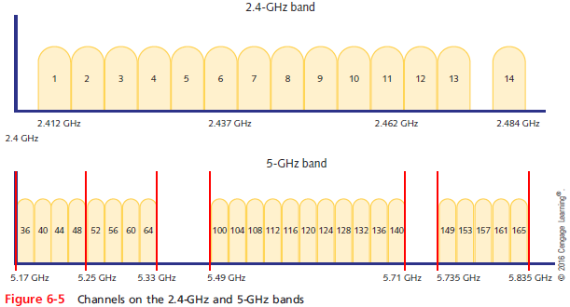
Frequency Ranges
Notes:
Frequency Ranges

Slide 15
Wireless PAN
WPANs rarely exceed a few meters geographically and usually only contain a few personal devices
Three common wireless technologies used to connect PAN devices are:
  Bluetooth
  Infrared (IR)
  Near-field communication (NFC)
Notes:
Wireless PAN
WPANs rarely exceed a few meters geographically and usually only contain a few personal devices
Three common wireless technologies used to connect PAN devices are:
Bluetooth
Infrared (IR)
Near-field communication (NFC)

Slide 16
Wireless PAN
Bluetooth
  Operates in the radio band of 2.4 GHz to 2.485 GHz
  Hops between frequencies within that band
    Called frequency hopping
  Requires close proximity to form a connection
  Before two Bluetooth devices can connect, they must be paired
  Bluejacking - a connection is used to send unsolicited data
  Bluesnarfing - a connection is used to download data without permission
Notes:
Wireless PAN
Bluetooth
Operates in the radio band of 2.4 GHz to 2.485 GHz
Hops between frequencies within that band
Called frequency hopping
Requires close proximity to form a connection
Before two Bluetooth devices can connect, they must be paired
Bluejacking - a connection is used to send unsolicited data
Bluesnarfing - a connection is used to download data without permission

Slide 17
Wireless PAN
NFC (Near-Field Communication)
  A form of radio communication that transfers data wirelessly over very short distances
  Signal can be transmitted one way by an NFC tag, or smart tag
    When employees need access to a secure area
  The NFC tag collects power from the smartphone or other device by magnetic induction
Notes:
Wireless PAN
NFC (Near-Field Communication)
A form of radio communication that transfers data wirelessly over very short distances
Signal can be transmitted one way by an NFC tag, or smart tag
When employees need access to a secure area
The NFC tag collects power from the smartphone or other device by magnetic induction

Slide 18
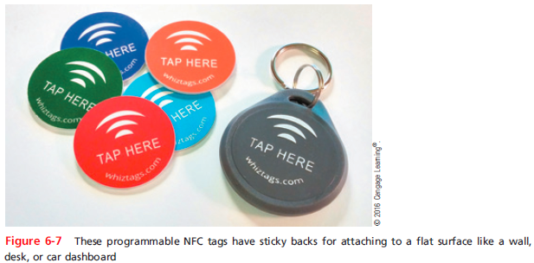
Wireless PAN
Notes:
Wireless PAN

Slide 19
Wi-Fi WLAN (Wireless LAN) Architecture
Ad hoc WLAN
  Wireless nodes transmit directly to each other
  Use wireless NICs
    No intervening connectivity device
Infrastructure WLAN
  Stations communicate with a wireless access point (WAP)
    Not directly with each other
  Access point requires sufficient power, strategic placement
Notes:
Wi-Fi WLAN (Wireless LAN) Architecture
Ad hoc WLAN
Wireless nodes transmit directly to each other
Use wireless NICs
No intervening connectivity device
Infrastructure WLAN
Stations communicate with a wireless access point (WAP)
Not directly with each other
Access point requires sufficient power, strategic placement

Slide 20
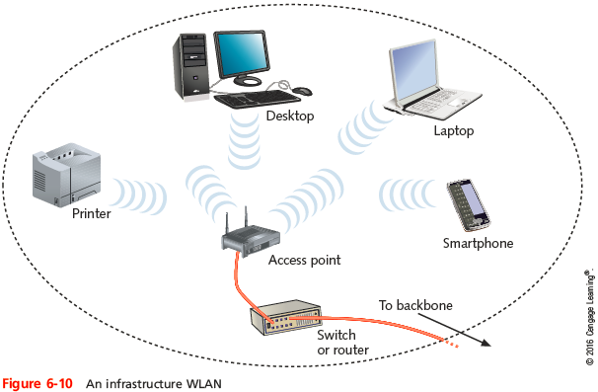
Wi-Fi WLAN (Wireless LAN) Architecture
Notes:
Wi-Fi WLAN (Wireless LAN) Architecture

Slide 21
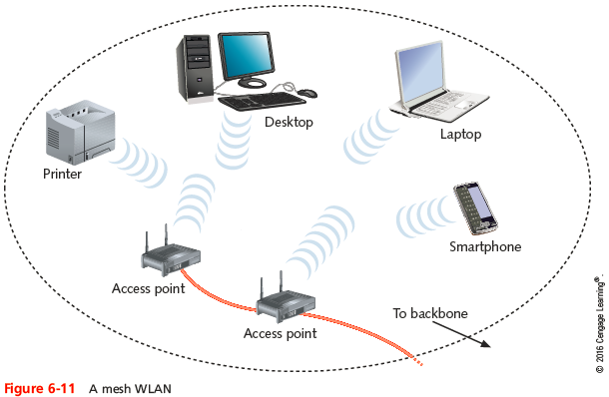
Wi-Fi WLAN (Wireless LAN) Architecture
Mesh WLAN
  May include several access points (APs)
  Provides more fault-tolerant network access to clients
Notes:
Wi-Fi WLAN (Wireless LAN) Architecture
Mesh WLAN
May include several access points (APs)
Provides more fault-tolerant network access to clients

Slide 22
Wi-Fi WLAN (Wireless LAN) Architecture
Mobile networking allows wireless nodes to roam
  Range dependent upon wireless access method, equipment manufacturer, office environment
    Access point range: 300 feet maximum
Wireless technology can connect two separate LANs
  Fixed link, directional antennas between two access points
    Allows access points 1000 feet apart
Support for same protocols, operating systems as wired LANs
Notes:
Wi-Fi WLAN (Wireless LAN) Architecture
Mobile networking allows wireless nodes to roam
Range dependent upon wireless access method, equipment manufacturer, office environment
Access point range: 300 feet maximum
Wireless technology can connect two separate LANs
Fixed link, directional antennas between two access points
Allows access points 1000 feet apart
Support for same protocols, operating systems as wired LANs

Slide 23
802.11 WLAN Standards
Wireless technology standards
  Most popular: developed by IEEE’s 802.11 committee
Notable Wi-Fi standards
  802.11b, 802.11a, 802.11g, 802.11n, 802.11ac
  All standards use half-duplex signaling
  Standards vary at the Physical layer
  802.11n and later modify the way frames are used at the MAC sublayer
Notes:
802.11 WLAN Standards
Wireless technology standards
Most popular: developed by IEEE’s 802.11 committee
Notable Wi-Fi standards
802.11b, 802.11a, 802.11g, 802.11n, 802.11ac
All standards use half-duplex signaling
Standards vary at the Physical layer
802.11n and later modify the way frames are used at the MAC sublayer

Slide 24
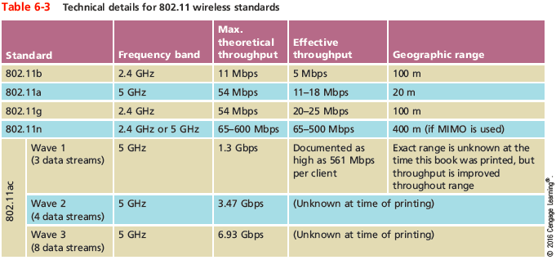
802.11 WLAN Standards
Notes:
802.11 WLAN Standards

Slide 25
Access Method
802.11 MAC services
  Append 48-bit physical addresses to frame
    Identifies source and destination
Same physical addressing scheme
  Allows easy combination with other IEEE networks
Wireless devices
  Not designed to simultaneously transmit and receive
  Cannot prevent collisions
  Use different access method than Ethernet
Notes:
Access Method
802.11 MAC services
Append 48-bit physical addresses to frame
Identifies source and destination
Same physical addressing scheme
Allows easy combination with other IEEE networks
Wireless devices
Not designed to simultaneously transmit and receive
Cannot prevent collisions
Use different access method than Ethernet

Slide 26
Access Method
CSMA/CA (Carrier Sense Multiple Access with Collision Avoidance)
  Minimizes collision potential
  Uses ACK packets to verify every transmission
    Requires more overhead than 802.3
    Real throughput less than theoretical maximum
RTS/CTS (Request to Send/Clear to Send) protocol
  Ensures packets not inhibited by other transmissions
  Efficient for large transmission packets
  Further decreases overall 802.11 efficiency
Notes:
Access Method
CSMA/CA (Carrier Sense Multiple Access with Collision Avoidance)
Minimizes collision potential
Uses ACK packets to verify every transmission
Requires more overhead than 802.3
Real throughput less than theoretical maximum
RTS/CTS (Request to Send/Clear to Send) protocol
Ensures packets not inhibited by other transmissions
Efficient for large transmission packets
Further decreases overall 802.11 efficiency

Slide 27
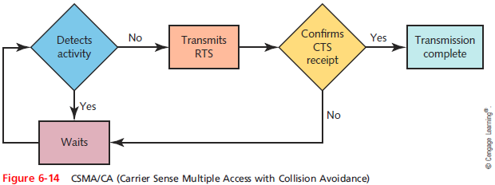
Access Method
Notes:
Access Method

Slide 28
Association
Packet exchanged between computer and access point in order to gain Internet access
  Another function of the MAC sublayer
Scanning
  Surveys surroundings for access point
  Active scanning transmits special frame
    Known as a probe
  Passive scanning listens for special signal
    Known as a beacon fame
Notes:
Association
Packet exchanged between computer and access point in order to gain Internet access
Another function of the MAC sublayer
Scanning
Surveys surroundings for access point
Active scanning transmits special frame
Known as a probe
Passive scanning listens for special signal
Known as a beacon fame

Slide 29
Association
SSID (service set identifier)
  Unique character string identifying access point
    In beacon frame information
  Configured in access point
  Better security, easier network management
BSS (basic service set)
  Group of stations sharing an access point
  BSSID (basic service set identifier)
    Group of stations identifier
Notes:
Association
SSID (service set identifier)
Unique character string identifying access point
In beacon frame information
Configured in access point
Better security, easier network management
BSS (basic service set)
Group of stations sharing an access point
BSSID (basic service set identifier)
Group of stations identifier

Slide 30
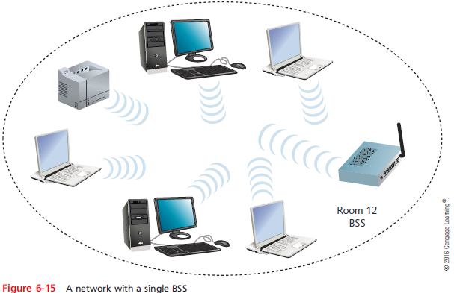
Association
Notes:
Association

Slide 31
Association
ESS (extended service set)
  Group of access points connected to same LAN
    Share ESSID (extended service set identifier)
  Allows roaming
    Station moving from one BSS to another without losing connectivity
When several access points are detected
  Select strongest signal, lowest error rate
  Poses security risk
    Could connect to a powerful, rogue access point
Notes:
Association
ESS (extended service set)
Group of access points connected to same LAN
Share ESSID (extended service set identifier)
Allows roaming
Station moving from one BSS to another without losing connectivity
When several access points are detected
Select strongest signal, lowest error rate
Poses security risk
Could connect to a powerful, rogue access point

Slide 32
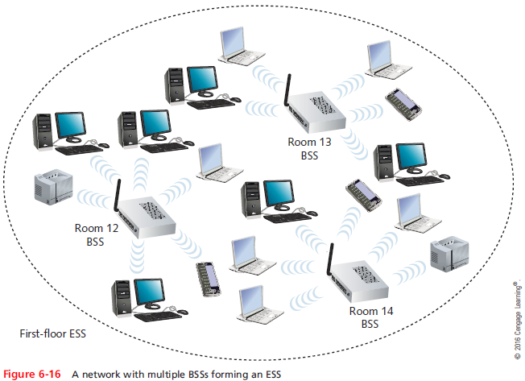
Association
Notes:
Association

Slide 33
Association
ESS with several authorized access points
  Must allow station association with any access point
    While maintaining network connectivity
Reassociation
  Mobile user moves from one access point’s range into another’s range
  Occurs by simply moving; high error rate
Stations’ scanning feature
  Used to automatically balance transmission loads between access points
Notes:
Association
ESS with several authorized access points
Must allow station association with any access point
While maintaining network connectivity
Reassociation
Mobile user moves from one access point’s range into another’s range
Occurs by simply moving; high error rate
Stations’ scanning feature
Used to automatically balance transmission loads between access points

Slide 34
IEEE 802.11 Frames
Types of overhead required to manage access to an 802.11 network
  ACKs, probes, and beacons
802.11 specifies MAC sublayer frame type
Multiple frame type groups
  Management: association and reassociation
  Control: medium access and data delivery
    ACK and RTS/CTS frames
  Data: carry data sent between stations
Notes:
IEEE 802.11 Frames
Types of overhead required to manage access to an 802.11 network
ACKs, probes, and beacons
802.11 specifies MAC sublayer frame type
Multiple frame type groups
Management: association and reassociation
Control: medium access and data delivery
ACK and RTS/CTS frames
Data: carry data sent between stations

Slide 35
IEEE 802.11 Frames
802.11 data frame overhead
  Four address fields
    Source address, transmitter address, receiver address, and destination address
  Sequence Control field
    How large packet fragmented
  Frame Control field
Wi-Fi share MAC sublayer characteristics
Wi-Fi differ in modulation methods, frequency usage, and range
Notes:
IEEE 802.11 Frames
802.11 data frame overhead
Four address fields
Source address, transmitter address, receiver address, and destination address
Sequence Control field
How large packet fragmented
Frame Control field
Wi-Fi share MAC sublayer characteristics
Wi-Fi differ in modulation methods, frequency usage, and range

Slide 36
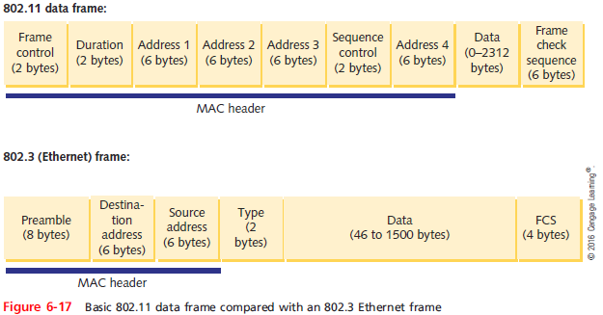
IEEE 802.11 Frames
Notes:
IEEE 802.11 Frames

Slide 37
Wireless Innovations
MIMO (multiple input-multiple output)
  Multiple access point antennas may issue signal to one or more receivers
  Increases network’s throughput, access point’s range
MU-MIMO (multiuser MIMO)
  Newer technology than MIMO that allows multiple antennas to service multiple clients simultaneously
  Reduces congestion and contributes to faster data transmission
  Available with WAVE 2 802.11ac products
Notes:
Wireless Innovations
MIMO (multiple input-multiple output)
Multiple access point antennas may issue signal to one or more receivers
Increases network’s throughput, access point’s range
MU-MIMO (multiuser MIMO)
Newer technology than MIMO that allows multiple antennas to service multiple clients simultaneously
Reduces congestion and contributes to faster data transmission
Available with WAVE 2 802.11ac products

Slide 38
Wireless Innovations
Channel bonding
  Two adjacent 20-MHz channels bonded to make 40-MHz channel
    Doubles the bandwidth available in single 20-MHz channel
Frame aggregation
  Combine multiple frames into one larger frame
  Two techniques:
    Aggregated Mac Service Data Unit (A-MSDU)
    Aggregated Mac Protocol Data Unit (A-MPDU)
  Advantage: reduces overhead
Notes:
Wireless Innovations
Channel bonding
Two adjacent 20-MHz channels bonded to make 40-MHz channel
Doubles the bandwidth available in single 20-MHz channel
Frame aggregation
Combine multiple frames into one larger frame
Two techniques:
Aggregated Mac Service Data Unit (A-MSDU)
Aggregated Mac Protocol Data Unit (A-MPDU)
Advantage: reduces overhead

Slide 39
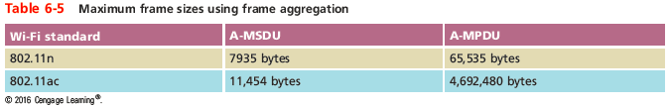
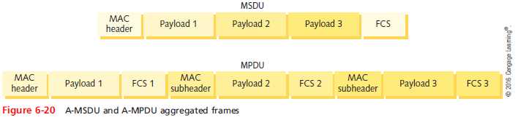
Wireless Innovations
Notes:
Wireless Innovations

Slide 40
Wireless Innovations
Maximum throughput depends upon:
  Number and type of strategies used
  Whether network uses 2.4-GHz or 5-GHz band
An 802.11n network’s actual throughput: 65 to 500 Mbps
  An 802.11ac Wave 1 network’s throughput has been documented as high as 561 Mbps per client
To ensure fastest data rates on an 802.11n LAN
  Use 802.11n-compatible devices
  802.11ac can be implemented with both 802.11n and 802.11 ac devices
Notes:
Wireless Innovations
Maximum throughput depends upon:
Number and type of strategies used
Whether network uses 2.4-GHz or 5-GHz band
An 802.11n network’s actual throughput: 65 to 500 Mbps
An 802.11ac Wave 1 network’s throughput has been documented as high as 561 Mbps per client
To ensure fastest data rates on an 802.11n LAN
Use 802.11n-compatible devices
802.11ac can be implemented with both 802.11n and 802.11 ac devices

Slide 41
Implementing a WAN
This section describes:
  How to design small WLANs
  How to install and configure access points and clients
Notes:
Implementing a WAN
This section describes:
How to design small WLANs
How to install and configure access points and clients

Slide 42
Determining the Design
One access point
  Often combined with switching, routing functions
  Connects wireless clients to LAN
  Acts as Internet gateway
Access point WLAN placement considerations
  Typical distances between access point and client
    Do not exceed the distance restriction for the 802.11 standard your access point is using
  Obstacles
    Type and number of, between access point and clients
Notes:
Determining the Design
One access point
Often combined with switching, routing functions
Connects wireless clients to LAN
Acts as Internet gateway
Access point WLAN placement considerations
Typical distances between access point and client
Do not exceed the distance restriction for the 802.11 standard your access point is using
Obstacles
Type and number of, between access point and clients

Slide 43
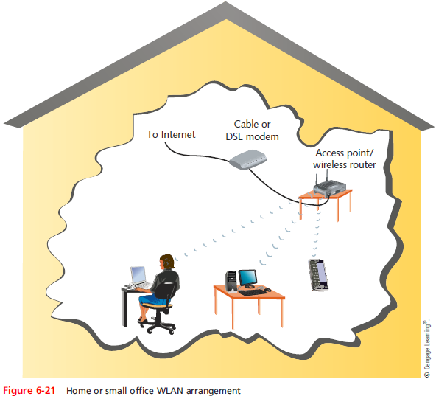
Determining the Design
Notes:
Determining the Design

Slide 44
Determining the Design
Larger WLANs warrant a more systematic approach to access point placement
Site survey
  Assesses client requirements, facility characteristics, coverage areas
  Determines access point arrangement ensuring reliable wireless connectivity
    Within given area
  Proposes access point testing
    Test wireless access from farthest corners
Notes:
Determining the Design
Larger WLANs warrant a more systematic approach to access point placement
Site survey
Assesses client requirements, facility characteristics, coverage areas
Determines access point arrangement ensuring reliable wireless connectivity
Within given area
Proposes access point testing
Test wireless access from farthest corners

Slide 45
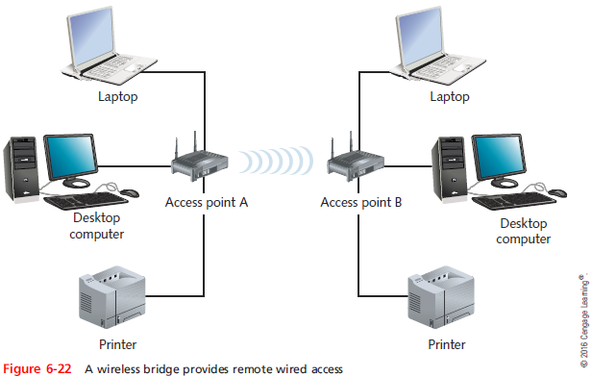
Determining the Design
Consider whether Wi-Fi access points will be used as wireless bridges to create remote wired access to the network
Notes:
Determining the Design
Consider whether Wi-Fi access points will be used as wireless bridges to create remote wired access to the network

Slide 46
Determining the Design
After site survey has identified and verified the quantity and location of access points, you are ready to install them
  Must belong to same ESS and share an ESSID
Enterprise-wide WLAN design considerations
  How wireless LAN portions will integrate with wired portions
Notes:
Determining the Design
After site survey has identified and verified the quantity and location of access points, you are ready to install them
Must belong to same ESS and share an ESSID
Enterprise-wide WLAN design considerations
How wireless LAN portions will integrate with wired portions

Slide 47
Configuring Wireless Connectivity Devices
Each AP comes with an installation program on CD-ROM or DVD
  Guides through setup process
Variables set during installation
  Administrator password
  SSID
  Whether or not DHCP is used
  Whether or not the SSID is broadcast
  Security options
Notes:
Configuring Wireless Connectivity Devices
Each AP comes with an installation program on CD-ROM or DVD
Guides through setup process
Variables set during installation
Administrator password
SSID
Whether or not DHCP is used
Whether or not the SSID is broadcast
Security options

Slide 48
Configuring Wireless Clients
Configuration varies from one client type to another
As long as an AP is broadcasting its SSID
  Clients in its vicinity will detect it and offer the user the option to associate with it
On-boarding
  Installing a specific program or app onto a device to give it trusted access to certain portions of the network
Off-boarding
  Removing programs that gave devices special permissions on the network
Notes:
Configuring Wireless Clients
Configuration varies from one client type to another
As long as an AP is broadcasting its SSID
Clients in its vicinity will detect it and offer the user the option to associate with it
On-boarding
Installing a specific program or app onto a device to give it trusted access to certain portions of the network
Off-boarding
Removing programs that gave devices special permissions on the network

Slide 49
802.11 Wireless Network Security
802.11 standard security
  None by default
  SSID: only item required
Authentication
  Process of comparing and matching a client’s credentials with the credentials in a database
MAC filtering
  Prevents the AP from authenticating any device whose MAC address is not listed
Encryption
  Use of an algorithm to scramble data
Notes:
802.11 Wireless Network Security
802.11 standard security
None by default
SSID: only item required
Authentication
Process of comparing and matching a client’s credentials with the credentials in a database
MAC filtering
Prevents the AP from authenticating any device whose MAC address is not listed
Encryption
Use of an algorithm to scramble data

Slide 50
WPA/WPA2 (Wi-Fi Protected Access)
WPA
  Dynamically assigns every transmission its own key
WPA2
  Replacement for WPA
  A stronger encryption protocol
Most secure communication is made possible by combining a RADIUS server with WPA/WPA2
  Known as WPA-Enterprise or WPA2-Enterprise
Notes:
WPA/WPA2 (Wi-Fi Protected Access)
WPA
Dynamically assigns every transmission its own key
WPA2
Replacement for WPA
A stronger encryption protocol
Most secure communication is made possible by combining a RADIUS server with WPA/WPA2
Known as WPA-Enterprise or WPA2-Enterprise

Slide 51
Security Threats to Wireless Networks
War driving
  A hacker searches for unprotected wireless networks by driving around with a laptop configured to receive and capture wireless data transmissions
War chalking
  Hackers draw symbols with chalk on the sidewalk or wall near a vulnerable AP
  To make it known to other hackers
Notes:
Security Threats to Wireless Networks
War driving
A hacker searches for unprotected wireless networks by driving around with a laptop configured to receive and capture wireless data transmissions
War chalking
Hackers draw symbols with chalk on the sidewalk or wall near a vulnerable AP
To make it known to other hackers

Slide 52
Security Threats to Wireless Networks
Evil twin
  A rogue AP planted in a network’s geological area to pose as an authorized AP
WPA attacks
  Involve an interception of the network keys communicated between stations and APs
  Also called WPA cracking
WPS attack
  Cracking a PIN in order to access an APs settings
  Cracked through a brute force attack
Notes:
Security Threats to Wireless Networks
Evil twin
A rogue AP planted in a network’s geological area to pose as an authorized AP
WPA attacks
Involve an interception of the network keys communicated between stations and APs
Also called WPA cracking
WPS attack
Cracking a PIN in order to access an APs settings
Cracked through a brute force attack

Slide 53
Troubleshooting Wireless LANs
Cable continuity and performance testers will tell nothing about wireless connections, stations, or APs on a network
To troubleshoot wireless LANS
  You need tools that contain wireless NICs and run wireless protocols
Notes:
Troubleshooting Wireless LANs
Cable continuity and performance testers will tell nothing about wireless connections, stations, or APs on a network
To troubleshoot wireless LANS
You need tools that contain wireless NICs and run wireless protocols

Slide 54
Wireless Network Tools
Two types of software tools:
  Wireless analyzer (Wi-Fi analyzer)
    Can evaluate Wi-Fi network availability, optimize Wi-Fi signal settings, and help identify Wi-Fi security threats
  Spectrum analyzer
    Can assess the quality of the wireless signal
List of capabilities common to wireless testing tools:
  Identify transmitting access points, stations, and channels over which they are communicating
  Measure signal strength from an AP
Notes:
Wireless Network Tools
Two types of software tools:
Wireless analyzer (Wi-Fi analyzer)
Can evaluate Wi-Fi network availability, optimize Wi-Fi signal settings, and help identify Wi-Fi security threats
Spectrum analyzer
Can assess the quality of the wireless signal
List of capabilities common to wireless testing tools:
Identify transmitting access points, stations, and channels over which they are communicating
Measure signal strength from an AP

Slide 55
Wireless Network Tools
List of capabilities common to wireless testing tools (cont’d):
  Indicate the effects of attenuation, signal loss, and noise
  Interpret signal strength information
  Ensure proper association and reassociation between APs
  Capture and interpret traffic
  Measure throughput and assess data transmission errors
  Analyze characteristics of each channel
Notes:
Wireless Network Tools
List of capabilities common to wireless testing tools (cont’d):
Indicate the effects of attenuation, signal loss, and noise
Interpret signal strength information
Ensure proper association and reassociation between APs
Capture and interpret traffic
Measure throughput and assess data transmission errors
Analyze characteristics of each channel

Slide 56
Avoiding Pitfalls
Wireless configuration pitfalls to avoid:
  SSID mismatch
  Incorrect encryption
  Incorrect or overlapping channels or frequencies
  Mismatched standards
  Incorrect antenna placement
  Interference
  Simultaneous wired and wireless connections
  Problems with firmware updates
Notes:
Avoiding Pitfalls
Wireless configuration pitfalls to avoid:
SSID mismatch
Incorrect encryption
Incorrect or overlapping channels or frequencies
Mismatched standards
Incorrect antenna placement
Interference
Simultaneous wired and wireless connections
Problems with firmware updates

Slide 57
Avoiding Pitfalls
Wireless configuration pitfalls to avoid (cont’d):
  Unoptimized access point power levels
  Inappropriate antenna type
  Client saturation
Notes:
Avoiding Pitfalls
Wireless configuration pitfalls to avoid (cont’d):
Unoptimized access point power levels
Inappropriate antenna type
Client saturation

Slide 58
Summary
Most wireless networks use frequencies around 2.4 GHz or 5 GHz
A signal may pass through an object, be absorbed by the object, or it may be subject to any of the following: reflection, diffraction, or scattering
Personal area networks (PANs) rarely exceed a few meters and usually only contain a few personal devices
Bluetooth technology unites mobile devices with PCs under a single communications standard
Notes:
Summary
Most wireless networks use frequencies around 2.4 GHz or 5 GHz
A signal may pass through an object, be absorbed by the object, or it may be subject to any of the following: reflection, diffraction, or scattering
Personal area networks (PANs) rarely exceed a few meters and usually only contain a few personal devices
Bluetooth technology unites mobile devices with PCs under a single communications standard

Slide 59
Summary
NFC is a form of radio communication that transfers data wirelessly over very short distances
The IEEE 802.11 task groups that have generated notable wireless standards are 802.11b, 802.11a, 802.11g, 802.11n, and 802.11ac
CSMA/CA minimized the potential for collisions but cannot detect the occurrence of a collision
Placement of an access point on a WLAN must take into account the typical distances between the access point and its clients
Notes:
Summary
NFC is a form of radio communication that transfers data wirelessly over very short distances
The IEEE 802.11 task groups that have generated notable wireless standards are 802.11b, 802.11a, 802.11g, 802.11n, and 802.11ac
CSMA/CA minimized the potential for collisions but cannot detect the occurrence of a collision
Placement of an access point on a WLAN must take into account the typical distances between the access point and its clients

Slide 60
Summary
If an access point is broadcasting its SSID clients in the vicinity will detect it
iwconfig is a command-line function for viewing and setting wireless interface parameters
By default the 802.11 standard does not offer any security
When configuring WEP, you establish a character string required to associate with the access point
WEP was replaced by WPA, which dynamically assigns every transmission its own key
Notes:
Summary
If an access point is broadcasting its SSID clients in the vicinity will detect it
iwconfig is a command-line function for viewing and setting wireless interface parameters
By default the 802.11 standard does not offer any security
When configuring WEP, you establish a character string required to associate with the access point
WEP was replaced by WPA, which dynamically assigns every transmission its own key

Slide 61
Summary
Wireless networks are susceptible to eavesdropping
Many programs exist that can scan for wireless signals over a certain geographical range
Wireless networks provide the best performance when the channels being used don’t overlap with those used by nearby networks
Notes:
Summary
Wireless networks are susceptible to eavesdropping
Many programs exist that can scan for wireless signals over a certain geographical range
Wireless networks provide the best performance when the channels being used don’t overlap with those used by nearby networks

