Slide 1
Chapter 7 Cloud Computing and Remote Access
Dr. Sayonnha Mandal
Notes:
Network+ Guide to Networks 7th Edition
Chapter 1
An Introduction to Networking

Slide 2
Objectives
Identify the features and benefits of cloud computing
Explain methods for remotely connecting to a network
Discuss VPNs (virtual private networks) and the protocols they rely on
Understand methods of encryption, such as IPsec, SSL/TLS, SFTP, and SSH, that can secure data in storage and in transit
Notes:
Objectives
Identify the features and benefits of cloud computing
Explain methods for remotely connecting to a network
Discuss VPNs (virtual private networks) and the protocols they rely on
Understand methods of encryption, such as IPsec, SSL/TLS, SFTP, and SSH, that can secure data in storage and in transit

Slide 3
Objectives
Describe how user authentication protocols such as RADIUS, TACACS+, EAP, and Kerberos function
Recognize symptoms of connectivity and security problems commonly encountered with remote connections
Notes:
Objectives
Describe how user authentication protocols such as RADIUS, TACACS+, EAP, and Kerberos function
Recognize symptoms of connectivity and security problems commonly encountered with remote connections

Slide 4
Cloud Computing
Internet is frequently pictured as a cloud
Cloud computing
Flexible provision of data storage, applications, and services to multiple clients over a network
Cloud computing distinguishing features
On-demand service
Elastic services and storage
Support for multiple platforms
Resource pooling and consolidation
Metered service
Notes:
Cloud Computing
Internet is frequently pictured as a cloud
Cloud computing
Flexible provision of data storage, applications, and services to multiple clients over a network
Cloud computing distinguishing features
On-demand service
Elastic services and storage
Support for multiple platforms
Resource pooling and consolidation
Metered service

Slide 5
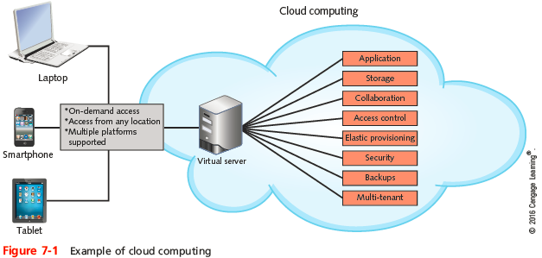
Cloud Computing
Notes:
Cloud Computing

Slide 6
Cloud Computing
Can provide virtual desktops
Operating environments hosted virtually
Developers can load any kind of software on the servers and test it form afar
Cloud services provider can make sure the development servers are secure and regularly backed up
Most cloud service providers use virtualization software to supply multiple platforms to multiple users
Notes:
Cloud Computing
Can provide virtual desktops
Operating environments hosted virtually
Developers can load any kind of software on the servers and test it form afar
Cloud services provider can make sure the development servers are secure and regularly backed up
Most cloud service providers use virtualization software to supply multiple platforms to multiple users

Slide 7
Cloud Computing Categories
Cloud computing service models are categorized by the types of services provided:
IaaS (Infrastructure as a Service)
Hardware services and network infrastructure devices
PaaS (Platform as a Service)
OS, runtime libraries or modules the OS provides to applications, and the hardware on which the OS runs
SaaS (Software as a Service)
Applications
XaaS (Anything as a Service)
Any combination of functions
Notes:
Cloud Computing Categories
Cloud computing service models are categorized by the types of services provided:
IaaS (Infrastructure as a Service)
Hardware services and network infrastructure devices
PaaS (Platform as a Service)
OS, runtime libraries or modules the OS provides to applications, and the hardware on which the OS runs
SaaS (Software as a Service)
Applications
XaaS (Anything as a Service)
Any combination of functions

Slide 8
Deployment Models
Public cloud
Service provided over public transmission lines
Private cloud
Service established on an organization’s own servers in its own data center
Community cloud
Service shared between multiple organizations
Hybrid cloud
Combination of the other service models into a single deployment
Notes:
Deployment Models
Public cloud
Service provided over public transmission lines
Private cloud
Service established on an organization’s own servers in its own data center
Community cloud
Service shared between multiple organizations
Hybrid cloud
Combination of the other service models into a single deployment

Slide 9
Remote Access
Remote access
Service that allows a client to connect with and log on to a server, LAN, or WAN in a different geographical location
Types of remote access:
Point-to-point over a dedicated line
Virtual private network (VPN)
Remote terminal emulation, also called remote virtual computing
Notes:
Remote Access
Remote access
Service that allows a client to connect with and log on to a server, LAN, or WAN in a different geographical location
Types of remote access:
Point-to-point over a dedicated line
Virtual private network (VPN)
Remote terminal emulation, also called remote virtual computing

Slide 10
Remote Access
Remote access server (RAS)
Accepts remote connections and grants access to network resources
Two types of remote access servers:
Dedicated devices
Example: Cisco’s AS5800
Software running on a server
Example: DirectAccess
Notes:
Remote Access
Remote access server (RAS)
Accepts remote connections and grants access to network resources
Two types of remote access servers:
Dedicated devices
Example: Cisco’s AS5800
Software running on a server
Example: DirectAccess

Slide 11
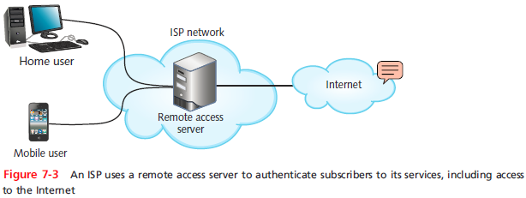
Remote Access
Notes:
Remote Access

Slide 12
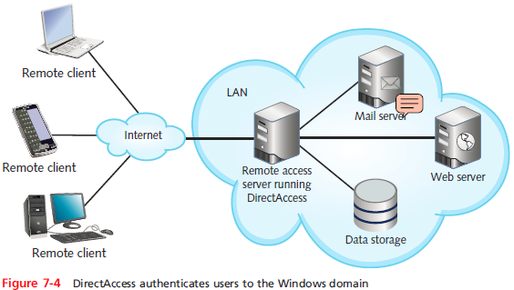
Remote Access
Notes:
Remote Access

Slide 13
Point-to-Point Remote Access Protocols
SLIP (Serial Line Internet Protocol)
Earlier and less sophisticated than PPP
Can only carry IP packets
Works strictly on serial connections
PPP (Point-to-Point Protocol)
Can negotiate and establish a connection between two computers
Can authenticate a client to a remote system
Can support several types of Network layer protocols
Can encrypt the transmissions, although PPP encryption is considered weak by today’s standards
Notes:
Point-to-Point Remote Access Protocols
SLIP (Serial Line Internet Protocol)
Earlier and less sophisticated than PPP
Can only carry IP packets
Works strictly on serial connections
PPP (Point-to-Point Protocol)
Can negotiate and establish a connection between two computers
Can authenticate a client to a remote system
Can support several types of Network layer protocols
Can encrypt the transmissions, although PPP encryption is considered weak by today’s standards

Slide 14
VPNs (Virtual Private Networks)
VPNs
Virtual networks logically defined for secure communication over public transmission systems
To ensure VPNs can carry all types of data securely
Special VPN protocols encapsulate higher-layer protocols in a process known as tunneling
VPNs can be classified according to two models:
Site-to-site VPN
Client-to-site VPN
Also called host-to-site VPN or remote-access VPN
Notes:
VPNs (Virtual Private Networks)
VPNs
Virtual networks logically defined for secure communication over public transmission systems
To ensure VPNs can carry all types of data securely
Special VPN protocols encapsulate higher-layer protocols in a process known as tunneling
VPNs can be classified according to two models:
Site-to-site VPN
Client-to-site VPN
Also called host-to-site VPN or remote-access VPN

Slide 15
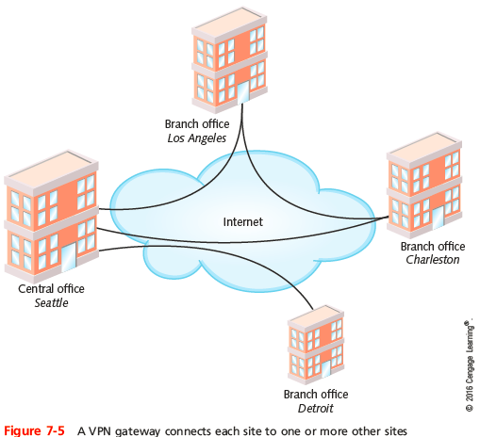
VPNs (Virtual Private Networks)
Notes:
VPNs (Virtual Private Networks)

Slide 16
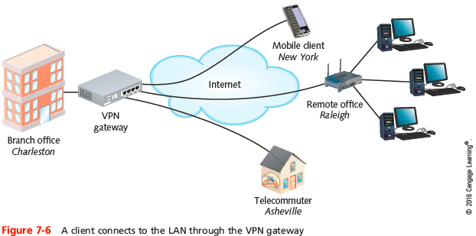
VPNs (Virtual Private Networks)
Notes:
VPNs (Virtual Private Networks)

Slide 17
VPNs (Virtual Private Networks)
VPN software embedded in the OS
RRAS (Routing and Remote Access Service) Microsoft’s remote access server software and VPN solution
Third-party solutions
OpenVIN is open source and is available on a variety of platforms
Implemented by routers or firewalls
Most common implementation of VPNs on UNIX-based networks
Notes:
VPNs (Virtual Private Networks)
VPN software embedded in the OS
RRAS (Routing and Remote Access Service) Microsoft’s remote access server software and VPN solution
Third-party solutions
OpenVIN is open source and is available on a variety of platforms
Implemented by routers or firewalls
Most common implementation of VPNs on UNIX-based networks

Slide 18
VPNs (Virtual Private Networks)
VPN concentrator
Specialized device that authenticates VPN clients, establishes tunnels for VPN connections, and manages encryption for VPN transmissions
Also known as an encryption device
Two primary encryption techniques used by VPNs:
IPsec
SSL
Notes:
VPNs (Virtual Private Networks)
VPN concentrator
Specialized device that authenticates VPN clients, establishes tunnels for VPN connections, and manages encryption for VPN transmissions
Also known as an encryption device
Two primary encryption techniques used by VPNs:
IPsec
SSL

Slide 19
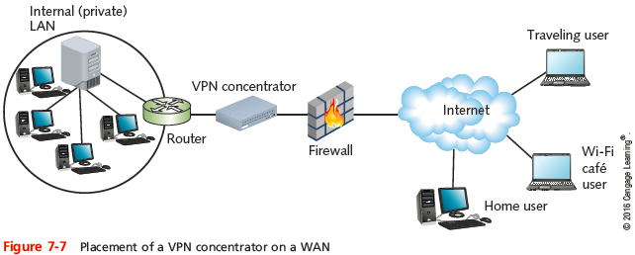
VPNs (Virtual Private Networks)
Notes:
VPNs (Virtual Private Networks)

Slide 20
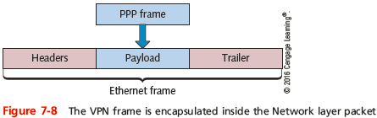
VPN Tunneling Protocols
VPN tunneling protocols operate at the Data Link layer
Encapsulate the VPN frame into a Network layer packet
Two VPN tunneling protocols:
PPTP and L2TP
Notes:
VPN Tunneling Protocols
VPN tunneling protocols operate at the Data Link layer
Encapsulate the VPN frame into a Network layer packet
Two VPN tunneling protocols:
PPTP and L2TP

Slide 21
VPN Tunneling Protocols
PPTP (Point-to-Point Tunneling Protocol)
A Layer 2 protocol that encapsulates PPP data frames so they can traverse the Internet masked as an IP transmission
Uses TCP segments at the Transport layer
GRE (Generic Routing Encapsulation)
Used to transmit PPP data frames through the tunnel
Encapsulates PPP frames to make them take on the temporary identity of IP packets
PPTP is no longer considered secure and L2TP is now recommended
Notes:
VPN Tunneling Protocols
PPTP (Point-to-Point Tunneling Protocol)
A Layer 2 protocol that encapsulates PPP data frames so they can traverse the Internet masked as an IP transmission
Uses TCP segments at the Transport layer
GRE (Generic Routing Encapsulation)
Used to transmit PPP data frames through the tunnel
Encapsulates PPP frames to make them take on the temporary identity of IP packets
PPTP is no longer considered secure and L2TP is now recommended

Slide 22
VPN Tunneling Protocols
L2TP (Layer 2 Tunneling Protocol)
Encapsulates PPP data in a similar manner to PPTP
Can connect a VPN that uses a mix of equipment types
It is a standard accepted and used by multiple vendors
Can connect two routers, a router and a RAS, or a client and a RAS
Notes:
VPN Tunneling Protocols
L2TP (Layer 2 Tunneling Protocol)
Encapsulates PPP data in a similar manner to PPTP
Can connect a VPN that uses a mix of equipment types
It is a standard accepted and used by multiple vendors
Can connect two routers, a router and a RAS, or a client and a RAS

Slide 23
Terminal Emulation or Remote Virtual Computing
Remote virtual computing (terminal emulation)
Allows a user on one computer to control another computer across a network connection
Examples of command-line software:
Telnet and SSH
Examples of GUI-based software:
Remote Desktop for Windows
join.me
VNC
Team Viewer
Notes:
Terminal Emulation or Remote Virtual Computing
Remote virtual computing (terminal emulation)
Allows a user on one computer to control another computer across a network connection
Examples of command-line software:
Telnet and SSH
Examples of GUI-based software:
Remote Desktop for Windows
join.me
VNC
Team Viewer

Slide 24
Encryption Techniques, Protocols, and Utilities
Encryption
Use of mathematical code, called a cipher, to scramble data into a format that can be read only by reversing the cipher
Used to keep information private
Provides the following assurances:
Confidentiality
Integrity
Availability
Notes:
Encryption Techniques, Protocols, and Utilities
Encryption
Use of mathematical code, called a cipher, to scramble data into a format that can be read only by reversing the cipher
Used to keep information private
Provides the following assurances:
Confidentiality
Integrity
Availability

Slide 25
Key Encryption
Key
Random string of characters
Woven into original data’s bits
Generates unique data block
Ciphertext
Scrambled data block
Brute force attack
Attempt to discover key
Trying numerous possible character combinations
Notes:
Key Encryption
Key
Random string of characters
Woven into original data’s bits
Generates unique data block
Ciphertext
Scrambled data block
Brute force attack
Attempt to discover key
Trying numerous possible character combinations

Slide 26
Key Encryption
Private key encryption
Data encrypted using single key
Known only by sender and receiver
Symmetric encryption
Same key used during both encryption and decryption
Notes:
Key Encryption
Private key encryption
Data encrypted using single key
Known only by sender and receiver
Symmetric encryption
Same key used during both encryption and decryption

Slide 27
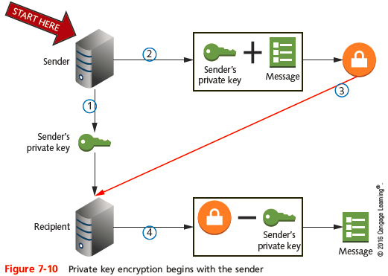
Key Encryption
Notes:
Key Encryption

Slide 28
Key Encryption
Public key encryption
Data encrypted using two keys
Private key: user knows
Public key: anyone may request
Public key server
Publicly accessible host
Freely provides users’ public keys
Key pair
Combination of public key and private key
Asymmetric encryption
Requires two different keys
Notes:
Key Encryption
Public key encryption
Data encrypted using two keys
Private key: user knows
Public key: anyone may request
Public key server
Publicly accessible host
Freely provides users’ public keys
Key pair
Combination of public key and private key
Asymmetric encryption
Requires two different keys

Slide 29
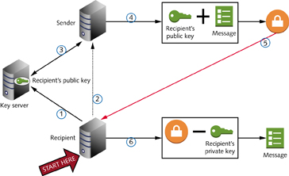
Key Encryption
Figure 7-11 Public key encryption begins with the recipient
Notes:
Key Encryption

Slide 30
Key Encryption
Digital certificate
Holds identification information
Includes public key
CA (certificate authority)
Issues, maintains digital certificates
Example: Verisign
PKI (public key infrastructure)
Use of certificate authorities to associate public keys with certain users
Notes:
Key Encryption
Digital certificate
Holds identification information
Includes public key
CA (certificate authority)
Issues, maintains digital certificates
Example: Verisign
PKI (public key infrastructure)
Use of certificate authorities to associate public keys with certain users

Slide 31
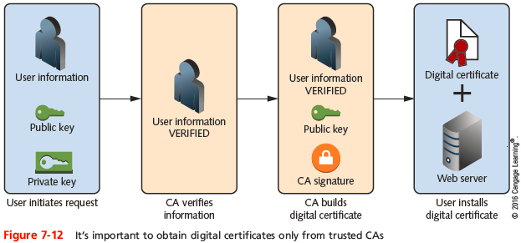
Key Encryption
Notes:
Key Encryption

Slide 32
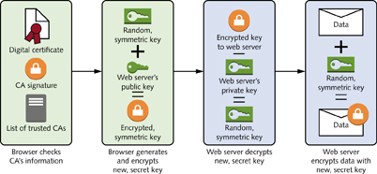
Key Encryption
Figure 7-13 When the CA that issues a digital certificate is trusted and verified, the Web server’s public key can be trusted
Notes:
Key Encryption

Slide 33
IPsec (Internet Protocol Security)
IPsec
Encryption protocol that defines rules for encryption, authentication, and key management for TCP/IP transmissions
IPsec creates secure connections in five steps:
IPsec initiation
Key management
Security negotiations
Data transfer
Termination
Notes:
IPsec (Internet Protocol Security)
IPsec
Encryption protocol that defines rules for encryption, authentication, and key management for TCP/IP transmissions
IPsec creates secure connections in five steps:
IPsec initiation
Key management
Security negotiations
Data transfer
Termination

Slide 34
SSL (Secure Sockets Layer) and TLS (Transport Layer Security)
Both are methods of encrypting TCP/IP transmissions
Including Web pages and data entered into Web forms
Both protocols work side by side and are widely known as SSL/TLS or TLS/SSL
SSL session
Association between client and server
Defined by agreement
Specific set of encryption techniques
Created by SSL handshake protocol
Notes:
SSL (Secure Sockets Layer) and TLS (Transport Layer Security)
Both are methods of encrypting TCP/IP transmissions
Including Web pages and data entered into Web forms
Both protocols work side by side and are widely known as SSL/TLS or TLS/SSL
SSL session
Association between client and server
Defined by agreement
Specific set of encryption techniques
Created by SSL handshake protocol

Slide 35
SSL (Secure Sockets Layer) and TLS (Transport Layer Security)
Handshake protocol
Allows client and server to authenticate
Similar to a TCP three-way handshake
TTLS (Tunneled Transport Layer Security)
Provides authentication like SSL/TLS, but does not require a certificate for each user
Authenticates the server end of the connection by certificate
Users are authenticated by password only
Notes:
SSL (Secure Sockets Layer) and TLS (Transport Layer Security)
Handshake protocol
Allows client and server to authenticate
Similar to a TCP three-way handshake
TTLS (Tunneled Transport Layer Security)
Provides authentication like SSL/TLS, but does not require a certificate for each user
Authenticates the server end of the connection by certificate
Users are authenticated by password only

Slide 36
SSL VPN
SSL VPN
A VPN configured to support SSL transmissions to and from services running on its protected network
Typically created and supported by software running on a VPN concentrator
Access by the user almost exclusively through a Web browser
For the most secure VPNs, a user must install a personal digital certificate along with SSL VPN software, called a SSL VPN client
Notes:
SSL VPN
SSL VPN
A VPN configured to support SSL transmissions to and from services running on its protected network
Typically created and supported by software running on a VPN concentrator
Access by the user almost exclusively through a Web browser
For the most secure VPNs, a user must install a personal digital certificate along with SSL VPN software, called a SSL VPN client

Slide 37
SSH (Secure Shell)
SSH is a collection of protocols that provides for secure authentication and encryption
Guards against a number of security threats
Unauthorized access to a host
IP spoofing
Interception of data in transit
DNS spoofing
Encryption algorithm (depends on version)
DES, Triple DES, RSA, Kerberos, others
Notes:
SSH (Secure Shell)
SSH is a collection of protocols that provides for secure authentication and encryption
Guards against a number of security threats
Unauthorized access to a host
IP spoofing
Interception of data in transit
DNS spoofing
Encryption algorithm (depends on version)
DES, Triple DES, RSA, Kerberos, others

Slide 38
SSH (Secure Shell)
Developed by SSH Communications Security
Version requires license fee
Open source versions available: OpenSSH
Secure connection requires SSH running on both machines
Requires public and private key generation
Configuration options
Use one of several encryption types
Require client password
Perform port forwarding
Notes:
SSH (Secure Shell)
Developed by SSH Communications Security
Version requires license fee
Open source versions available: OpenSSH
Secure connection requires SSH running on both machines
Requires public and private key generation
Configuration options
Use one of several encryption types
Require client password
Perform port forwarding

Slide 39
SFTP (Secure File Transfer Protocol)
SFTP
Secure version of FTP
Uses SSH for encryption
Sometimes called FTP over SSH or SSH FTP
Can be configured to listen on any port
Normally uses SSH’s port 22
Notes:
SFTP (Secure File Transfer Protocol)
SFTP
Secure version of FTP
Uses SSH for encryption
Sometimes called FTP over SSH or SSH FTP
Can be configured to listen on any port
Normally uses SSH’s port 22

Slide 40
Hashes: MD5 and SHA
Hashed data
Data that has been transformed through a particular algorithm that generally reduces the amount of space needed for the data
Can only be retrieved by comparing it with known data
Which receives the same hash function and then produces the same hash output
Notes:
Hashes: MD5 and SHA
Hashed data
Data that has been transformed through a particular algorithm that generally reduces the amount of space needed for the data
Can only be retrieved by comparing it with known data
Which receives the same hash function and then produces the same hash output

Slide 41
Hashes: MD5 and SHA
MD5 (Message Digest 5) Hash
Uses 128-bit hash values to replace actual data with values computed according to the hash algorithm
Primary weakness of MD5 is a propensity for collisions
Still in use, however, it is usually only enabled alongside the more secure SHA hash
Notes:
Hashes: MD5 and SHA
MD5 (Message Digest 5) Hash
Uses 128-bit hash values to replace actual data with values computed according to the hash algorithm
Primary weakness of MD5 is a propensity for collisions
Still in use, however, it is usually only enabled alongside the more secure SHA hash

Slide 42
Hashes: MD5 and SHA
SHA (Secure Hash Algorithm)
Advantage over MD5 is its resistance to collisions
SHA-2 supports a variety of hash sizes
Most popular are SHA-256 (256-bit hash) and SHA-512 (512-bit hash)
SHA-3 is the most recent iteration of SHA
Both are often implemented together for increased security
Notes:
Hashes: MD5 and SHA
SHA (Secure Hash Algorithm)
Advantage over MD5 is its resistance to collisions
SHA-2 supports a variety of hash sizes
Most popular are SHA-256 (256-bit hash) and SHA-512 (512-bit hash)
SHA-3 is the most recent iteration of SHA
Both are often implemented together for increased security

Slide 43
Authentication Protocols
Authentication
Process of verifying user’s credentials to grant user access to secured resources
Authentication protocols
Rules computers follow to accomplish authentication
Several authentication protocol types
Vary by encryption scheme:
And steps taken to verify credentials
Notes:
Authentication Protocols
Authentication
Process of verifying user’s credentials to grant user access to secured resources
Authentication protocols
Rules computers follow to accomplish authentication
Several authentication protocol types
Vary by encryption scheme:
And steps taken to verify credentials

Slide 44
RADIUS and TACACS+
Environments that support many simultaneous connections should use a centralized service
Often used to manage resource access
AAA (authentication, authorization, and accounting)
Category of protocols that provide service
Authenticate a client’s identity
Authorize a user for certain privileges on a system
Keep an account of the client’s system or network usage
Notes:
RADIUS and TACACS+
Environments that support many simultaneous connections should use a centralized service
Often used to manage resource access
AAA (authentication, authorization, and accounting)
Category of protocols that provide service
Authenticate a client’s identity
Authorize a user for certain privileges on a system
Keep an account of the client’s system or network usage

Slide 45
RADIUS and TACACS+
RADIUS (Remote Authentication Dial-In User Service)
Defined by the IETF
Transported over UDP
Can operate as application on remote access server
Or on dedicated RADIUS server
Highly scalable
May be used to authenticate wireless connections
Can work in conjunction with other network servers
Notes:
RADIUS and TACACS+
RADIUS (Remote Authentication Dial-In User Service)
Defined by the IETF
Transported over UDP
Can operate as application on remote access server
Or on dedicated RADIUS server
Highly scalable
May be used to authenticate wireless connections
Can work in conjunction with other network servers

Slide 46
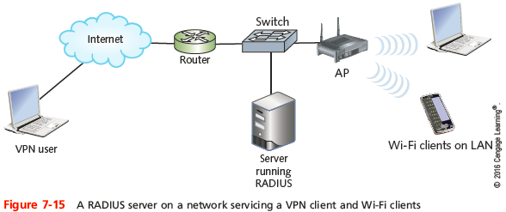
RADIUS and TACACS+
Notes:
RADIUS and TACACS+

Slide 47
RADIUS and TACACS+
TACACS+ (Terminal Access Controller Access Control System Plus)
Offers option of separating access, authentication, and auditing capabilities
Differences from RADIUS
Relies on TCP at the Network layer
Proprietary protocol developed by Cisco Systems, Inc.
Typically installed on a router
Encrypts all information transmitted for AAA
Notes:
RADIUS and TACACS+
TACACS+ (Terminal Access Controller Access Control System Plus)
Offers option of separating access, authentication, and auditing capabilities
Differences from RADIUS
Relies on TCP at the Network layer
Proprietary protocol developed by Cisco Systems, Inc.
Typically installed on a router
Encrypts all information transmitted for AAA

Slide 48
PAP (Password Authentication Protocol)
PPP does not secure connections
Requires authentication protocols
PAP authentication protocol
Operates over PPP
Uses two-step authentication process
Simple
Not secure
Sends client’s credentials in clear text
Notes:
PAP (Password Authentication Protocol)
PPP does not secure connections
Requires authentication protocols
PAP authentication protocol
Operates over PPP
Uses two-step authentication process
Simple
Not secure
Sends client’s credentials in clear text

Slide 49
CHAP and MS-CHAP
CHAP (Challenge Handshake Authentication Protocol)
Operates over PPP
Encrypts user names, passwords
Uses three-way handshake
Three steps to complete authentication process
Benefit over PAP
Password never transmitted alone
Password never transmitted in clear text
Notes:
CHAP and MS-CHAP
CHAP (Challenge Handshake Authentication Protocol)
Operates over PPP
Encrypts user names, passwords
Uses three-way handshake
Three steps to complete authentication process
Benefit over PAP
Password never transmitted alone
Password never transmitted in clear text

Slide 50
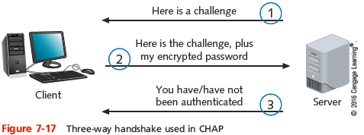
CHAP and MS-CHAP
Notes:
CHAP and MS-CHAP

Slide 51
CHAP and MS-CHAP
MS-CHAP (Microsoft Challenge Authentication Protocol)
Used on Windows-based computers
CHAP, MS-CHAP vulnerability
Eavesdropping could capture character string encrypted with password, then decrypt
MS-CHAPv2 uses stronger encryption, does not use the same encryption strings, and requires mutual authentication
Both computers verify the credentials of the other
Notes:
CHAP and MS-CHAP
MS-CHAP (Microsoft Challenge Authentication Protocol)
Used on Windows-based computers
CHAP, MS-CHAP vulnerability
Eavesdropping could capture character string encrypted with password, then decrypt
MS-CHAPv2 uses stronger encryption, does not use the same encryption strings, and requires mutual authentication
Both computers verify the credentials of the other

Slide 52
EAP (Extensible Authentication Protocol)
Another authentication protocol
Operates over PPP
Works with other encryption and authentication schemes
Verifies client, server credentials
Requires authenticator to initiate authentication process
Ask connected computer to verify itself
EAP’s advantages: flexibility, adaptability
Notes:
EAP (Extensible Authentication Protocol)
Another authentication protocol
Operates over PPP
Works with other encryption and authentication schemes
Verifies client, server credentials
Requires authenticator to initiate authentication process
Ask connected computer to verify itself
EAP’s advantages: flexibility, adaptability

Slide 53
802.1x (EAPoL)
Codified by IEEE
Specifies use of one of many authentication methods plus EAP
Grant access to and dynamically generate and update authentication keys for transmissions to a particular port
Primarily used with wireless networks
Originally designed for wired LAN
EAPoL (EAP over LAN)
Only defines process for authentication
Commonly used with RADIUS authentication
Notes:
802.1x (EAPoL)
Codified by IEEE
Specifies use of one of many authentication methods plus EAP
Grant access to and dynamically generate and update authentication keys for transmissions to a particular port
Primarily used with wireless networks
Originally designed for wired LAN
EAPoL (EAP over LAN)
Only defines process for authentication
Commonly used with RADIUS authentication

Slide 54
TKIP (Temporary Key Integrity Protocol) and AES (Advanced Encryption System)
TKIP
Encryption key generation and management scheme
WPA2 does continue to offer TKIP to provide compatibility with older wireless devices
AES
Provides faster and more secure encryption than TKIP for wireless transmissions
Uses a more sophisticated family of ciphers
Notes:
TKIP (Temporary Key Integrity Protocol) and AES (Advanced Encryption System)
TKIP
Encryption key generation and management scheme
WPA2 does continue to offer TKIP to provide compatibility with older wireless devices
AES
Provides faster and more secure encryption than TKIP for wireless transmissions
Uses a more sophisticated family of ciphers

Slide 55
Kerberos
Cross-platform authentication protocol
Uses key encryption
Verifies client identity
Securely exchanges information after client logs on
Private key encryption service
Provides significant security advantages over simple NOS authentication
Notes:
Kerberos
Cross-platform authentication protocol
Uses key encryption
Verifies client identity
Securely exchanges information after client logs on
Private key encryption service
Provides significant security advantages over simple NOS authentication

Slide 56
Kerberos
Terms
KDC (Key Distribution Center)
AS (authentication service)
Ticket
Principal
TGS (Ticket-Granting Service)
An application running separate from the AS that also runs on the KDC
Alleviates the need for the client to request a new ticket from the TGS each time it wants to use a different service on the network
Notes:
Kerberos
Terms
KDC (Key Distribution Center)
AS (authentication service)
Ticket
Principal
TGS (Ticket-Granting Service)
An application running separate from the AS that also runs on the KDC
Alleviates the need for the client to request a new ticket from the TGS each time it wants to use a different service on the network

Slide 57
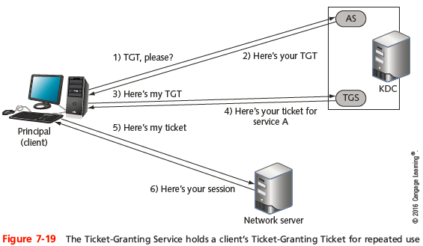
Kerberos
Notes:
Kerberos

Slide 58
SSO (Single Sign-On)
SSO
Form of authentication in which a client signs on one time to access multiple systems or resources
Primary advantage is convenience
Disadvantage is that once authentication is cleared, the user has access to numerous resources
Two-factor authentication
User must provide something and know something
Multifactor authentication (MFA)
Process that requires two or more pieces of information
Notes:
SSO (Single Sign-On)
SSO
Form of authentication in which a client signs on one time to access multiple systems or resources
Primary advantage is convenience
Disadvantage is that once authentication is cleared, the user has access to numerous resources
Two-factor authentication
User must provide something and know something
Multifactor authentication (MFA)
Process that requires two or more pieces of information

Slide 59
SSO (Single Sign-On)
Three categories of authentication factors:
Knowledge - something you know, ex: password
Possession - something you have, ex: ATM card
Inherence - something you are, ex: your fingerprint
MFA requires at least one authentication method from at least two different categories
Notes:
SSO (Single Sign-On)
Three categories of authentication factors:
Knowledge - something you know, ex: password
Possession - something you have, ex: ATM card
Inherence - something you are, ex: your fingerprint
MFA requires at least one authentication method from at least two different categories

Slide 60
Troubleshooting Cloud Computing and Remote Access
Choosing a secure password
Easiest and least expensive ways to guard against unauthorized access
Network administrators should:
Choose difficult passwords
Keep passwords confidential
Change them frequently
See page 366 for tips on making and keeping passwords secure
Notes:
Troubleshooting Cloud Computing and Remote Access
Choosing a secure password
Easiest and least expensive ways to guard against unauthorized access
Network administrators should:
Choose difficult passwords
Keep passwords confidential
Change them frequently
See page 360 for tips on making and keeping passwords secure

Slide 61
Misconfigurations
Common issues to look out for:
Mistyped username or password
Incompatible encryption or authentication settings
Improperly activated or inactivated user account
Incorrectly assigned port
Improperly configured firewall
Network connection failure
Failed handshake
Check configurations on the server handling AAA services
Notes:
Misconfigurations
Common issues to look out for:
Mistyped username or password
Incompatible encryption or authentication settings
Improperly activated or inactivated user account
Incorrectly assigned port
Improperly configured firewall
Network connection failure
Failed handshake
Check configurations on the server handling AAA services

Slide 62
Misconfigurations
Make sure server’s date and time are correct
User roles must be properly defined
User accounts must be properly activated
Check server logs for issues about configuration or individual client access
Use network connection troubleshooting tools to help narrow down the location of a connection problem
Such as ping and tracert
Notes:
Misconfigurations
Make sure server’s date and time are correct
User roles must be properly defined
User accounts must be properly activated
Check server logs for issues about configuration or individual client access
Use network connection troubleshooting tools to help narrow down the location of a connection problem
Such as ping and tracert

Slide 63
Summary
Cloud computing refers to flexible provision of data storage, applications, or services to multiple clients over a network
Cloud services may be managed and delivered by any of a variety of deployment models
A remote client can access files, applications, and other shared resources, such as printers
SLIP is an earlier PPP protocol that does not support encryption, can carry only IP packets, and works strictly on serial connections
Notes:
Summary
Cloud computing refers to flexible provision of data storage, applications, or services to multiple clients over a network
Cloud services may be managed and delivered by any of a variety of deployment models
A remote client can access files, applications, and other shared resources, such as printers
SLIP is an earlier PPP protocol that does not support encryption, can carry only IP packets, and works strictly on serial connections

Slide 64
Summary
A VPN tunneling protocol operates at the Data Link layer to encapsulate the VPN frame into a Network layer packet
GRE encapsulates PPP frames to make them take on the temporary identity of IP packets at Layer 3
Remote virtual computing, also called terminal emulation, allows a user on one computer to control another computer across a network connection
Encryption is the use of a mathematical code, called a cipher, to scramble data into a format that can be read only by reversing the cipher
Notes:
Summary
A VPN tunneling protocol operates at the Data Link layer to encapsulate the VPN frame into a Network layer packet
GRE encapsulates PPP frames to make them take on the temporary identity of IP packets at Layer 3
Remote virtual computing, also called terminal emulation, allows a user on one computer to control another computer across a network connection
Encryption is the use of a mathematical code, called a cipher, to scramble data into a format that can be read only by reversing the cipher

Slide 65
Summary
Private key encryption is also known as symmetric encryption because the same key is used during encryption and decryption of data
In public key encryption, a user’s public key can be obtained from a third-party source, such as a public key server
IPsec is an encryption protocol that works at the Network layer and adds security information to the header of IP packets
Notes:
Summary
Private key encryption is also known as symmetric encryption because the same key is used during encryption and decryption of data
In public key encryption, a user’s public key can be obtained from a third-party source, such as a public key server
IPsec is an encryption protocol that works at the Network layer and adds security information to the header of IP packets

Slide 66
Summary
Authentication protocols vary according to which encryption schemes they rely on
RADIUS, MS-CHAPv2, EAP, AES, Kerberos are all examples of authentication protocols
Choosing a secure password is one of the easiest and least expensive ways to guard against unauthorized access
When troubleshooting problems with remote connections, be sure to check configurations on the server handling AAA services
Notes:
Summary
Authentication protocols vary according to which encryption schemes they rely on
RADIUS, MS-CHAPv2, EAP, AES, Kerberos are all examples of authentication protocols
Choosing a secure password is one of the easiest and least expensive ways to guard against unauthorized access
When troubleshooting problems with remote connections, be sure to check configurations on the server handling AAA services

