Slide 1
Chapter 8 Cloud Computing and Remote Access
Dr. Sayonnha Mandal
Notes:
Network+ Guide to Networks 7th Edition
Chapter 1
An Introduction to Networking

Slide 2
Objectives
Assess a network’s security needs and vulnerabilities
Describe security risks associated with people, hardware, software, and Internet access
Discuss the elements of an effective security policy
Apply appropriate security measures and devices when designing a network
Prevent and respond to malware infections
Notes:
Objectives
Assess a network’s security needs and vulnerabilities
Describe security risks associated with people, hardware, software, and Internet access
Discuss the elements of an effective security policy
Apply appropriate security measures and devices when designing a network
Prevent and respond to malware infections

Slide 3
Security Assessment
Different types of organizations have different levels of network security risk
Posture assessment
A thorough examination of each aspect of the network to determine how it might be compromised
Should be performed at least annually
Security audit
An assessment performed by a company that has been accredited by an agency that sets network security standards
Notes:
Security Assessment
Different types of organizations have different levels of network security risk
Posture assessment
A thorough examination of each aspect of the network to determine how it might be compromised
Should be performed at least annually
Security audit
An assessment performed by a company that has been accredited by an agency that sets network security standards

Slide 4
Security Risks
Hacker
Individual who gains unauthorized access to systems
Vulnerability
Weakness of a system, process, or architecture
Exploit
Means of taking advantage of a vulnerability
Zero-day exploit or zero-day attack
Taking advantage of undiscovered software vulnerability
Most vulnerabilities are well known
Notes:
Security Risks
Hacker
Individual who gains unauthorized access to systems
Vulnerability
Weakness of a system, process, or architecture
Exploit
Means of taking advantage of a vulnerability
Zero-day exploit or zero-day attack
Taking advantage of undiscovered software vulnerability
Most vulnerabilities are well known

Slide 5
Risks Associated with People
Half of all security breaches
Human errors, ignorance, omissions
Social engineering
Strategy to gain password
Phishing
Glean access, authentication information
Pose as someone needing information
Many risks associated with people exist
Easiest way to circumvent network security
Take advantage of human error
Notes:
Risks Associated with People
Half of all security breaches
Human errors, ignorance, omissions
Social engineering
Strategy to gain password
Phishing
Glean access, authentication information
Pose as someone needing information
Many risks associated with people exist
Easiest way to circumvent network security
Take advantage of human error

Slide 6
Risks Associated with Transmission and Hardware
Physical, Data Link, and Network layer security risks
Require more technical sophistication
Risks inherent in network hardware and design
Transmission interception
Jamming
RF emanation
Created by the leaking of signals from equipment
Eavesdropping
Networks connecting to Internet via leased public lines
Notes:
Risks Associated with Transmission and Hardware
Physical, Data Link, and Network layer security risks
Require more technical sophistication
Risks inherent in network hardware and design
Transmission interception
Jamming
RF emanation
Created by the leaking of signals from equipment
Eavesdropping
Networks connecting to Internet via leased public lines

Slide 7
Risks Associated with Transmission and Hardware
Risks inherent in network hardware and design (cont’d.)
Sniffing
Data traveling over public wireless networks
Port access via port scanner
Unused switch, router, server ports not secured
Private address availability to outside
Routers not properly configured to mask internal subnets
Router attack
Routers not configured to drop suspicious packets
Notes:
Risks Associated with Transmission and Hardware
Risks inherent in network hardware and design (cont’d.)
Sniffing
Data traveling over public wireless networks
Port access via port scanner
Unused switch, router, server ports not secured
Private address availability to outside
Routers not properly configured to mask internal subnets
Router attack
Routers not configured to drop suspicious packets

Slide 8
Risks Associated with Transmission and Hardware
Risks inherent in network hardware and design (cont’d.)
Access servers not secured and monitored
Computers hosting sensitive data:
May coexist on same subnet as public computers
Insecure passwords
Easily guessable or default values
ARP tables might be altered
Notes:
Risks Associated with Transmission and Hardware
Risks inherent in network hardware and design (cont’d.)
Access servers not secured and monitored
Computers hosting sensitive data:
May coexist on same subnet as public computers
Insecure passwords
Easily guessable or default values
ARP tables might be altered

Slide 9
Risks Associated with Protocols and Software
Includes Transport, Session, Presentation, and Application layers
Networking protocols and software risks
TCP/IP security flaws
Banner-grabbing attack
Session hijacking attack
Man-in-the-middle (MitM) attack
Invalid trust relationships
DHCP snooping
Dynamic ARP inspection (DAI)
Notes:
Risks Associated with Protocols and Software
Includes Transport, Session, Presentation, and Application layers
Networking protocols and software risks
TCP/IP security flaws
Banner-grabbing attack
Session hijacking attack
Man-in-the-middle (MitM) attack
Invalid trust relationships
DHCP snooping
Dynamic ARP inspection (DAI)

Slide 10
Risks Associated with Protocols and Software
Networking protocols and software risks (cont’d)
NOS back doors, security flaws
Buffer overflow
NOS allows server operators to exit to command prompt
Administrators default security options
Intercepting transactions between applications
Notes:
Risks Associated with Protocols and Software
Networking protocols and software risks (cont’d)
NOS back doors, security flaws
Buffer overflow
NOS allows server operators to exit to command prompt
Administrators default security options
Intercepting transactions between applications

Slide 11
Risks Associated with Internet Access
Web browsers permit scripts to access systems
Users must be careful about providing information to sites
Common Internet-related security issues
Improperly configured firewall
Outsiders obtain internal IP addresses: IP spoofing
Telnets or FTPs
Transmit user ID and password in plain text
Notes:
Risks Associated with Internet Access
Web browsers permit scripts to access systems
Users must be careful about providing information to sites
Common Internet-related security issues
Improperly configured firewall
Outsiders obtain internal IP addresses: IP spoofing
Telnets or FTPs
Transmit user ID and password in plain text

Slide 12
Risks Associated with Internet Access
Common Internet-related security issues (cont’d)
Improperly configured firewall
Outsiders obtain internal IP addresses: IP spoofing
Telnets or FTPs
Transmit user ID and password in plain text
Newsgroups, mailing lists, forms
Provide hackers user information
Chat session flashing
Denial-of-service (DoS) attack
Hacker issues flood of broadcast ping messages
Notes:
Risks Associated with Internet Access
Common Internet-related security issues (cont’d)
Improperly configured firewall
Outsiders obtain internal IP addresses: IP spoofing
Telnets or FTPs
Transmit user ID and password in plain text
Newsgroups, mailing lists, forms
Provide hackers user information
Chat session flashing
Denial-of-service (DoS) attack
Hacker issues flood of broadcast ping messages

Slide 13
Risks Associated with Internet Access
Four types of DoS attacks:
Distributed DoS (DDoS) attack
Orchestrated through several sources, called zombies
Distributed reflector DoS (DRDoS) attack
A DDoS attack bounced off of uninfected computers, called reflectors, before being directed at target
Permanent DoS (PDoS) attack
Physical attack on a device that attempts to alter management interfaces beyond repair
Unintentional DoS attack
Called a friendly attack because it is not done with malicious intent
Notes:
Risks Associated with Internet Access
Four types of DoS attacks:
Distributed DoS (DDoS) attack
Orchestrated through several sources, called zombies
Distributed reflector DoS (DRDoS) attack
A DDoS attack bounced off of uninfected computers, called reflectors, before being directed at target
Permanent DoS (PDoS) attack
Physical attack on a device that attempts to alter management interfaces beyond repair
Unintentional DoS attack
Called a friendly attack because it is not done with malicious intent

Slide 14
Effective Security Policies
To minimize break-ins
Communicate with and manage users via a thoroughly planned security policy
Security policy
Identifies security goals, risks, authority levels, designated security coordinator, and team members
Responsibilities of each team member and employee
How to address security breaches
Not included in policy:
Hardware, software, architecture, and protocols
Configuration details
Notes:
Effective Security Policies
To minimize break-ins
Communicate with and manage users via a thoroughly planned security policy
Security policy
Identifies security goals, risks, authority levels, designated security coordinator, and team members
Responsibilities of each team member and employee
How to address security breaches
Not included in policy:
Hardware, software, architecture, and protocols
Configuration details

Slide 15
Security Policy Goals
Typical goals
Ensure authorized users have appropriate resource access
Prevent unauthorized user access
Protect unauthorized sensitive data access
Prevent accidental hardware and software damage
Prevent intentional hardware or software damage
Create secure environment
Withstand, respond to, and recover from threat
Communicate employees’ responsibilities
Have employees sign a consent to monitoring form
Notes:
Security Policy Goals
Typical goals
Ensure authorized users have appropriate resource access
Prevent unauthorized user access
Protect unauthorized sensitive data access
Prevent accidental hardware and software damage
Prevent intentional hardware or software damage
Create secure environment
Withstand, respond to, and recover from threat
Communicate employees’ responsibilities
Have employees sign a consent to monitoring form

Slide 16
Security Policy Goals
Strategy
Form committee
Involve as many decision makers as possible
Assign security coordinator to drive policy creation
Understand risks
Conduct posture assessment
Rate severity and likelihood of each threat
Assign person responsible for addressing threats
Notes:
Security Policy Goals
Strategy
Form committee
Involve as many decision makers as possible
Assign security coordinator to drive policy creation
Understand risks
Conduct posture assessment
Rate severity and likelihood of each threat
Assign person responsible for addressing threats

Slide 17
Security Policy Content
Outline policy content
Define policy subheadings
Should detail the acceptable use policy (AUP), which explains to users:
What they can and cannot do
Clarifies expectations for everyone
Include a section aimed at a particular function
Example: a “Passwords” section
User security policy section
Define what confidential means to the organization
Notes:
Security Policy Content
Outline policy content
Define policy subheadings
Should detail the acceptable use policy (AUP), which explains to users:
What they can and cannot do
Clarifies expectations for everyone
Include a section aimed at a particular function
Example: a “Passwords” section
User security policy section
Define what confidential means to the organization

Slide 18
Security in Network Design
Breaches may occur due to poor LAN or WAN design
Address though intelligent network design
Preventing external LAN security breaches
Restrict access at every point where LAN connects to rest of the world
Notes:
Security in Network Design
Breaches may occur due to poor LAN or WAN design
Address though intelligent network design
Preventing external LAN security breaches
Restrict access at every point where LAN connects to rest of the world

Slide 19
NOS Security
Restrict user authorization
Access to server files and directories
Public rights
Conferred to all users
Very limited
Group users according to security levels
Assign additional rights
Notes:
NOS Security
Restrict user authorization
Access to server files and directories
Public rights
Conferred to all users
Very limited
Group users according to security levels
Assign additional rights

Slide 20
Logon Restrictions
Additional restrictions to strengthen security
Time of day
Total time logged on
Source address
Unsuccessful logon attempts
Secure passwords
A security technique that can be enforced by a network administrator through the NOS
Notes:
Logon Restrictions
Additional restrictions to strengthen security
Time of day
Total time logged on
Source address
Unsuccessful logon attempts
Secure passwords
A security technique that can be enforced by a network administrator through the NOS

Slide 21
Network Access Control
A network access control (NAC) solution employs a set of rules called network policies
Which determine the level and type of access granted to a device when it joins a network
NAC authenticates and authorizes devices
By verifying that the device complies with predefined security benchmarks
An agent can be installed on the device before it can be authenticated
Monitors device’s status to determine the device’s compliance
Notes:
Network Access Control
A network access control (NAC) solution employs a set of rules called network policies
Which determine the level and type of access granted to a device when it joins a network
NAC authenticates and authorizes devices
By verifying that the device complies with predefined security benchmarks
An agent can be installed on the device before it can be authenticated
Monitors device’s status to determine the device’s compliance

Slide 22
Network Access Control
Two types of agents:
Nonpersistent agent remains on the device long enough to verify compliance and complete authentication and then uninstalls
Also called dissolvable agent
Persistent agent is permanently installed on a device
Devices that do not meet compliance requirements can be placed in a quarantine network
Separate from sensitive network resources
Notes:
Network Access Control
Two types of agents:
Nonpersistent agent remains on the device long enough to verify compliance and complete authentication and then uninstalls
Also called dissolvable agent
Persistent agent is permanently installed on a device
Devices that do not meet compliance requirements can be placed in a quarantine network
Separate from sensitive network resources

Slide 23
Access Control Lists Used by Routers
Router’s main functions
Examine packets
Determine destination
Based on Network layer addressing information
ACL (access control list)
Also called access list
Routers can decline to forward certain packets
Notes:
Access Control Lists Used by Routers
Router’s main functions
Examine packets
Determine destination
Based on Network layer addressing information
ACL (access control list)
Also called access list
Routers can decline to forward certain packets

Slide 24
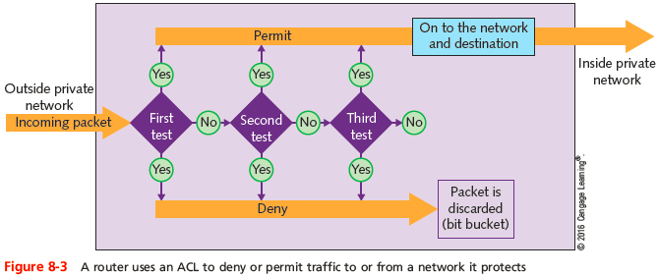
Access Control Lists Used by Routers
Notes:
Access Control Lists Used by Routers

Slide 25
Access Control Lists Used by Routers
Router receives packet, examines packet
Refers to ACL for permit, deny criteria
Drops packet if deny characteristics match
Forwards packet if permit characteristics match
If the packet does not match any criteria given, the packet is dropped
Called the implicit deny rule
Each router interface must be assigned a separate ACL
Different ACLs may be associated with inbound and outbound traffic
Notes:
Access Control Lists Used by Routers
Router receives packet, examines packet
Refers to ACL for permit, deny criteria
Drops packet if deny characteristics match
Forwards packet if permit characteristics match
If the packet does not match any criteria given, the packet is dropped
Called the implicit deny rule
Each router interface must be assigned a separate ACL
Different ACLs may be associated with inbound and outbound traffic

Slide 26
Access Control Lists Used by Routers
The access-list command is used to assign a statement to an already-installed ACL
Must identify the ACL and include a permit or deny argument
Example: To permit TCP traffic from 2.2.2.2 host machine to 5.5.5.5 host machine:
access-list acl_2 permit tcp host 2.2.2.2 host 5.5.5.5
ACLs do affect router performance
The more statements or tests a router must scan the more time it takes a router to act
Notes:
Access Control Lists Used by Routers
The access-list command is used to assign a statement to an already-installed ACL
Must identify the ACL and include a permit or deny argument
Example: To permit TCP traffic from 2.2.2.2 host machine to 5.5.5.5 host machine:
access-list acl_2 permit tcp host 2.2.2.2 host 5.5.5.5
ACLs do affect router performance
The more statements or tests a router must scan the more time it takes a router to act

Slide 27
Intrusion Detection and Prevention
Proactive security measure
Detecting suspicious network activity
IDS (intrusion detection system)
Software monitoring traffic
On dedicated IDS device
On another device performing other functions
Port mirroring
One port makes copy of traffic and sends to second port for monitoring
Notes:
Intrusion Detection and Prevention
Proactive security measure
Detecting suspicious network activity
IDS (intrusion detection system)
Software monitoring traffic
On dedicated IDS device
On another device performing other functions
Port mirroring
One port makes copy of traffic and sends to second port for monitoring

Slide 28
Intrusion Detection and Prevention
Two types of IDS implementations
HIDS (host-based IDS) runs on a single computer to alert about attacks to that one host
NIDS (network-based IDS) protects a network and is usually situated at the edge of the network or in the DMZ (demilitarized zone)
Network’s protective perimeter
IDS drawback
Number of false positives logged
IDS can only detect and log suspicious activity
Notes:
Intrusion Detection and Prevention
Two types of IDS implementations
HIDS (host-based IDS) runs on a single computer to alert about attacks to that one host
NIDS (network-based IDS) protects a network and is usually situated at the edge of the network or in the DMZ (demilitarized zone)
Network’s protective perimeter
IDS drawback
Number of false positives logged
IDS can only detect and log suspicious activity

Slide 29
Intrusion Detection and Prevention
IPS (intrusion prevention system)
Reacts to suspicious activity when alerted
Detects threat and prevents traffic from flowing to network
Based on originating IP address
NIPS (network-based intrusion prevention)
Protects entire networks
HIPS (host-based intrusion prevention)
Protects certain hosts
Notes:
Intrusion Detection and Prevention
IPS (intrusion prevention system)
Reacts to suspicious activity when alerted
Detects threat and prevents traffic from flowing to network
Based on originating IP address
NIPS (network-based intrusion prevention)
Protects entire networks
HIPS (host-based intrusion prevention)
Protects certain hosts

Slide 30
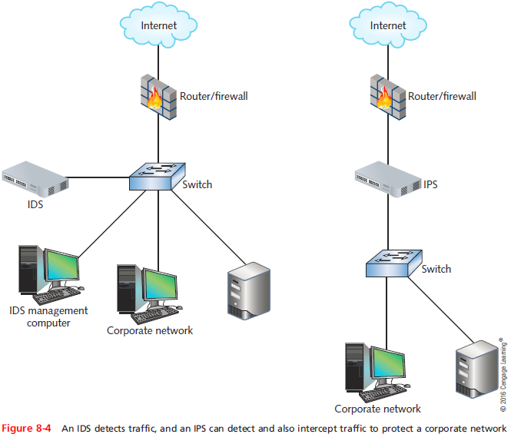
Intrusion Detection and Prevention
Notes:
Intrusion Detection and Prevention

Slide 31
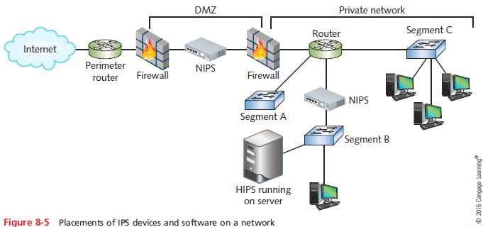
Intrusion Detection and Prevention
Notes:
Intrusion Detection and Prevention

Slide 32
Firewalls
Specialized device or computer installed with specialized software
Selectively filters and blocks traffic between networks
Typically involves hardware and software combination
Firewall location
Between two interconnected private networks
Between private network and public network (network-based firewall)
Notes:
Firewalls
Specialized device or computer installed with specialized software
Selectively filters and blocks traffic between networks
Typically involves hardware and software combination
Firewall location
Between two interconnected private networks
Between private network and public network (network-based firewall)

Slide 33
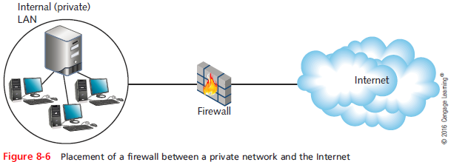
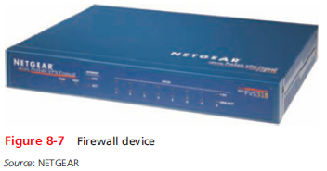
Firewalls
Notes:
Firewalls

Slide 34
Firewalls
Packet-filtering firewall
Simplest firewall
Examines header of every entering packet (inbound traffic)
Can block traffic entering or exiting a LAN (outbound traffic)
Firewall default configuration
Blocks most common security threats
Preconfigured to accept and deny certain traffic types
Network administrators often customize settings
Notes:
Firewalls
Packet-filtering firewall
Simplest firewall
Examines header of every entering packet (inbound traffic)
Can block traffic entering or exiting a LAN (outbound traffic)
Firewall default configuration
Blocks most common security threats
Preconfigured to accept and deny certain traffic types
Network administrators often customize settings

Slide 35
Firewalls
Common packet-filtering firewall criteria
Source and destination IP addresses
Source and destination ports
Flags set in the TCP header
Transmissions using UDP or ICMP protocols
Packet’s status as first packet in new data stream, subsequent packet
Packet’s status as inbound to, outbound from private network
Notes:
Firewalls
Common packet-filtering firewall criteria
Source and destination IP addresses
Source and destination ports
Flags set in the TCP header
Transmissions using UDP or ICMP protocols
Packet’s status as first packet in new data stream, subsequent packet
Packet’s status as inbound to, outbound from private network

Slide 36
Firewalls
Port blocking
Prevents connection to and transmission completion through ports
Optional firewall functions
Encryption
User authentication
Centralized management
Easy rule establishment
Content-filtering based on data contained in packets
Notes:
Firewalls
Port blocking
Prevents connection to and transmission completion through ports
Optional firewall functions
Encryption
User authentication
Centralized management
Easy rule establishment
Content-filtering based on data contained in packets

Slide 37
Firewalls
Optional firewall functions (cont’d.)
Logging, auditing capabilities
Protect internal LAN’s address identity
Monitor packets according to existing traffic streams (stateful firewall)
A stateless firewall manages each incoming packet as a stand-along entity without regard to active connections
Unified Threat Management (UTM)
Strategy that combines multiple layers of security appliances and technologies into a single safety net
Notes:
Firewalls
Optional firewall functions (cont’d.)
Logging, auditing capabilities
Protect internal LAN’s address identity
Monitor packets according to existing traffic streams (stateful firewall)
A stateless firewall manages each incoming packet as a stand-along entity without regard to active connections
Unified Threat Management (UTM)
Strategy that combines multiple layers of security appliances and technologies into a single safety net

Slide 38
Firewalls
Next Generation Firewalls (NGFW)
Have built-in Application Control features and are application aware
They can monitor and limit traffic of specific applications
May also be context aware
They adapt to various applications, users, and devices
Most common cause of firewall failure is firewall misconfiguration
Notes:
Firewalls
Next Generation Firewalls (NGFW)
Have built-in Application Control features and are application aware
They can monitor and limit traffic of specific applications
May also be context aware
They adapt to various applications, users, and devices
Most common cause of firewall failure is firewall misconfiguration

Slide 39
Proxy Servers
Proxy service
Software application on a network host
Acts as an intermediary between external and internal networks
Screens all incoming and outgoing traffic
Proxy server (proxy)
Network host running proxy service
Manages security at Application layer
Appears an internal network server to the outside world, but is a filtering device for internal LAN
Notes:
Proxy Servers
Proxy service
Software application on a network host
Acts as an intermediary between external and internal networks
Screens all incoming and outgoing traffic
Proxy server (proxy)
Network host running proxy service
Manages security at Application layer
Appears an internal network server to the outside world, but is a filtering device for internal LAN

Slide 40
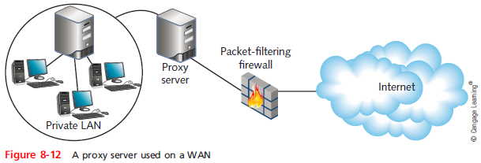
Proxy Servers
Notes:
Proxy Servers

Slide 41
Proxy Servers
Reverse proxy
Provides services to Internet clients from servers on its own network
Provides identity protection for the server rather than the client
Useful when multiple Web servers are accessed through the same public IP address
Notes:
Proxy Servers
Reverse proxy
Provides services to Internet clients from servers on its own network
Provides identity protection for the server rather than the client
Useful when multiple Web servers are accessed through the same public IP address

Slide 42
SIEM (Security Information and Event Management)
SIEM systems can be configured to evaluate all log data
Looking for significant events that require attention from the IT staff
Capability of the SIEM
Determined by the amount of storage space needed for the amount of data generated
Network administrators can fine-tune a SIEM’s configuration rules for the specific needs
Which event should trigger responses
Notes:
SIEM (Security Information and Event Management)
SIEM systems can be configured to evaluate all log data
Looking for significant events that require attention from the IT staff
Capability of the SIEM
Determined by the amount of storage space needed for the amount of data generated
Network administrators can fine-tune a SIEM’s configuration rules for the specific needs
Which event should trigger responses

Slide 43
Scanning Tools
Used during posture assessment
Duplicate hacker methods
NMAP (Network Mapper)
Designed to scan large networks
Provides information about network and hosts
Free to download
Nessus
Performs more sophisticated scans than NMAP
Notes:
Scanning Tools
Used during posture assessment
Duplicate hacker methods
NMAP (Network Mapper)
Designed to scan large networks
Provides information about network and hosts
Free to download
Nessus
Performs more sophisticated scans than NMAP

Slide 44
Honeypots and Honeynets
Honeypot
Decoy system that is purposefully vulnerable
Designed to fool hackers and gain information about their behavior
Honeynet
Network of honeypots
Decoy systems, called lures, can provide unique information about hacking behavior
Notes:
Honeypots and Honeynets
Honeypot
Decoy system that is purposefully vulnerable
Designed to fool hackers and gain information about their behavior
Honeynet
Network of honeypots
Decoy systems, called lures, can provide unique information about hacking behavior

Slide 45
Troubleshooting Malware Risks and Infections
Malicious software
Program designed to intrude upon or harm system, resources
Examples: viruses, Trojan horses, worms, bots
Virus
Replicating program intent to infect more computers
Copied to system without user knowledge
Replicates through network connections or exchange of external storage devices
Notes:
Troubleshooting Malware Risks and Infections
Malicious software
Program designed to intrude upon or harm system, resources
Examples: viruses, Trojan horses, worms, bots
Virus
Replicating program intent to infect more computers
Copied to system without user knowledge
Replicates through network connections or exchange of external storage devices

Slide 46
Troubleshooting Malware Risks and Infections
Trojan horse (Trojan)
Program that disguises itself as something useful
Actually harms your system
Notes:
Troubleshooting Malware Risks and Infections
Trojan horse (Trojan)
Program that disguises itself as something useful
Actually harms your system

Slide 47
Malware Types and Characteristics
Malware categorized by location and propagation method
Boot sector viruses
Position code in boot sector of hard disk
Macro viruses
Take the form of a macro
File-infector viruses
Attach themselves to executable files
Worms
Programs that run independently and travel between computers and across networks
Notes:
Malware Types and Characteristics
Malware categorized by location and propagation method
Boot sector viruses
Position code in boot sector of hard disk
Macro viruses
Take the form of a macro
File-infector viruses
Attach themselves to executable files
Worms
Programs that run independently and travel between computers and across networks

Slide 48
Malware Types and Characteristics
Malware categorized by location and propagation method (cont’d)
Trojan horses
Program that claims to do something useful but instead harms the computer or system
Network viruses
Propagate themselves via network protocols, commands, messaging programs, and data links
Bots
Program that runs automatically
Many bots spread through IRC (Internet Relay Chat)
Notes:
Malware Types and Characteristics
Malware categorized by location and propagation method (cont’d)
Trojan horses
Program that claims to do something useful but instead harms the computer or system
Network viruses
Propagate themselves via network protocols, commands, messaging programs, and data links
Bots
Program that runs automatically
Many bots spread through IRC (Internet Relay Chat)

Slide 49
Malware Types and Characteristics
Malware characteristics
Encryption
Some viruses, worms, Trojan horses
Stealth
Hidden to prevent detection
Disguised as legitimate programs
Polymorphism
Change characteristics every time they transfer to new system
Use complicated algorithms; incorporate nonsensical commands
Notes:
Malware Types and Characteristics
Malware characteristics
Encryption
Some viruses, worms, Trojan horses
Stealth
Hidden to prevent detection
Disguised as legitimate programs
Polymorphism
Change characteristics every time they transfer to new system
Use complicated algorithms; incorporate nonsensical commands

Slide 50
Malware Types and Characteristics
Malware characteristics (cont’d.)
Time dependence
Programmed to activate on particular date
Can remain dormant and harmless until date arrives
Logic bombs: programs designed to start when certain conditions met
Malware can exhibit more than one characteristic
Notes:
Malware Types and Characteristics
Malware characteristics (cont’d.)
Time dependence
Programmed to activate on particular date
Can remain dormant and harmless until date arrives
Logic bombs: programs designed to start when certain conditions met
Malware can exhibit more than one characteristic

Slide 51
Anti-Malware Software
Effective malware protection requires:
Choosing appropriate anti-malware program
Monitoring network
Continually updating anti-malware program
Educating users
Notes:
Anti-Malware Software
Effective malware protection requires:
Choosing appropriate anti-malware program
Monitoring network
Continually updating anti-malware program
Educating users

Slide 52
Anti-Malware Software
Malware leaves evidence
Some detectable only via anti-malware software
Symptoms
Unexplained file size increases
Significant, unexplained system performance decline
Unusual error messages
Significant, unexpected system memory loss
Periodic, unexpected rebooting
Display quality fluctuations
Malware often discovered after damage done
Notes:
Anti-Malware Software
Malware leaves evidence
Some detectable only via anti-malware software
Symptoms
Unexplained file size increases
Significant, unexplained system performance decline
Unusual error messages
Significant, unexpected system memory loss
Periodic, unexpected rebooting
Display quality fluctuations
Malware often discovered after damage done

Slide 53
Anti-Malware Software
Look for anti-malware software that perform the following functions:
Signature scanning
Compares file’s content with known malware signatures
Integrity checking
Compares current file characteristics against archived version
Monitoring unexpected file changes
Receive regular updates from central network console
Consistently report valid instances of malware
Notes:
Anti-Malware Software
Look for anti-malware software that perform the following functions:
Signature scanning
Compares file’s content with known malware signatures
Integrity checking
Compares current file characteristics against archived version
Monitoring unexpected file changes
Receive regular updates from central network console
Consistently report valid instances of malware

Slide 54
Anti-Malware Software
Anti-malware software implementation
Dependent upon environment’s needs
Key: deciding where to install software
Host-based
Server-based
Network-based
Cloud-based
Balance protection with performance impact
Notes:
Anti-Malware Software
Anti-malware software implementation
Dependent upon environment’s needs
Key: deciding where to install software
Host-based
Server-based
Network-based
Cloud-based
Balance protection with performance impact

Slide 55
Anti-Malware Policies
Anti-malware policies provide:
Rules for using anti-malware software
Rules for installing programs, sharing files, using external disks
Management should authorize and support policy
Anti-malware policy guidelines
See Pages 419-420 of the text
Measures should be designed to protect network from damage and downtime
Notes:
Anti-Malware Software
Anti-malware policies provide:
Rules for using anti-malware software
Rules for installing programs, sharing files, using external disks
Management should authorize and support policy
Anti-malware policy guidelines
See Pages 419-420 of text
Measures should be designed to protect network from damage and downtime

Slide 56
Summary
Different types of organizations have different levels of network security risk
A weakness of a system, process, or architecture that could lead to compromised information or unauthorized access is known as a vulnerability
Human error accounts for so many security breaches because taking advantage of people is often an easy way to circumvent network security
Attacks at Layers 1, 2, and 3 of the OSI model require more technical sophistication than those that take advantage of human errors
Notes:
Summary
Different types of organizations have different levels of network security risk
A weakness of a system, process, or architecture that could lead to compromised information or unauthorized access is known as a vulnerability
Human error accounts for so many security breaches because taking advantage of people is often an easy way to circumvent network security
Attacks at Layers 1, 2, and 3 of the OSI model require more technical sophistication than those that take advantage of human errors

Slide 57
Summary
Attacks at Layers 1, 2, and 3 require more technical sophistication than those that take advantage of human errors
Networked software is only as secure as you configure it to be
A security policy must address an organization’s specific risks
Preventing external security breaches from affecting your network is a matter of restricting access at every point where your LAN connects to the world
Notes:
Summary
Attacks at Layers 1, 2, and 3 require more technical sophistication than those that take advantage of human errors
Networked software is only as secure as you configure it to be
A security policy must address an organization’s specific risks
Preventing external security breaches from affecting your network is a matter of restricting access at every point where your LAN connects to the world

Slide 58
Summary
Network administrators should group users according to their security levels
A network access control (NAC) solution employs a set of rules, called network policies, which determine the level and type of access granted to a device when it joins a network
ACLs can be configured on routers in order to decline certain packets from being forwarded
A firewall typically involves a combination of hardware and software
Notes:
Summary
Network administrators should group users according to their security levels
A network access control (NAC) solution employs a set of rules, called network policies, which determine the level and type of access granted to a device when it joins a network
ACLs can be configured on routers in order to decline certain packets from being forwarded
A firewall typically involves a combination of hardware and software

Slide 59
Summary
A proxy server represents a private network to another network
A honeypot is a decoy system used to attract hacking attacks in order to learn more about the techniques being used against a network
Malware can harm computers running any type of operating system at any time
An anti-malware team should be appointed to focus on maintaining anti-malware measures
Notes:
Summary
A proxy server represents a private network to another network
A honeypot is a decoy system used to attract hacking attacks in order to learn more about the techniques being used against a network
Malware can harm computers running any type of operating system at any time
An anti-malware team should be appointed to focus on maintaining anti-malware measures

